Slide 1
Data Structures and Algorithms -3 (25CS2103E) | Review - 2
Question Bank Management System
Team Members
S. Prem Sai (2520030561)
D. Mohit Venkat Sai (2520030106)
Under the Esteemed Guidance of
Dr. V. Sireesha, Professor, Department of CSE

Slide 2
Contents
Abstract
Introduction
Literature survey
Problem Statement and Objectives
Flow Chart
Hardware and Software requirements
Implementation Progress (Results)
Conclusion
Future Scope

Slide 3
Abstract
Educational institutions maintain large collections of examination questions, making it difficult for faculty to retrieve suitable questions efficiently. The Question Bank Management System simplifies the storage, organization, and retrieval of questions using core Data Structures and Algorithms. Questions are categorized by subject, topic, difficulty level, marks, and keywords, and the system uses Hash Maps, Trees, and Arrays for efficient storage, alongside pattern matching, fuzzy search, and similarity algorithms to enable fast, typo-tolerant, and duplicate-aware retrieval. This report presents the Review-2 status: repository setup and the pattern matching, fuzzy search, and similarity algorithm modules implemented so far.

Slide 4
Introduction
Faculty at educational institutions manage examination question repositories that grow into thousands of entries across subjects, topics, and difficulty levels, making manual search slow and error-prone. The Question Bank Management System addresses this by combining classical Data Structures and Algorithms with text-search techniques — pattern matching for exact keyword lookup, fuzzy search for typo-tolerant queries, and similarity scoring to flag near-duplicate questions — so faculty can search, filter, and assemble balanced question papers quickly and reliably.

Slide 5
Literature Survey
Existing question-bank tools rely mostly on exact-match SQL queries (LIKE clauses), which fail on typos, synonyms, or minor keyword variations.
Knuth-Morris-Pratt (KMP) and Boyer-Moore algorithms are established solutions for efficient exact substring/pattern matching in text corpora.
Levenshtein (edit) distance is a widely used metric for fuzzy/approximate string matching and spell-tolerant search.
Cosine similarity and Jaccard similarity are standard techniques in information retrieval for measuring textual similarity and detecting near-duplicate content.
Hash Maps and balanced Trees are commonly used in existing systems to index records for O(1)/O(log n) retrieval by category, topic, or difficulty.

Slide 6
Problem Statement and Objectives
Problem Statement: Manually searching, filtering, and de-duplicating large question banks is time-consuming and error-prone for faculty preparing exams.
Design efficient storage of questions using Hash Maps, Trees, and Arrays, indexed by subject, topic, difficulty, and marks.
Implement pattern matching for fast, exact keyword search across the question corpus.
Implement fuzzy search so queries with typos or partial keywords still return relevant results.
Implement similarity algorithms to detect and flag near-duplicate or highly similar questions.
Support add, update, delete, and multi-criteria filtering operations on the question bank.

Slide 7
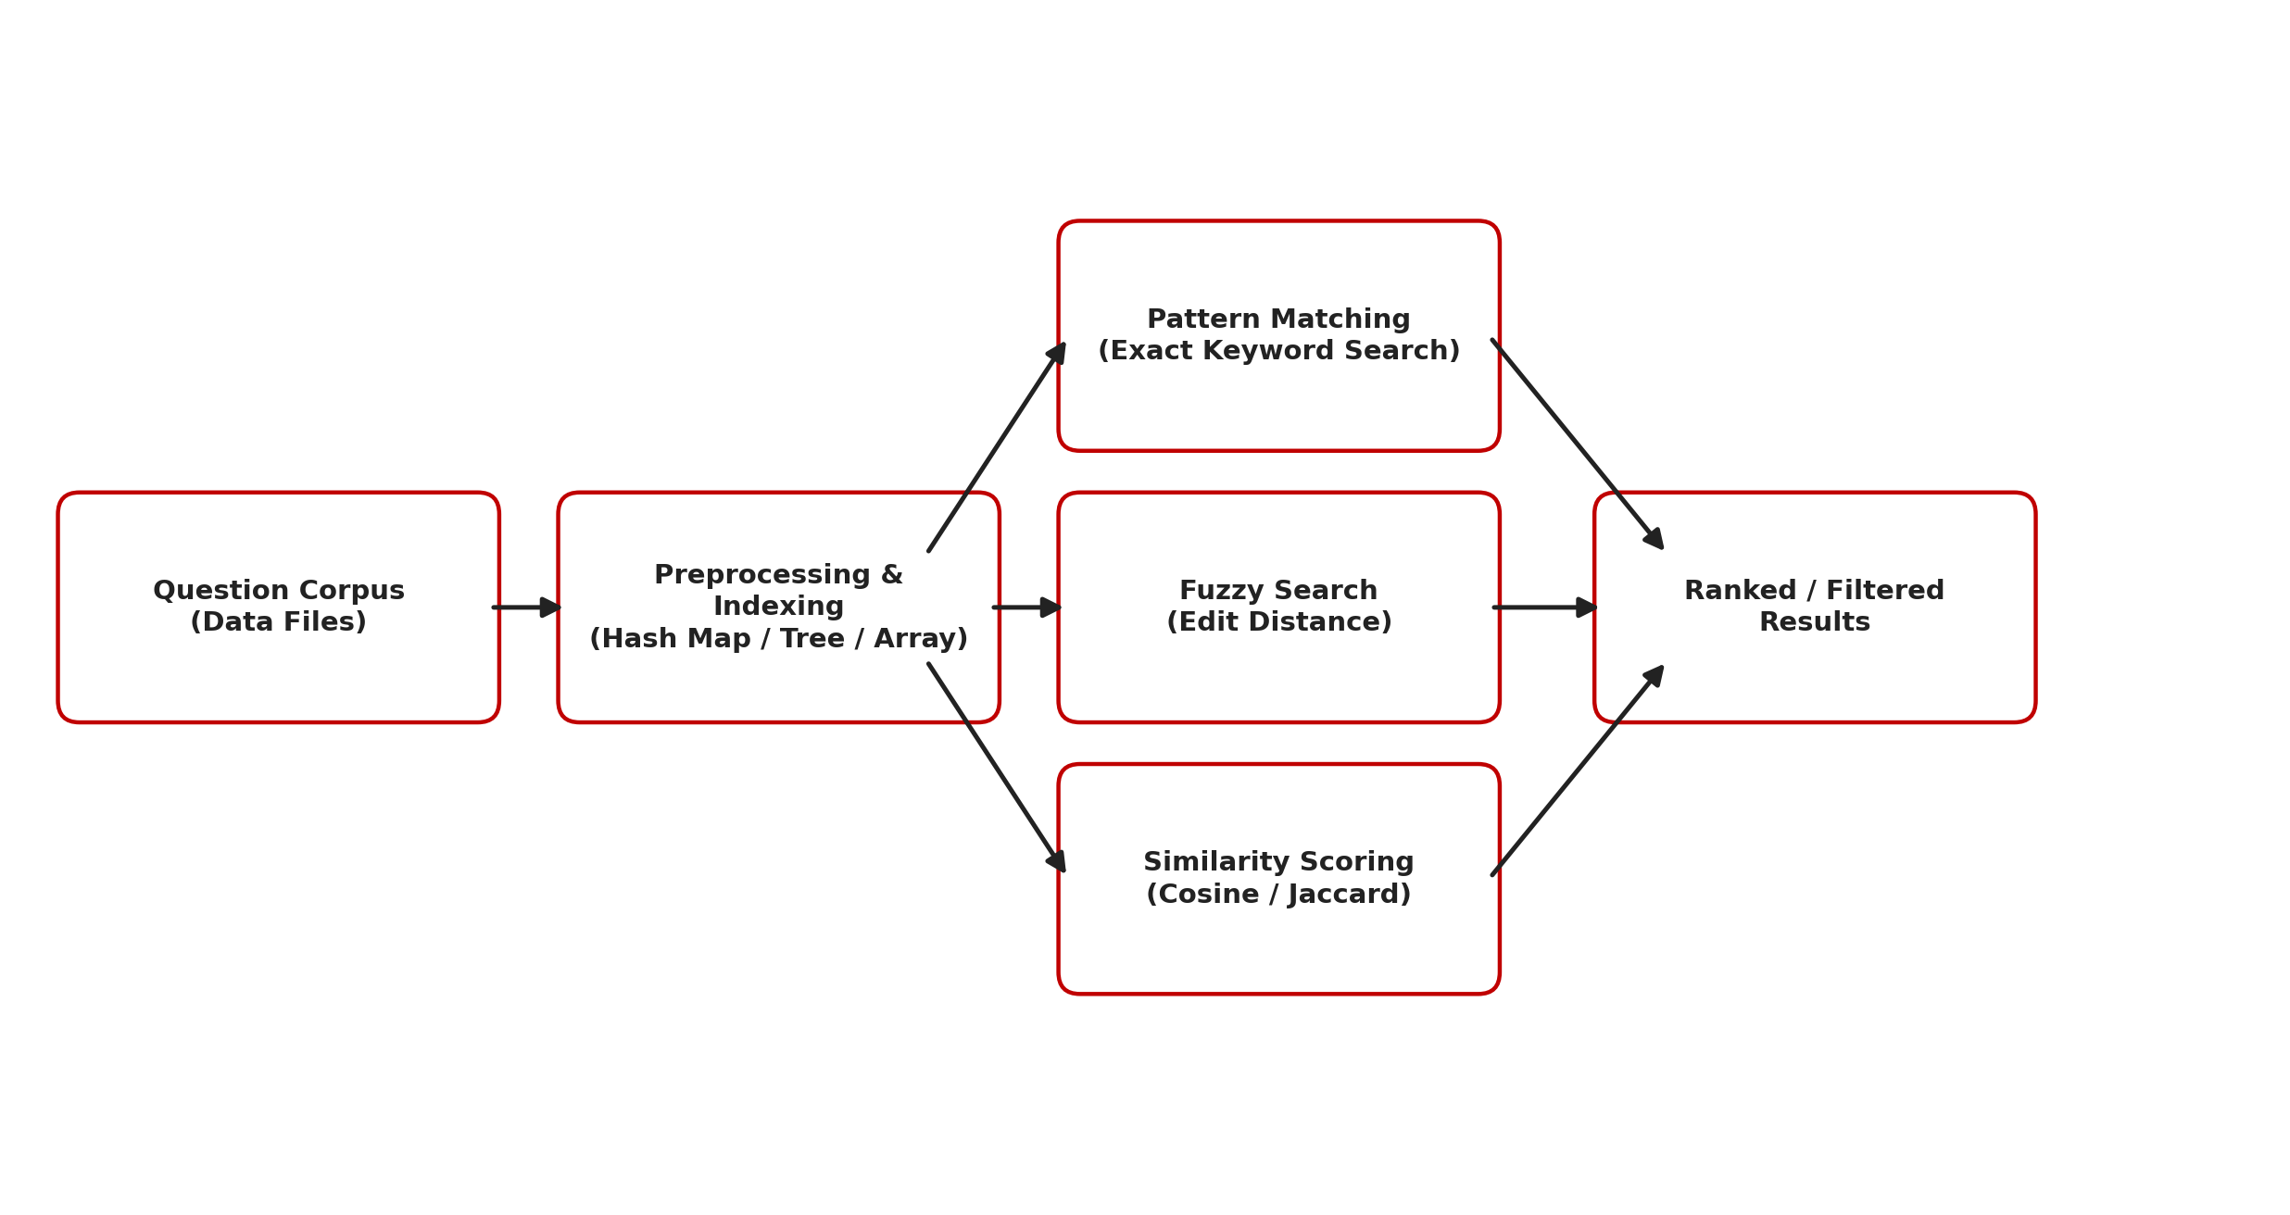
Flow Chart

Slide 8
Results
GitHub repository created following KLH submission norms — /src, /docs, /data, /results, /reports structure with a documented README (title, team, guide, abstract, setup instructions).
Pattern Matching: implemented for exact keyword search over the question corpus, locating all occurrences of a search term across question text in linear time.
Fuzzy Search: implemented using edit-distance (Levenshtein) based matching, so queries with minor spelling variations or typos still return relevant questions.
Similarity Algorithms: implemented (cosine/Jaccard similarity) to score how closely two questions match, enabling near-duplicate detection within the corpus.
Progressive commits made by each team member individually, verifiable from commit history, as required for Review-2.

Slide 9
Hardware and Software requirements
Hardware: Minimum 8 GB RAM, dual-core processor or higher, 500 MB free disk space.
Software: Python 3.x (or Java/C++, per implementation), VS Code / PyCharm IDE.
Version Control: Git and GitHub for repository management and collaboration.
Operating System: Windows / Linux / macOS.
Libraries/Tools: standard data-structure and string-processing libraries used for hashing, tree indexing, and similarity scoring.

Slide 10
Conclusion
At this Review-2 stage, the project repository has been set up per the required submission norms, and the core text-search modules — pattern matching, fuzzy search, and similarity scoring — have been implemented and tested on sample question data. These modules form the retrieval backbone of the Question Bank Management System, and early testing confirms they correctly locate exact keyword matches, tolerate minor typos, and flag similar questions.

Slide 11
Future Scope
Integrate the implemented search modules with the full storage layer (Hash Maps, Trees, Arrays) for end-to-end add/update/delete/filter operations.
Build a user interface for faculty to search, filter, and export question papers.
Benchmark pattern matching, fuzzy search, and similarity algorithms on larger corpora for performance tuning.
Add difficulty-balancing logic to auto-suggest a mix of questions for exam paper generation.
Complete testing, documentation, and final deployment ahead of the final review.

Slide 12
Thank you

