Slide 1

Machine Learning Project
FantasyScore AI · Project Presentation
2026 OCTOBER 5
Fantasy Points Prediction
with LightGBM
PRESENTED BY
GUIDED BY
SURISETTI PREM SAI · 2520030561
MOHIT VENKAT SAI · 2520030106
M. RANI
Notes:
Good morning. Our project, FantasyScore AI, predicts how many fantasy points a cricket player will score in a match, using a LightGBM gradient-boosted regression model, and serves the predictions through a Flask web app.

Slide 2
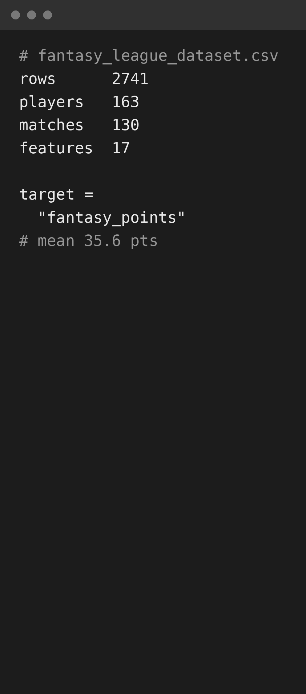
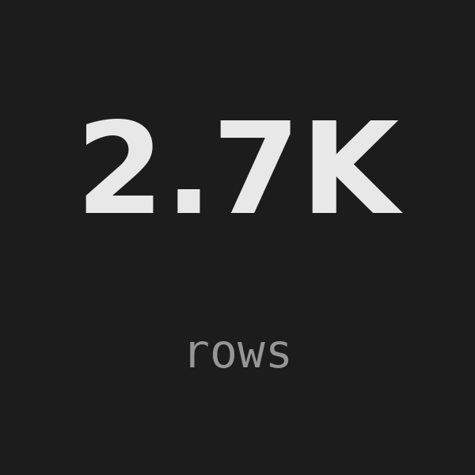
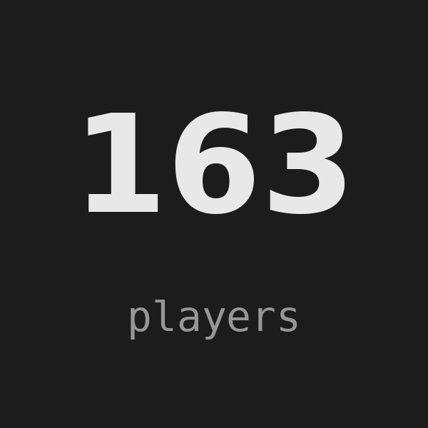
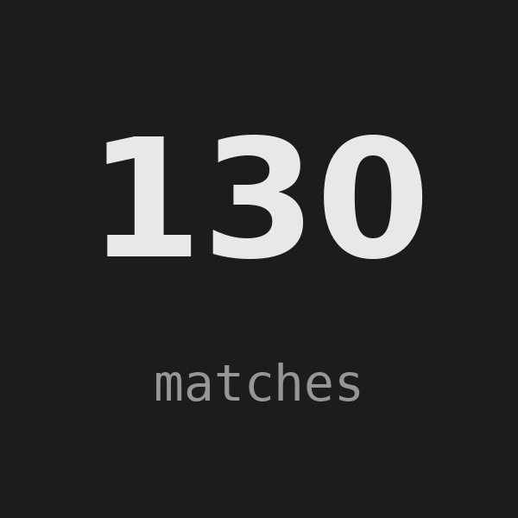
What Problem Are We Solving?
Fantasy players must choose 11 cricketers before a match starts. We predict each player’s fantasy points from recent form, batting, bowling and match context, so squad and captain picks are data-driven.
The Dataset at a Glance
2,741 records
163 players
130 matches
Player-match rows, 2026
Across 10 IPL teams
About 21 players each
2
Notes:
Picking a fantasy team is guesswork without data. We framed it as supervised regression: the target is fantasy_points, a continuous number. The dataset has 2,741 player-match rows for 163 players across 130 matches of the 2026 season.

Slide 3
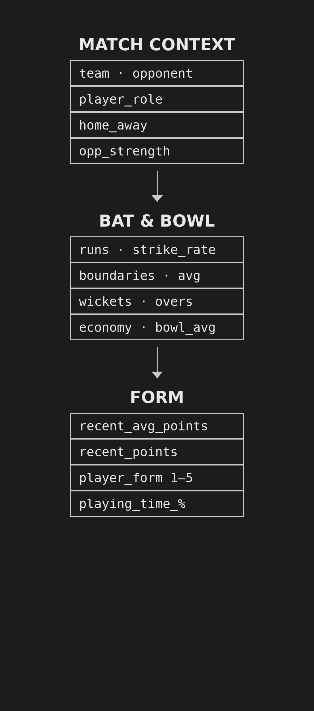
17 Features in Three Groups
Match Context (5)
Team, opponent, role, home/away and opponent strength (1–5). Four are categorical and handled natively by LightGBM.
Batting & Bowling (8)
Per-player averages for runs, strike rate, boundaries, wickets, economy and overs — the skill profile.
Form & Availability (4)
Recent points, recent average, form rating and playing-time %. Missing values are filled with training medians.
3
Notes:
We use 17 input features. Match context covers who the player is playing for and against. Batting and bowling averages describe skill. Form and availability capture how the player has been doing lately. Identifier columns like match_id and player_name are excluded from training.

Slide 4
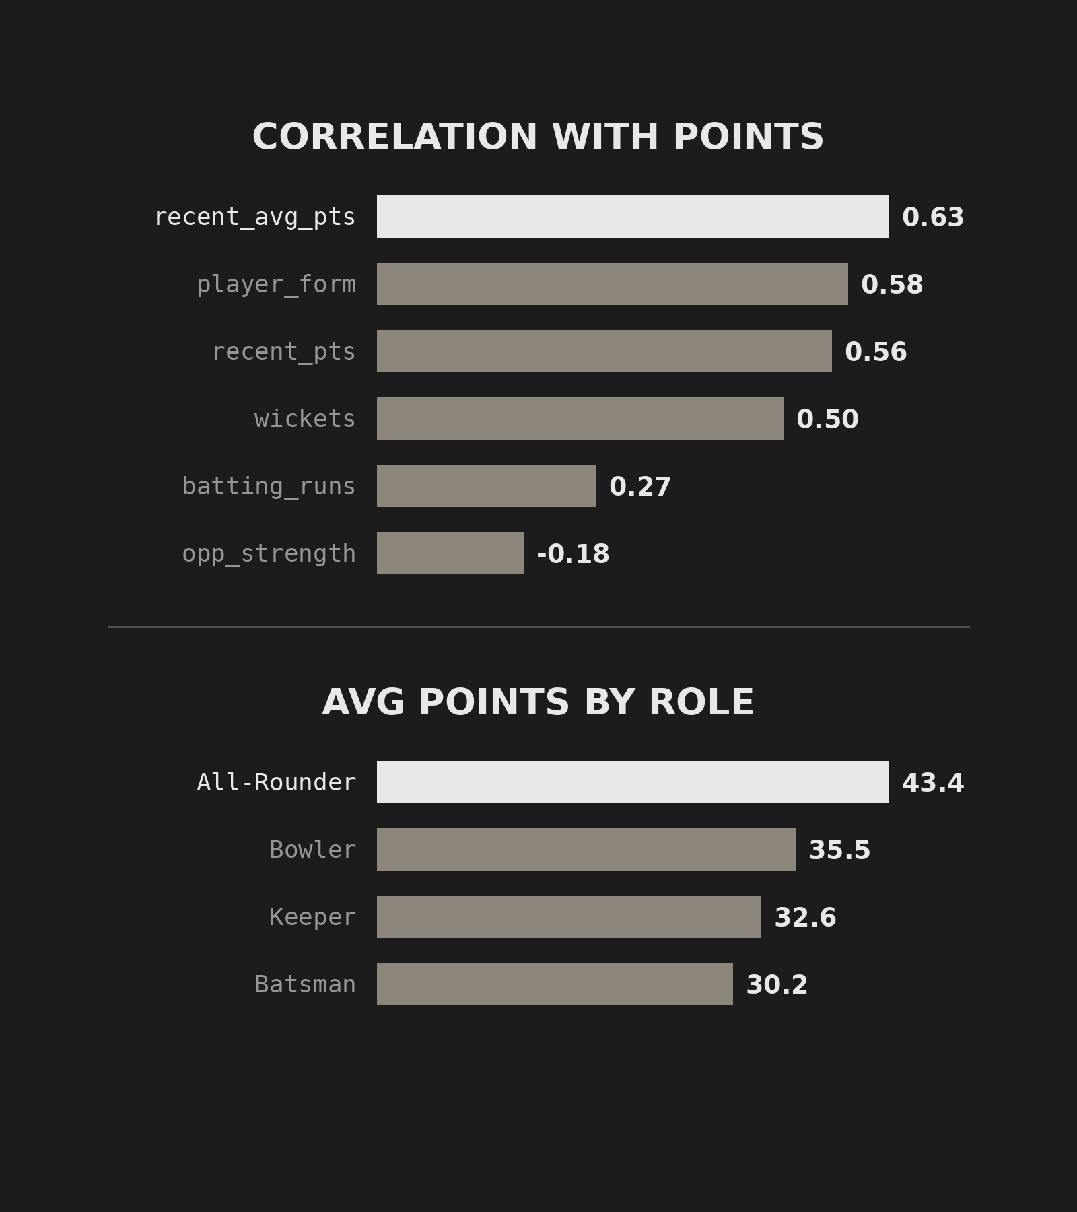
Exploratory Data Analysis
Target Distribution
Fantasy points average 35.6 (median 34.4), range 0–114, with a mild right skew of 0.55.
Key Patterns
  Recent form is the strongest signal
  All-rounders score the most on average
  Stronger opponents lower the score
Data Quality
Only 1.1% of values are missing; fixing casing and spaces cut 19 team labels to 10.
4
Notes:
Before modelling we explored the data. Fantasy points average 35.6 and are mildly right-skewed. Recent average points, player form and wickets correlate most strongly with the target, while stronger opponents lower scores. All-rounders score the most on average, at 43.4 points. Data quality was good: only about 1% of values were missing, and fixing inconsistent casing and spacing reduced 19 team labels to the real 10.

Slide 5
End-to-End ML Pipeline
1
2
3
4
Preprocess
Split 80 / 20
Train
Deploy
Fill missing values with training medians and sort rows by match_id.
Earlier matches train the model; the last 549 rows are held out for testing.
LightGBM boosted trees with early stopping; best fit at 197 trees.
Flask serves Predict, Rankings, Model and EDA pages on port 5000.
5
Notes:
The pipeline has four stages. We impute missing numbers with medians computed only on training rows. We split chronologically so the model never sees future matches. LightGBM stopped at 197 trees. Finally the saved model is loaded by a Flask app.

Slide 6
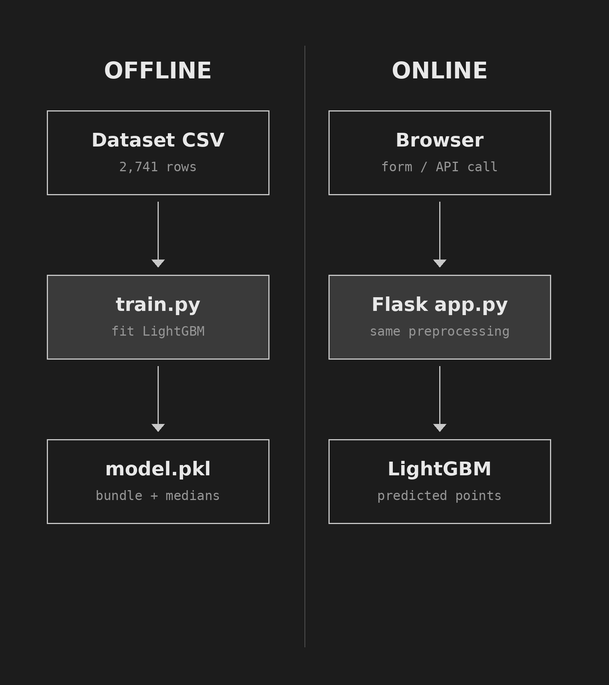
System Architecture
Offline Training
train.py reads the CSV, fits LightGBM and saves one bundle with medians and categories.
Online Web App
  Flask loads the bundle once at startup
  Auto-fill pulls a player’s latest stats
  Leaderboard ranks all 163 players
Key Idea
The same preprocessing runs at training and prediction time, so inputs match.
6
Notes:
Training happens offline in train.py and produces a single model bundle that stores the model, the feature list, the medians and the category lists. The Flask app loads that bundle once, applies identical preprocessing to user input, and returns a prediction.

Slide 7
How Well Does It Predict?
The Evaluation
Tested on the last 20% of matches (549 rows) the model never trained on, against three baseline regressors.
LightGBM: MAE 8.10
Linear: MAE 7.86
R² 0.68 and RMSE 10.17 — it explains about two-thirds of the variance.
Slightly better (R² 0.70), showing the signal in this data is mostly linear.
7
Notes:
On the held-out test set LightGBM is off by about 8 points on average, with R-squared 0.68. It beats the decision tree and random forest. Plain linear regression is slightly better, at 7.86 MAE, which tells us the relationships in this dataset are largely linear. Note: early stopping currently uses the test set, which should move to a separate validation split.

Slide 8
Key Findings & Future Scope
Top Predictors
Limitations
Recent average points drive ~41% of split gain; wickets add ~22%.
Synthetic 2026 data; 80% of errors fall within ±13 points.
Future Scope
Next Step
Live match APIs, pitch and weather data, and SHAP explanations.
A knapsack solver to pick the best 11 within a credit cap.
8
Notes:
Recent form is by far the strongest signal, followed by wickets. The data is synthetic, and the typical error band is about plus or minus 13 points, so predictions guide rather than guarantee picks. Next we want live data, richer context, SHAP explanations and an automatic squad optimiser.

Slide 9
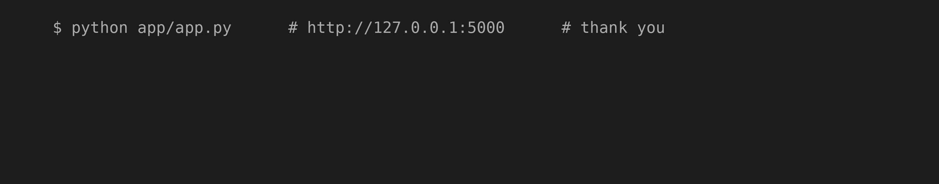
Thank You
2026 OCTOBER 5
PRESENTED BY
GUIDED BY
SURISETTI PREM SAI · 2520030561
MOHIT VENKAT SAI · 2520030106
M. RANI
Notes:
Thank you. The app runs locally with python app/app.py. We are happy to take questions.

