Slide 1

Optimizing Online Retail Sales Performance Using a Data-Driven Approach
IIT Madras, BS degree
A Presentation for the BDM capstone Project
- Premshuk Saha
23f1000448
1

Slide 2

Business Overview
The UK-based online retail company specializes in selling unique homeware and gift items to both individual customers and wholesalers.
The company operates globally, with a diverse customer base purchasing through its e-commerce platform.

Slide 3



Challenges to Explore
High Value Products
High Value Customers
Segmenting Customers based on purchase style

Slide 4
Data Collection and Methodology
• Data Source: UCI Machine Learning Repository
• Data columns: InvoiceNo, StockCode, Description, Quantity, InvoiceDate, UnitPrice, CustomerID and Country.
• Sales records from Dec 2010 - Dec 2011 (1 year worth of data)
• Data preprocessing: Handling missing values, Removing duplicates, adding new columns like revenue etc.
• Methods used for analysing problems:
Pareto Analysis for identifying high value Products and Customers
K-Means Clustering for Customer Segmentation.
Time Series Analysis for Analysing Trends in Demand
Demand Forecasting using ARIMA
Return Analysis
• Tools Used:
Python
Python Libraries: Pandas, StatsModels, Matplotlib, Scikit-learn etc

Slide 5
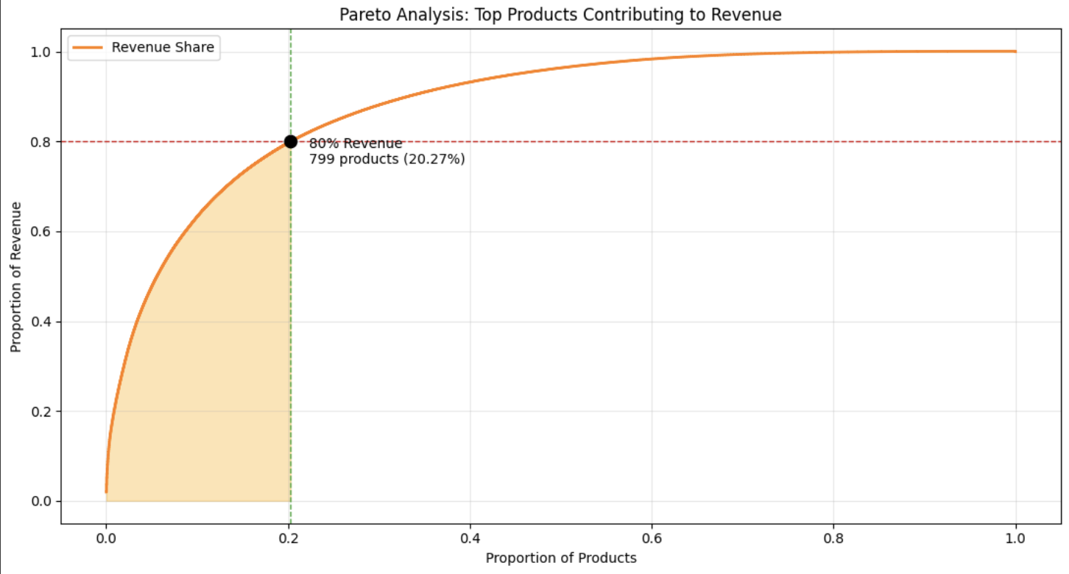
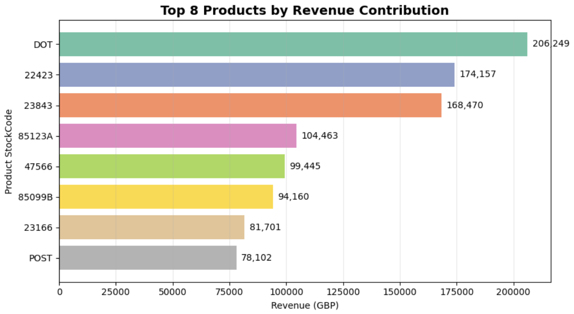
Results & Findings: Product Pareto Analysis
Total Products: 3,941
Products contributing to 80% of revenue: 799 (20.27%)
Key Takeaway: A small fraction of products generate the majority of sales, so inventory and marketing efforts should prioritize these high-revenue items.
5

Slide 6
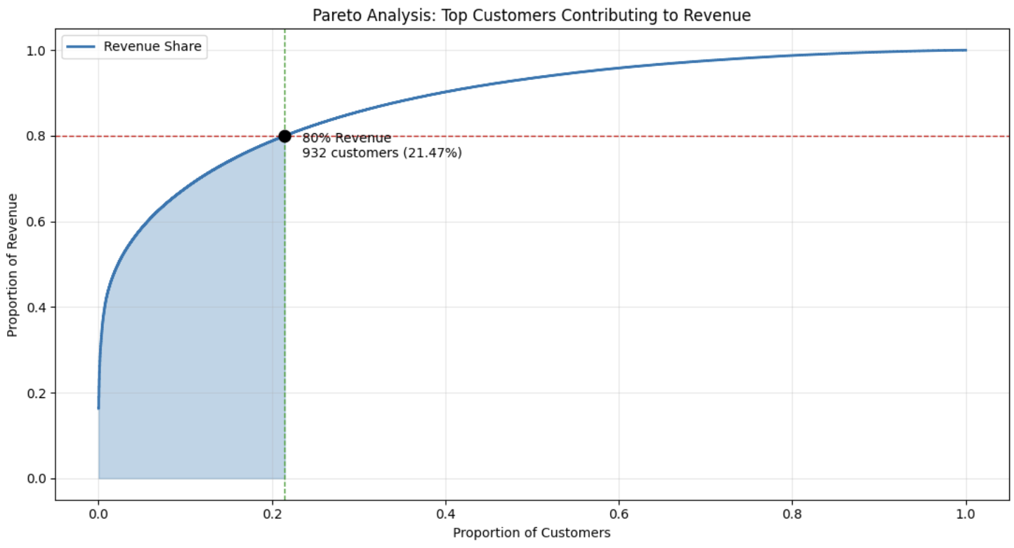
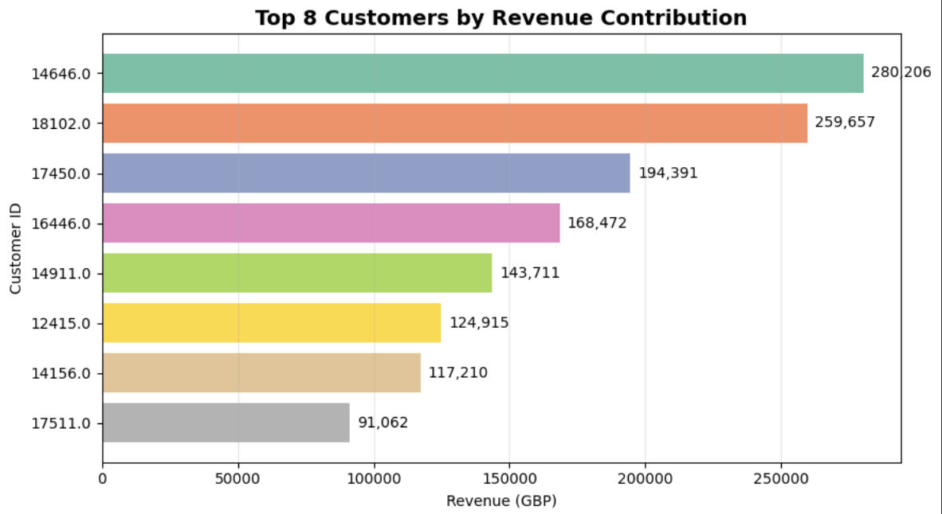
Results & Findings: Customer Pareto Analysis
Total Customers: 4,340
Customers contributing to 80% of revenue: 932 (21.47%)
Key takeaway: A small group of high-value customers drive most revenue, so personalized marketing and loyalty programs can maximize retention.
6

Slide 7
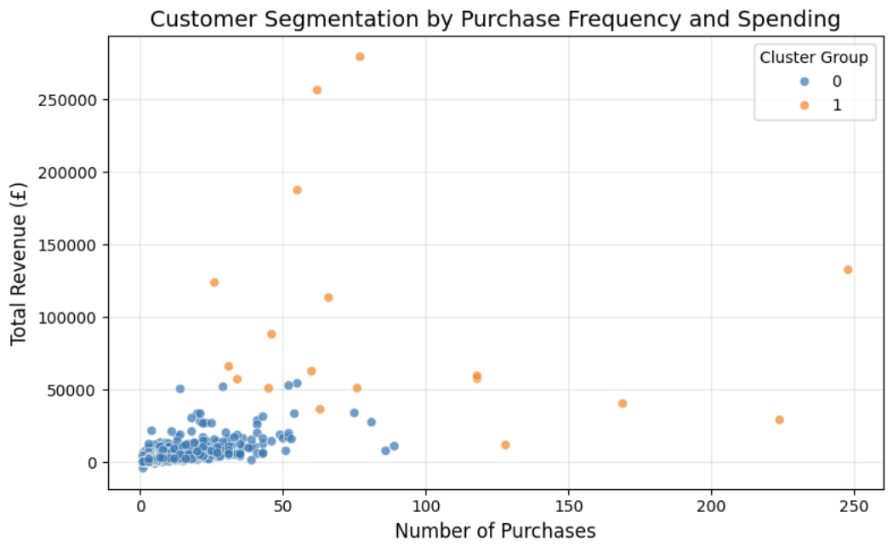
Results & Findings: Customer Segmentation
K-Means Clustering with 2 clusters (K = 2)
Blue Cluster – Regular Shoppers
• Majority of customers fall in this group.
• They make occasional purchases with lower total spending.
• Fewer product returns (Return Frequency = 1.81).
Orange Cluster – High-Value Customers
• These customers spend significantly more.
• They make frequent purchases and buy a wide variety of products.
• Higher return frequency (56.57), indicating potential dissatisfaction or bulk purchasing behavior.

Slide 8
Problems that need Attention
CustomerID: About 135,080 missing values (about 24.9% of the sample).
During pareto analysis, Unknown Customers generated over 1,732,777 (16.3%) in revenue.
During return analysis Unknown Customers generated over 285,470 (31.83%) in returns.
Total return summed to 896,812 (9.2%).
Demand forecasting and trend analysis was ineffective as the data only spanned for over a year. For effective demand forecasting, at least 2-3 years worth of data is needed.
8

Slide 9
Sugesstions and Solutions
Better Data Management: Improve data collection on customer identities, ask for reviews, reasons for returns etc.
Inventory Optimization: Focus on the top 20% of revenue-generating products to improve stock efficiency.
Customer Retention: Use loyalty programs and personalized marketing for high-value customers.
High value Customers: Can be offered premium services (exclusive deals, faster shipping, or VIP support).
More Data: Attempt demand forecasting with at least 2-3 years of time series data using ARIMA or other models to yield significant results .
Return Reduction: Investigate high-return products/customers and implement stricter policies.
Targeted Marketing: Use segmentation insights to offer promotions for regular shoppers and exclusive perks for high-value customers.

Slide 10
Thank You !

