Slide 1
TASKFLOW
Enterprise-Grade Project Management SaaS
Frontend: React 19 + Redux + Vite + Axios
Backend: Node.js + Express.js + JWT Auth + Bcryptjs
Database: MongoDB (11 Collections) + Mongoose ODM
Email: Resend Integration for Notifications
✓ 11 DB Models | ✓ 40+ Endpoints | ✓ 10 Middleware functions | ✓ Multi-Tenant

Slide 2
System Architecture
3-Tier Multi-Tenant Design

Slide 3
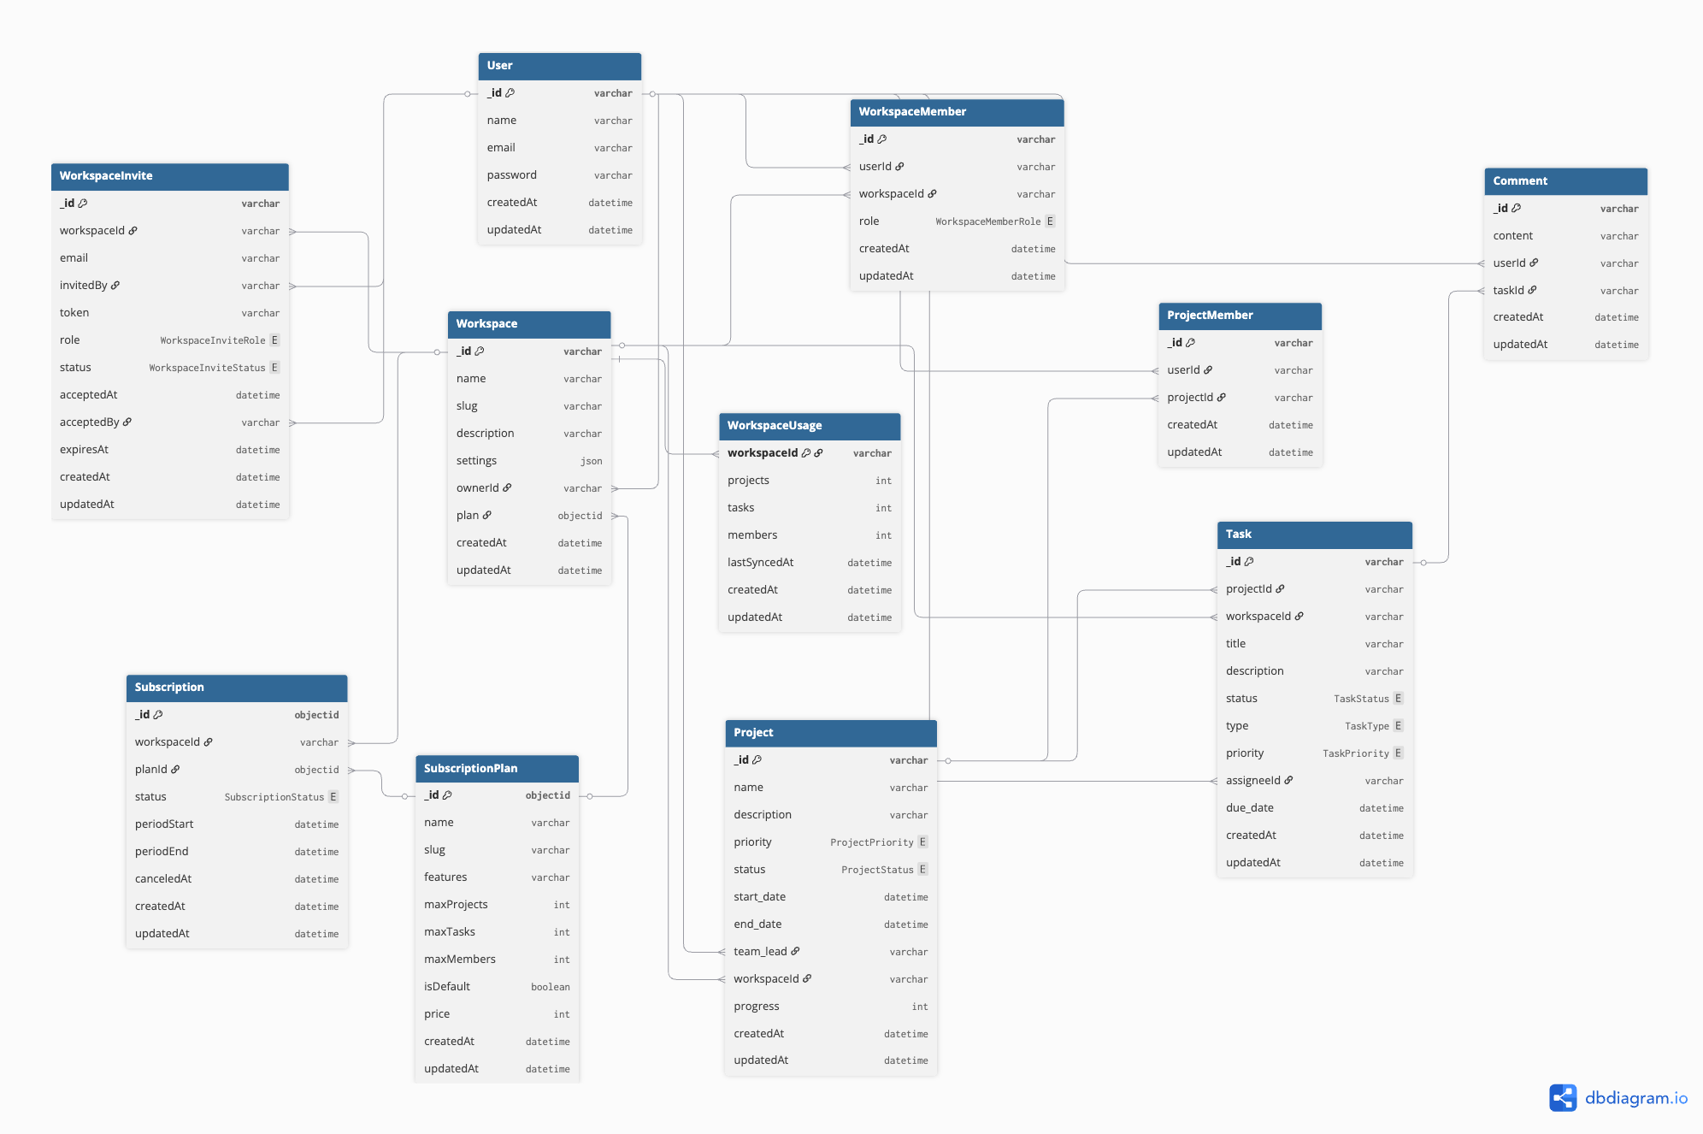
Data Model & ER Diagram
11 MongoDB Collections with Multi-Tenant Isolation
Collections
▸ Global Scope
Users
SubscriptionPlans
▸ Workspace-Scoped
Workspaces
WorkspaceMembers
WorkspaceInvites
WorkspaceUsage
Subscriptions
▸ Domain Models
Projects
ProjectMembers
Tasks
Comments

Slide 4
Request Security Pipeline
Multi-Layer Protection & Validation
Layer | Function | Validation
1. JWT Auth | Bearer token validation | Extracts userId, verifies signature
2. Subscription | Active plan check | Auto-downgrade if EXPIRED
3. Role Check | Admin/Member validation | Workspace permission validation
4. Feature Gate | Plan feature access | Checks MAX_PROJECTS, MAX_TASKS
5. Usage Limit | Real-time quota check | Prevents over-limit creation
6. Multi-Tenant | Workspace isolation | All requests scoped to workspaceId

Slide 5
Role-Based Access Control
Granular Permission System
Permission | Admin | Member
Create Workspace | ✅ | ❌
Manage Members | ✅ | ❌
Invite Users | ✅ | ❌
Create Tasks | ✅ | ✅
Edit Tasks | ✅ | ⚠️
Delete Projects | ✅ | ❌
Delete Tasks | ✅ | ❌
View Analytics | ✅ | ✅
Manage Settings | ✅ | ❌
Upgrade Plan | ✅ | ❌

Slide 6
Subscription Management
Intelligent Plan Enforcement
Feature | FREE | PRO
Projects | 3 | Unlimited
Tasks | 10 | Unlimited
Members | 10 | Unlimited
Advanced Analytics | Disabled | Enabled

Slide 7
Production-Ready Features
Enterprise-Grade Implementation
🔐 Security
✓ JWT 7-day tokens
✓ Bcryptjs hashing
✓ Role-based access
✓ Workspace scoping
✓ Invite tokens
✓ Subscription gates
✓ Feature gating
✓ Usage limits
✓ Input validation
✓ Request auth guard
✓ Ownership checks
✓ Session expiry
📊 Data
✓ 11 collections
✓ Mongoose ODM
✓ Indexes on workspaceId
✓ WorkspaceUsage tracking
✓ Atomic updates
✓ Model references
✓ Soft deletes
✓ Audit-ready
✓ Schema validation
✓ Relationship mapping
🔌 API & Routes
✓ 40+ endpoints
✓ 8 route modules
✓ JWT middleware
✓ Usage enforcement
✓ Feature gating
✓ Consistent errors
✓ Pagination ready
✓ RBAC checks
✓ Rate limiting
✓ Audit logging
⚛️ Frontend
✓ React 19
✓ Redux state
✓ Axios client
✓ Auth context
✓ Route protection
✓ Responsive UI
✓ Theme support
✓ Reusable UI
✓ Form validation
✓ Optimistic UI
Design Rationale
• Why this design: 3-tier separation keeps UI, API, and data isolated for deployability and scaling.
• Multi-tenant safety: every query is scoped by workspaceId to prevent cross-tenant access.
• Consistency: centralized middleware standardizes auth, roles, features, and usage checks.
• Race-condition proof: atomic usage increments prevent over-limit creation under concurrency.
• Extensibility: plan-feature mapping allows premium features without schema changes.
• Operational clarity: usage tracking and subscription states simplify audits and support.

