Slide 1
NOVA CONGLOMERATE
Q2 Performance Portfolio & Operational Optimization Roadmap
Prepared for the Board of Directors | Data Science Capstone Project

Slide 2
EXECUTIVE SCOPE & BUSINESS BRIEF
Evaluating operational data and strategic optimizations across three main business divisions:
• NOVA RETAIL (sales_data.csv)
Product performance, regional sales strategy, and price elasticity modeling.
• NOVA TELECOM (customer_churn.csv)
Analyzing customer churn drivers, contract structure stability, and K-Means segmentation.
• NOVA PROPERTY (house_prices.csv)
Predictive property valuation using OLS regression to capture physical and geographical pricing premiums.

Slide 3
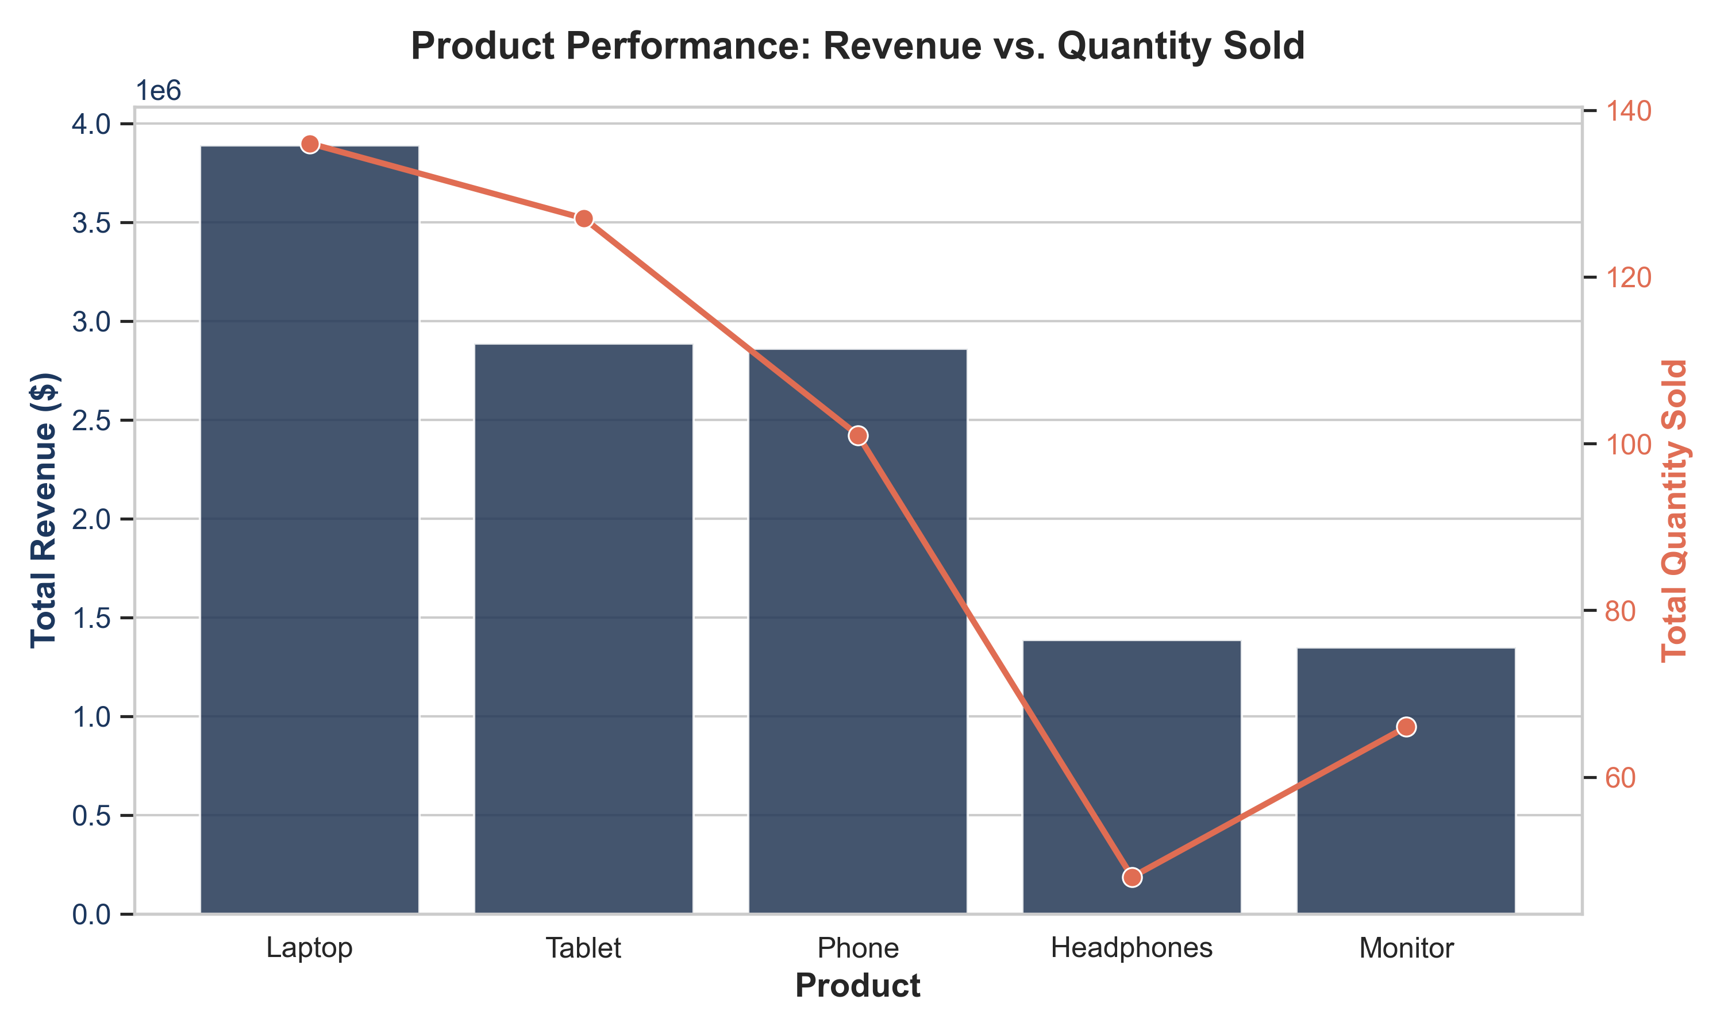
NOVA RETAIL: PRODUCT PERFORMANCE & ELASTICITY
Laptops lead revenue generation, contributing $3.89M (31.5% of total division sales).
Top 3 products (Laptops, Tablets, Phones) generate 77.9% of division revenue, validating the Pareto 80/20 principle.
Price Elasticity regression reveals price is not a significant predictor of volume sold (p = 0.937).
Demand is highly inelastic; Nova Retail holds substantial brand power to implement margin-boosting price adjustments.
North and South are high-volume sales leaders, significantly outperforming East and West.

Slide 4
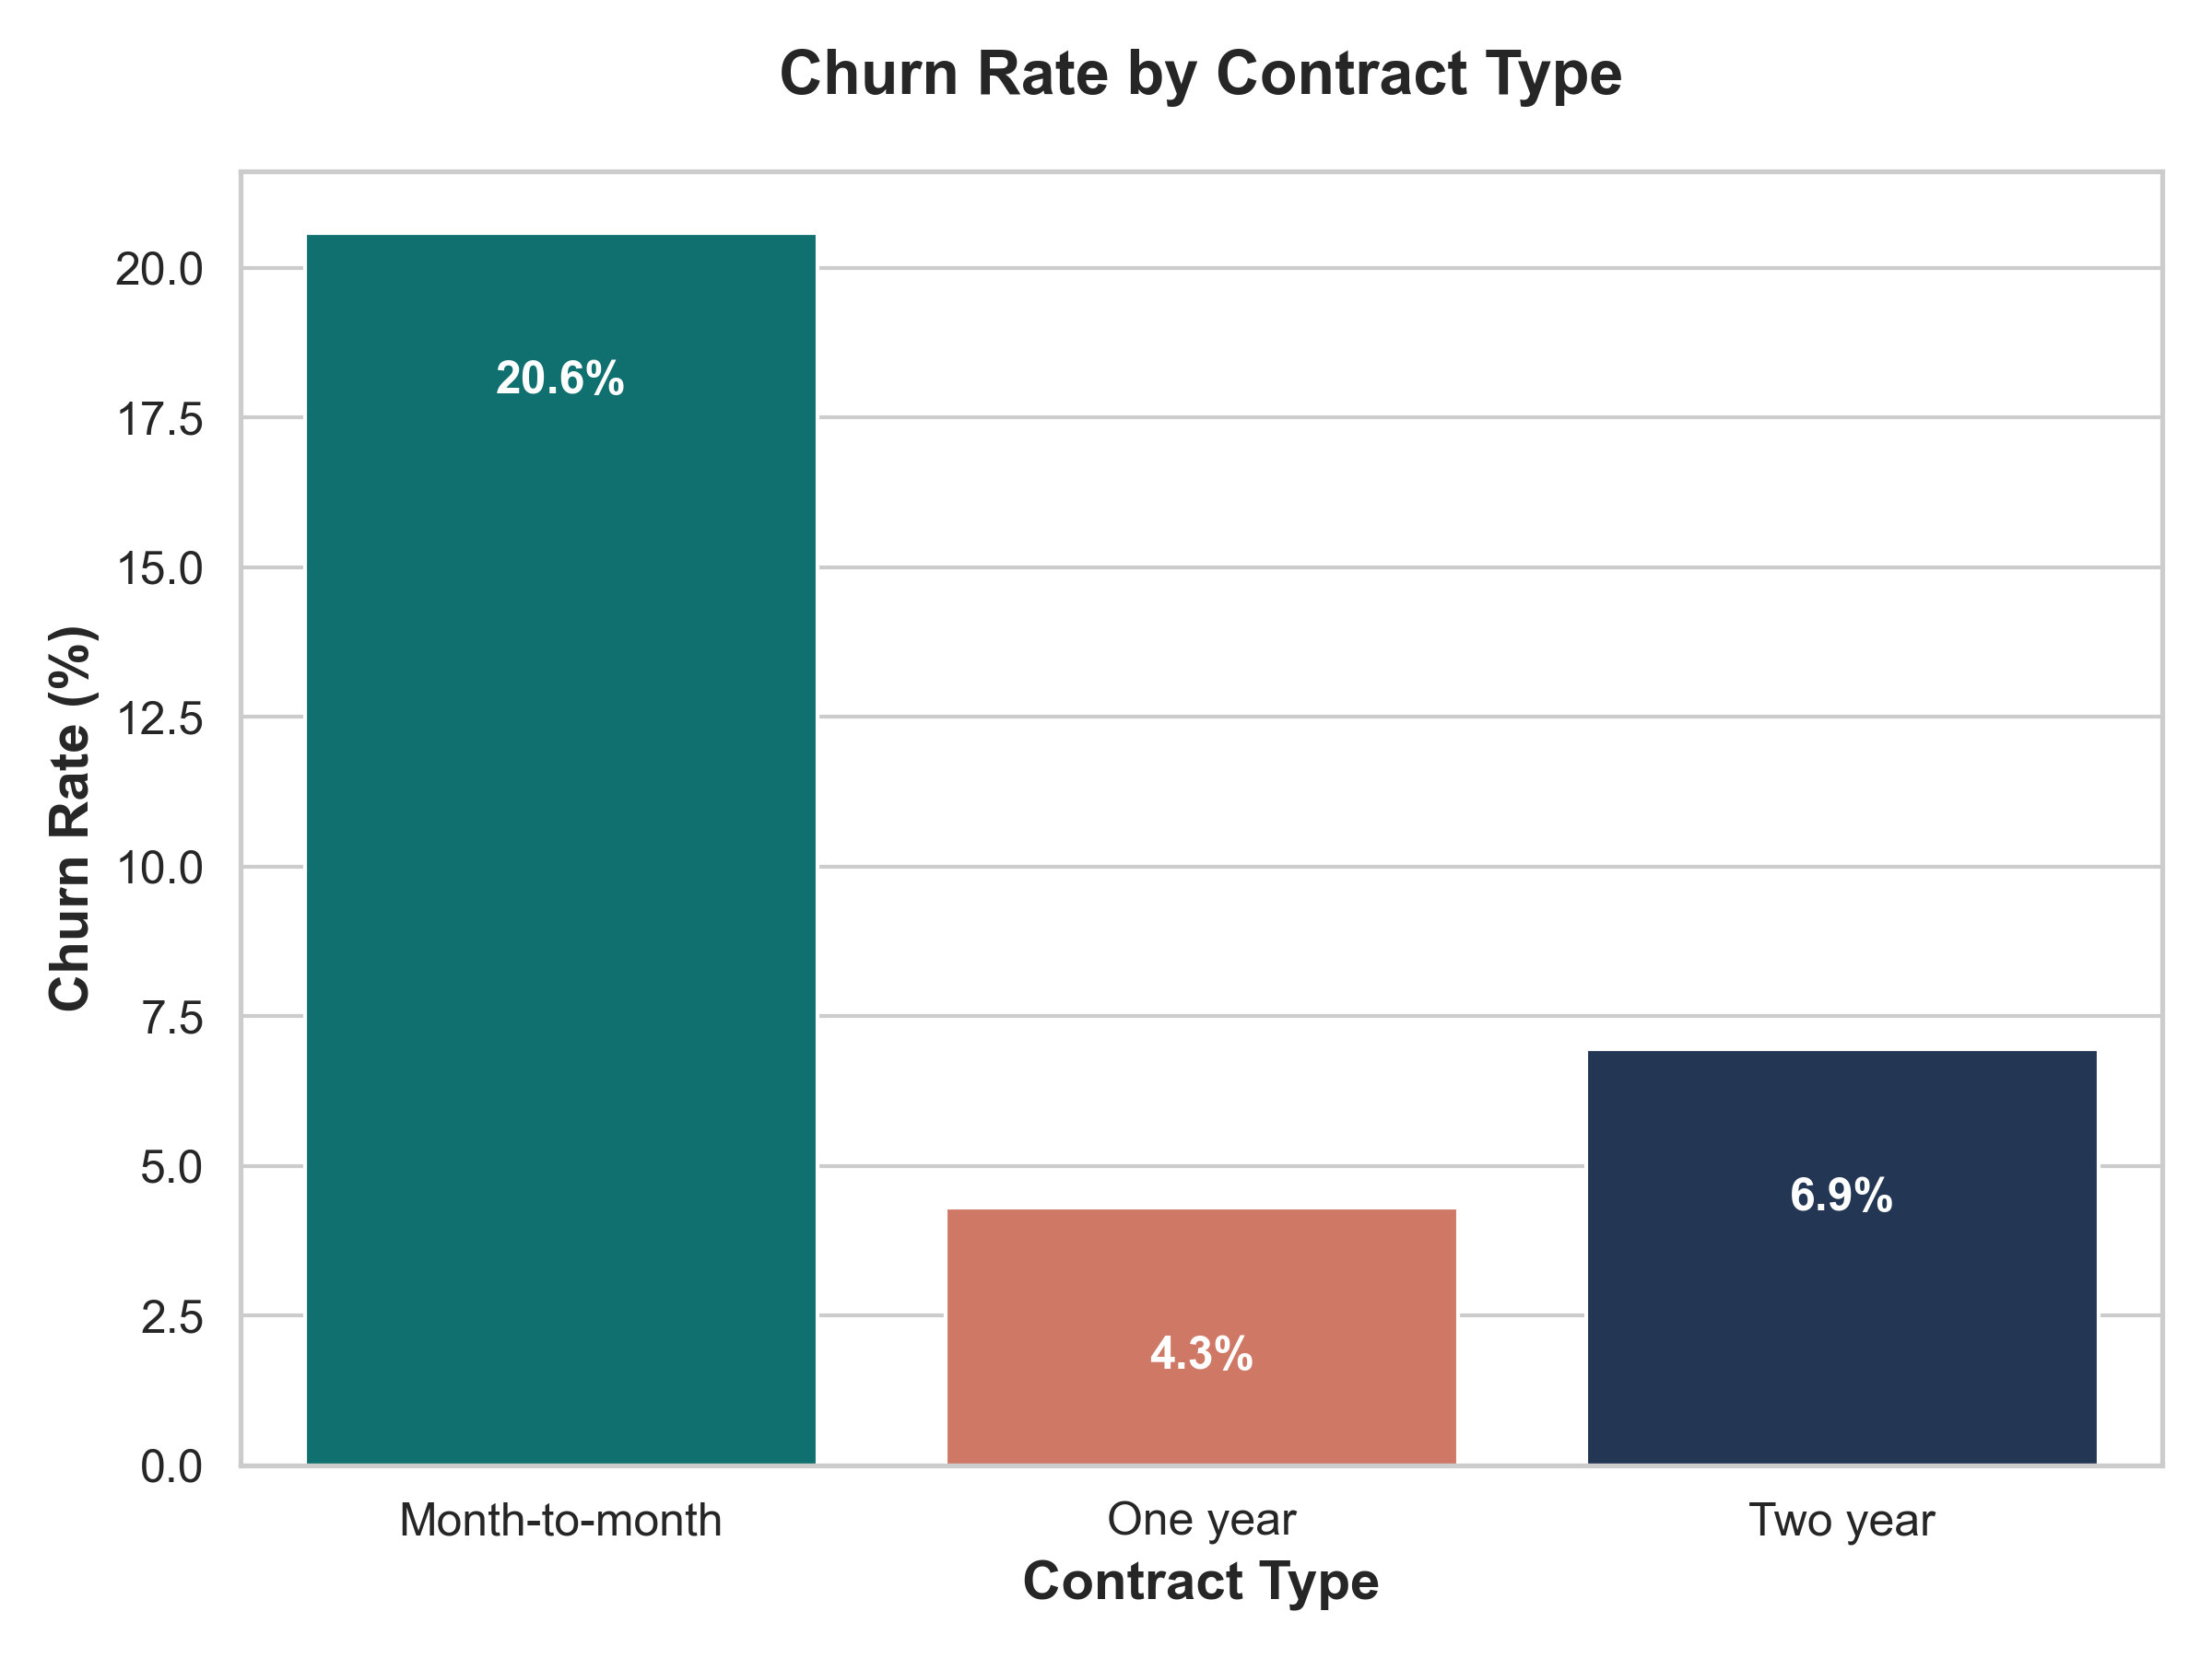
NOVA TELECOM: CHURN & RETENTION STATISTICS
Baseline customer churn rate is 10.60% across 500 subscribers.
Contract type is a critical churn indicator: Month-to-month contracts suffer a massive 20.59% churn rate.
One-year (4.30%) and Two-year (6.94%) contracts show high retention stability.
Chi-Square Test is highly significant (p < 0.001), indicating churn is heavily dependent on contract duration.
T-Test confirms churned customers had significantly higher monthly fees ($129.77 vs. $111.72 for active, p = 0.0101).

Slide 5
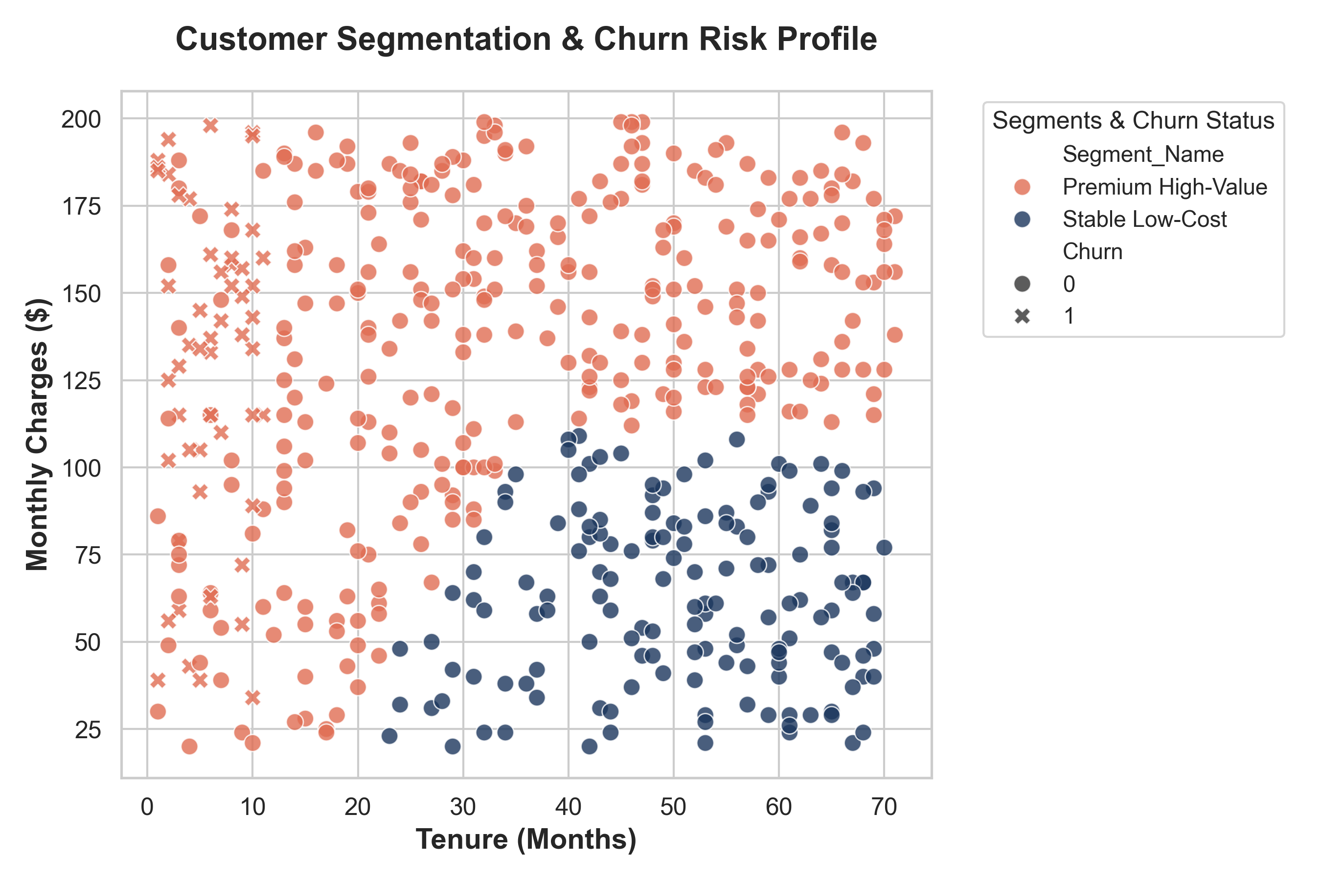
NOVA TELECOM: K-MEANS RISK PROFILING
K-Means clustering on scaled Tenure & Monthly Charges yields 3 distinct consumer cohorts:
Cluster 0 ('Stable Low-Cost'): Long tenure (50.6 Mo), low fees ($62.71), 0% churn. Highly loyal base.
Cluster 2 ('Premium High-Value'): Long tenure (48.8 Mo), very high fees ($158.25), 0% churn. High-paying advocates.
Cluster 1 ('High Risk / New'): Short tenure (14.2 Mo), high fees ($113.58), and a critical 28.65% churn rate.
Strategic Target: Launch retention outreach program focusing exclusively on Cluster 1 to migrate to 1-year contract tiers.

Slide 6
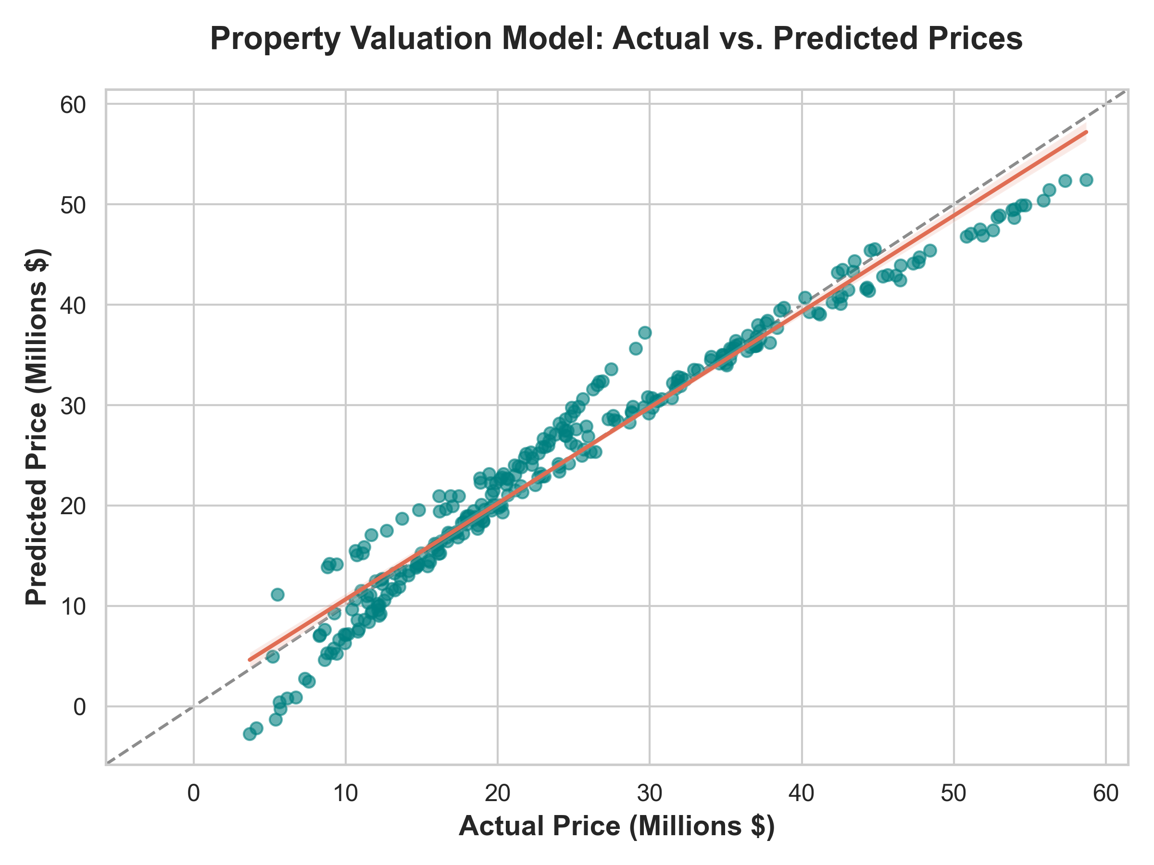
NOVA PROPERTY: VALUATION REGRESSION ANALYSIS
Multiple Linear Regression achieves an Adjusted R-squared of 95.4%, explaining almost all price variance.
Physical Premiums: Each square foot adds $7,615.15, each bedroom adds $1.67M, and each bathroom adds $645.5K to valuations.
Depreciation Loss: Assets depreciate by $83,790 annually as they age (highly significant, p < 0.001).
Geographic Discounts: Compared to City Center, Suburb properties face an $8.35M discount, and Rural properties face a massive $16.54M discount.

Slide 7
NOVA CONGLOMERATE: Q2 BOARD EXECUTION ROADMAP
Timeline | Nova Retail | Nova Telecom | Nova Property
Short-Term (0-3 Months) | Reallocate Laptop inventory to North and South regions to match high purchasing velocity. | Offer 10% loyalty discounts to Cluster 1 month-to-month subscribers to migrate them to 1-year contract tiers. | Divert asset acquisition funds away from Rural listings due to the severe -$16.5M location discount.
Medium-Term (3-6 Months) | Implement a 3% price adjustment on Monitors and Headphones (inelastic products) to expand margin. | Deploy automated billing notifications to prevent credit transfer failures. | Purchase depreciated Suburb housing and add bedrooms to capture the $1.67M bedroom premium.
Long-Term (6+ Months) | Integrate sales CRM tracking tools to capture corporate purchasing cycles. | Implement 12-month contract minimum default terms for premium service tiers. | Exclusively focus development pipeline on high-premium City Center apartments and villas.

Slide 8
THANK YOU
Questions & Board Discussions

