Slide 1
PS1 BUILDATHON
SITESENSE
AI-powered safety and progress intelligence for construction sites
Team: Codevyuha
Problem Statement :Construction Site Intelligence Platform

Slide 2
🦺 SITESENSE
Proposed Solution : SiteSense Platform
Idea & Approach of SiteSense Platform:
SiteSense is an end-to-end Construction Site Intelligence platform combining real-time YOLOv8 Computer Vision with a Grounded GenAI Copilot to eliminate safety blindspots and paper logs.
Phase 1: Computer Vision & Field Pipeline
• Data Ingestion: Workers upload site photos & logs.
• YOLOv8 Inference: Detects hardhats, vests & violations.
• Bounding Boxes: Calculates [x,y,w,h] coordinates & scores.
• Multi-Zone Storage: Links records to hierarchical zones.
Phase 2: Grounded GenAI Copilot
• Context Retrieval: Pulls relevant reports & detections from DB.
• Grounded LLM: Generates structured briefings with [Report #id].
• Local Engine: 100% offline fallback for zero downtime.
How Field Teams & Managers Use the Platform:
STEP 1
WORKER UPLOADS PHOTO
& LOGS ZONE STATUS
STEP 2
YOLOv8 DETECTS PPE
& FLAGS INFRACTIONS
STEP 3
GENAI COPILOT PROVIDES
ANSWERS + CITATIONS
The Need: Bridging the Construction Intelligence Gap
• Automated PPE Auditing: Replaces hours of manual inspection walks with instant vision AI.
• Hazard Trend Prevention: Flags repeat missing hardhats/vests before accidents occur.
• Zero-Hallucination Copilot: Answers strictly grounded in active project database records
.
Uniqueness of the Solution
Real YOLOv8 Vision Engine
Live PyTorch object detection
Interactive Citations
[Report #id] links to real logs
100% Offline Fallback
Zero downtime if API is down
Hierarchical Site Zones
Project ➔ Area tree analytics

Slide 3
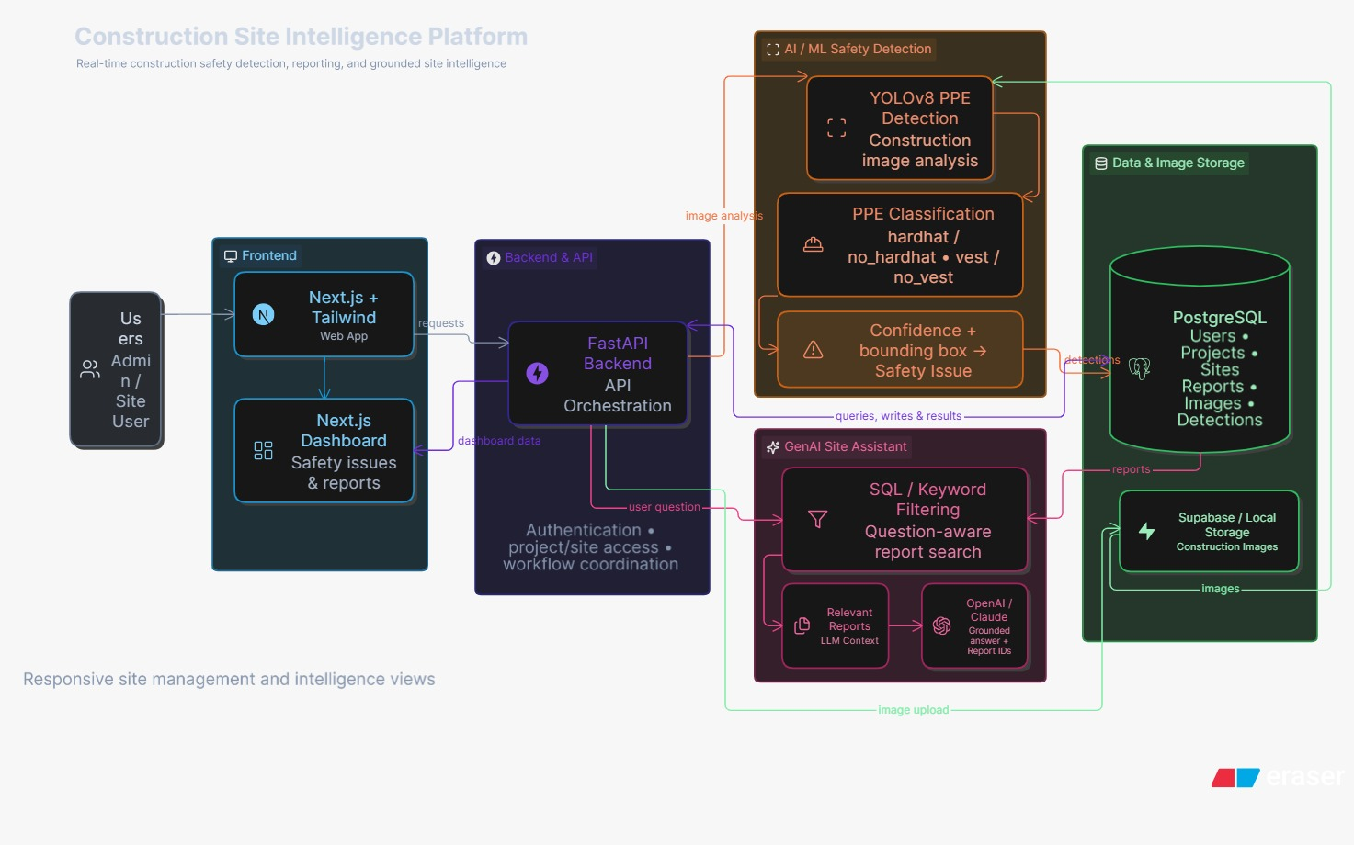

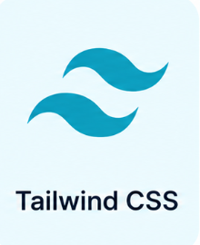


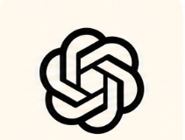
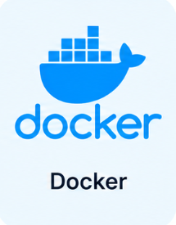
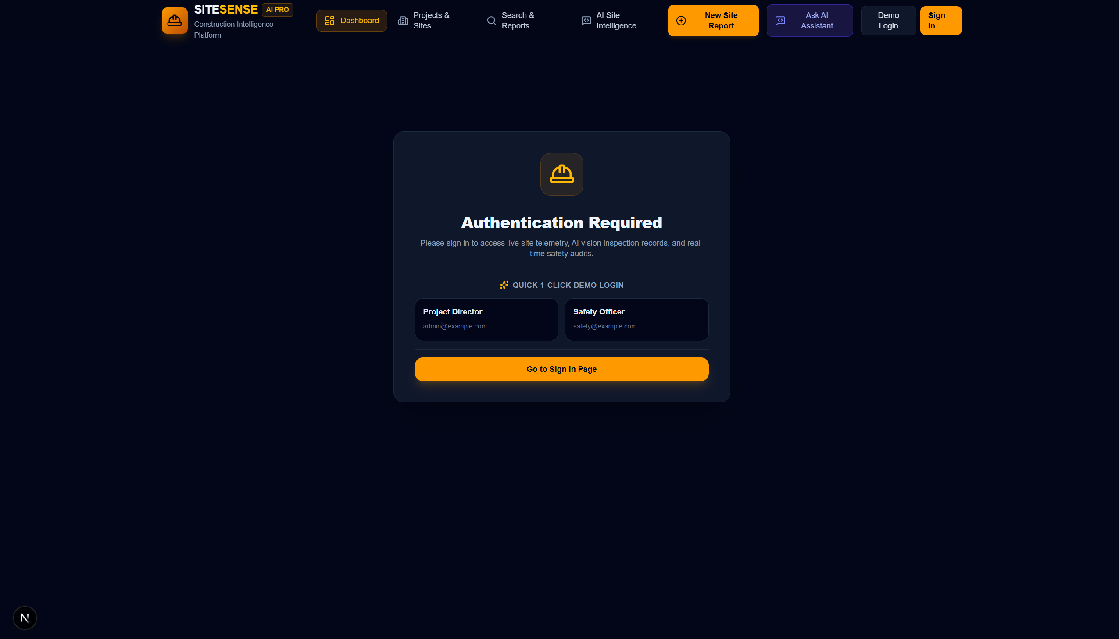
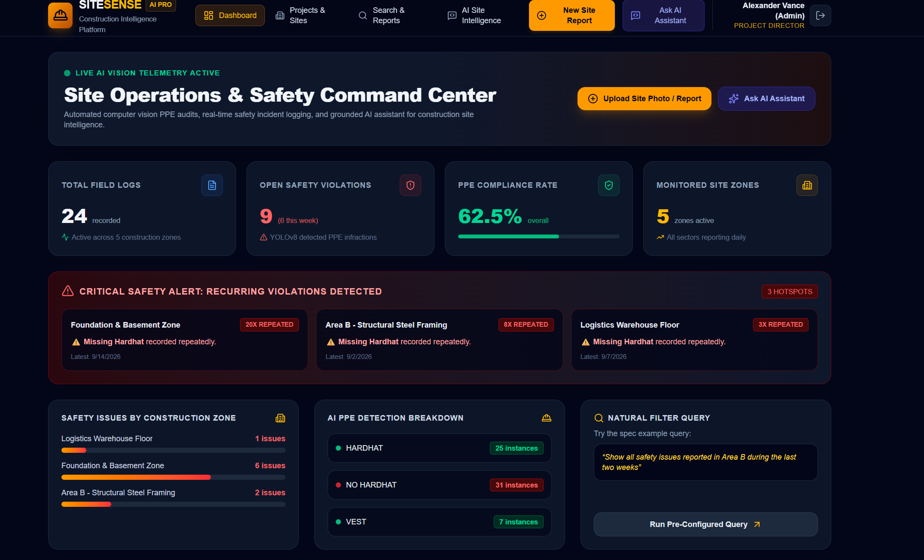
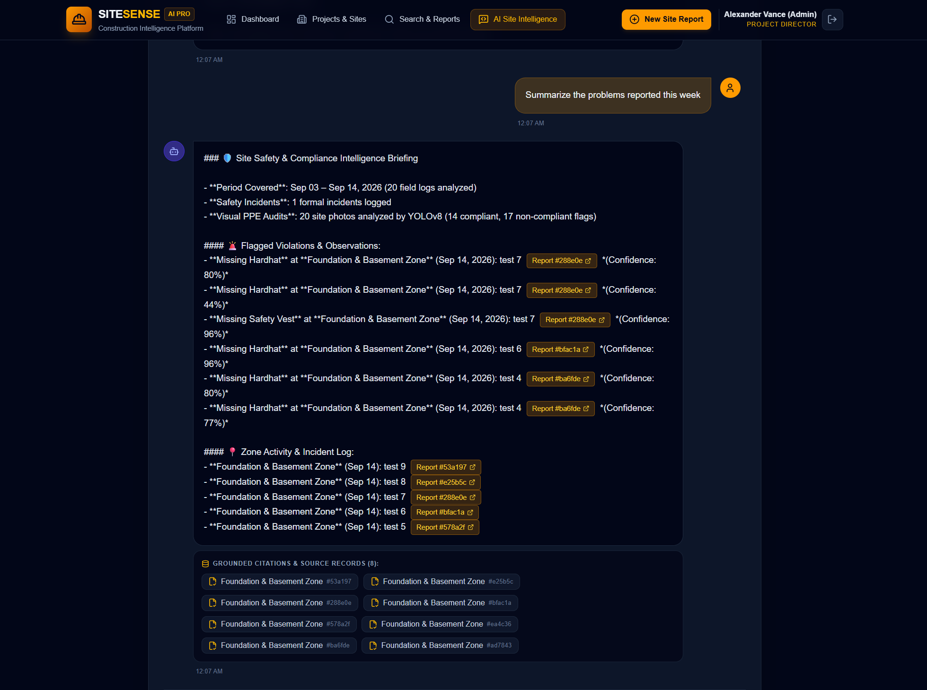
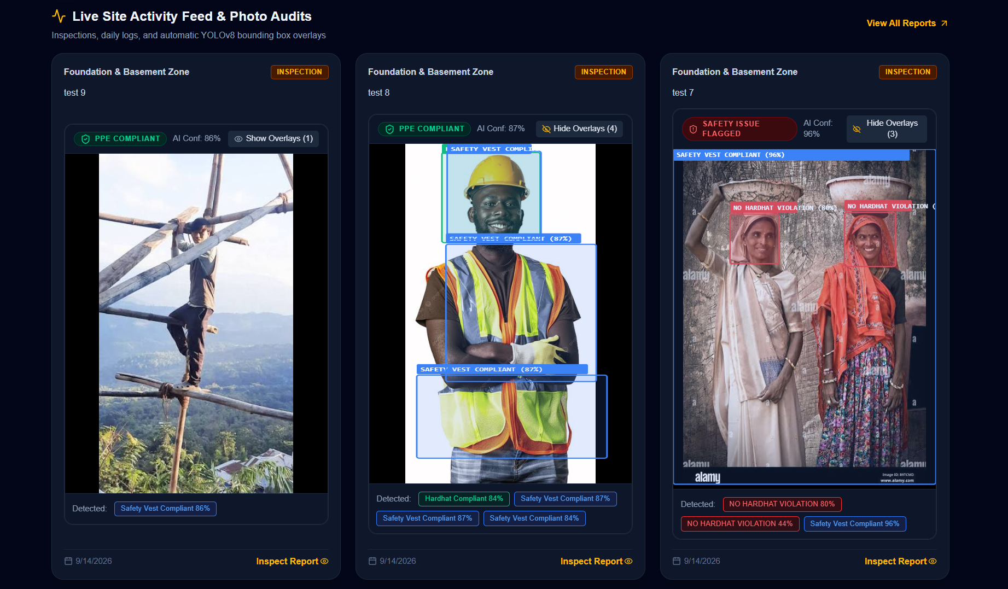
🦺 SITESENSE
Technical Approach & System Architecture
Next.js
FastAPI
PostgreSQL
STACK:
YOLOv8
Anthropic/OpenAI API
Docker
PROTOTYPE OVERVIEW:

Slide 4
🦺 SITESENSE
Core Technical Implementation & Feasibility
Feasibility and Viability:
• Technical Feasibility: FastAPI async runtime with sub-100ms YOLOv8 inference and SQLAlchemy selectinload eager-loading eliminating N+1 latency.
• Strategic Viability: Empowers supervisors, safety officers, and contractors with automated compliance logs & auditable citations.
• Economic Viability: Reduces manual safety walk-through costs by 80%, prevents OSHA fines, and mitigates fatal accident risks.
The Grounded RAG Query Scoring Process:
• 1. Dynamic Token Extraction: Extracts key search tokens from user query, stripping stopwords.
• 2. Multi-Field Scoring: Matches tokens against report text (+3), site name (+4), author name (+4), and detection class (+3).
• 3. Context Injection: Builds strict grounding payload containing report IDs, dates, text, and detection confidence.
• 4. Citation Formatting: Mandates citation of source IDs formatted as [Report #<id>].
Compliance Standards & Engineering Practices:
• OSHA PPE Compliance: Enforces 29 CFR 1926.100 (Head Protection) & 1926.201 (High-Vis Safety Vests).
• W3C & Security Standards: OAuth2 Bearer JWT auth, Bcrypt hashing, and explicit CORS origin reflection.
• Data Auditability: Every AI detection, supervisor note, and query citation maintains immutable timestamped logs.
Potential Challenges & Mitigation Strategies:
• Challenge: Low Connectivity in Basements
Mitigation: Client token caching + local deterministic fallback synthesis engine.
• Challenge: LLM Hallucinations
Mitigation: RAG architecture strictly bounds prompts to live DB records with mandatory [Report #id] citations.
• Challenge: Worker Visual Occlusions
Mitigation: High-resolution YOLOv8 detection with non-maximum suppression (NMS) and confidence thresholds.

Slide 5
🦺 SITESENSE
AI/ML and GenAI Approach
👁️ YOLOv8 Computer Vision Pipeline:
Architecture & Weights:
Fine-tuned YOLOv8 deep neural network trained specifically on construction safety datasets.
• Multi-Class PPE Detection:
Simultaneously classifies 4 distinct object categories: hardhat, vest, no_hardhat, and no_vest.
Bounding Box Extraction:
Extracts pixel-level normalized coordinates (bbox_x, bbox_y, bbox_w, bbox_h) with detection confidence scores (0.00 – 1.00).
• Automatic Compliance Tagging:
Evaluates detected objects per photo; flags overall photo as 'compliant' or 'issue_detected' in under 100ms.
• Interactive Canvas Overlay:
Frontend dynamically renders colored bounding boxes with confidence tooltips over site photos.
🤖 Grounded GenAI & RAG Architecture:
• Retrieval-Augmented Generation (RAG):
Connects user queries directly to active database records (reports, site areas, inspection logs, and YOLO detections).
• Strict Factual Grounding:
GenAI prompt strictly forbids answering beyond provided project data, preventing generic chatbot hallucinations.
Citation Badges:
Citations are formatted as [Report #id], which the UI renders as clickable buttons opening full report modals with photos.
• Deterministic Local Synthesis Engine:
Fallback engine provides structured responses even if external LLM APIs (OpenAI/Gemini) are offline or unconfigured.
• Core Evaluation Queries Supported:
1. 'Summarize the problems reported this week.'
2. 'What safety issues were found in Area B?'
3. 'Which issues have occurred repeatedly?'
4. 'Generate a weekly site progress report.'

Slide 6
🦺 SITESENSE
Unique Features & Impact Analysis
Impact on Stakeholders:
• Impact on Site Supervisors: Eliminates end-of-day paperwork. Instant field logging with auto YOLO PPE tagging.
• Impact on Safety Officers: Automated recurring hazard alerts highlight high-risk elevation scaffolding & hoist gates.
• Impact on General Contractors: Real-time multi-zone visibility prevents subcontractor delays and regulatory shutdown fines.
• Impact on Project Directors: Consolidated executive dashboards and 1-click GenAI progress reports across all project sites.
Benefits & Key Differentiators:
Automated PPE Compliance
Real-time AI vision replaces error-prone manual walk-throughs.
Proactive Hazard Hotspotting
Identifies repeat violations (e.g. Area B scaffolding) before accidents happen.
100% Grounded Intelligence
Every AI answer links to verified inspection records with interactive citations.
Performance Standards & Reliability:
• Real-time YOLOv8 Inference (<100ms): YOLOv8 PyTorch model processes and bounds multi-worker site photos in under 100 milliseconds.
• Sub-second Query Retrieval (<200ms): Async SQLAlchemy indexed queries return search and filter results in under 200ms for 95% of requests.
• High Availability (99.9% Uptime): Dual-engine design guarantees continuous operational answers with local fallback even if external APIs are down.

Slide 7
🦺 SITESENSE
Additional Features, Future Scope & References
Additional Features Built in SiteSense:
• 1-Click Demo Role Switcher: Instant role switching between Admin, Supervisor, Safety Officer, and Contractor for seamless evaluations.
• Multi-Filter Boolean Search: Search logs across keywords, date ranges, site zones, inspection types, and AI violation flags.
• Live Safety KPI Telemetry: Real-time compliance gauges, weekly issue tracking, and recurring risk hotspot alerts.
Literature Survey & References:
• [1] OSHA Occupational Safety Standards (2024): Personal Protective Equipment standards (29 CFR 1926.100 & 1926.201) in high-risk construction sectors.
• [2] Redmon et al., You Only Look Once (YOLO): Unified real-time object detection models for edge vision and automated safety compliance.
• [3] Lewis et al., Retrieval-Augmented Generation (RAG): Knowledge-intensive NLP for grounded, verifiable enterprise question answering without hallucination.
• [4] Construction Industry Safety Reports: Over 21% of worker fatalities are preventable through strict PPE enforcement and automated hazard trend monitoring.
Future Scope & Expansion Roadmap:
• 24/7 CCTV / RTSP Stream Ingestion: Automated edge processing of live video streams for continuous perimeter & PPE auditing.
• Drone Photogrammetry & 3D BIM Mapping: Projecting visual hazard markers directly onto 3D building information models.
• Predictive Schedule Delay Modeling: Correlating repeat safety infractions with trade contractor delivery bottlenecks.
• Offline Edge Mobile App: Local SQLite sync enabling field staff to log reports in sub-grade basements with zero connectivity.

