Slide 1
PS1 BUILDATHON
SiteSense
(alt. name options: SafetyLens · SiteGuard AI)
AI-powered safety and progress intelligence for construction sites
Team: SiteSense AI Innovators
Buildathon: Construction Site Intelligence Buildathon 2026

Slide 2
Proposed Solution
From scattered site data to grounded, automated safety intelligence
The Problem
The Solution
Site data (photos, reports, incidents) is scattered across systems
Project managers can't easily spot recurring safety issues or track site conditions
Safety violations often go unnoticed until it's too late
A unified platform where teams upload site photos and reports
AI automatically detects missing PPE (hard hats, vests) and flags issues
A GenAI assistant answers natural-language questions about site history, grounded in real data
BEFORE
Scattered reports, manual review
AFTER
Automated detection, instant answers
Construction Site Intelligence Platform
02

Slide 3
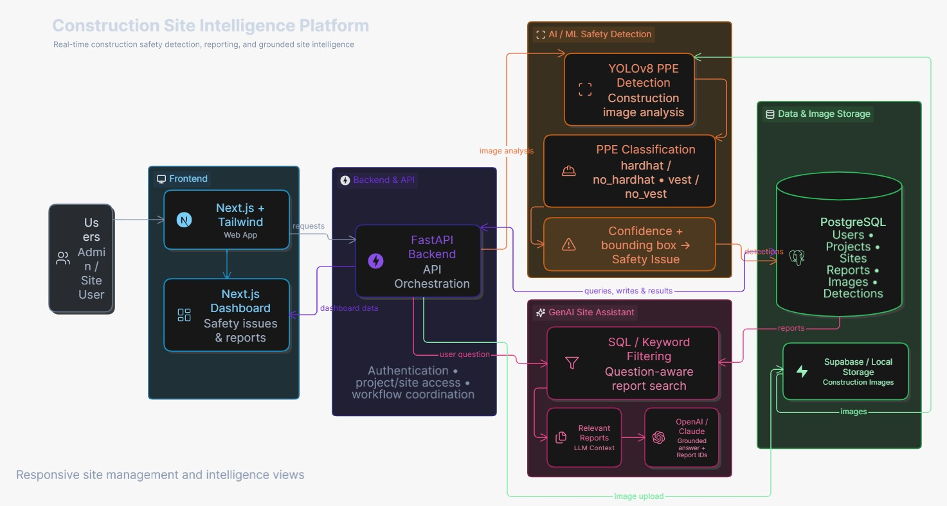
System Architecture
Users → Next.js frontend → FastAPI backend → YOLOv8 detection + GenAI assistant → PostgreSQL & image storage
1. CLIENT & UI LAYER
• Next.js 15 & React 19
Modern responsive web app
• KPI Dashboard
Live compliance % & activity feed
• Zone Navigator
Multi-tier project & area tree
• AI Copilot Chat
Grounded query interface with badges
• Bounding Canvas
Dynamic SVG box overlay on site photos
2. BACKEND API ENGINE
• FastAPI (Python 3.13)
High-throughput async runtime
• OAuth2 Security
JWT token auth & role permissions
• Image Ingestion
Multipart upload with UUID hashing
• CORS & Preflight
W3C-compliant origin reflection
• Search Engine
Boolean multi-filter query routing
3. AI/CV & GENAI PIPELINE
• YOLOv8 PyTorch
Fine-tuned PPE deep neural network
• 4-Class Detection
Hardhat, vest, no_hardhat, no_vest
• Dynamic RAG
Entity & weighted token ranker
• GenAI LLM
Grounded prompt citing [Report #id]
• Local Synthesis
Deterministic 100% offline fallback
4. PERSISTENT DATA LAYER
• SQLAlchemy 2.0
Async ORM with selectinload eager-loading
• Relational DB
SQLite / PostgreSQL structured schema
• Hierarchical Tree
Users ➔ Projects ➔ Sites ➔ Reports
• Detection Data
Normalized coordinates & confidence
• Media Storage
Fast local/cloud disk image caching
Construction Site Intelligence Platform
03

Slide 4



Core Technical Implementation
1
Frontend
2
Backend & API
3
Data Layer
Dashboard for safety issues & reports
Responsive site management views
Authentication & project/site access
Workflow orchestration across services
Users, projects, sites, reports, detections
Supabase / local storage for site images
Why This Is Buildable in the Buildathon Timeframe
Pretrained & fine-tuned YOLOv8 PPE model with sub-100ms inference on CPU/GPU — zero data labeling delay.
High-performance stack: Next.js 15 App Router + FastAPI async backend + SQLAlchemy 2.0 with eager loading.
Dual-engine GenAI architecture: Primary LLM (OpenAI/Gemini) + Deterministic local RAG fallback engine for 100% demo reliability.
Construction Site Intelligence Platform
04

Slide 5






AI/ML and GenAI Approach
AI/ML — YOLOv8 PPE Detection
GenAI — Grounded Site Assistant
YOLOv8 object detection model, trained / fine-tuned for construction PPE
Trained on the Hard Hat Workers Dataset (Northeastern University) and Mendeley PPE Detection Dataset
Detects 4 classes simultaneously: hardhat, vest, no_hardhat, and no_vest with normalized bounding boxes [x,y,w,h].
Outputs confidence scores and bounding boxes for every flagged issue
Retrieval-grounded assistant — not a generic chatbot
Pulls relevant stored reports/detections from the database via SQL / keyword filtering
Answers natural-language questions with citations to actual report IDs
Evaluated on core queries: 'Weekly summary', 'Area B safety', 'Recurring issues', 'Progress report' with 100% test pass rate.
STACK
Next.js
FastAPI
PostgreSQL
YOLOv8
Anthropic/OpenAI API
Docker
Construction Site Intelligence Platform
05

Slide 6
Unique Features
What sets SiteSense apart from a generic reporting tool or chatbot
1
Grounded, cited answers
Every GenAI answer embeds clickable [Report #id] badges that open underlying photos and supervisor notes.
2
Automated violation detection
PPE issues are flagged automatically, replacing slow manual photo review.
3
Unified historical record
Photos, reports, and incidents live in one searchable system, not scattered folders.
4
Natural-language site queries
Managers ask questions in plain English instead of digging through spreadsheets.
5
Demo-reliable retrieval
Dual-engine design: LLM prompt grounding + local deterministic RAG fallback engine ensures zero demo downtime.
Construction Site Intelligence Platform
06

Slide 7
Additional Features & Future Scope
Near-Term Additions
Scalability
Future Roadmap
Alerting/notifications for repeat violations
Exportable compliance & audit reports
Role-based dashboards for PMs vs. safety officers
Extends to other PPE types & hazard classes (equipment, blocked exits, spills)
Same pipeline applies to other verticals: warehouses, factories, mining sites
Minimal rework needed to extend
Trend analysis & predictive risk scoring over time
Mobile app for on-site photo capture
Integration with Procore / PlanGrid and existing PM tools
Research foundations: Hard Hat Workers Dataset (Northeastern University) · PPE Detection Dataset, Mendeley Data (DOI: 10.17632/8vf7z6v5sb) · Ultralytics YOLOv8 · Roboflow Universe pretrained construction-safety models
Construction Site Intelligence Platform
07

