Slide 1
Automated Short Answer Grading Educational Natural Language Processing - Project Presentation
CSE Dept. IIT Kharagpur.
Submitted To:
Prof. Plaban Kumar Bhowmick
Guided By:
Miss. Archana Sahu
Submitted By:
Ashwani Kumar Verma
Neha Banerjee
Prem Narayan Yadav
Shakti Papdeja.

Slide 2
Project Definition:
Short Answer Grading with Semantic Similarity and Alignment based features.
- Automatic Short Answer Grading(ASAG) is the problem of assigning holistic grades to the student answers. ASAG problem can be modeled as a regression problem as well as classification problem. In classification based formulation, the task can be modeled as n-way classification problem.

Slide 3
Dataset Description
Wikipedia Dump
- The Wikipedia dump – 190Mb contains the relevant pages from the
Wikipedia corpus for the questions under consideration.
- Currently the targeted questions are from Data-Structures Domain,
Expert Graded Question Answer Dump between 0 to 5
- It contains 89 questions from Data-Structures Domain, along with
reference answers.
- Total 2000 student responses to these questions.
- Every answer is graded between 0 to 5.

Slide 4
Model Flow
Wikipedia Dump
Wang2Vec
NN
Score prediction

Slide 5
Flow of Work
I. Wang2Vec Model
- It considers 2 major modifications to the original models in Word2Vec that improves word embeddings obtained for syntactically motivated tasks.
- It makes the network aware of the relative positioning of the context words.
- Word2Vec uses
1. Continuous Bag of Words Model
II. Skip-gram Model.
- Wang2Vec uses
I. Cwindow
II. Structured Skip gram Model.
Ref: http://www.cs.cmu.edu/~lingwang/papers/naacl2015.pdf

Slide 6
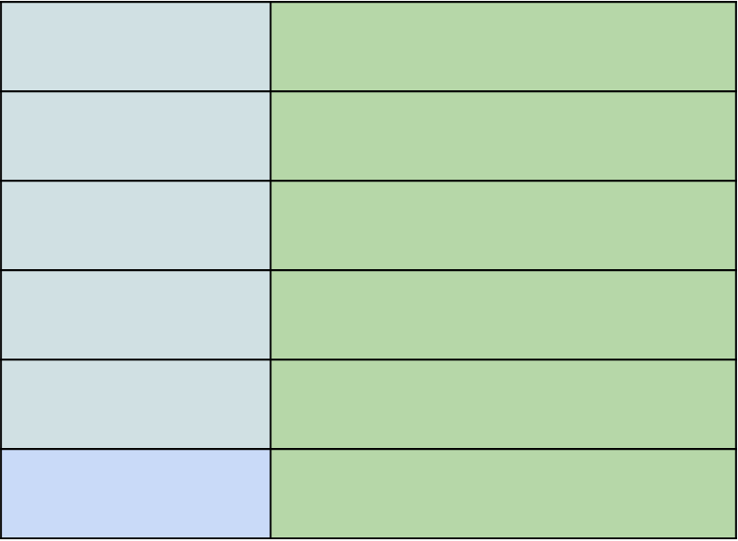
Wang2Vec
FEATURE VECTOR
WORD
Corpus
Text
1 Layer
NN
W

Slide 7
Wang2Vec Continued…
The Wikipedia corpus is supplied to Wand2Vec model, to get the word embeddings for the words of the corpus keeping semantic analysis in focus.
This model is trained for window size of 5, using structured skip gram method, which returns the word embedding vectors of size 50 indexed for each word of Wiki corpus
II. Feature Vector Construction and Output Class
The dataset of student given answers is divided into 2 parts –
1. Training Set – 70%
II. Testing Set – 30%
Following Operations are performed on both the sets:
Feature I – Using Wang2Vec model, the vector of size 50 is constructed for Reference Answer and Student Given Answer and Cosine Similarity between them is found as Feature I
Feature II – Using Edit Distance Algorithm, the Distance Between Reference answer and Student Given Answer is found, and is used as Feature II.

Slide 8
Continued…
Feature III – The Wordnet Similarity between Reference answer and Student answer is used as Feature III.
Feature IV – TER-Plus (TERp)- TERp is an extension of Translation Edit Rate (TER). It builds on the success of TER as an evaluation metric and alignment tool and addresses several of its weaknesses through the use of paraphrases, stemming, synonyms, as well as edit costs that can be automatically optimized to correlate better with various types of human judgments.

Slide 9
Continued…
Output Class is actual score given for the question by expert – it ranges from 0 to 5 at distance of 0.5, so it defines total 11 classes for classification.
Neural Network Training and Testing Phase.
- For training the neural network, the training feature sets are used with 3 hidden layers, with Keras library of python.
Precision is : 0.137907882369
Recall is : 0.517699115044
F1 Score is : 0.354771533807
Accuracy on Trained Data acc : 49.79%
Accuracy on Test data acc: 51.47%

Slide 10
Responsibility:
Ashwani Kumar Verma Initial processing on Wikipedia dump
Neha Banerjee feature extraction from dataset.
Prem Narayan Yadav Neural network training and processing.
Shakti Papdeja.

Slide 11
Thank You

