Slide 1

Design and Implementation of Algorithms to Solve the Sudoku Puzzle
Prem Narayan Yadav-16CS60R68
Under the supervision of
Professor Abhijit Das

Slide 2
Abstract
Sudoku is a very popular logical puzzle.
Various Artificial Intelligence techniques such as constraint propagation, forward checking, minimum remaining heuristic,etc have been developed to solve constraint satisfaction problems.
The objective of this project is to optimize the algorithm for solving sudoku puzzles using artificial techniques combined with a heuristic approach to prune the search space of the puzzle.

Slide 3
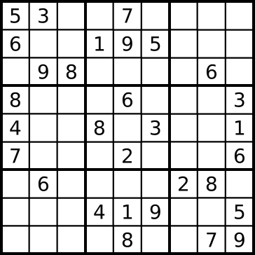
Sudoku
9 X 9 Puzzle
Divided into 3X3 sub-blocks
Each of the 81 squares must be filled in with a number from 1 to 9
For a solution, each row, column and sub-block must contain all the numbers from 1 to 9

Slide 4
Graphical Notation
9 | 10 | 11
1 | d | 2 | 3 | 4 | 5 | 6 | 7 | 8
12 | 13 | 14
 | 15
 | 16
 | 17
 | 18
 | 19
 | 20
d
1
2
20

Slide 5
Backtracking search
A simple method to find a solution is backtracking search
In which we guess a value at one unfilled place and move forward
If the assignment leads to an inconsistency afterwards, we track back and try different value
This method guarantees a solution if exists

Slide 6

Backtracking (animation)
dead end
?
dead end
dead end
?
start
?
?
dead end
dead end
?
success!

Slide 7
Time Complexity
If there are N filled squares out of 81 in a 9 X 9 sudoku grid
The number of states for backtracking search will be 9 ^ (81 - N) in the worst case eg. For N = 20, size of search space = 1.617 * 10 ^ 58
In general, the problem of solving sudoku puzzles on n^2 X n^2 grids with sub-blocks of size n X n is known to be NP-Complete

Slide 8
Optimization Techniques
Many Artificial Intelligence techniques has been developed for solving Constraint
satisfaction problems. We can use these for optimising sudoku solving algorithm
Forward checking - If a position is assigned with some value then that value
cannot be in same row, column and sub-block
Constraint Propagation - Since forward checking does not look far enough ahead, constraint propagation looks for changes to a further level
Minimum Remaining Values

Slide 9
Minimum remaining values(MRV) heuristic
Important heuristic for solving Constraint Satisfaction Problems
Choose the position with fewest legal values for guessing
Effective since the probability of guessing a wrong value becomes lesser

Slide 10
Heuristics

Slide 11
I.Presence Rule
 | d
This is the basic rule
If a value is present in a square then it can’t be in any other square in the same row, column or sub-block

Slide 12
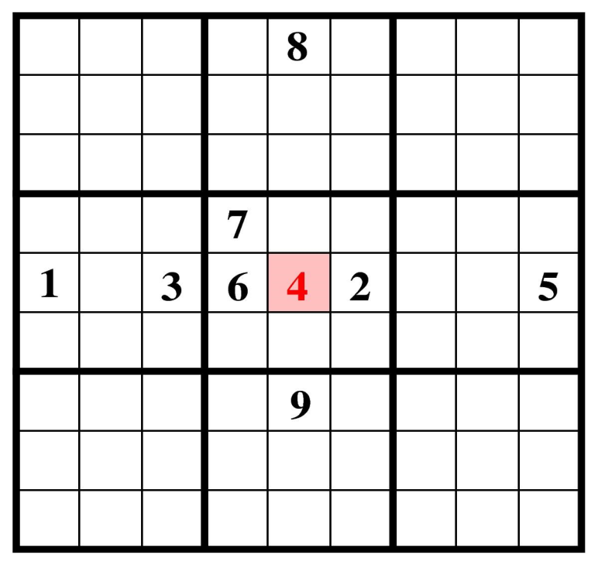
II. Absence Rule 1
If due to row constraints, column constraints and sub-block constraints, a position has only one legal value, assign it
4

Slide 13
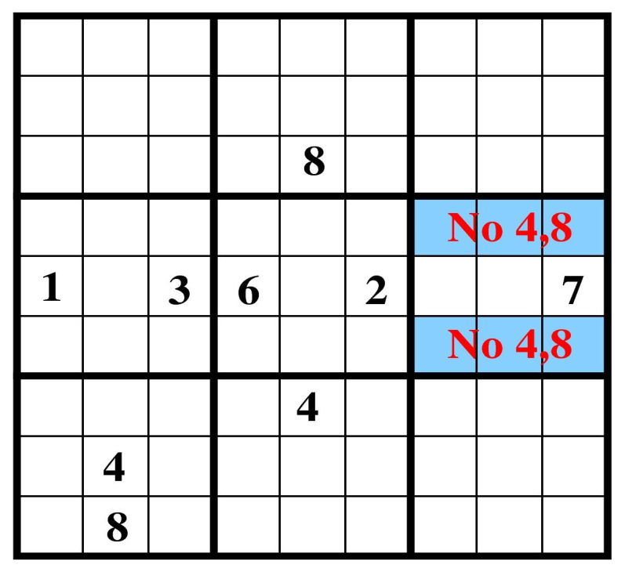
III. Absence Rule 2
If due to row constraints, two numbers are allowed in only two squares in the same row, these two numbers cannot be allowed in any other position in the corresponding sub-block.
This also applies to columns as well
No 4,8
No 4,8

Slide 14
Implementation

Slide 15
Depth First Search
To find a solution to sudoku problem, we select an unassigned position using the minimum remaining values heuristic, guess a value from the legal values for that position
Do forward checking and constraint propagation
Track back if any inconsistency is located
Using the heuristics prunes the large search space which makes the search
faster

Slide 16
Pseudo Code
Assign_and_Propagate( row, column, value) :
Remove numbers other than value from Allowed[row][column] if( Check_Heuristic_Conditions() == true)
Propagate()
DFS_search() :
Find MRV_position Guess a value
If( Assign_and_Propagate(MRV_position, guessed value) == true)
DFS_search()
Else
Try different value
SolveSudoku() :
Initialize 81 lists with Allowed values = 1 to 9 Assign_and_Propagate(initial values) DFS_search()

Slide 17
1
1
1
1
1
1
1
1
1
1
1
1
1
1
1
1
1
2
3
20

Slide 18
Integer Linear Programming Method
Transform the puzzle from a square 9 X 9 grid to a cubic 9 X 9 X 9 array of
integer values
The value of Array[i][j][k] indicates whether cell referred by the i^{th} row and the j^{th}
column is occupied by the value k or not.
The objective function is not needed here.

Slide 19
 | d
 | d

Slide 20




Constraints for Sudoku ILP
Each cell must have only one value
Each row must contain all unique digits
Each column must contain all unique digits
Each 3X3 box must contain all unique digits

Slide 21
Branch and Bound
Begin with the original ILP
Remove all the integrality restrictions. The resulting LP is called the linear-
programming relaxation of the original ILP.
Solve this LP.
Pick some variable that is restricted to be integer, but whose value in the LP relaxation is fractional.
We branch on that variable to get 2 ILPs. For example, suppose the value of x in the LP relaxation is 5.7. We can then exclude this value by imposing the restrictions x ≤ 5.0 and x ≥ 6.0.

Slide 22
Solving Sudoku ILP problem
Using this algorithm we can find a feasible solution for the constraints of our
Sudoku puzzle, which gives a solution to the Sudoku puzzle.
We can further improve the ILP method by using all the previously mentioned
heuristics. Using these heuristics will prune the search space for the ILP solver.
The number of constraints is much larger than the number of variables. So, converting the Sudoku ILP problem to its dual problem may improve the algorithm further.

Slide 23
Dataset
https://projecteuler.net/project/resources/p096_sudoku.txt 50 sudoku puzzles, easy to hard, all having unique solutions
http://norvig.com/top95.txt 95 hard sudoku puzzles
http://norvig.com/hardest.txt
11 very hard puzzles
http://staffhome.ecm.uwa.edu.au/~00013890/sudoku17 500 sudoku puzzles with 17 filled positions

Slide 24
Results
Time (in seconds) | Avg & max time with backtracking | Avg & max time with heuristics | Avg &max time with ILP
Euler’s 50 puzzles | 0.011 & 0.102 | 0.0049 & 0.043 | 0.0125 & 0.046
Norvig’s 11 hardest puzzles | 0.044 & 0.152 | 0.0122 & 0.0373 | 0.018 & 0.037
Norvig’s 95 hard puzzles | 1.98 & 55.45 | 0.05 & 0.661 | 0.011 & 0.038
As compared to simple backtracking method, the heuristic search & ILP method took much lesser time and was very efficient.

Slide 25
FUTURE PLAN
Converting the Sudoku ILP problem to its dual problem may improve the algorithm further.
Design of faster algorithms.
Handling general n x n boards.
Parallel implementation.
CNN Implementation.

Slide 26
References
Solving every sudoku puzzle By Peter Norvig http://norvig.com/sudoku.html
Felgenhauer, Bertram and Frazer Jarvis. “Enumerating possible Sudoku grids.” 20 June 2005 http://www.afjarvis.staff.shef.ac.uk/sudoku/sudoku.pdf
Taruna Kumari, Preeti Yadav, Lavina , " Study Of Brute Force and Heuristic Approach to solve sodoku" , International Journal of Emerging Trends & Technology in Computer Science (IJETTCS) , Volume 4, Issue 5(2), September - October 2015 , pp. 052-055 , ISSN 2278-6856 http://www.ijettcs.org/pabstract.php?vol=Volume4Issue5(2)&pid=IJETTCS-2015-10-10-17
Mike Schermerhorn. “A Sudoku Solver” https://www.cs.rochester.edu/u/brown/242/assts/termprojs/Sudoku09.pdf
Anshul Kanakia and John Klingner. “Methods for Solving Sudoku Puzzles”
http://tuvalu.santafe.edu/~aaronc/courses/5454/csci5454_spring2013_CSL5.pdf
Felgenhauer, Bertram and Frazer Jarvis. “Enumerating possible Sudoku grids.” 2
http://www.afjarvis.staff.shef.ac.uk/sudoku/sudoku.pdf
0 June 2005

Slide 27
Thank You

