Slide 1

VISUAL COMFORT–FLAVORED · PUBLIC DEMO
Retail analytics
wiring,
explained.
Local SQLite + optional Snowflake — same UI, governed metrics, synthetic dealers.
Open live demo →
https://vc.datasharkbi.com/
Login: dlr-0001 / vc-demo
Paul Rendleman

Slide 2
START HERE
Click the button — opens the live demo
https://vc.datasharkbi.com/
If the button doesn’t open: copy the URL, or Ctrl/Cmd-click the underlined link below.
https://vc.datasharkbi.com/
1
2
3
4
Open
Sign in
Confirm
Walk
Click the dark bar above
operator / vc-demo
SYNTHETIC badge on
Overview → Analytics (Market) → Lab → Assistant
VC Retail Analytics · synthetic
https://vc.datasharkbi.com
2/18

Slide 3

WHY THIS EXISTS
Support pattern vs warehouse truth
Site support handles FAQ and escalation. Dealer sell-through, margin, and stock risk are not in chat — this demo grounds those answers in governed metrics (local or Snowflake).
Session tenancy
Dual backend
Traceable assistant
Dealer scope from auth cookie — never from the prompt.
Same UI: SQLite local or Snowflake SERVING views.
Proposed answers include SQL + params in the tool trace.
VC Retail Analytics · synthetic
https://vc.datasharkbi.com
3/18

Slide 4
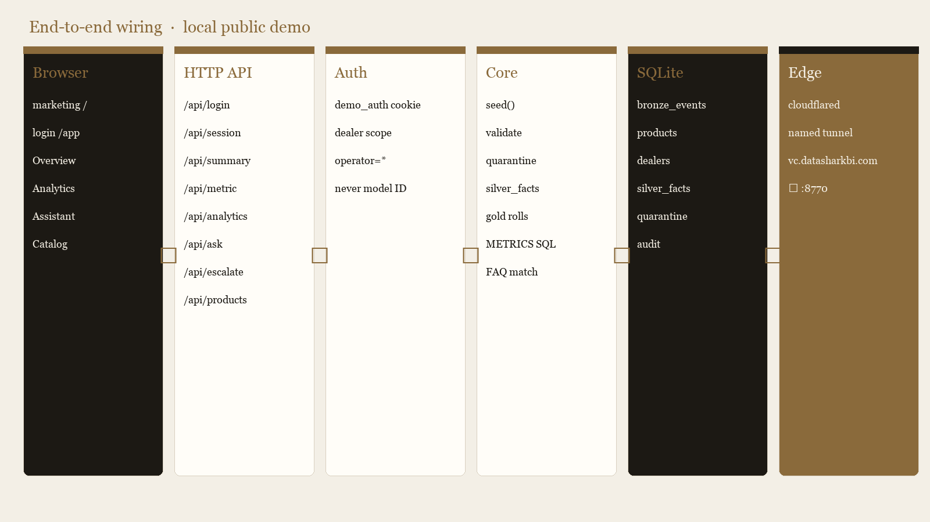
DEEP WIRING · LOCAL
Browser → API → SQLite → public edge
VC Retail Analytics · synthetic
https://vc.datasharkbi.com
4/18

Slide 5
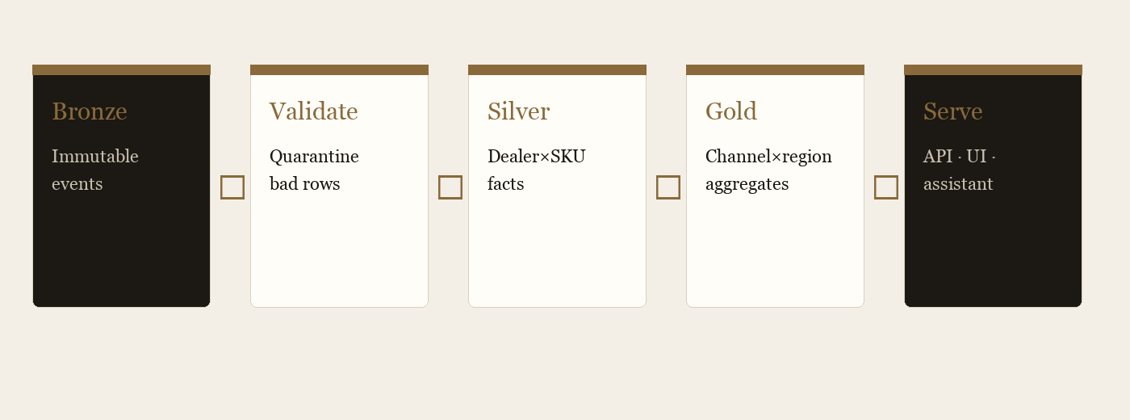
WAREHOUSE
Bronze → Silver → Gold grain
Bronze
Immutable events. Keys: event_id + (dealer_id, source_id, version).
Validate
Reject bad money/units/channels → quarantine.
Silver
Latest valid (dealer_id, sku_id) sell-through + on-hand.
Gold
Channel × region × family aggregates.
Serve
:8770 /api/metric with session dealer WHERE.
Edge
cloudflared tunnel → vc.datasharkbi.com
VC Retail Analytics · synthetic
https://vc.datasharkbi.com
5/18

Slide 6
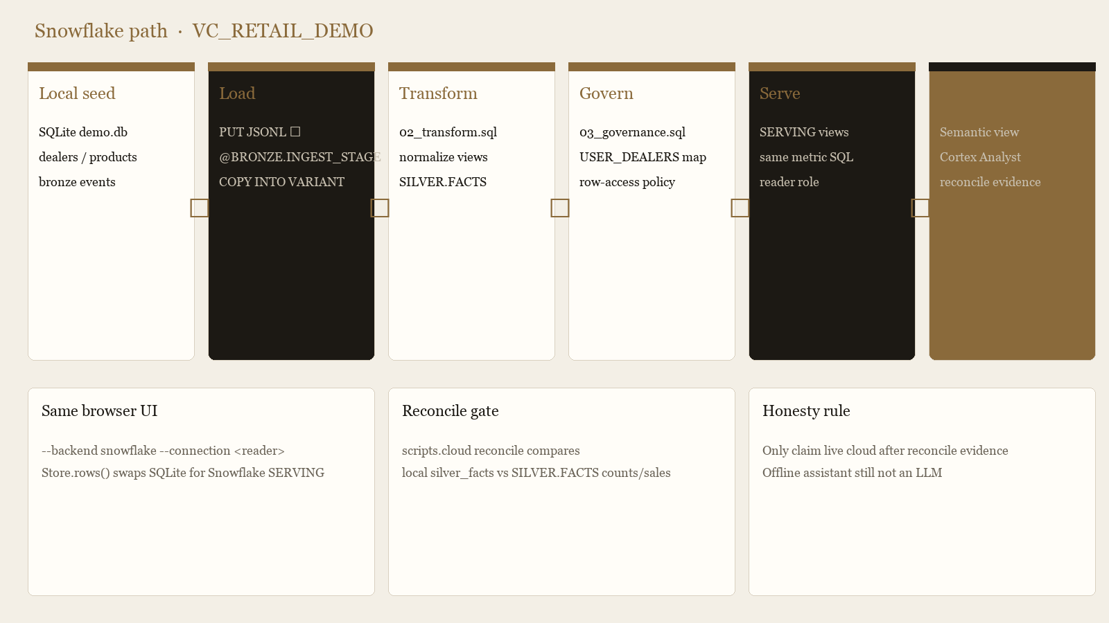
DEEP WIRING · SNOWFLAKE
Optional cloud path — same contracts
VC Retail Analytics · synthetic
https://vc.datasharkbi.com
6/18

Slide 7
SNOWFLAKE SETUP
Ordered scripts.cloud pipeline
doctor
Verify connection profile (account / user / role / warehouse)
platform
01_platform.sql → DB VC_RETAIL_DEMO + BRONZE/SILVER/GOLD/GOVERNANCE/SERVING + WH
load
Seed local SQLite → PUT JSONL → @BRONZE.INGEST_STAGE → COPY INTO VARIANT
transform
02_transform.sql → normalize → SILVER.FACTS (+ quarantine)
governance
03_governance.sql → USER_DEALERS + row-access policy on SERVING views
semantic
04_semantic.sql → SERVING.VC_RETAIL_SEMANTICS for Cortex Analyst
validate
05_validation.sql smoke checks
reconcile
Compare local silver_facts vs SILVER.FACTS → docs/evidence/reconcile.json
VC Retail Analytics · synthetic
https://vc.datasharkbi.com
7/18

Slide 8
SNOWFLAKE SECURITY
Database layout + dealer row policy
BRONZE
DEALERS, PRODUCTS, EVENTS (VARIANT), INGEST_STAGE, INCOMING
SILVER
FACTS (current dealer×SKU), QUARANTINE
GOLD
Channel / family / region rolls
GOVERNANCE
USER_DEALERS map + DEALER_SCOPE row-access policy
SERVING
Secure views for the app reader role + semantic view
Row policy: CURRENT_USER() must map in GOVERNANCE.USER_DEALERS to DLR-#### or '*'.
Attached on SERVING.SILVER_FACTS, DEALERS, QUARANTINE, GOLD_CHANNEL_FAMILY.
Reader role gets USAGE on WH/DB/SERVING + SELECT on serving views — not raw Bronze.
VC Retail Analytics · synthetic
https://vc.datasharkbi.com
8/18

Slide 9
APP WIRING
One UI, two Store backends
Local (default)
Snowflake
▪ python3 -m app.server
▪ Store.rows → sqlite3 on data/demo.db
▪ Tables: silver_facts, quarantine, …
▪ Dealer WHERE from session cookie
▪ No cloud credentials required
▪ python3 -m app.server --backend snowflake --connection <reader>
▪ Store.rows → snowflake.connector
▪ USE SCHEMA SERVING
▪ Same metric SQL shapes against views
▪ RAP enforces dealer scope in-warehouse
VC Retail Analytics · synthetic
https://vc.datasharkbi.com
9/18

Slide 10
OPTIONAL CORTEX
Semantic view — not arbitrary SQL
SERVING.VC_RETAIL_SEMANTICS binds dimensions (dealer, channel, family, region) and metrics (units, net_sales, margin, on_hand) over SILVER_FACTS.
▪ Comment on the view: synthetic VC-flavored snapshot — do not invent forecasts or live order status
▪ scripts/cortex.py calls Cortex Analyst against that semantic view (needs SNOWFLAKE_HOST + PAT)
▪ Offline /api/ask Proposed path remains a closed METRICS vocabulary — not an LLM
▪ Only claim “live Snowflake / Cortex” after scripts.cloud reconcile evidence exists
▪ Isolated DB VC_RETAIL_DEMO — do not reuse other demo databases
Open public demo →
VC Retail Analytics · synthetic
https://vc.datasharkbi.com
10/18

Slide 11
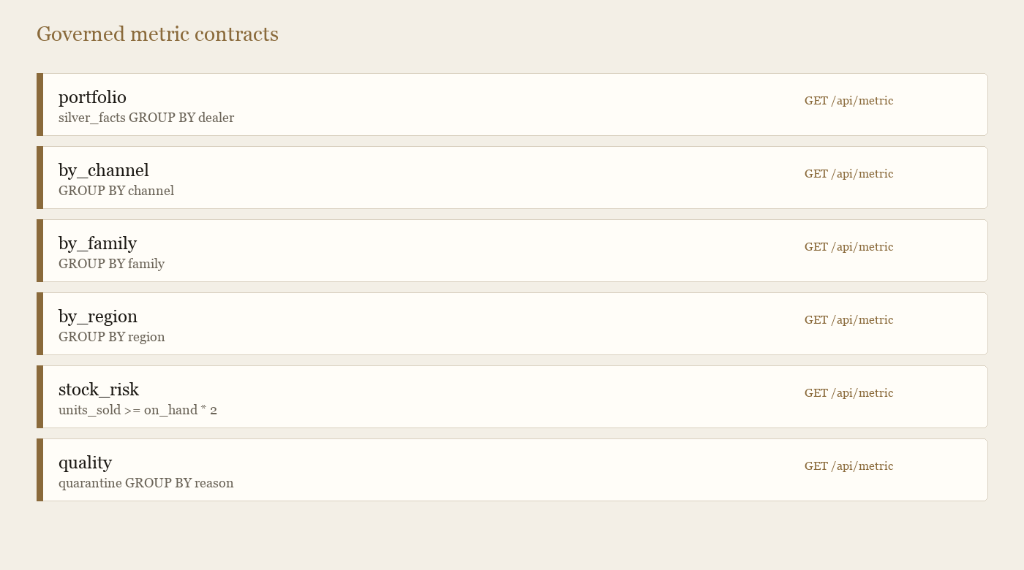
CONTRACTS
Governed metrics (closed vocabulary)
VC Retail Analytics · synthetic
https://vc.datasharkbi.com
11/18

Slide 12
HTTP SURFACE
API map the UI calls
POST /api/login
Session cookie; binds dealer or operator
GET /api/session · /api/health
Identity + backend label + synthetic flag
GET /api/summary · /api/metric
Overview KPIs; one of six METRICS
GET /api/analytics
Bundled channel/family/region/stock_risk
POST /api/ask
mode=today|proposed → FAQ / metric / escalate
POST /api/escalate
Structured handoff JSON (demo)
GET /api/products · /api/catalog
Catalog search + metric lineage notes
VC Retail Analytics · synthetic
https://vc.datasharkbi.com
12/18

Slide 13
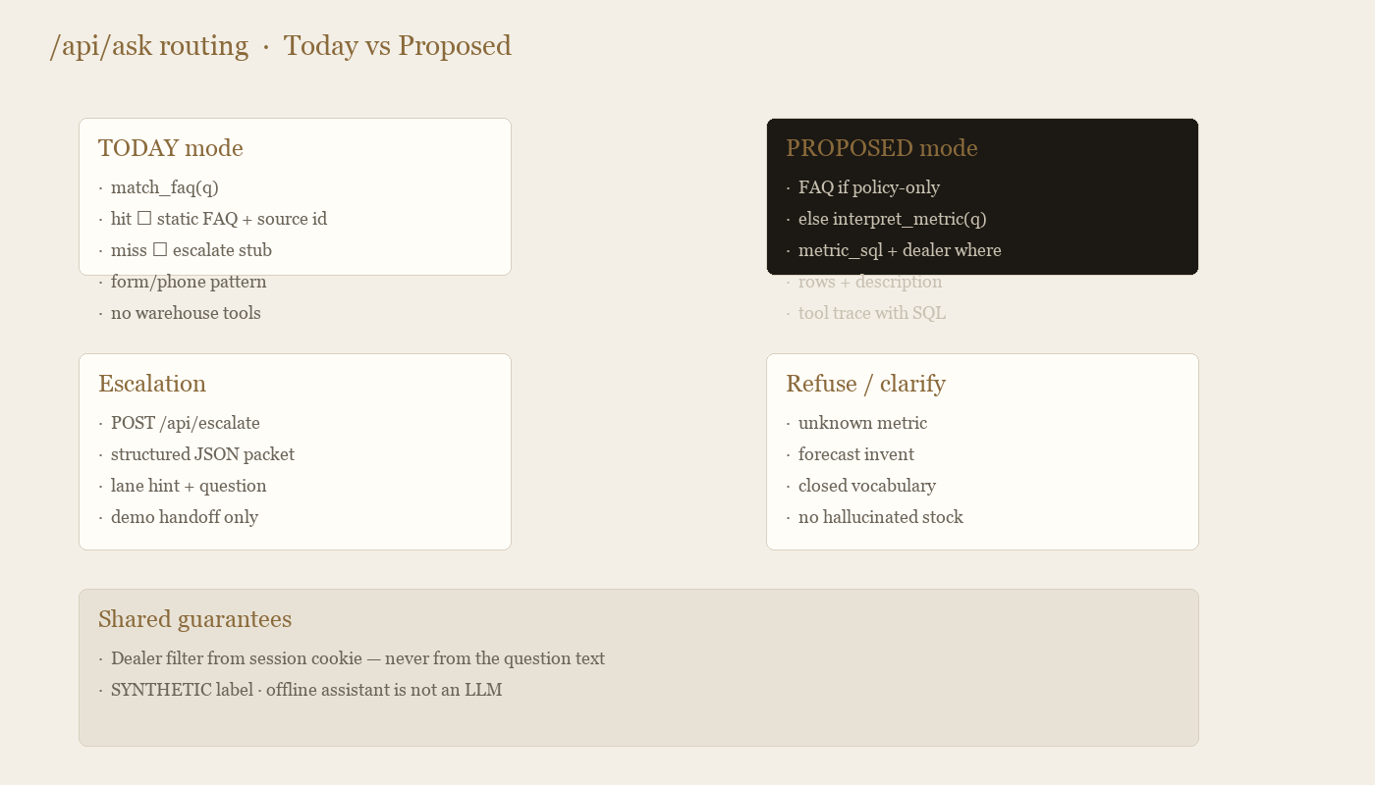
ASSISTANT
Today vs Proposed request router
VC Retail Analytics · synthetic
https://vc.datasharkbi.com
13/18

Slide 14
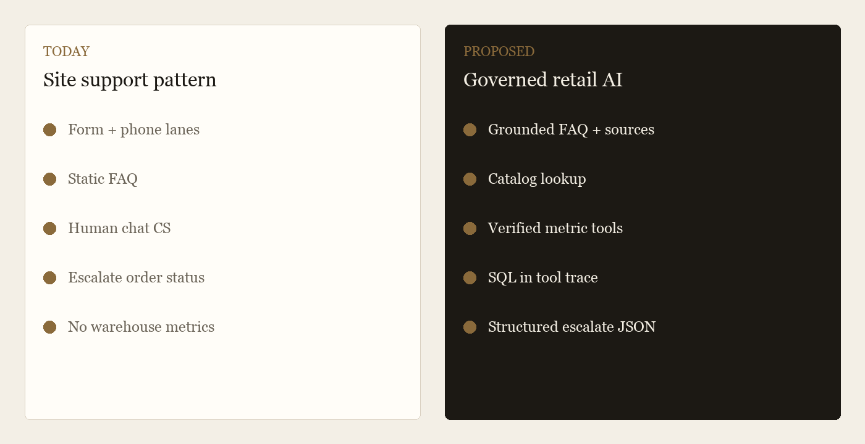
CHATBOT GAP
What changes for the dealer
VC Retail Analytics · synthetic
https://vc.datasharkbi.com
14/18

Slide 15
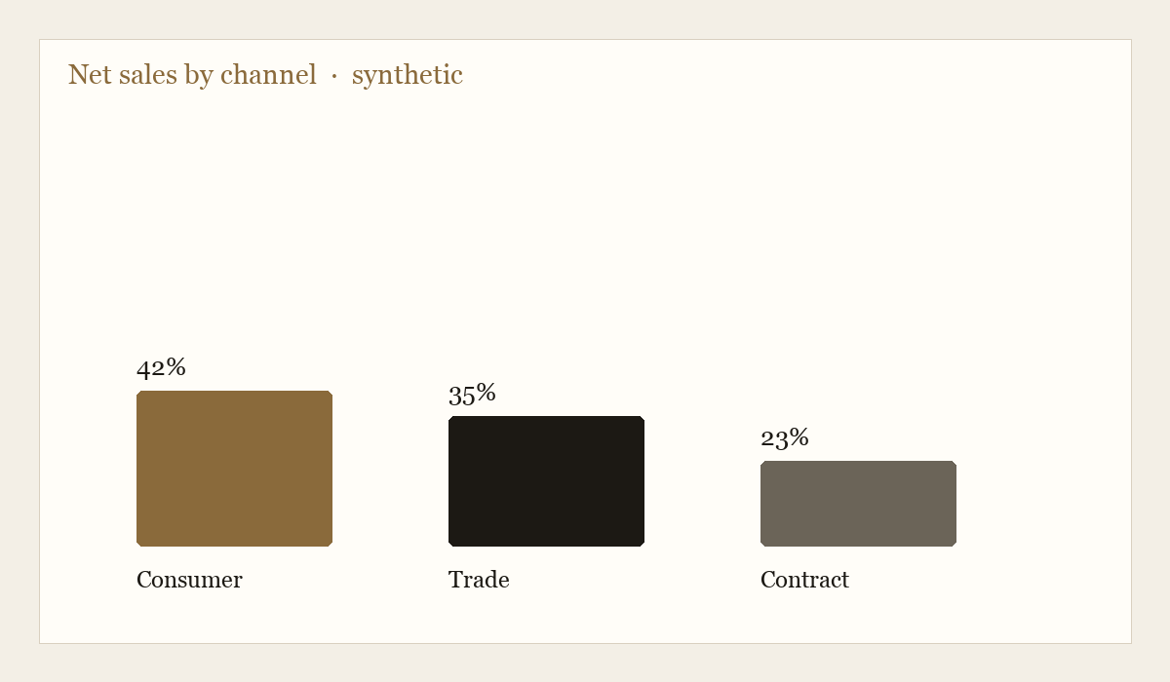
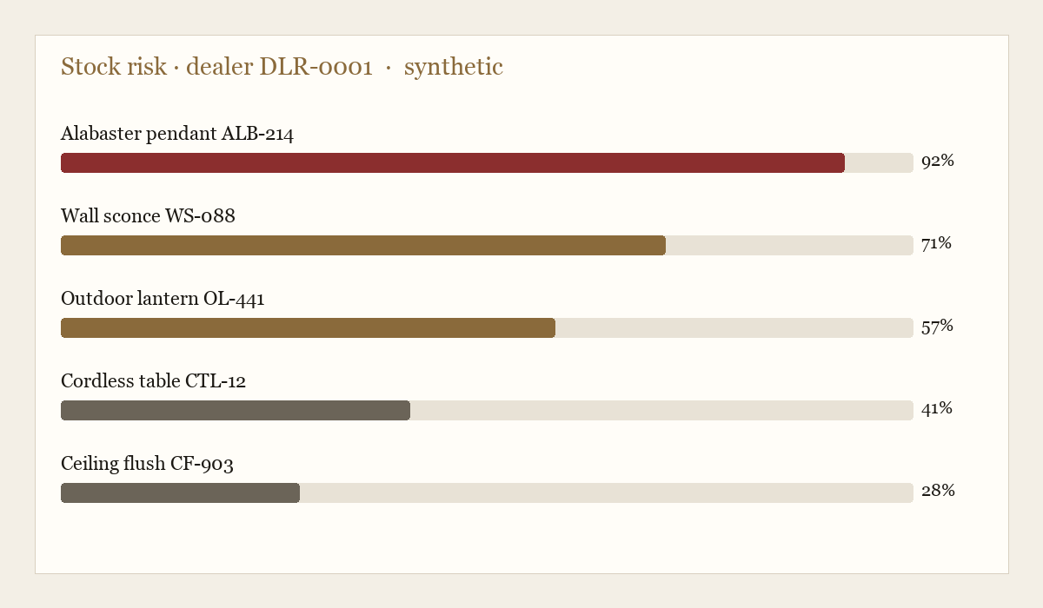
ANALYTICS
Example panels (synthetic)
VC Retail Analytics · synthetic
https://vc.datasharkbi.com
15/18

Slide 16
DEMO SCRIPT
Prompts that exercise the wiring
Open demo · https://vc.datasharkbi.com
Today
Proposed
▪ custom order lead time → FAQ + source
▪ what is open box → policy
▪ where is my order 12345 → escalate
▪ show sales by channel → SQL + rows
▪ show stock risk → stock_risk
▪ alabaster → catalog
▪ invent forecast → refuse
VC Retail Analytics · synthetic
https://vc.datasharkbi.com
16/18

Slide 17
INTERVIEW LAB
What to open with an AI Engineer
Board brief
Eval harness
Cortex vs governed
Chains share expansion → GM lift → forecast vs run-rate → growth into one spoken narrative.
20 golden prompts: FAQ · metric · voice fuzzy · refuse. Pass/fail + latency on screen.
Same question side-by-side. Prefer closed metrics; Cortex is discovery/fallback.
Scope / RAP story
90-day plan
Market + voice
Operator pins DLR-0001 — same ask, fewer rows. App-layer mirror of Snowflake RAP.
Grounding → measure → harden. Non-goals: no invented order status, no day-one phone replacement.
Competitor landscape (public-estimate), continuous Mic on Snowflake, Market analytics tab.
VC Retail Analytics · synthetic
https://vc.datasharkbi.com
17/18

Slide 18
LOCAL · SNOWFLAKE · PUBLIC
Open the wiring.
Click the demo.
Open live demo →
https://vc.datasharkbi.com/
operator / vc-demo
Not Visual Comfort production data.
Paul Rendleman

