Slide 1
Enhanced Veterinary Care AI Samyuktha Kathirvel
Prenitha S P
Arunachalam M Kongu Engineering College India

Slide 2
Contents
Introduction
Abstract
Objective
Literature Survey
Proposed Solution
Methodology
Workflow
Results
Future work
Conclusion
Reference

Slide 3
Introduction
Traditional methods of accessing pet care information are time-consuming, lack personalization, and are often unreliable, creating a growing need for a user-friendly, intelligent solution that provides accurate, real-time, and tailored advice for pet owners and veterinarians.

Slide 4
Abstract
AI is transforming veterinary medicine, focusing on predictive analytics and personalized treatment plans.
AI-driven tools, such as chatbots, can assess animal injuries, provide treatment plans, and automate vaccination reminders.
AI enhances diagnostic imaging and predictive models, enabling veterinarians to make more accurate decisions.
It leads to more efficient, accurate, and personalized medical interventions, improving animal patient outcomes.
The future of veterinary medicine holds great promise with the advancement of AI technologies.

Slide 5
Objectives
To address Information Overload by simplifying access to veterinary data and pet care resources.
To overcome Language Barriers by creating a chatbot that supports multiple languages, catering to diverse users.
To enhance User Engagement through an intuitive, user-friendly interface and compelling, interactive content.
To ensure Accuracy and Reliability of information to provide trusted, evidence-based responses in pet care and veterinary inquiries.

Slide 6
Literature Survey
NO | Authors | Title | Journal/ Source | Year | Methodology/Algorithms
1 | Appleby, R. B., & Basran, P. S. | Artificial intelligence in veterinary medicine | Journal of the American Veterinary Medical Association | 2022 | Review of AI integration in veterinary practices, focusing on diagnostic tools, patient management, and emerging AI trends.
2 | Boissady, E., de La Comble, A., Zhu, X., & Hespel, A. | Artificial intelligence evaluating primary thoracic lesions | Veterinary Radiology & Ultrasound | 2020 | Comparative study using AI models and veterinarians to diagnose thoracic lesions, using a dataset of thoracic imaging. Error rates compared between AI, veterinarians, and combined approaches.
3 | Huang, D. H., & Chueh, H. E. | Chatbot usage intention analysis: Veterinary consultation | Journal of Innovation & Knowledge | 2021 | Survey-based study analyzing chatbot usage intention in veterinary consultations. Data from veterinary professionals and pet owners were analyzed to determine preferences and reliability.

Slide 7
Literature Survey
NO | Authors | Title | Journal/ Source | Year | Methodology/Algorithms
4 | Cihan, P | A Review of Machine Learning Applications in Veterinary Field | KAFKAS UNIVERSITESI VETERINER FAKULTESI DERGISI | 2017 | Literature review of machine learning applications in veterinary medicine, including case studies on diagnostics, treatment planning, and disease prediction.
5 | Bowman, D. D., & Lucio-Forster, A. | Cryptosporidiosis and giardiasis in dogs and cats: veterinary and public health importance | Experimental Parasitology | 2021 | Experimental study focusing on cryptosporidiosis and giardiasis in dogs and cats, exploring veterinary and public health importance.
6 | Bouhali, O., Bensmail, H., Sheharyar, A., David, F., & Johnson, J. P. | A review of radiomics and artificial intelligence and their application in veterinary diagnostic imaging | Veterinary Sciences | 2022 | Review of radiomics and AI applications in veterinary diagnostic imaging, assessing AI’s potential to enhance image-based diagnostics.
7 | Gulzar, M. W., & Hussain, J. | The implementation of artificial intelligence in veterinary diseases and practices: A comprehensive review | Hosts and Viruses | 2023 | Comprehensive review of AI implementation in veterinary diseases and practices, discussing key AI models, their applications, and outcomes in veterinary settings.

Slide 8
Literature Survey
NO | Authors | Title | Journal/ Source | Year | Methodology/Algorithms
8 | Albadrani, B. A., Abdel-Raheem, M. A., & Al-Farwachi, M. I. | Artificial Intelligence in Veterinary Care: A Review of Applications for Animal Health | Egyptian Journal of Veterinary Sciences | 2024 | |Review of AI applications in veterinary care, particularly in animal health monitoring and predictive analytics, highlighting improvements in treatment protocols.
9 | Chu, C. P. | ChatGPT in Veterinary Medicine: A Practical Guidance of Generative Artificial Intelligence in Clinics, Education, and Research | arXiv preprint arXiv:2403.14654 | - | 2024 | Study exploring ChatGPT’s potential role in veterinary clinics, education, and research, focusing on generative AI applications in day-to-day operations.
10 | Basran, P. S., & Appleby, R. B. | The unmet potential of artificial intelligence in veterinary medicine | American Journal of Veterinary Research | 2022 | Analysis of unmet potential in AI applications in veterinary medicine, discussing limitations and opportunities for future AI integration.
11 | Bair, Henry, & Norden, Justin | Large Language Models and Their Implications on Medical Education | Academic Medicine | 2023 | Review of large language models (LLMs) and their implications for medical education, with a focus on veterinary and human medicine training programs.

Slide 9
Literature Survey
NO | Authors | Title | Journal/ Source | Year | Methodology/Algorithms
8 | Albadrani, B. A., Abdel-Raheem, M. A., & Al-Farwachi, M. I. | Artificial Intelligence in Veterinary Care: A Review of Applications for Animal Health | Egyptian Journal of Veterinary Sciences | 2024 | |Review of AI applications in veterinary care, particularly in animal health monitoring and predictive analytics, highlighting improvements in treatment protocols.
9 | Chu, C. P. | ChatGPT in Veterinary Medicine: A Practical Guidance of Generative Artificial Intelligence in Clinics, Education, and Research | arXiv preprint arXiv:2403.14654 | - | 2024 | Study exploring ChatGPT’s potential role in veterinary clinics, education, and research, focusing on generative AI applications in day-to-day operations.
10 | Basran, P. S., & Appleby, R. B. | The unmet potential of artificial intelligence in veterinary medicine | American Journal of Veterinary Research | 2022 | Analysis of unmet potential in AI applications in veterinary medicine, discussing limitations and opportunities for future AI integration.
11 | Bair, Henry, & Norden, Justin | Large Language Models and Their Implications on Medical Education | Academic Medicine | 2023 | Review of large language models (LLMs) and their implications for medical education, with a focus on veterinary and human medicine training programs.

Slide 10
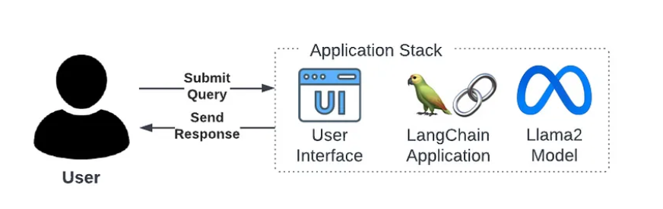
Proposed Solutions
PetCare AI ChatBot:
Data Source:
Utilize veterinary-related case studies, dog care encyclopedias, and various relevant documents to train the chatbot on a comprehensive dataset.
Embedding Model:
Implement the Multilingual E5 embedding model to enable the chatbot to understand and respond to queries in multiple languages, enhancing its accessibility.

Slide 11
LLM (Large Language Model):
Leverage the power of Llama 2, an open-source large language model developed by meta AI, to enhance the chatbot natural language processing capabilities.
Framework:
Employ LangChain as the underlying framework for PetCare AI ChatBot, providing a robust structure for seamless integration of language models and efficient query processing.
Backend:
Implement Fast API for the backend, ensuring fast and efficient communication between the frontend interface and the underlying language model.
UI (User Interface):
Utilize Bootstrap V5 to design a user-friendly interface, ensuring a smooth and visually appealing experience for users.

Slide 12
Workflow
Load LangChain
FrameWork
BootStrap V5
Multilingual E5
Define Embedding
UI
Load LLM model
Load Data
Decoding
Llama 2
Define Chunk
Encoding
Fast API
Query Processing

Slide 13
Methodology:Image Processing Techniques
Image Enhancement: Utilized to improve the visual quality of diagnostic images using techniques like contrast adjustment, histogram equalization, and noise reduction, allowing veterinarians to make more precise evaluations.
Feature Extraction: Methods such as edge detection, texture analysis, and shape delineation are applied to extract crucial anatomical and pathological information from images for accurate diagnostics.
Segmentation: Techniques like thresholding, region-growing, and clustering divide medical images into cohesive areas, enabling the accurate identification of anatomical structures and abnormalities for targeted treatments.

Slide 14
Methodology:AI Techniques for Image Classification
Convolutional Neural Networks (CNNs): Used for automatic feature extraction and classification of veterinary images, CNNs analyze raw pixel data to detect and classify anatomical features and wounds with an accuracy of 95%.
Support Vector Machine (SVM): Effective for high-dimensional data classification tasks, SVMs use kernel functions to identify wounds based on patterns and textures achieving an accuracy of 92%.
K-Nearest Neighbors (KNN): A simple yet effective algorithm that classifies images based on similarity to known examples, achieving 89% accuracy in wound detection across various animal species.

Slide 15
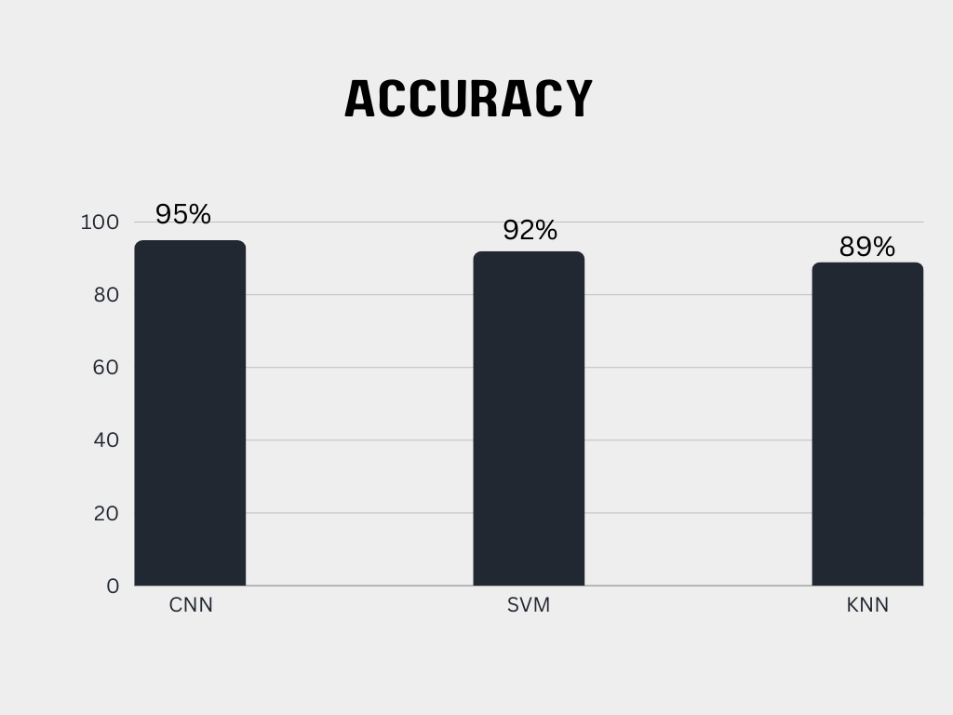

Slide 16
Results
Accessible Information: Provide users with easy access to accurate and reliable information on veterinary care, pet health, and general pet care practices.
Multilingual Support: Cater to a diverse audience by supporting multiple languages, breaking down language barriers in the pet care community.
User Engagement: Enhance user engagement through an intuitive and visually appealing UI, encouraging users to seek and interact with the chatbot.
Reliability: Ensure the chatbot delivers accurate information, promoting trust among users, including veterinary professionals and pet owners.

Slide 17
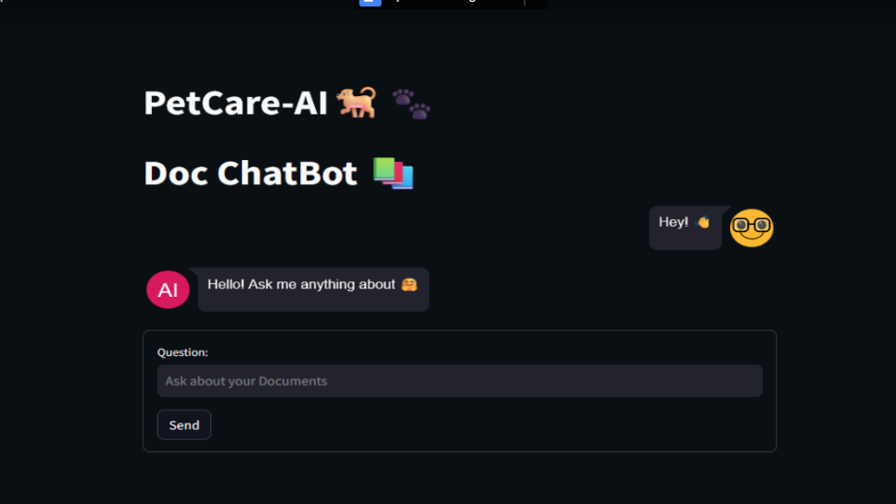

Slide 18
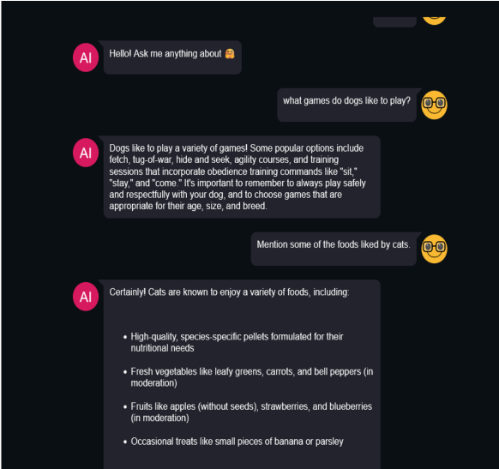

Slide 19
Future Work
Expand the chatbot’s multilingual capabilities to cater to a broader global audience and overcome language barriers more effectively.
Incorporate advanced AI algorithms for real-time analysis of pet health conditions, including behavioral assessments and disease prediction.
Enhance integration with wearable technology for continuous monitoring of pets’ health, allowing the chatbot to provide more personalized and timely interventions.
Develop a collaborative platform where veterinarians can contribute and verify information, ensuring ongoing accuracy and reliability.
Explore machine learning models for more precise diagnostic support, including AI-driven suggestions for treatment plans based on historical case data.
Incorporate natural language processing (NLP) advancements to enable more intuitive and human-like chatbot interactions.

Slide 20
Conclusion
AI-powered solutions are essential for addressing challenges in veterinary care, such as information overload, language barriers, and user engagement.
A chatbot designed with accuracy, reliability, and user-friendly features can transform the way pet owners and veterinary professionals access information.
By integrating predictive analytics, personalized treatment plans, and multilingual support, AI enhances both the quality and accessibility of pet care.
The future of veterinary medicine lies in leveraging AI to deliver more efficient, accurate, and personalized care, ultimately improving outcomes for animals and providing better support for their caregivers.

Slide 21
References
[1]Appleby, R. B., & Basran, P. S. (2022). Artificial intelligence in veterinary medicine. Journal of the American Veterinary Medical Association, 260(8), 819-824.doi:https://doi.org/10.2460/javma.22.03.00 93
[2]Boissady, E., deLaComble,A., Zhu,X.,& Hespel, A. M. (2020). Artificial intelligence evaluatingprimarythoraciclesionshasanoverall lower error rate compared to veterinarians or veterinarians in conjunctionwith the artificial intelligence. Veterinary Radiology&Ultrasound, 61(6),619-627. doi:https://doi.org/10.1111/vru.12912
[3]Huang,D.H.,&Chueh,H.E. (2021).Chatbot usage intentionanalysis:Veterinaryconsultation. Journal of Innovation & Knowledge, 6(3), 135-144.doi:https://doi.org/10.1016/j.jik.2020.09.0 02
[4]Cihan,P. EtAl. 2017.AReviewofMachine Learning Applications in Veterinary Field. KAFKAS UNIVERSITESI VETERINER FAKULTESIDERGISI, vol.23,no.4,673-680. doi:10.9775/kvfd.2016.17281
[5]Bowman,D.D.,&Lucio-Forster,A. (2010). Cryptosporidiosisandgiardiasisindogsandcats: veterinary and public health importance. Experimental parasitology, 124(1), 121-127.doi:https://doi.org/10.1016/j.exppara.2009 .01.003

Slide 22
References
[6]Bouhali, O., Bensmail, H., Sheharyar, A., David, F.,&Johnson, J. P. (2022).Areviewof radiomics and artificial intelligence and their application in veterinary diagnostic imaging. Veterinary Sciences, 9(11), 620.doi:https://doi.org/10.3390/vetsci9110620
[7]Gulzar, M. W., &Hussain, J. (2023). The implementation of artificial intelligence in veterinary diseases and practices. A comprehensive review. Hosts and Viruses, 10, 43-50. doi:https://dx.doi.org/10.17582/journal.hv/2023/10 .43.50
[8]Albadrani, B. A., Abdel-Raheem, M. A., & Al-Farwachi,M. I. (2024)."ArtificialIntelligence inVeterinaryCare:AReviewofApplicationsfor Animal Health. Egyptian Journal of Veterinary Sciences, 55(6), 1725-1736. doi:10.21608/ejvs.2024.260989.1769
[9]Chu, C. P. (2024). ChatGPT inVeterinary Medicine: APractical Guidance ofGenerative Artificial Intelligence inClinics, Education, and Research.arXivpreprintarXiv:2403.14654.doi: https://doi.org/10.48550/arXiv.2403.14654
[10]Basran,P.S.,&Appleby,R.B. (2022).The unmet potential of artificial intelligence in veterinary medicine. American Journal of Veterinary Research, 83(5), 385-392. doi:https://doi.org/10.2460/ajvr.22.03.0038

Slide 23
References
[11]Bair, Henry1; Norden, Justin MD, MBA, MPhil2. Large Language Models and Their Implications onMedical Education. Academic Medicine 98(8):p 869-870, August 2023.doi:10.1097/ACM.0000000000005265
[12]Bellamy JEC. Artificial intelligence in veterinarymedicinerequiresregulation.CanVet J. 2023 Oct;64(10):968-970. PMID: 37780472; PMCID:PMC10506349.
[13]Angel, M., Patel, A., Xing, H., Balsz, D., Arbuckle, C., Bruyette, D., &Baldi, P. (2023, November). AI and Veterinary Medicine: Performance ofLargeLanguageModels on the NorthAmericanLicensingExamination. In2023 TenthInternationalConferenceonSocialNetworks Analysis,ManagementandSecurity(SNAMS)(pp. 1-4). IEEE.doi:10.1109/SNAMS60348.2023.10375414
[14]Zhang,L.,Guo,W.,Lv,C.,Guo,M.,Yang,M., Fu, Q., & Liu, X. (2024). Advancements in artificial intelligence technology for improving animalwelfare:Currentapplicationsandresearch progress. Animal Research and One Health, 2(1), 93-109.doi:https://doi.org/10.1002/aro2.44

Slide 24


