Slide 1
Sales Analysis & Dashboard
ShadowFox Data Analyst Internship — Beginner Level
Superstore Sales Dataset
Prepared by: Prensi
Tools: Microsoft Excel

Slide 2
Project Overview
Business-focused analysis of sales, profitability and product performance
• Analyze Superstore sales data to understand overall business performance.
• Clean and organize the dataset before analysis.
• Measure key KPIs including Sales, Profit, Quantity and Orders.
• Identify monthly trends, category performance and top-selling products.
• Convert findings into actionable business insights and recommendations.
Focus: turn raw sales data into clear, decision-ready business information.
2

Slide 3
Dataset & Tools
Source structure and analysis environment
RECORDS
COLUMNS
ANALYSIS TOOL
10,194
21
Excel
Key fields used
Order Date • Order ID • Customer • Segment • Region
Category • Sub-Category • Product Name • Sales • Quantity
Discount • Profit
Dataset used for the project: Superstore Sales Dataset (Kaggle).
3

Slide 4
Data Cleaning & Preparation
Steps completed before analysis
01
Dataset structure
Reviewed 21 columns and 10,194 records.
02
Duplicate check
Checked the dataset for duplicate rows; no duplicate values were found.
03
Missing values
Checked key fields including dates, customer, category, product, sales, quantity and profit.
04
Date standardization
Standardized mixed Order Date formats into a clean date field.
05
Excel organization
Converted the data into an Excel Table for easier filtering and analysis.
4

Slide 5
KPI Summary
Overall business performance
TOTAL SALES
TOTAL PROFIT
TOTAL QUANTITY
TOTAL ORDERS
₹23,26,534.35
₹2,92,296.81
38,654
5,111
Overall Profit Margin
12.56%
The dashboard combines revenue, profitability, volume and order-level KPIs for a quick business overview.
5

Slide 6
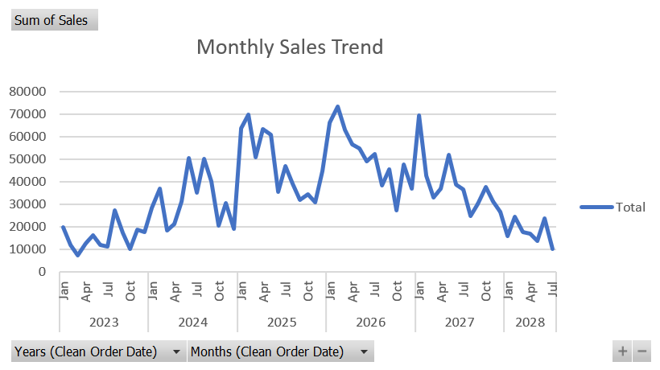
Monthly Sales Trend
Sales movement across the available Order Date periods
The trend shows clear month-to-month variation, with several strong sales peaks followed by lower periods.
6

Slide 7
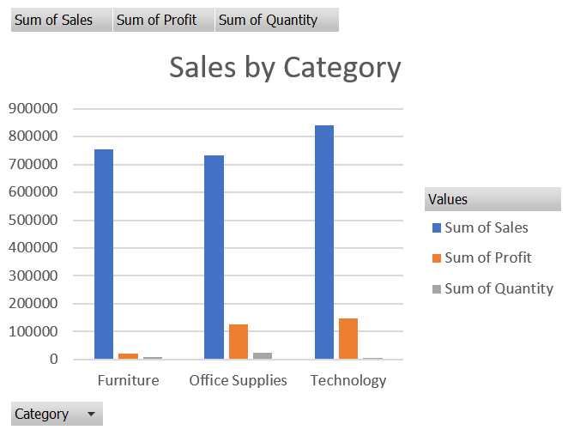
Category Performance
Sales, profit and profitability by major category
TECHNOLOGY SALES
₹839,893.28
TECHNOLOGY PROFIT
₹146,543.38
TECHNOLOGY MARGIN
17.45%
Furniture margin: 2.61% — substantially lower than the other categories.
7

Slide 8
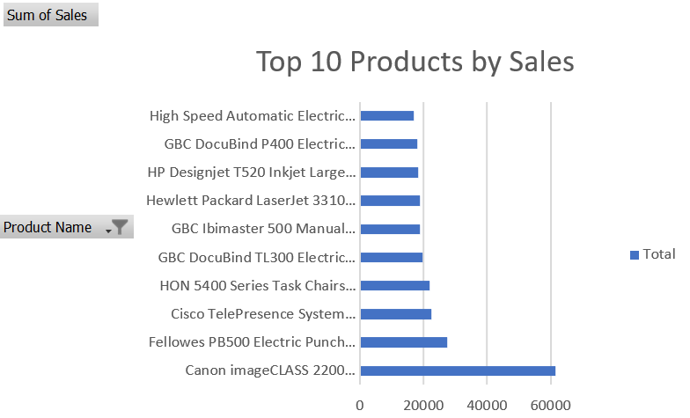
Top 10 Products by Sales
Highest-sales products identified from the dataset
TOP PRODUCT
Canon imageCLASS 2200
TOP PRODUCT SALES
₹61,599.82
TOP 10 SALES
₹244,620.20
8

Slide 9
Key Business Insights
What the analysis tells us
Overall Performance
Total sales were ₹2.33 million and total profit was ₹292.30K.
Category Performance
Technology generated the highest sales (₹839,893.28) and highest profit (₹146,543.38).
Furniture Performance
Furniture generated ₹754,747.76 in sales but only ₹19,729.99 in profit, indicating lower profitability.
Product Performance
Canon imageCLASS 2200 Advanced Copier was the highest-sales product at ₹61,599.82.
Loss-Making Products
Some top-selling products recorded negative profit and require further pricing, discount or cost review.
Profitability
Technology had the highest margin at 17.45%, followed by Office Supplies at 17.22%; Furniture was 2.61%.
9

Slide 10
Business Recommendations
Actions suggested from the observed patterns
Technology
Continue monitoring high-performing Technology products because the category contributes strongly to both sales and profit.
1
Furniture
Investigate pricing, discounts and product-level margins to understand the low profit relative to sales.
2
Loss-Making Products
Review products with negative profit and investigate whether pricing, discounts or costs are driving losses.
3
Product Performance
Monitor high-sales products regularly to ensure strong revenue is also translating into healthy profitability.
4
10

Slide 11
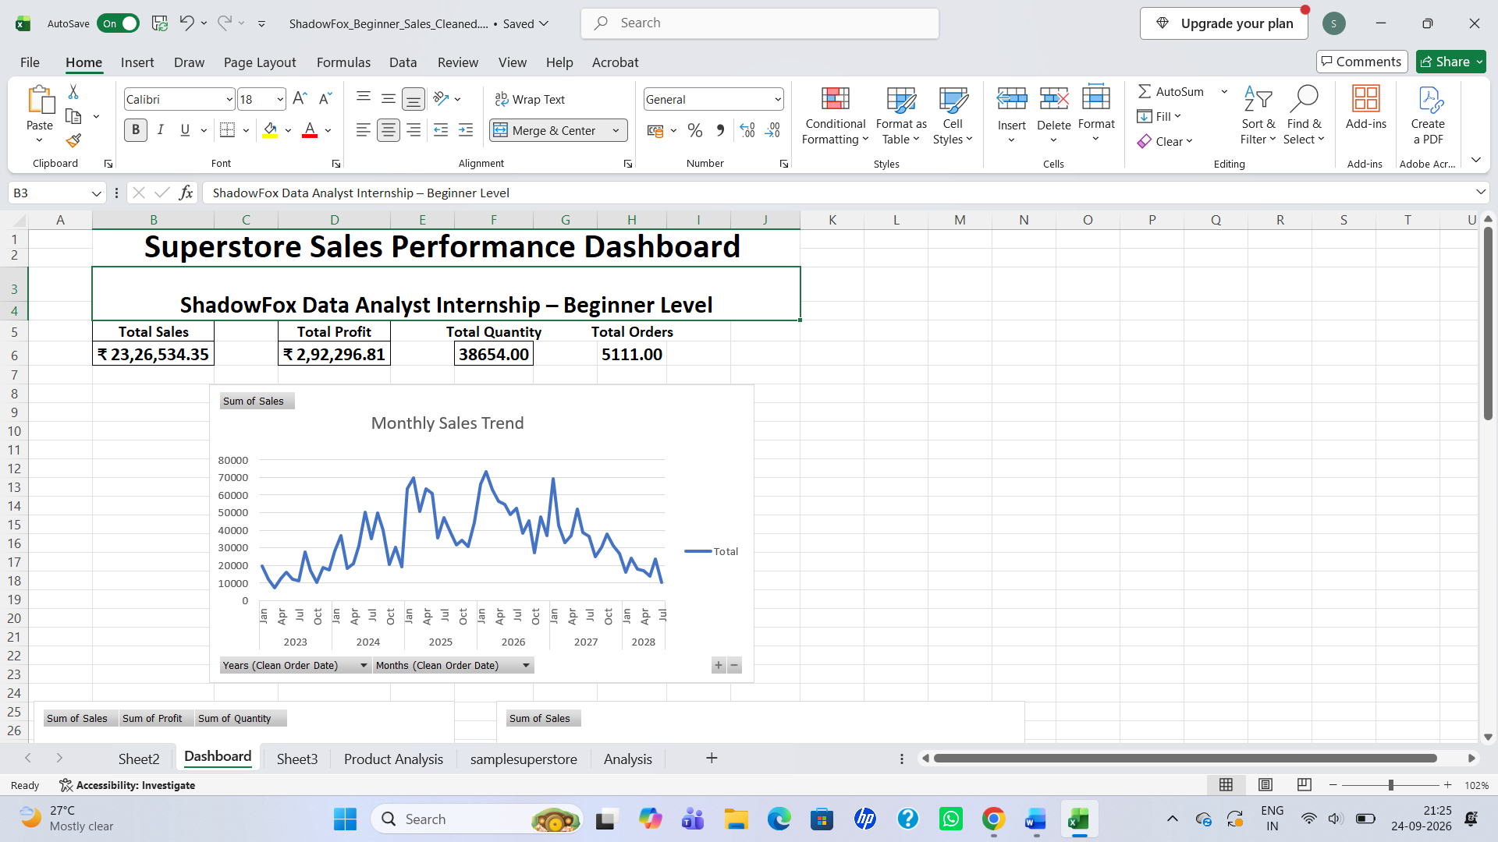
Final Dashboard
Excel dashboard developed for business reporting
11

Slide 12
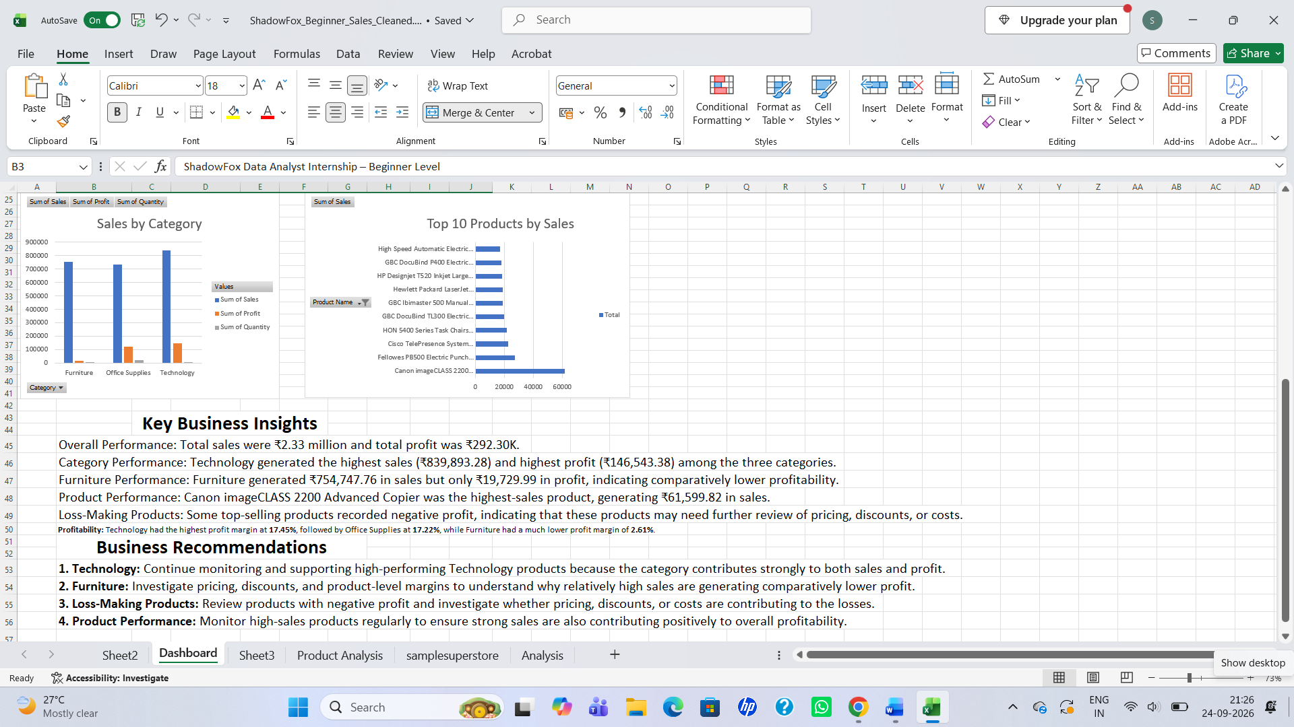

Slide 13
Conclusion
The analysis transformed raw Superstore sales data into a structured Excel dashboard with
clear KPIs, trends, category comparisons and product-level insights.
The findings highlight opportunities to protect strong Technology performance and improve
profitability in lower-margin and loss-making products.
Thank You
ShadowFox Data Analyst Internship — Beginner Level | Prensi

