Slide 1





Introduction to Linux, Jupyter Notebook and Conda
Anisur Rahman
CHRF Genomics Team
11-June-2023

Slide 2

Linux for Bioinformatics
Basic Concepts and Common Terminologies

Slide 3

Unix
Unix is a class of operating system
Used the command line as the primary mode of interaction with the user
Developed by Bell labs and is not open source (licensed OS)
Its concepts and ideas influenced Linux, macOS, and various other Unix-like systems.
Ken Thompson (sitting) and Dennis Ritchie at PDP-11 (source)

Slide 4






Linux
Linux is an open source operating system kernel
Foundation of many different Linux-based operating systems (Distribution or Distros)
Developed by Linus Torvalds and first released in 1991
Commonly used distros: Ubuntu, Mint, Debian, Kali Linux, Fedora, Zorin etc.

Slide 5
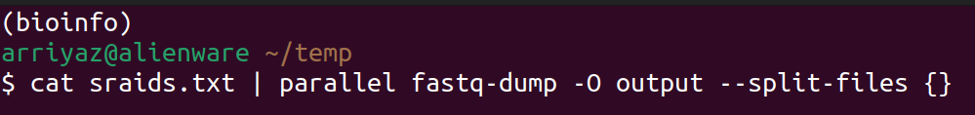

Terminal, Command Line and Shell
Terminal:
Window or program that provides a text-based interface to interact with the computer system
Command Line Interface (CLI):
Refers to the text-based interface within the terminal
Type and execute commands to interact with the computer system
“Linux” and “Unix” and “Command Line” are used interchangeably

Slide 6

SHELL
Shell:
Program or command interpreter that runs within the terminal
Provide a set of commands, syntax, and features to work with files, directories
Also support scripting capabilities
Example of Shell:
Bourne shell (sh)
Korn shell (ksh)
Bourne Again shell (bash)

Slide 7




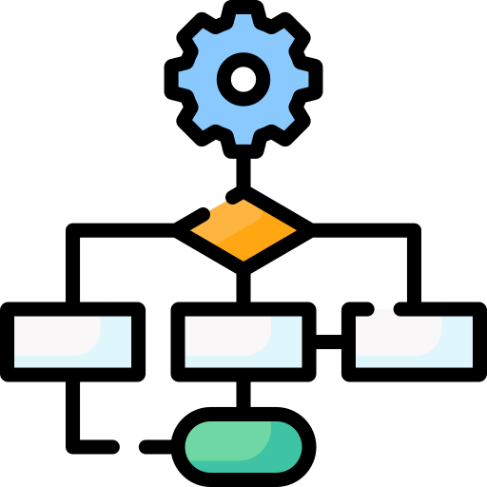


Command Line for Bioinformatics
Why command line (linux) is necessary for bioinformatics??
Availability of Bioinformatics Tools
Efficient Data Manipulation
Scripting and Automation
Integration with Workflows and Tools
Reproducibility and Collaboration
Access to Advanced Features

Slide 8

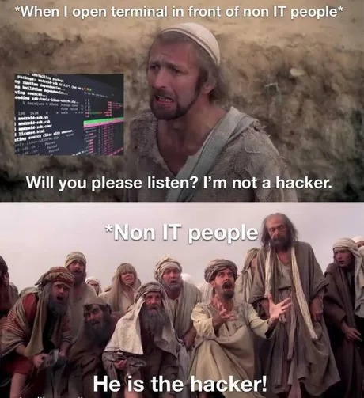

Command Line for Bioinformatics
Are you already excited??
What are the challenges of the command line?
Requires additional training
Initially overwhelming

Slide 9
Jupyter Notebook
Basic Concepts and Common Terminologies

Slide 10
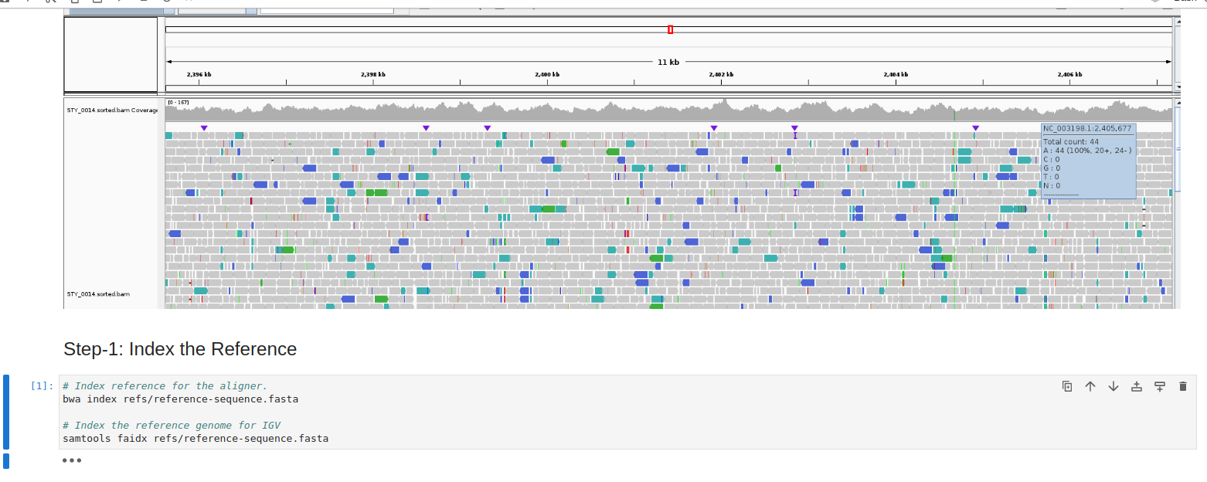
What is Jupyter Notebook
Open-source web-based application
Add code, equations, visualizations, and narrative text
Interactively write and execute code, view the output

Slide 11
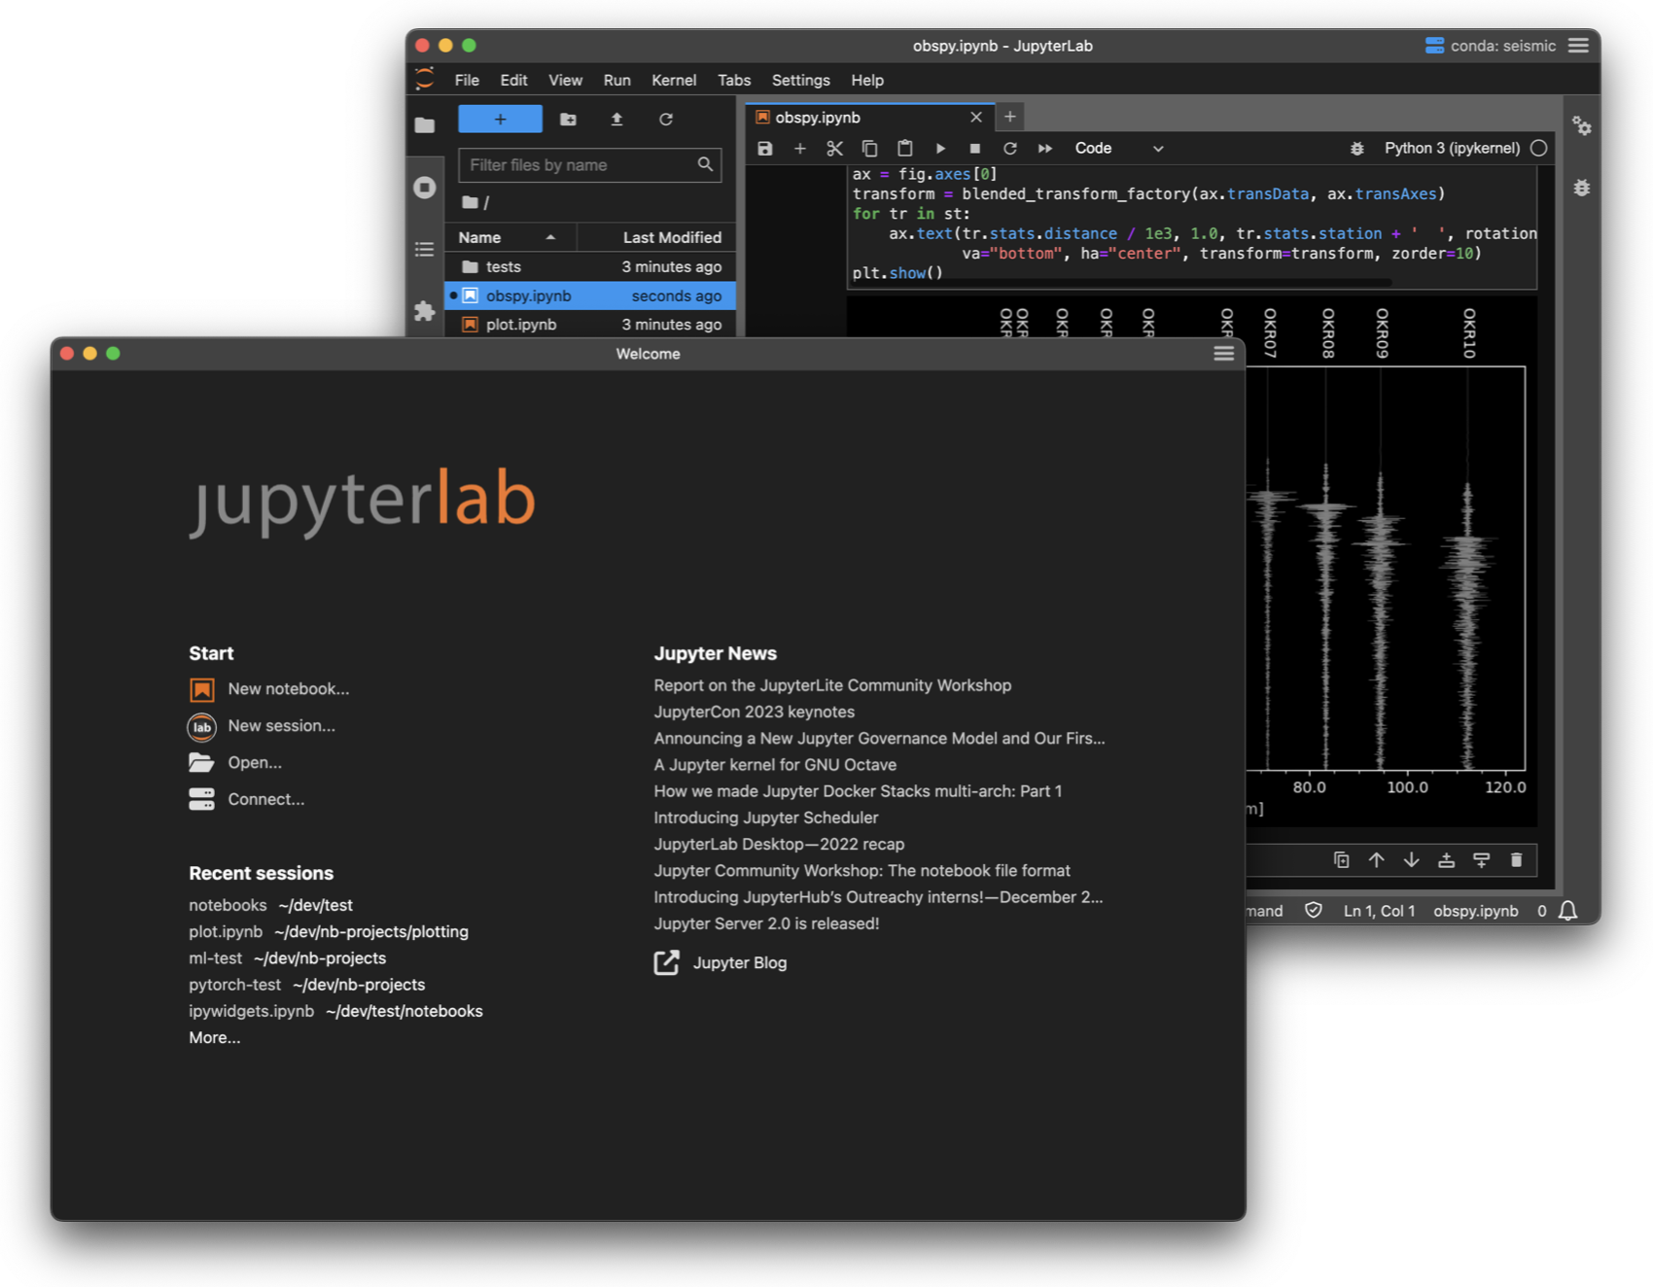
JupyterLab Desktop App
Download link: https://github.com/jupyterlab/jupyterlab-desktop

Slide 12
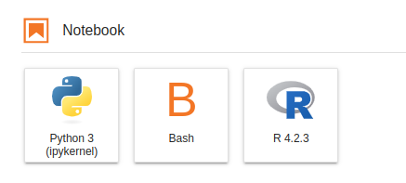

Setting Bash in Jupyter Notebook
By default Jupyter Notebook supports Python language
Can also be used for other languages like Bash, R, Julia etc. by adding specific kernel
Kernel: "computational engine" that executes the code contained in a notebook document
Install Bash kernel:
Run the following codes one by one and restart JupyterLab
pip install bash_kernel
python -m bash_kernel.install
Jupyter Notebook doesn’t show prompt for Bash input

Slide 13

Conda Environment
Basic Concepts and Common Terminologies

Slide 14
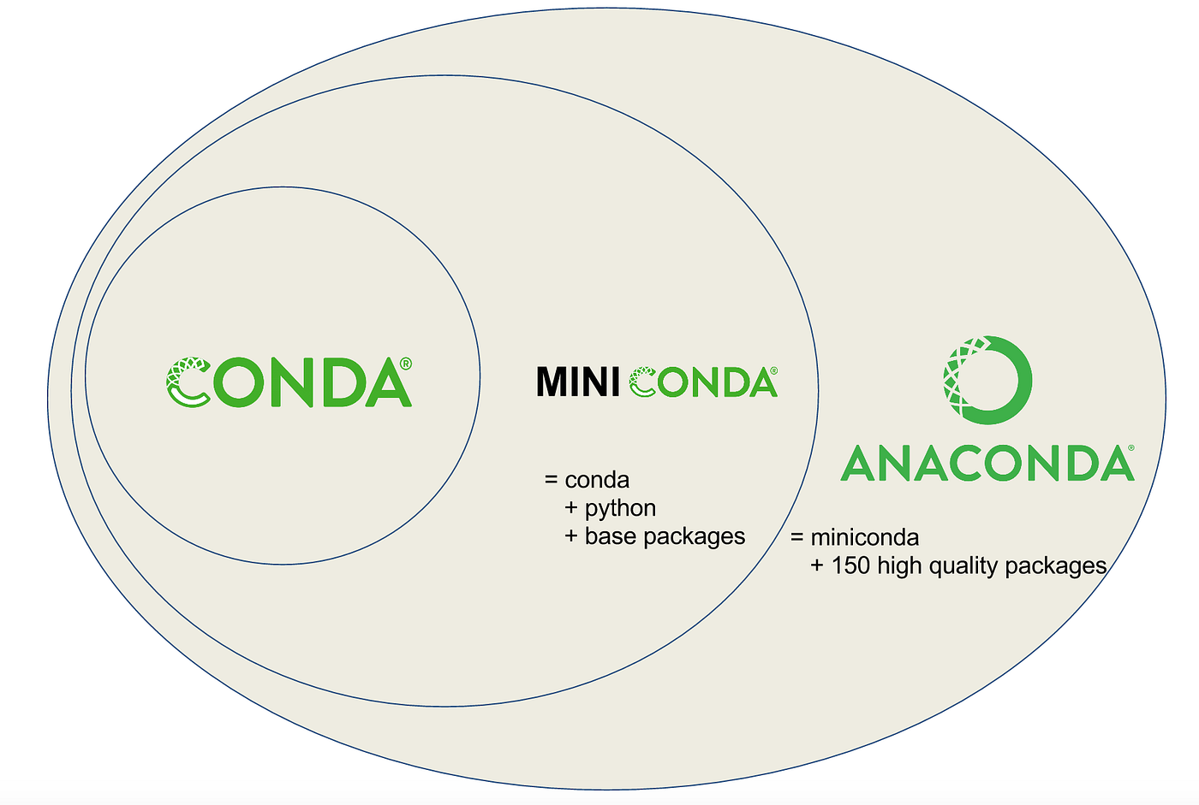
What is Conda?
Open-source package management system and environment management system
Quickly installs, runs, and updates packages and their dependencies.
Easily creates, saves, loads, and switches between environments on your local computer.
It was created for Python program, but it can package and distribute software for any language.

Slide 15
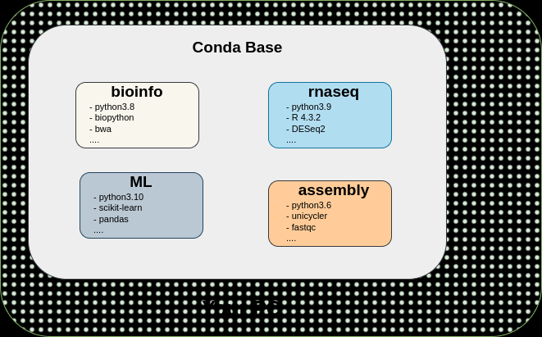
What is Conda Environment?

Slide 16



