Slide 1


Basic Bacterial Genomic Analysis
Preonath Chondrow Dev
Bioinformatician,
Child Health Research Foundation

Slide 2
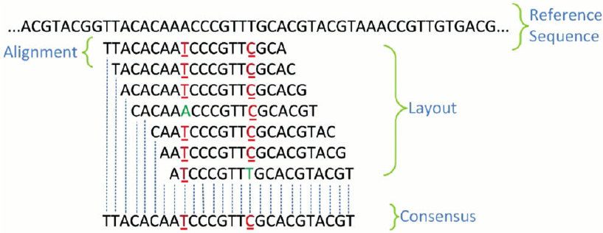
Consensus Genome Assembly
Consensus genome assembly combines multiple genomic sequences to create a representative genome by selecting the most common nucleotide at each position.

Slide 3
Thank You

