Slide 1
Prokka
Preonath Chondrow Dev
Bioinformatician
Child Health Research Foundation

Slide 2
Overall Workflow
The Genome contains the organism's molecular history
The process of identifying the location of genes and the coding regions in a genome to determine what those genes do
Finding and attaching the structural elements and its related function to each genome location

Slide 3
Overall Workflow
Genome Annotation
Structural Annotation
Gene Structure Prediction
Identifying elements (introns, exons, CDS) in genome
Functional Annotation
Attaching biological information to these elements

Slide 4

Structural Annotation
Identification of genomic elements
Open reading frame and their localization
Gene structure
Coding regions
Location of regulatory motifs
S/MAR Enhancer Promoter Exons/Introns Repeats S/MAR

Slide 5
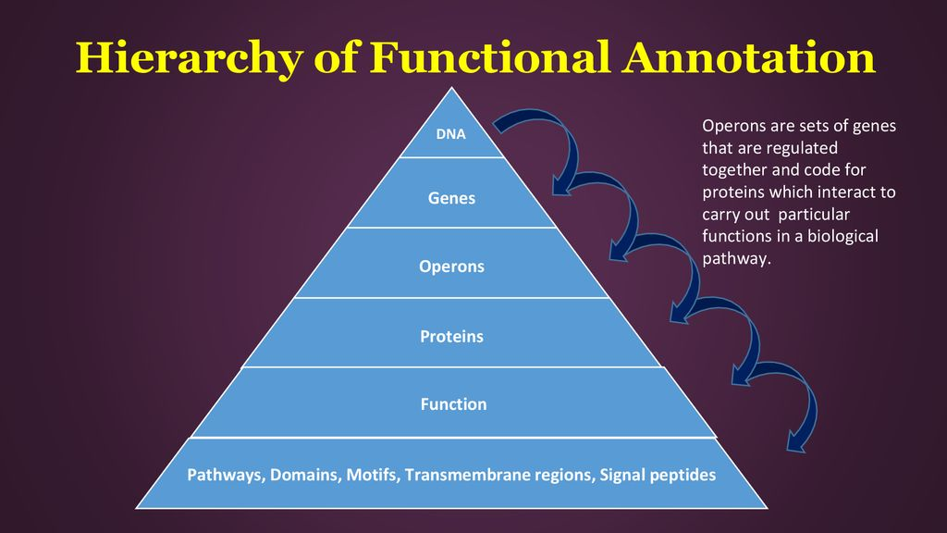
Functional Annotation
Biological meaning to genomic sequence
Biochemical function (molecules and their interactions)
Biological function (biological process)
Involved regulations (how gene work together)
Gene expression (to produce a phenotype)

