Slide 1
Genome Annotation
Preonath Chondrow Dev
Bioinformatician
Child Health Research Foundation

Slide 2
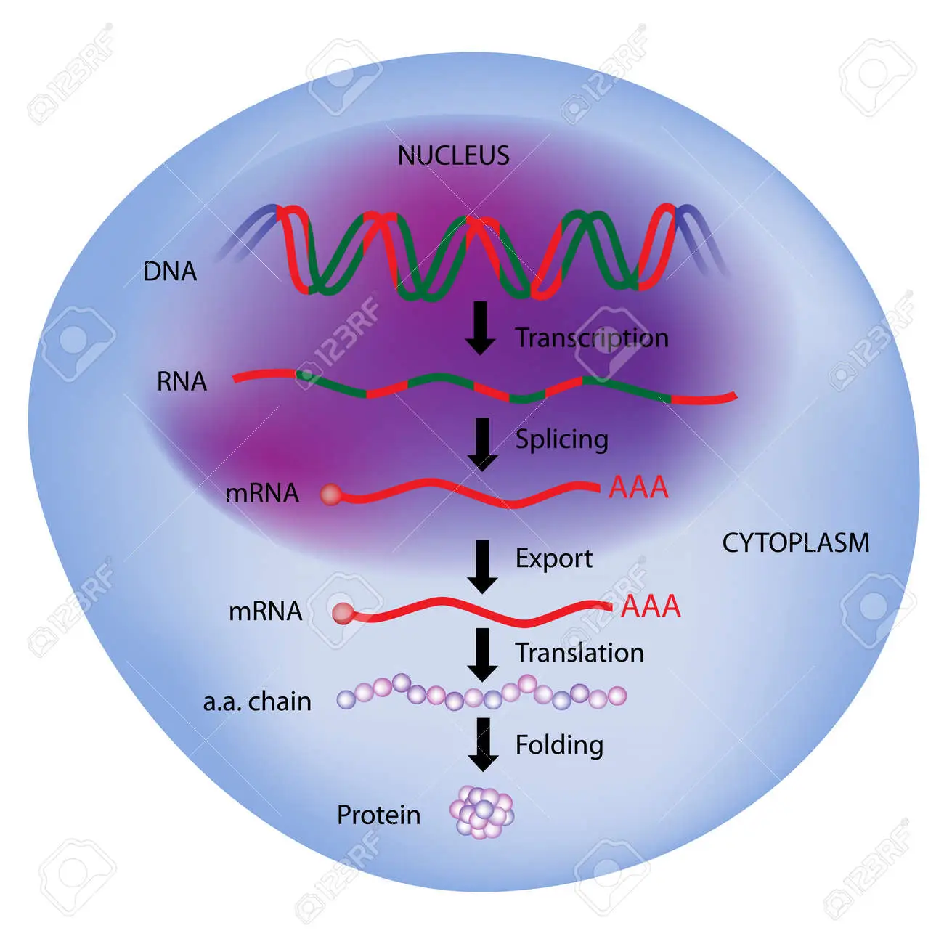
Central Dogma of Molecular Biology

Slide 3
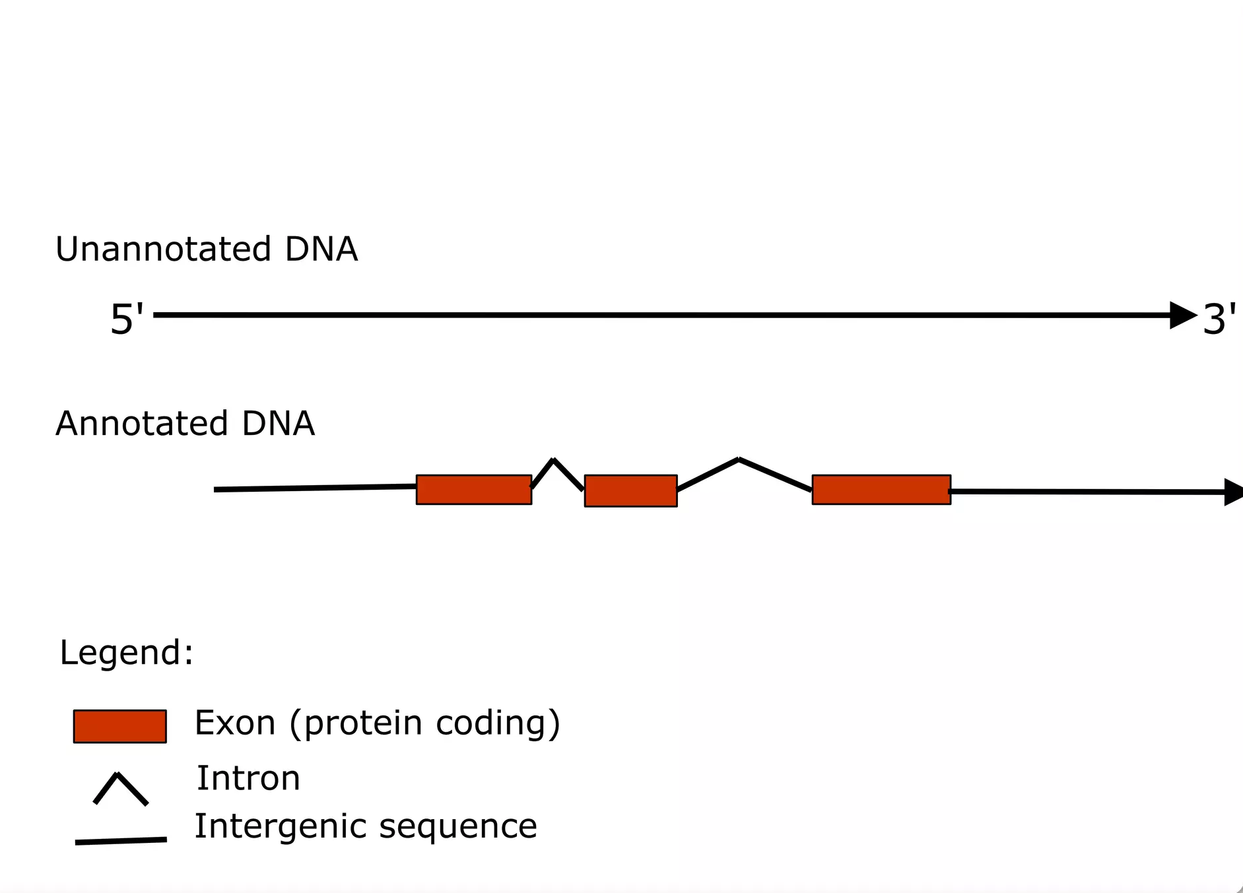
Genome Annotation

Slide 4
Things we are looking to annotate
Protein coding genes
Promoter (-10,-35) [located upstream of the CDC]
Ribosome binding site (RBS)
Coding sequence (CDS)
Terminator [located at the end of a gene]
Non coding genes
tRNA (Transfer RNA)
rRNA (Ribosomal RNA)
ncRNA (Non-coding RNA)
Others
Operons
Origin of replication
Repeats

Slide 5
Genome Annotation
The Genome contains the organism's molecular history.
Identifying the location of genes and the coding regions in a genome to determine what those genes do
Finding and attaching the structural elements and its related function to each genome location

Slide 6
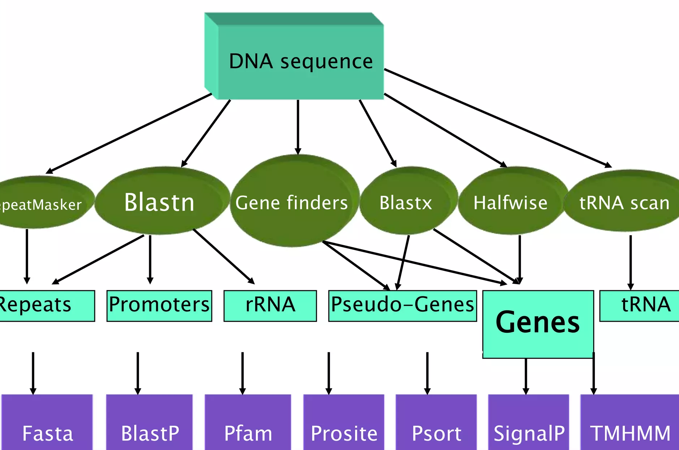
Annotation Process

Slide 7
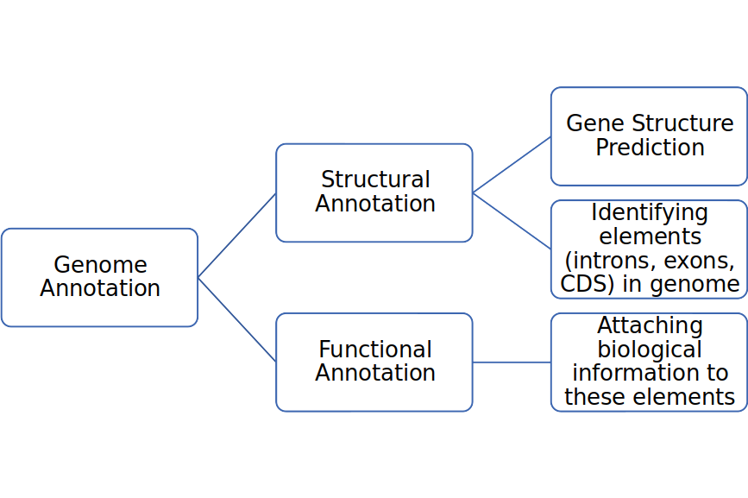

Slide 8

Structural Annotation
Identification of genomic elements
Open reading frame and their localization
Gene structure
Coding regions
Location of regulatory motifs
S/MAR Enhancer Promoter Exons/Introns Repeats S/MAR

Slide 9
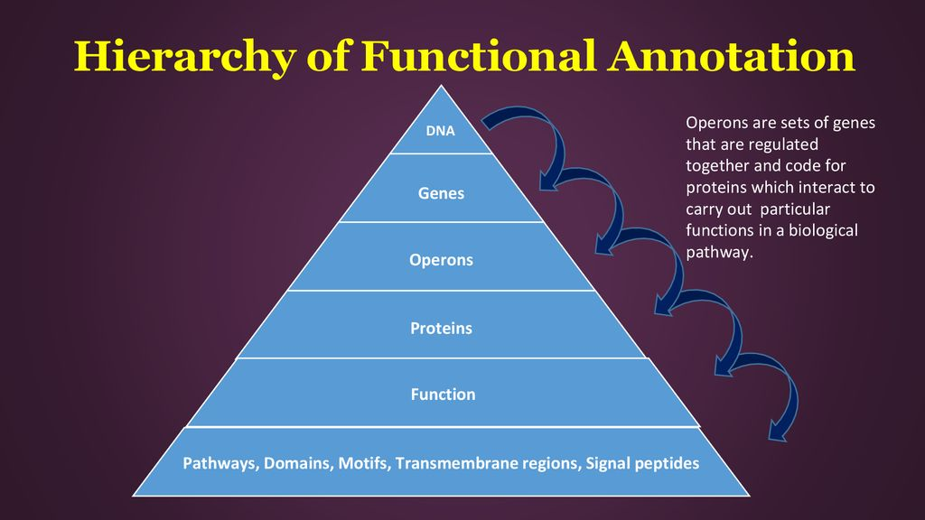
Functional Annotation
Biological meaning to genomic sequence
Biochemical function (molecules and their interactions)
Biological function (biological process)
Involved regulations (how gene work together)
Gene expression (to produce a phenotype)

Slide 10
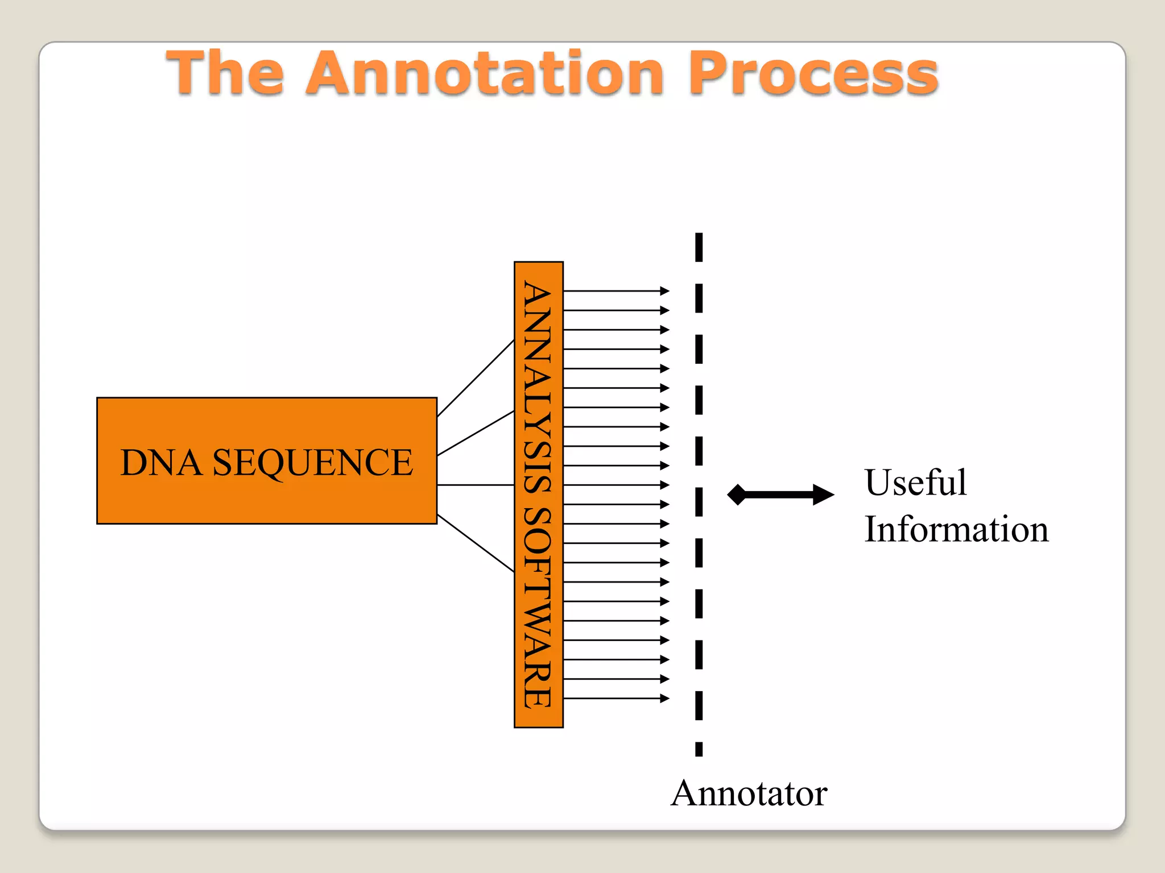
Which tool for automatic annotation of genome?
Prokka
Fast
Structural and Functional annotation
Standards compliant
GFF3/GBK, TBL/FSA for GenBank
Archaea, mitochondria, viruses

Slide 11
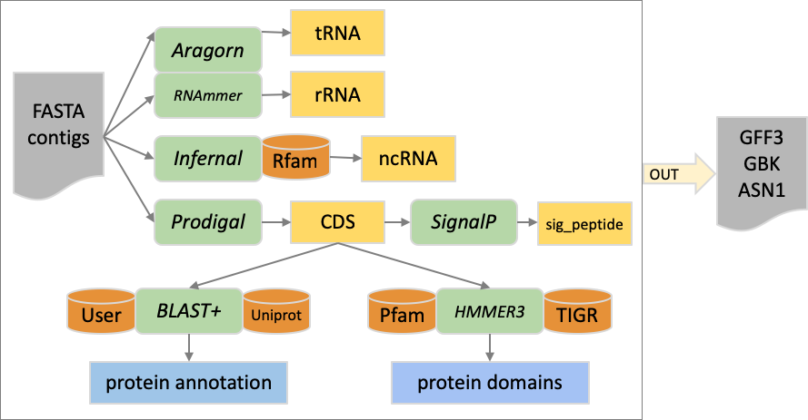
Prokka
‹#›

Slide 12
Prokka
Input
prokka assembly.fasta --outdir prokka --gcode 11 --prefix <prefix_name> --locustag <locus_tag> --quiet
assembly.fasta:
--outdir prokka: Output directory.
--gcode 11: Specifies the genetic code to use for annotation. In this case, code 11 corresponds to the bacterial/archaeal standard code.
--prefix <prefix_name>: Prefix name for the output files.
--locustag <locus_tag>: Specifies the locus tag prefix for the annotated features.
--quiet: Suppressing some non-essential output.

