Slide 1
Genome Assembly
Preonath Chondrow Dev
Bioinformatician
Child Health Research Foundation

Slide 2
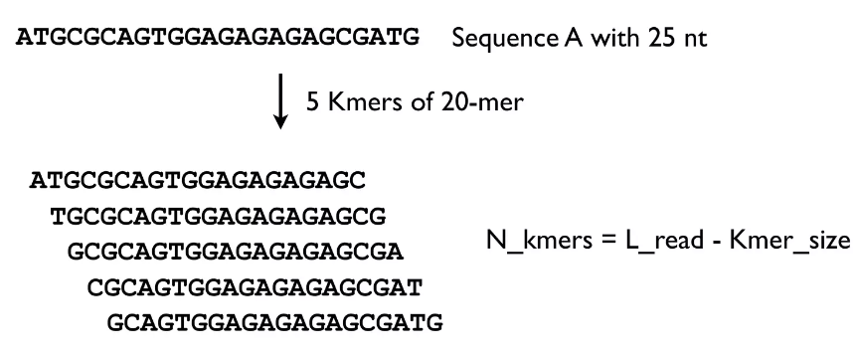
K-mer generation
1

Slide 3
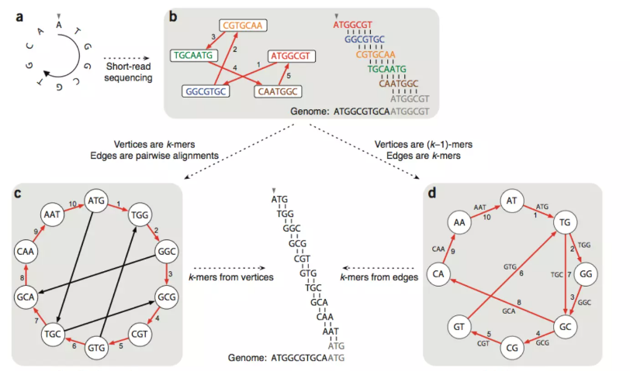
Euler Cycle and Hamilton Path

Slide 4
Assembly Tools
unicycler: This is the name of the software being invoked.
-1 $R1_Trim_P: This specifies the path to the first input read file.
-2 $R2_Trim_P: This specifies the path to the second input read file.
-o $dir/3_Unicycler/: This specifies the output directory where the assembly results will be saved.
-t 92: This specifies the number of computational threads to use for the assembly process.
--min_fasta_length 200: This specifies the minimum length of contigs to keep in the final assembly. Any contigs shorter than 200 bp will be discarded.
--keep 1: This specifies that intermediate assembly files should be kept for debugging purposes. The value of 1 indicates that the files should be kept.

Slide 5
Assembly command
Input
unicycler -1 $R1_Trim_P -2 $R2_Trim_P -o $dir/3_Unicycler/ -t 92 --min_fasta_length 200 --keep 1
Output
assembly.fasta

