Slide 1
SRA Upload to NCBI
Preonath Chondrow Dev
Bioinformatician
Child Health Research Foundation

Slide 2
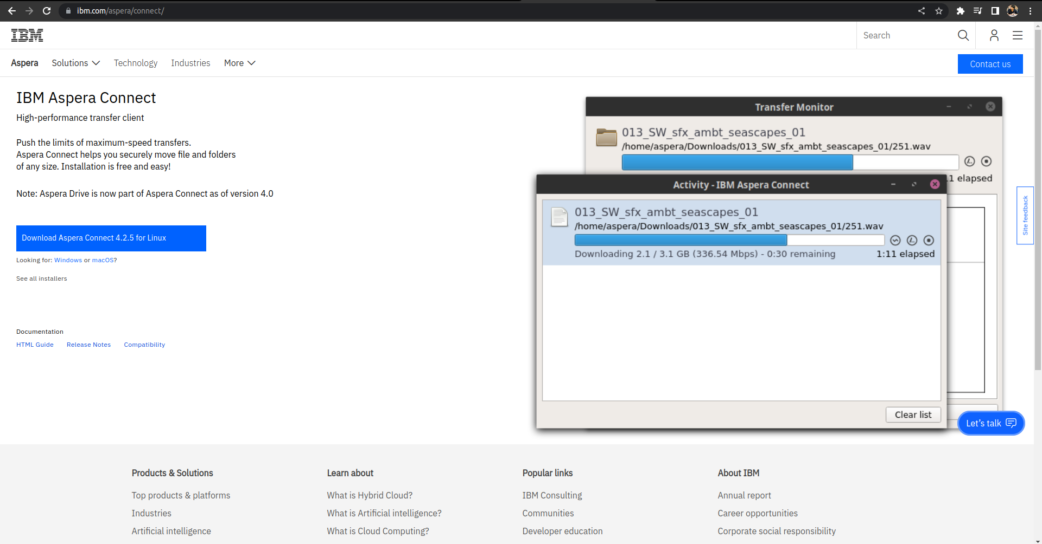
IBM Aspera Connect

Slide 3
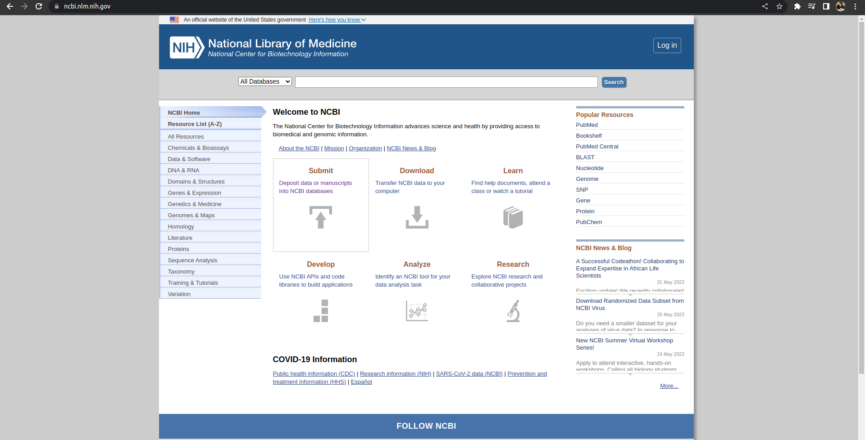
Welcome to NCBI

Slide 4
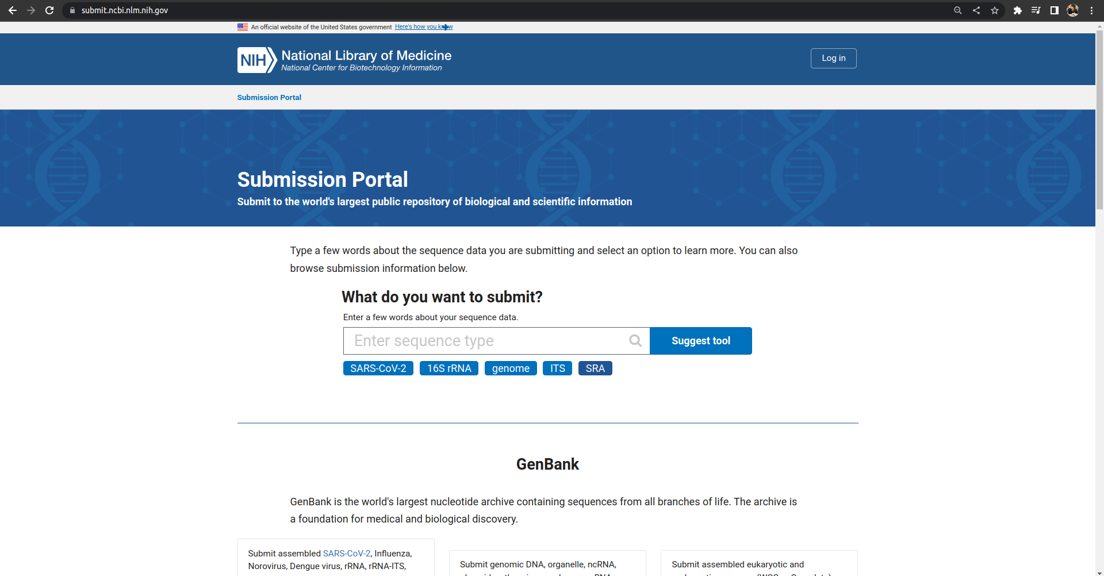
Submission Portal

Slide 5
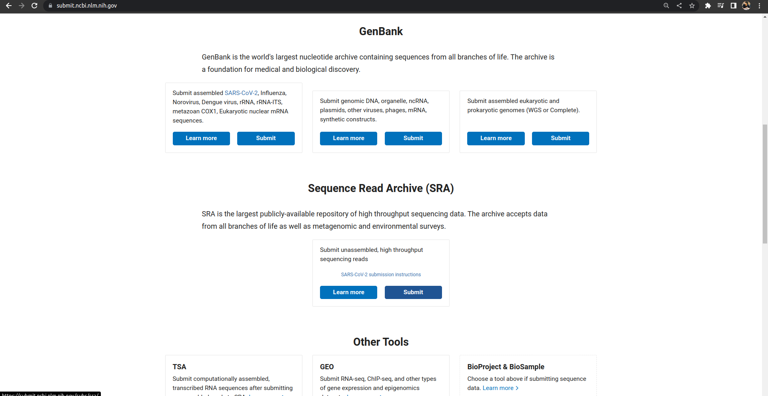
GenBank / SRA

Slide 6
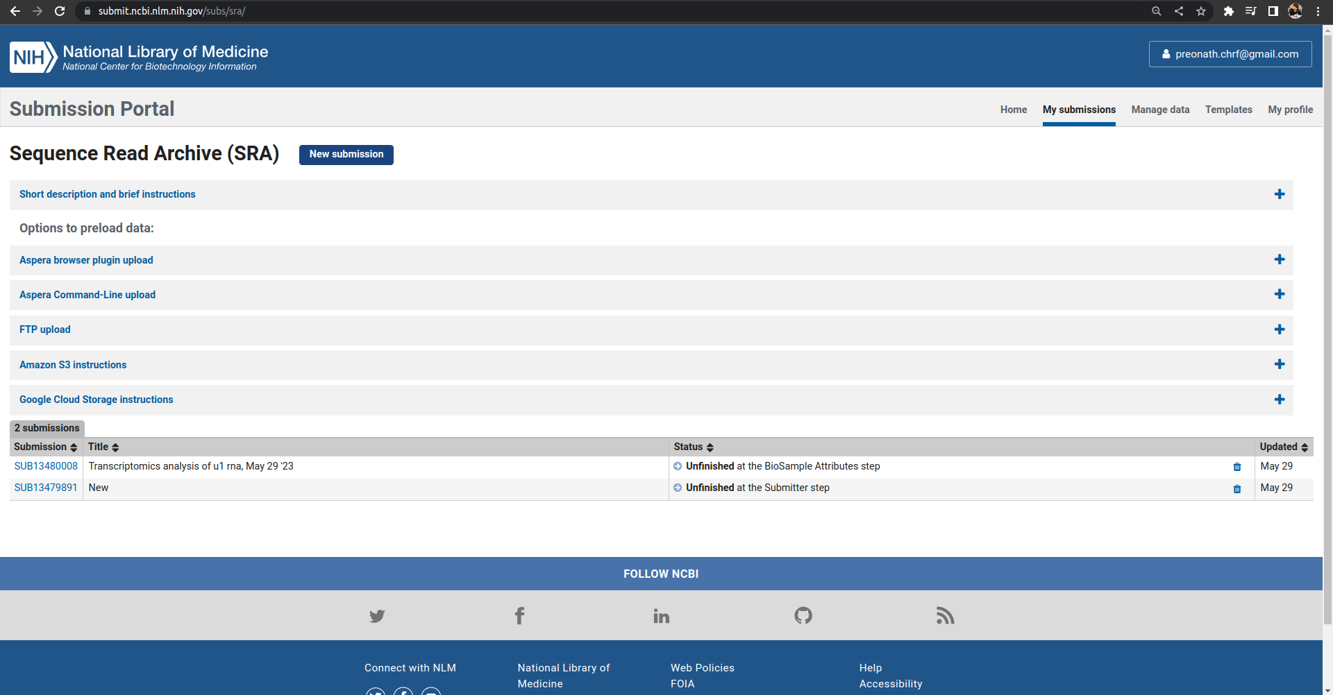
Submission Portal : Sequence Read Archive

Slide 7
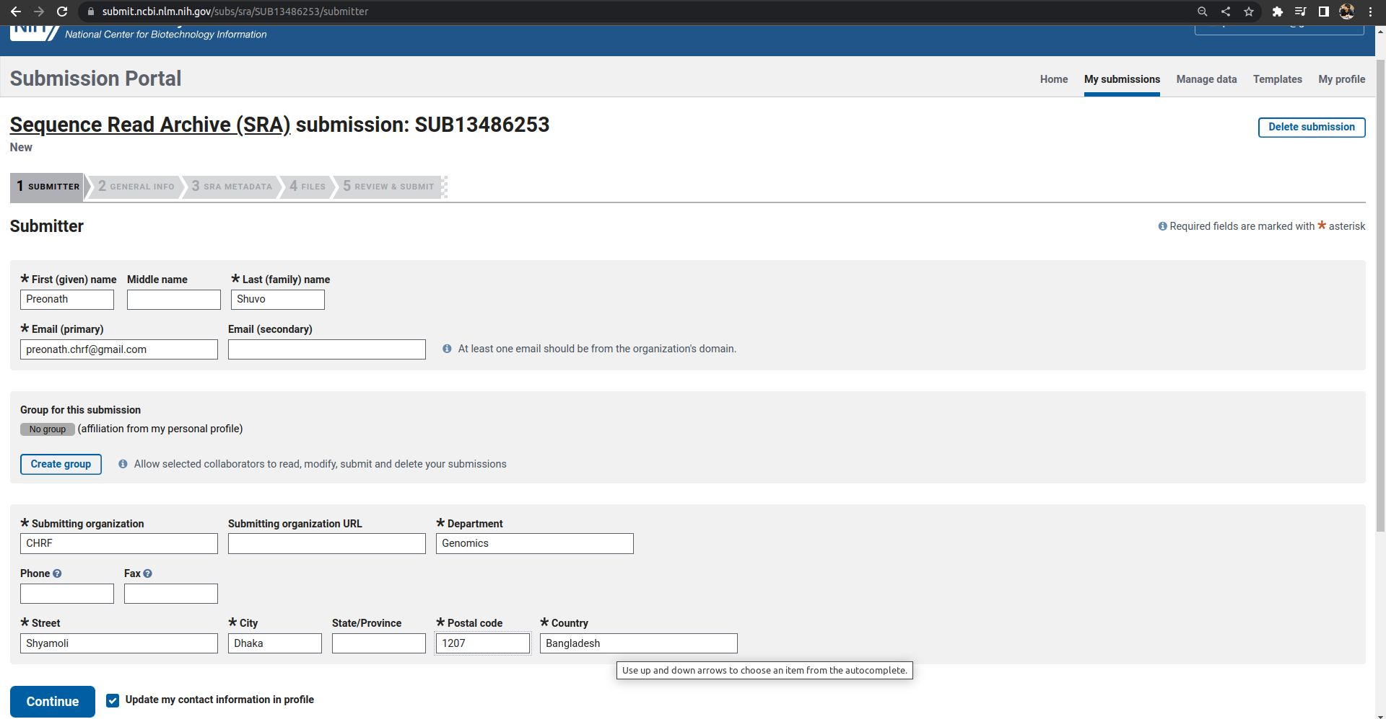
SRA Submission

Slide 8
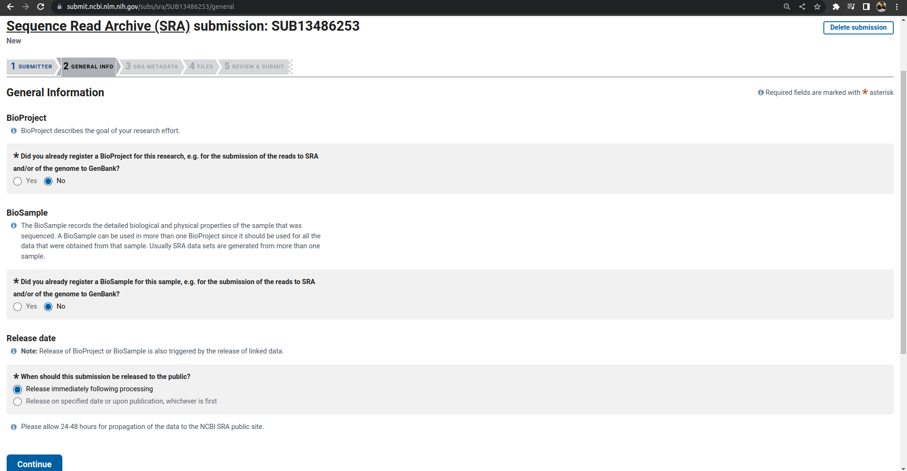
SRA Submission: General Info

Slide 9
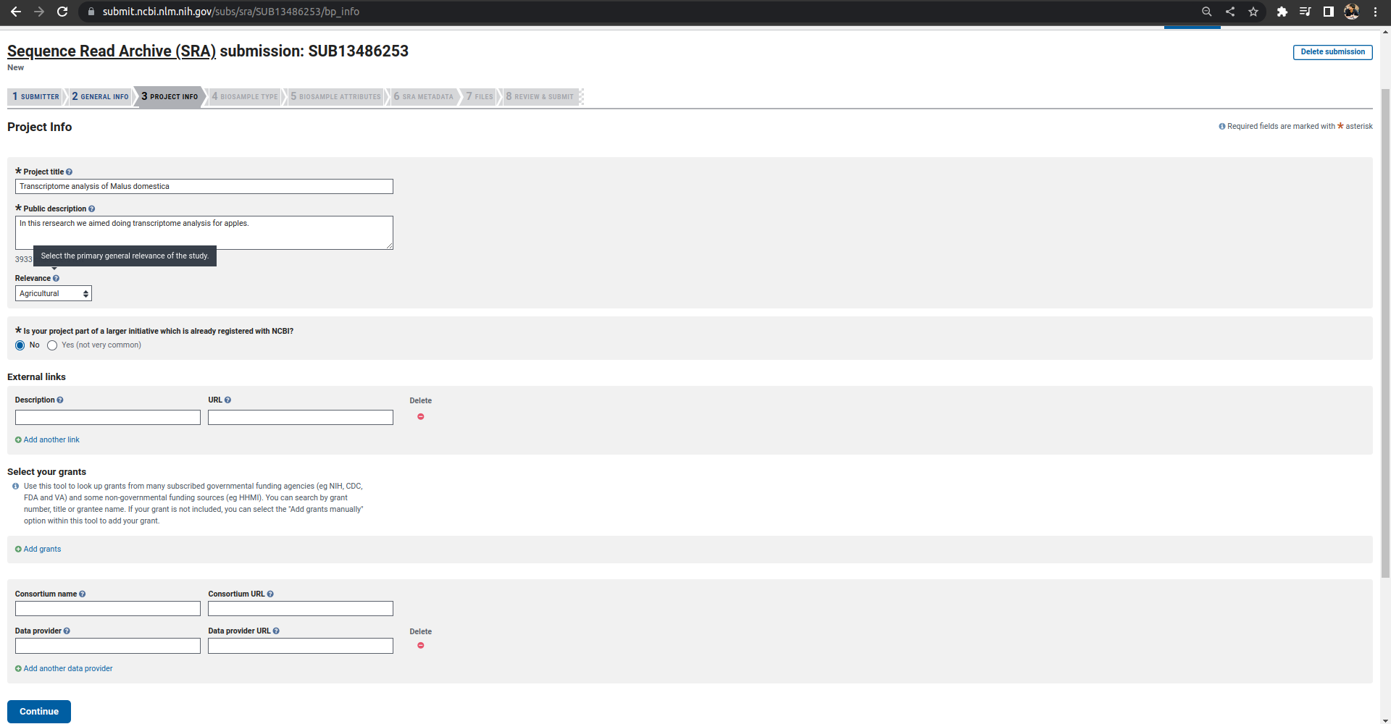
SRA Submission: Project Info

Slide 10
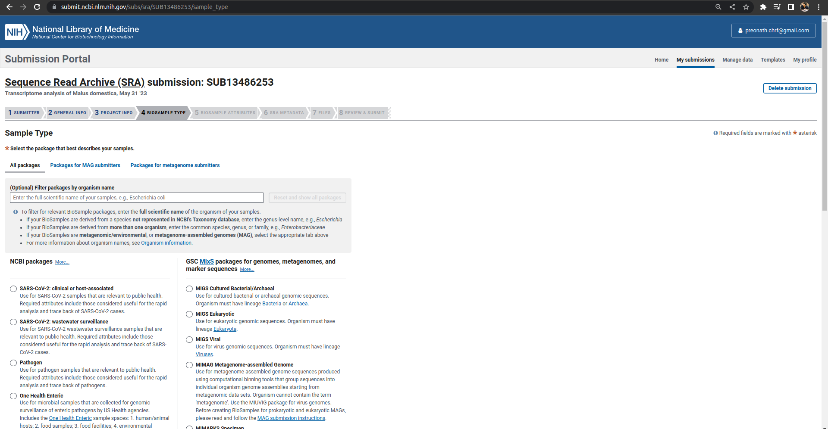
SRA Submission: Biosample Type

Slide 11
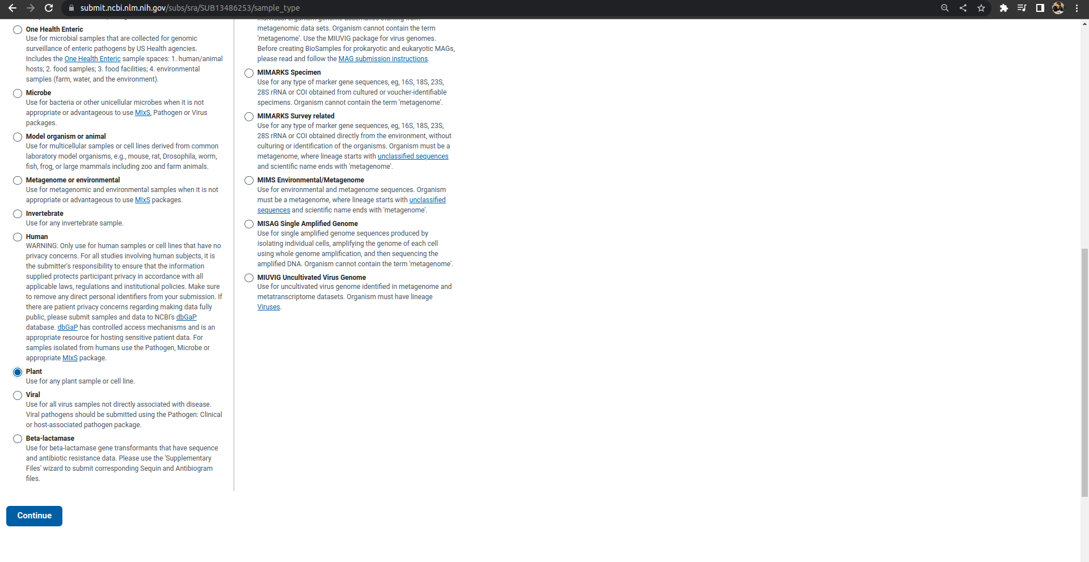
Sample Type (Organism)

Slide 12
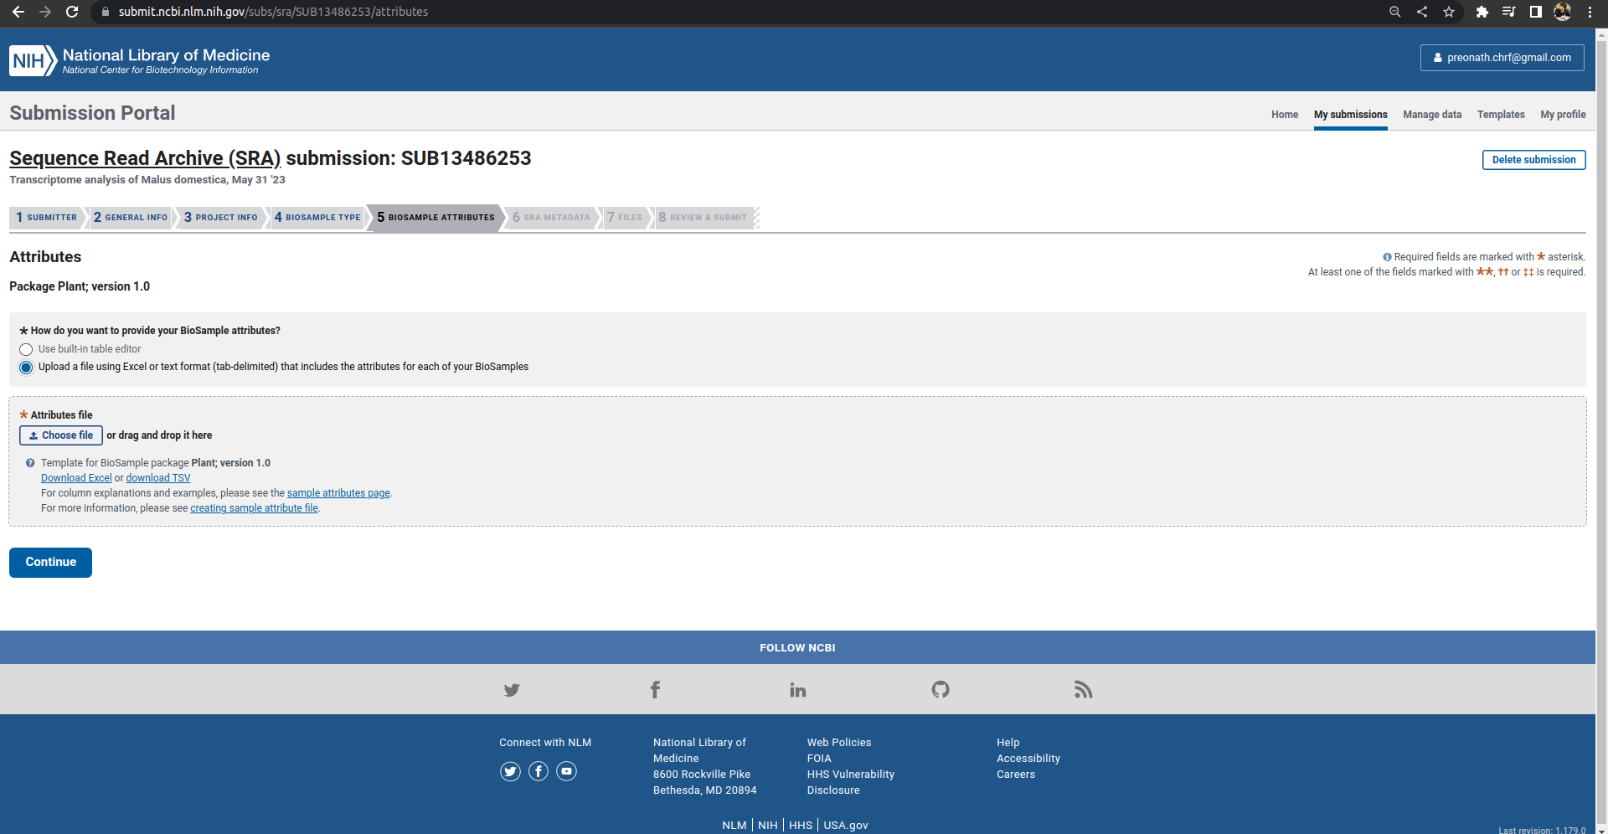
Biosample Attributes

Slide 13
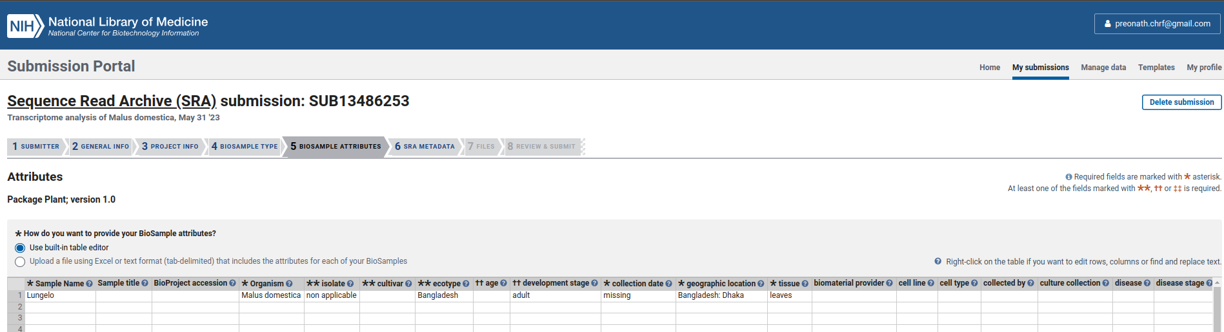

Slide 14
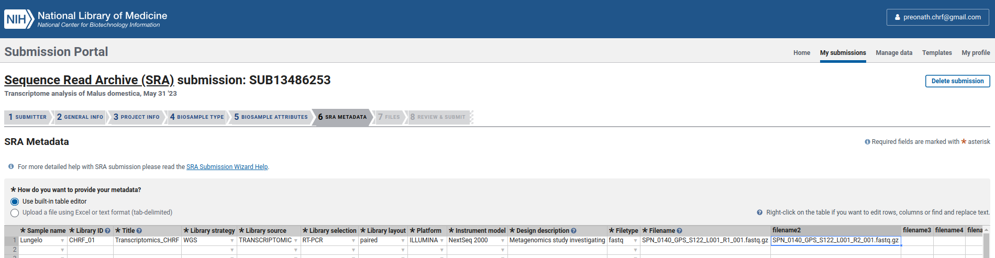

Slide 15
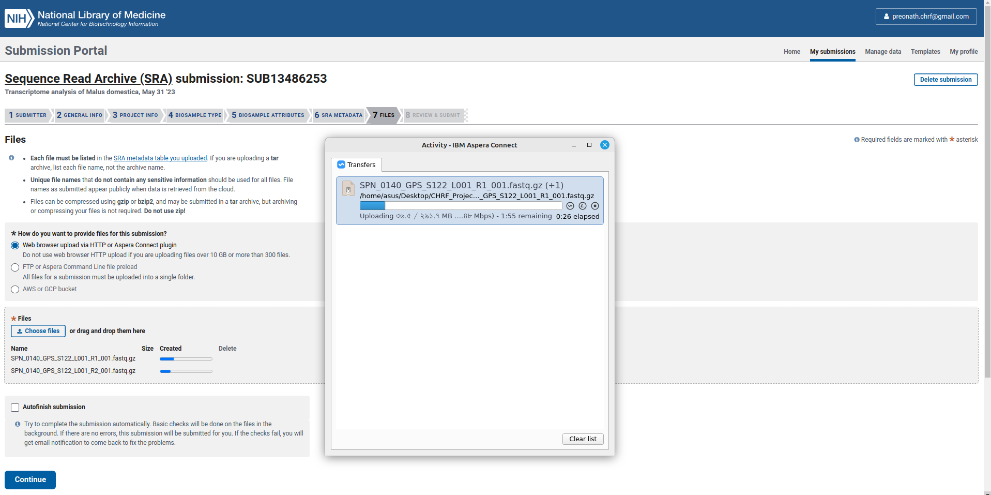

Slide 16
