Slide 1


Jan 04, 2023
SARS-CoV-2
Genome Sequencing
Presented by: CHRF Genomics Team

Slide 2
Contents
Sample sheet preparation
Sequencing quality check (Q30 and PF)
Sars-CoV-2 consensus preparation (CZ ID)
Variant identification
GISAID file preparation
Nextstrain tour
Virtual tour to basespace
Troubleshooting
1. BCL to Fastq conversion
2. Requeue

Slide 3
Sample sheet preparation
Required Fields:
1. Experiment Name
2. Sample_ID
3. Sample_Name
4. Description
5. Index
6. I7_Index_ID
7. index2
8. I5_Index_ID
10. Sample_Project

Slide 4
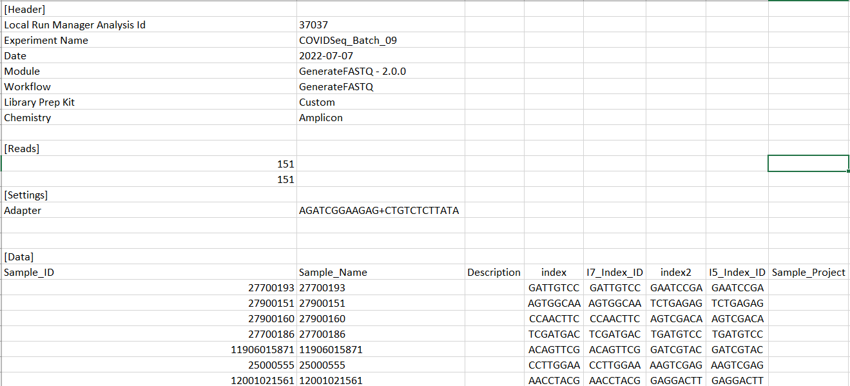
Sample sheet Template

Slide 5
Sample sheet preparation
Precautions:
1. Never use space between words (e.g. KPN 132) . Corrected form (KPN_132 , CHRF_COVID_098)
2. Delete last 2 bp from index if Barcode has 10bp sequences.
3. Delete first 2 bp from index2 Barcode has 10bp sequences
4. Date format should be this way “YYYY-MM-DD”
5. It should be a CSV file.

Slide 6
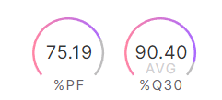
Sequencing quality check (Q30 and PF)
PF (Pass filter)
Illumina sequencers perform an internal quality filtering procedure called chastity filter, and reads that pass this filter are called PF for pass-filter. According to Illumina, chastity is defined as the ratio of the brightest base intensity divided by the sum of the brightest and second brightest base intensities. Clusters of reads pass the filter if no more than 1 base call has a chastity value below 0.6 in the first 25 cycles.
Q30
The percentage of bases with a quality score of 30 or higher, respectively (see “Quality Scores Explained” below). Most Illumina runs will generate >70-80% Q30 data.

Slide 7
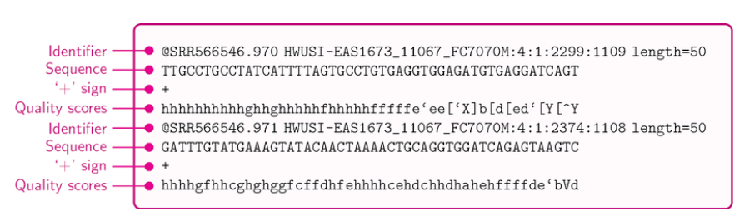
Sequencing quality check (Q30 and PF)
Fastq File:

Slide 8
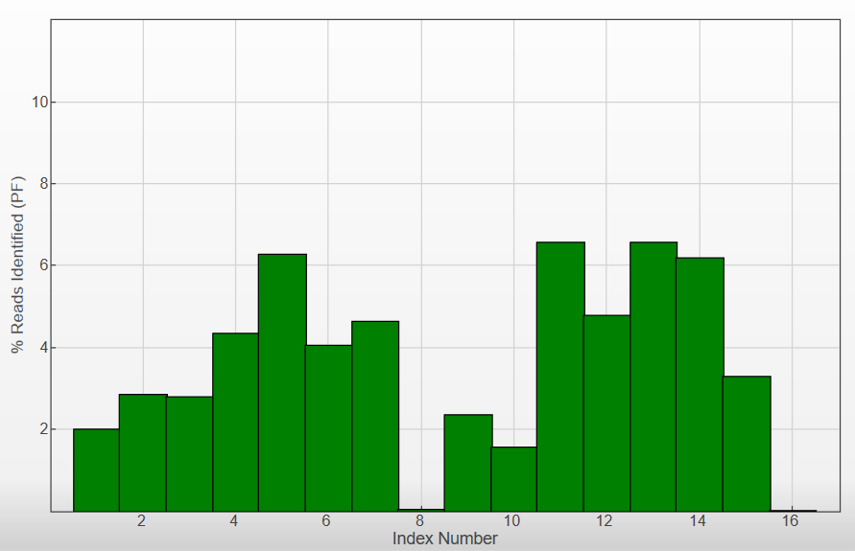
Illumina Sequence Analysis Viewer
This softwear help to see the indexing ratio.
Facilitate to quantify the loading concentration

Slide 9
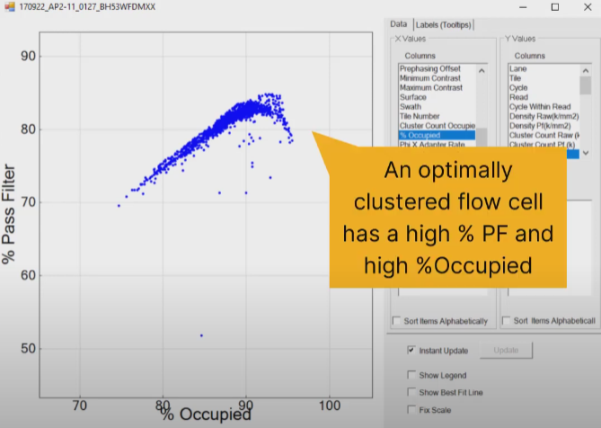
Illumina Sequence Analysis Viewer
This softwear help to see the indexing ratio.
Facilitate to quantify the loading concentration

Slide 10
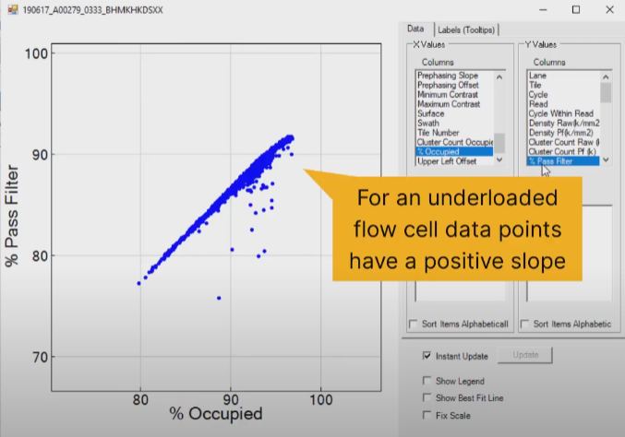
Illumina Sequence Analysis Viewer
This softwear help to see the indexing ratio.
Facilitate to quantify the loading concentration

Slide 11
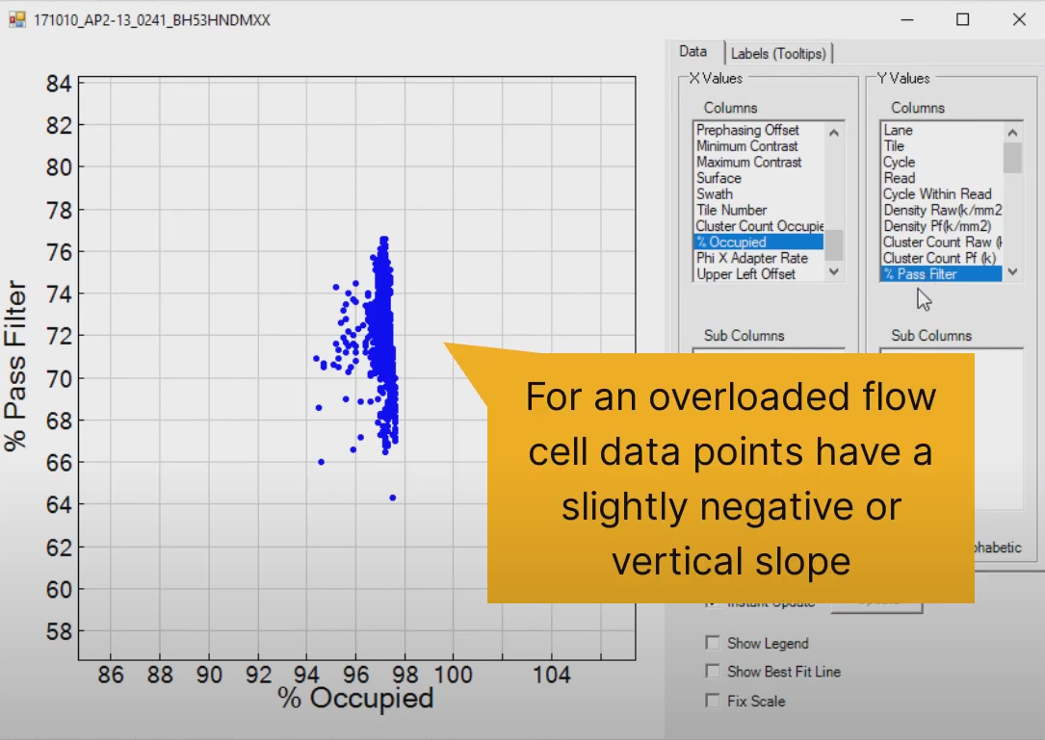
Illumina Sequence Analysis Viewer
This softwear help to see the indexing ratio.
Facilitate to quantify the loading concentration

Slide 12
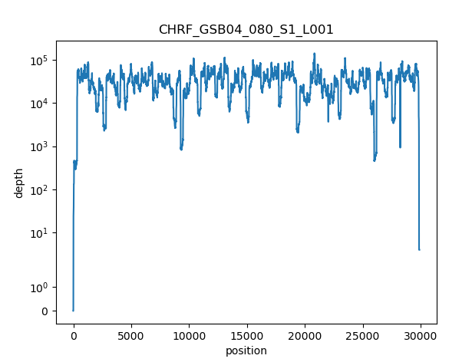

Sars-CoV-2 consensus genome preparation (CZ ID)
sc2-illumina-pipeline output:
Fasta file (consensus)
Multiqc result
Coverage plot
sample_name | depth_avg | mapped_reads | total_reads | n_actg | n_missing | n_gap | n_ambiguous
CHRF_GSB04_080_S1_L001 | 33891.354 | 9472195 | 14415600 | 29838 | 49 | 0 | 7
CHRF_GSB04_081_S2_L001 | 37037.561 | 10301531 | 14074768 | 29846 | 12 | 0 | 12

Slide 13
Basespace Tour

Slide 14
Thank You !

