Slide 1
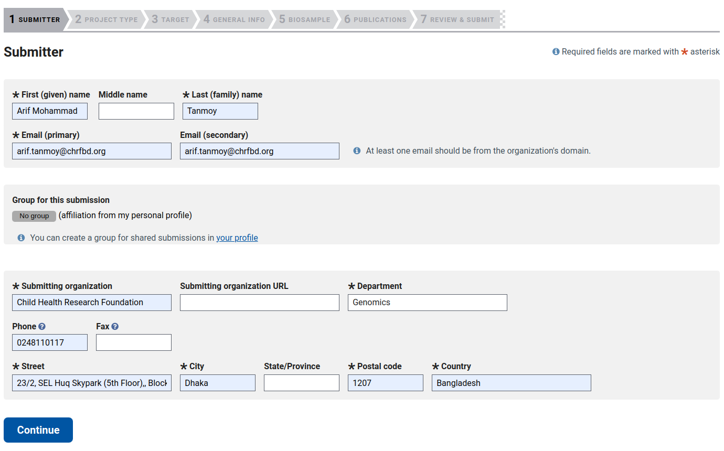

Slide 2
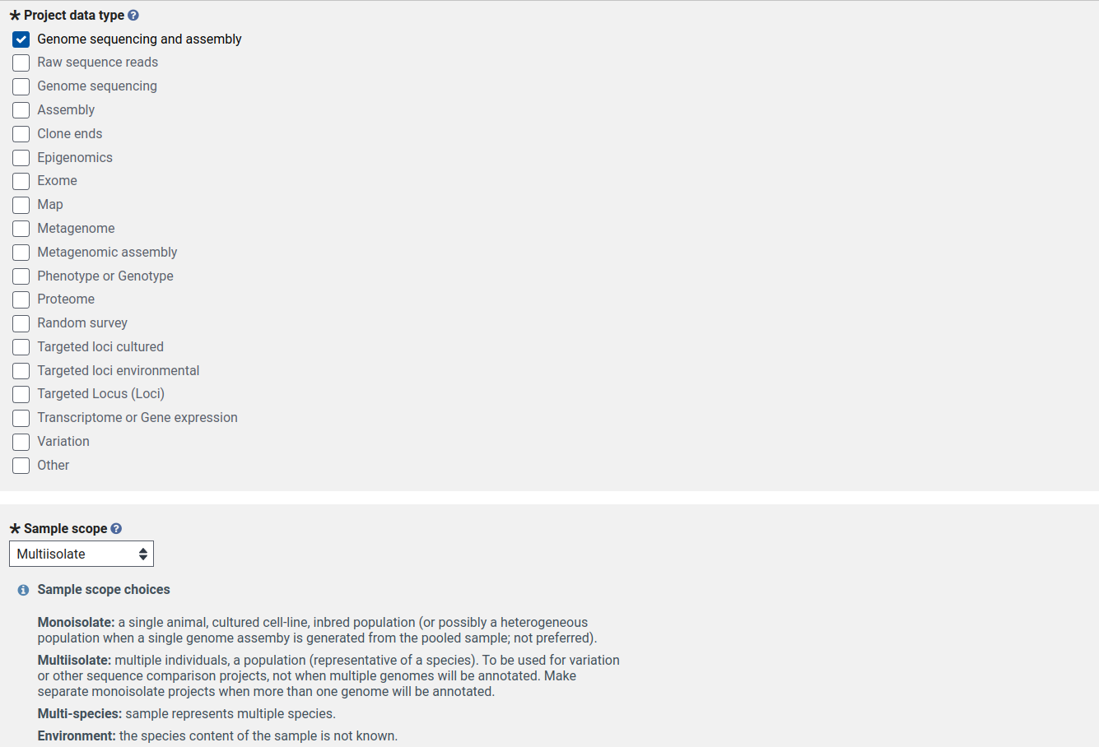

Slide 3
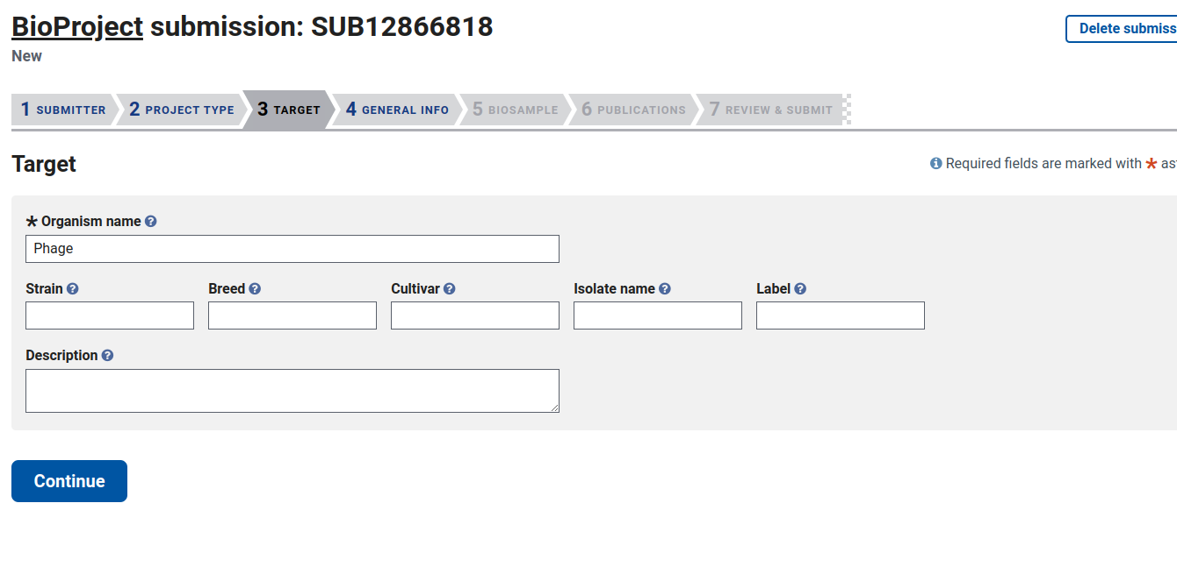

Slide 4
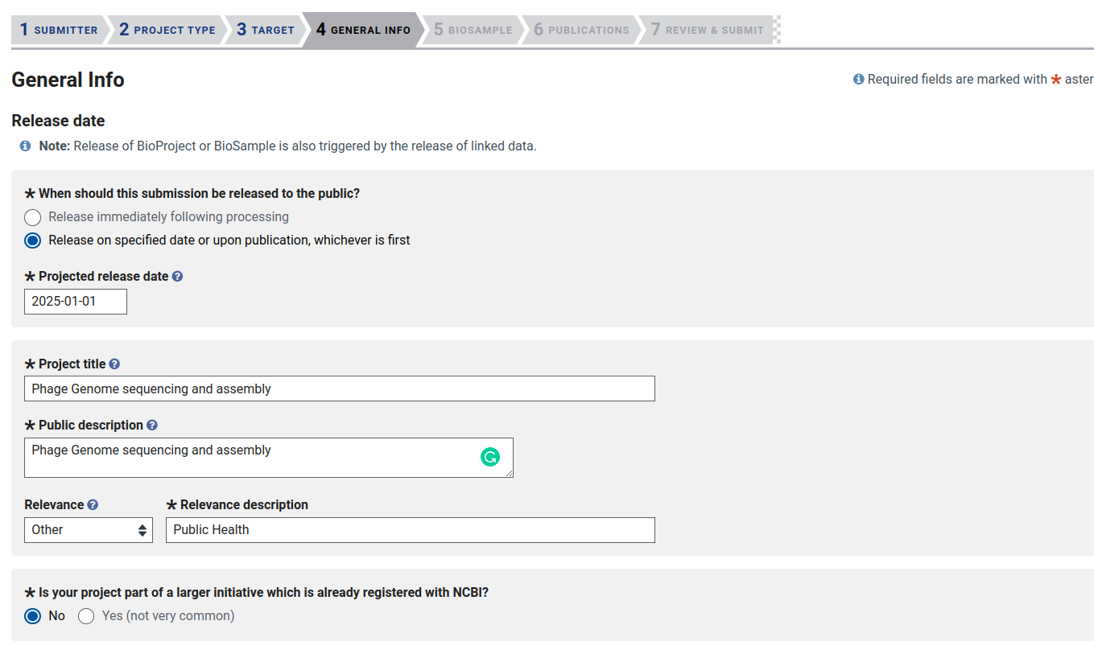

Slide 5
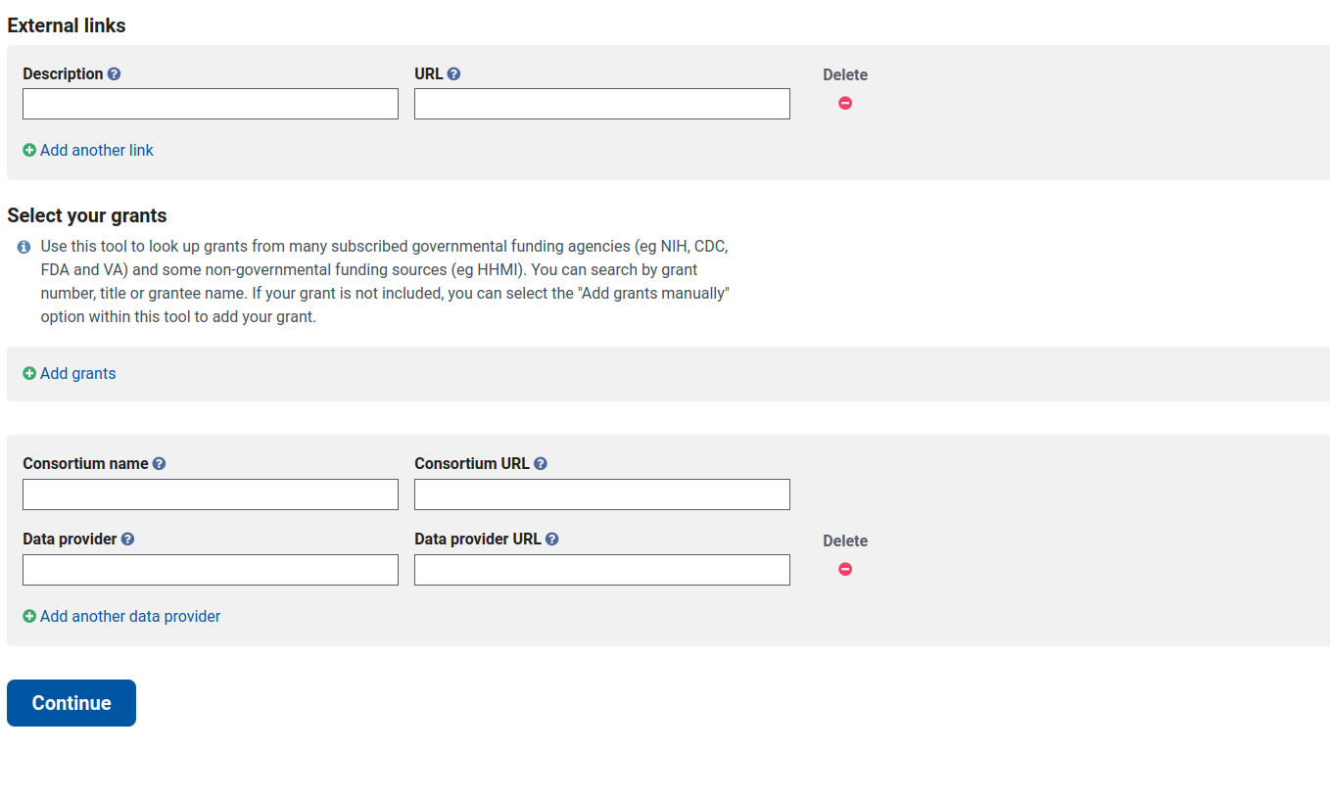

Slide 6
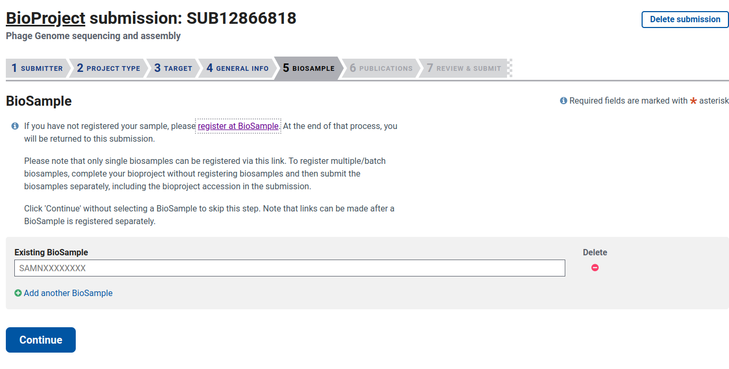

Slide 7
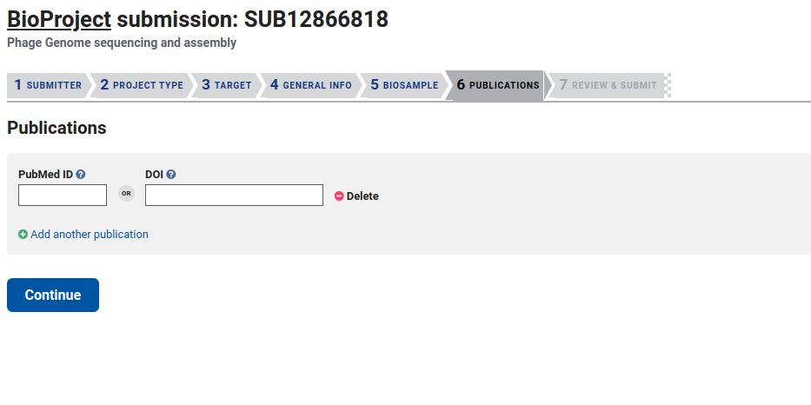
Skipping BioSample now to complete project registration.

Slide 8
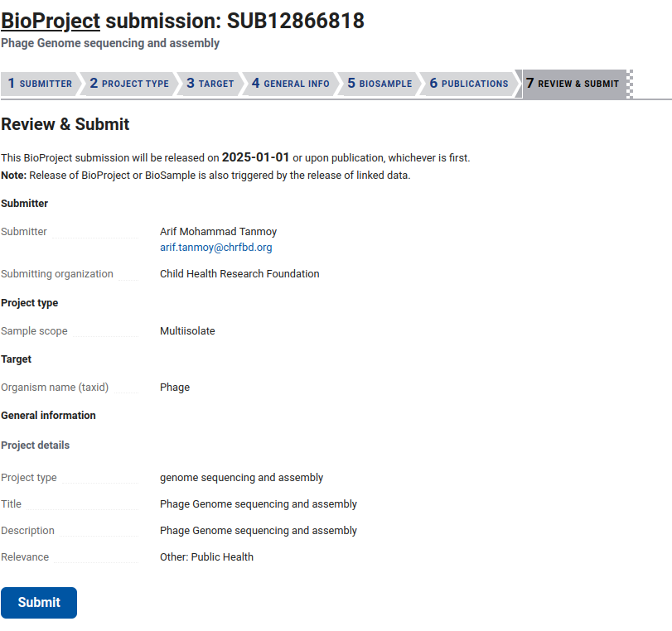

Slide 10
Registering BioSamples.

Slide 11
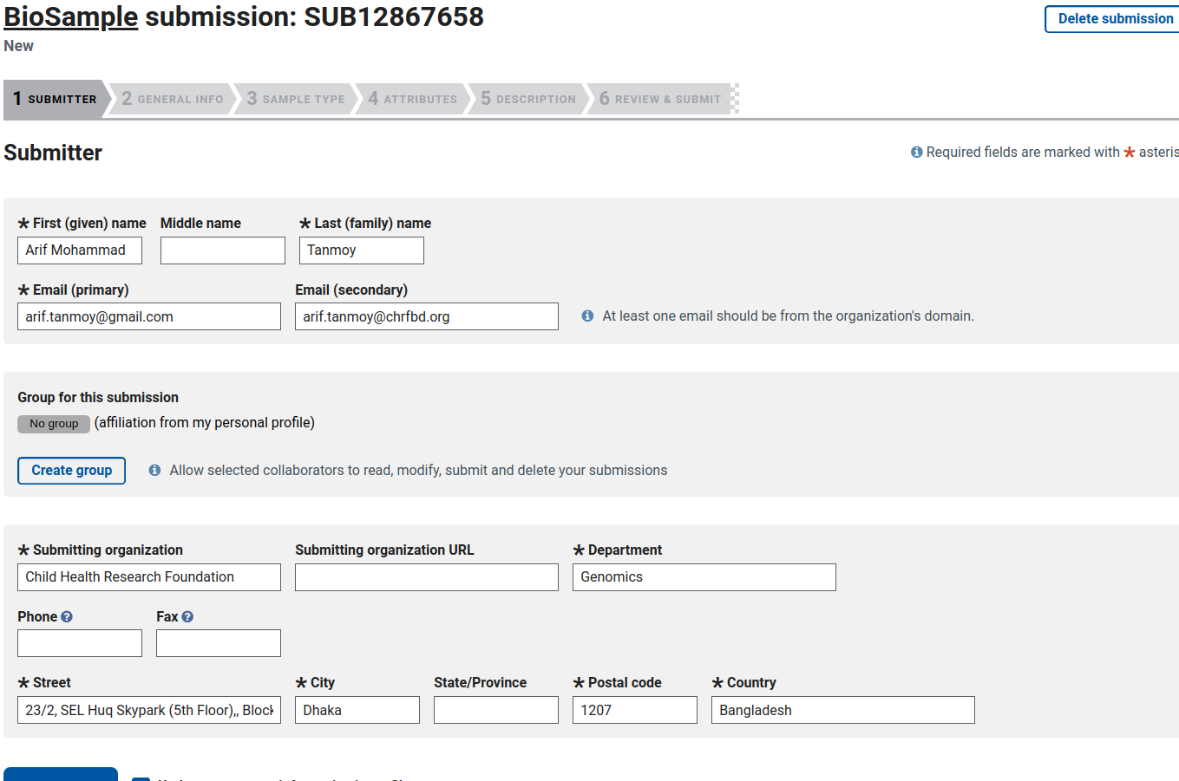

Slide 12
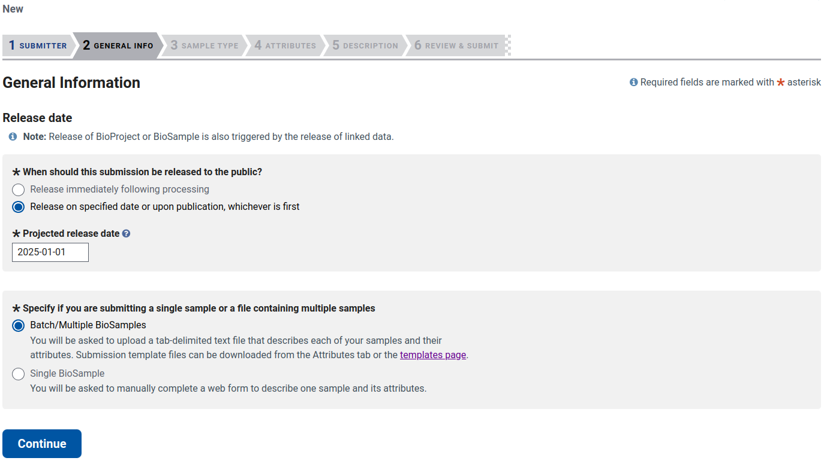

Slide 13
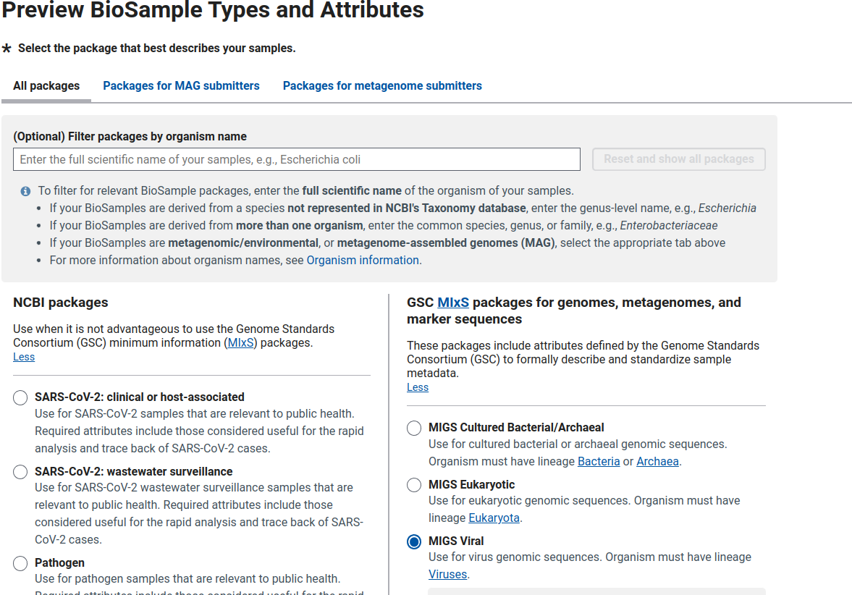
Template

Slide 14
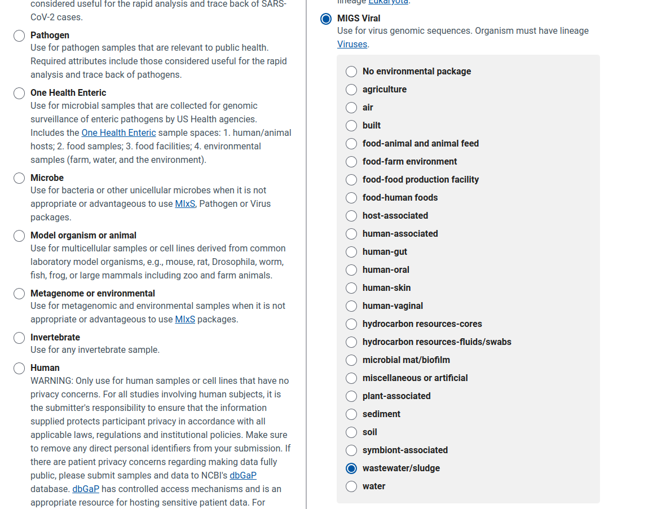
Template.
Download excel.
Fill up and upload.
Example and attribute details are in next 2 slides .

Slide 15
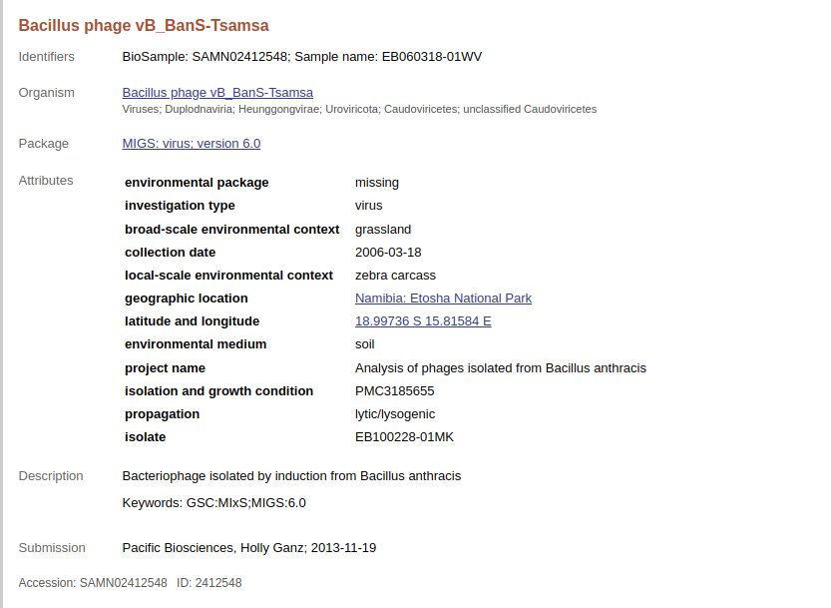
Template
Example BioSample

Slide 16
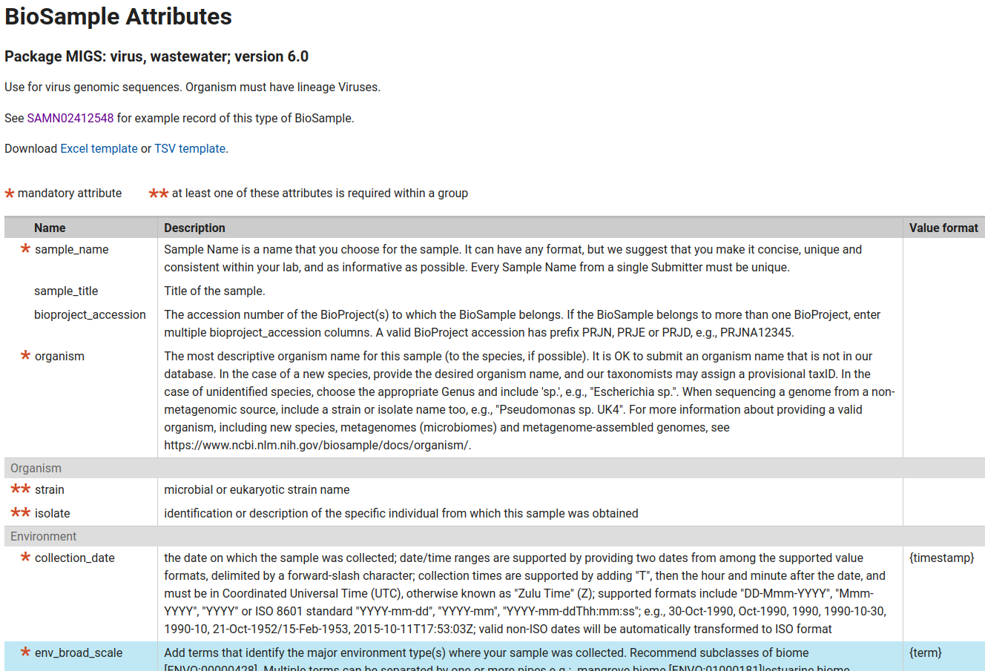
Template
https://submit.ncbi.nlm.nih.gov/biosample/template/?organism-organism_name=&organism-taxonomy_id=&package-0=MIGS.vi&package-1=MIGS.vi.wastewater.6.0&action=definition

Slide 17
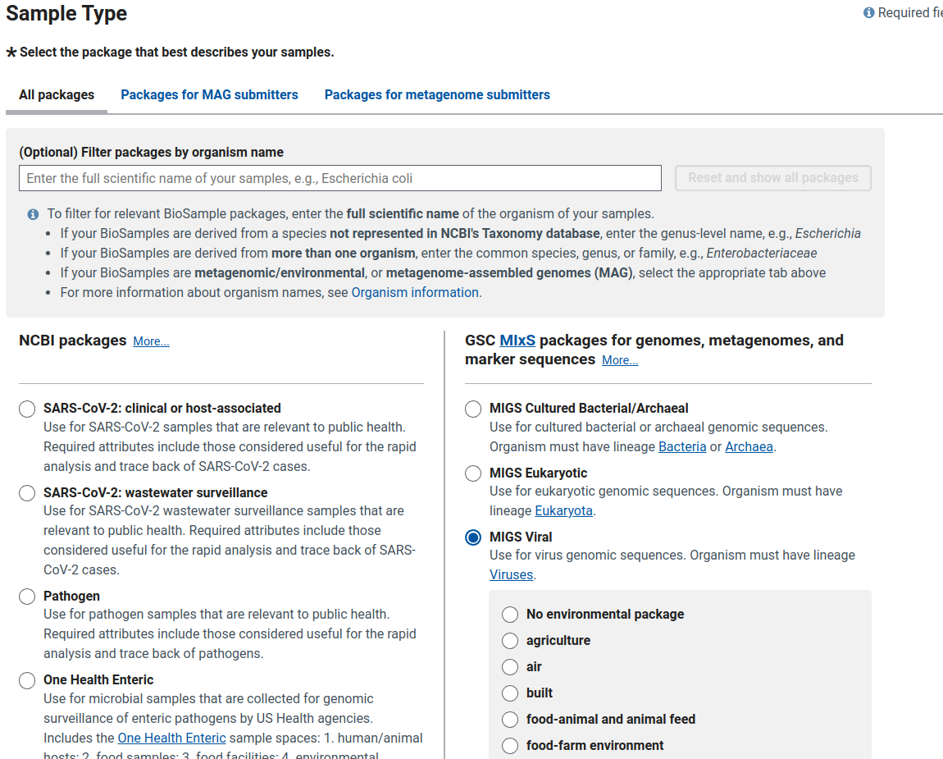
Back to
Submission
page

Slide 18
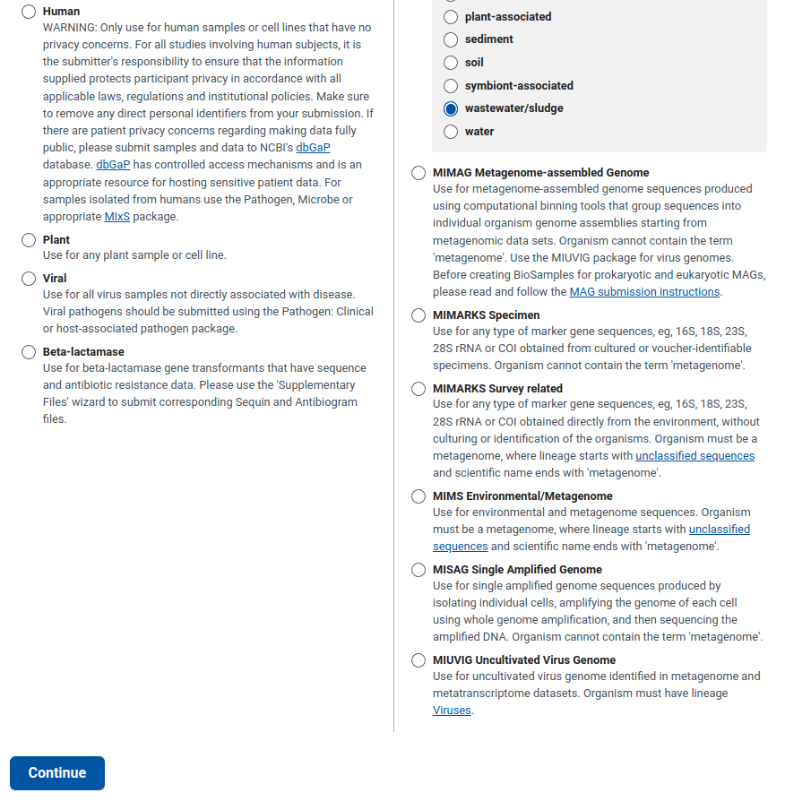

Slide 19
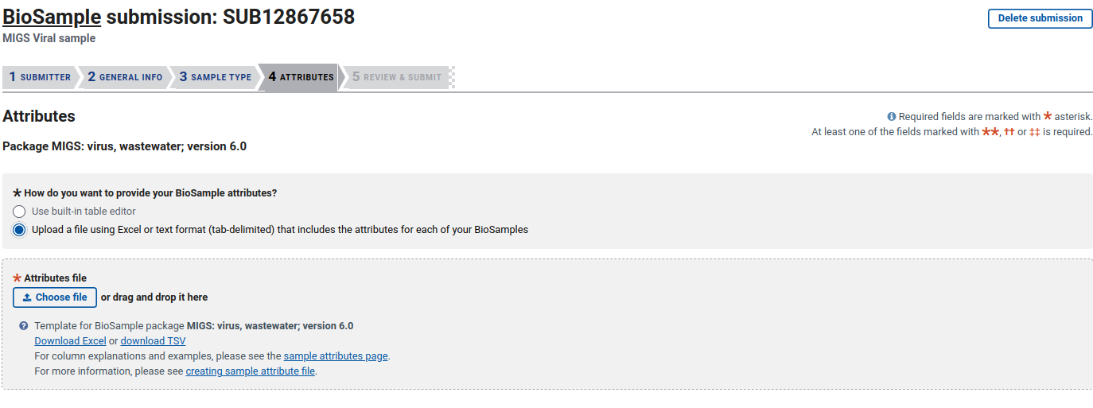
After uploading, review the data and submit.

