Slide 1
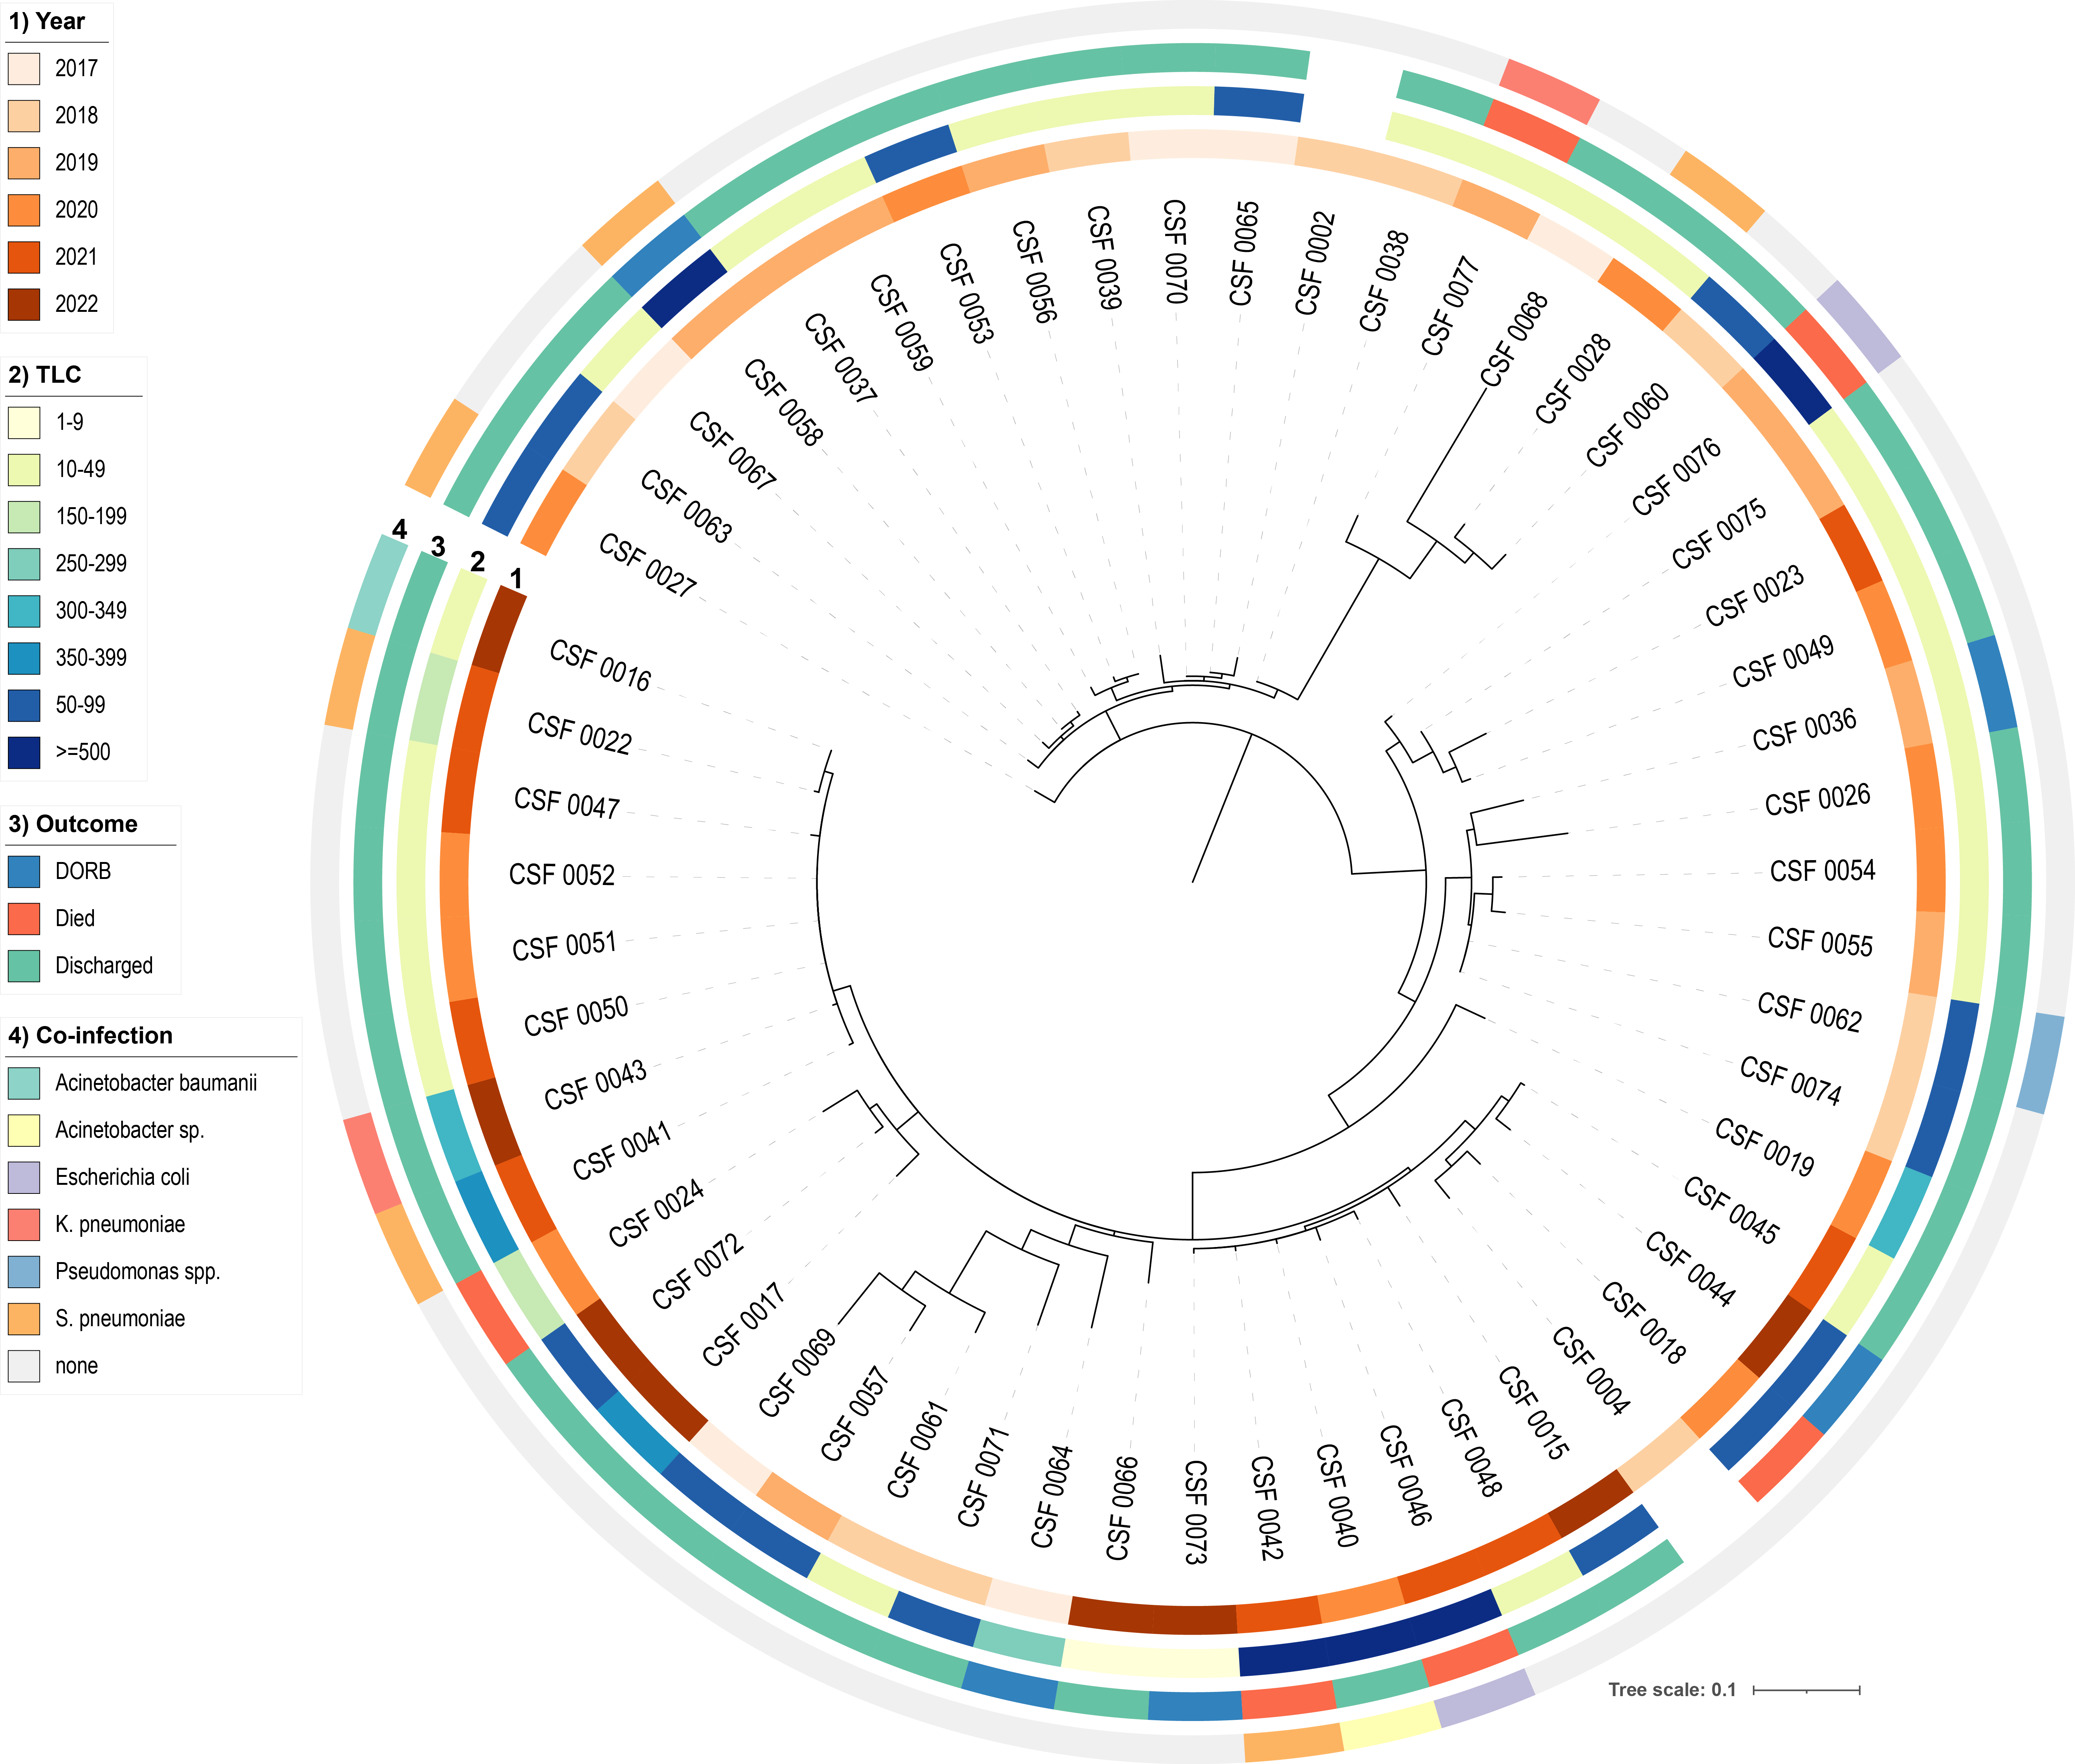
Diversity of TPRV in Bangladesh
Two dominant clusters.
One is dominant in 2017-2018.
Another is dominant in 2020-2022.
4/6 death cases had co-infection.
75% cases had 10-99 cell count.

Slide 2
SNP positions in TPRV genome
NS1
VP1

