Slide 1
Taxi Density Analysis
By
Preoyati Khan

Slide 2
Problem
Finding taxi density in a area(zipcode) based on Pickup location of each trip.

Slide 3
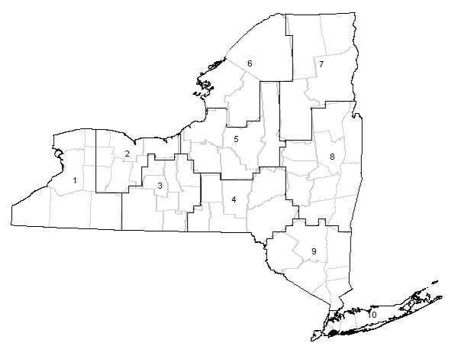
Zipcode
Zipcode
Address of Zipcode
Number of Taxies
Ziopcde
Zipcode
Zipcode
Zipcode
Zipcode
Zipcode
Map of New York
Zipcode

Slide 4
Essential Libraries
ZeoPY :To get address of a location from latitude and longitude.
Find zipcode from that address.
PyZipcode:To get latitude and longitude from zipcode.

Slide 5
Methodology
Implementd MapReduce using mrjob.
Calculated Zipcode using latitude and longitude.
Grouped pickup entries by zipcode
Calculated latitude and longitude back from zipcode and printed the output (latitude, longitude, count)
Created Map using output.

Slide 6
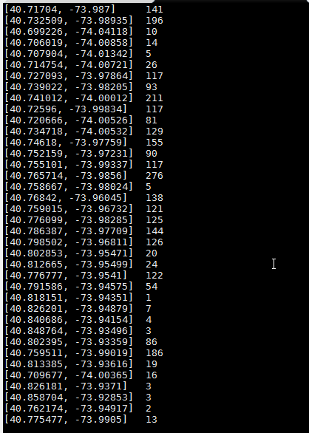
Output

Slide 7
Visualization of Output
Batchgeo - to make map from the output.
Output includes:
Coloring each location based on density
Purple -> Red
Address of location(zipcode)
Number of Taxies in a location

Slide 8
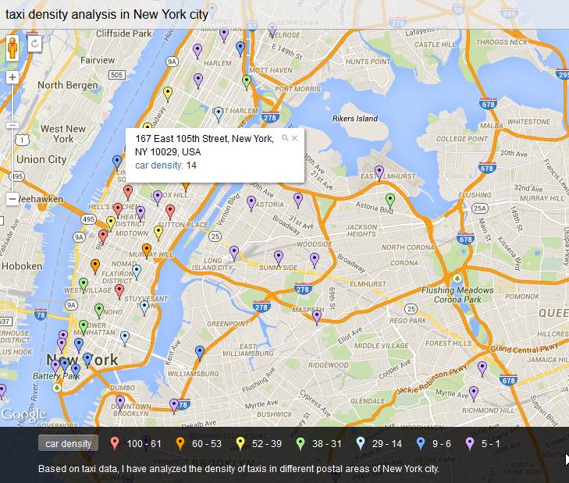
Visualization of Output(cont.)
With about 223kb data
https://batchgeo.com/map/5aa5aaaf8d9dbd7e6f73b555819ff4a9

Slide 9
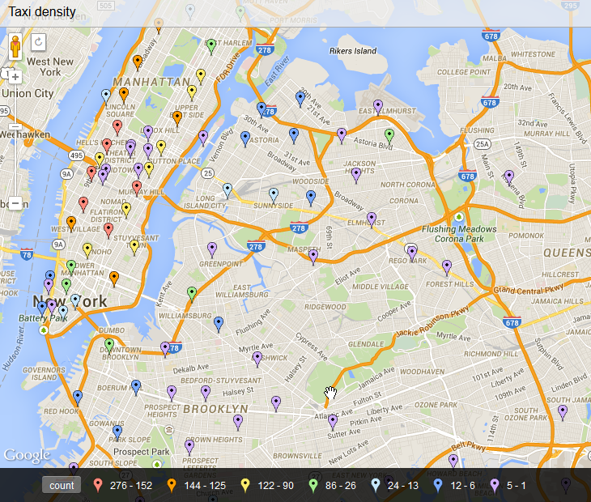
Visualization of Output(cont.)
With about 1.11MB data
https://batchgeo.com/map/5bcfb27a692ad2a917bda3a256bbed08

Slide 10
Thank You

