Slide 1
Clutch Nexus
Supply Chain Disruption Assistant & Fleet Utilisation Optimizer
IBM Bob Hackathon 2026
Team Members
Track: AI
Team: Clutch Nexus
Bhargav Zalariya — Team Lead
Prey Patel
Himesh Male
Kanan Sharma
From disruption detection to recovery — one connected supply-chain control tower.

Slide 2

Supply-Chain Disruptions Create a Chain Reaction
A disruption rarely affects only one shipment. Traditional response is fragmented — each layer of impact handled in isolation, slowing recovery and compounding risk.
The Cascade
Key Challenges
01
Disruptions can affect multiple shipments and routes simultaneously
Operations teams need to identify the full downstream impact quickly
Disruption
02
Affected Shipments
Fleet capacity may become poorly utilised while urgent cargo is delayed
Temperature-sensitive cargo requires additional monitoring
03
Routes & Network Nodes
Recovery options involve trade-offs between time, cost, capacity and risk
Decision-making across these factors is often fragmented
04
Fleet Capacity
When a disruption occurs, what is affected, how severe is the impact, and what recovery action should be taken?
05
Cold-Chain Risk
06
Financial Exposure
07
Recovery Decisions

Slide 3

Clutch Nexus: A Connected Supply-Chain Recovery Control Tower
Clutch Nexus connects disruption analysis and operational recovery in a single workflow.
Detect
Cascade
Identify active supply-chain disruptions
Trace impact across shipments, routes, network nodes, fleet capacity, cold-chain cargo, and financial exposure
Prioritise
Optimise
Identify critical shipments and high-risk cargo
Use Google OR-Tools CP-SAT to generate fleet redeployment recommendations
Simulate
Monitor
Compare alternative recovery strategies using What-If scenarios
Track cold-chain excursions and network conditions
Impact Cascade Engine — connects a disruption to its operational and financial consequences instead of treating it as an isolated alert.

Slide 4
How Clutch Nexus Works
System Architecture
Technology Stack
Layer | Technology
Frontend | Next.js 14, TypeScript, Tailwind CSS
Backend | FastAPI, Python 3.11+
Optimisation | Google OR-Tools CP-SAT
Data | SQLite, SQLAlchemy, Pydantic v2
Visualisation | Recharts, Leaflet
Development | IBM Bob
Next.js Frontend
Dashboard · Maps · UI
FastAPI Backend
REST API layer — Python 3.11+
Core Engines
Impact Cascade Engine · Fleet Optimizer (OR-Tools CP-SAT) · What-If Scenarios
Operational Data Layer
SQLite + SQLAlchemy · Pydantic v2
Visualisation
Recharts · Leaflet · Cold-Chain Telemetry + Network Data

Slide 5
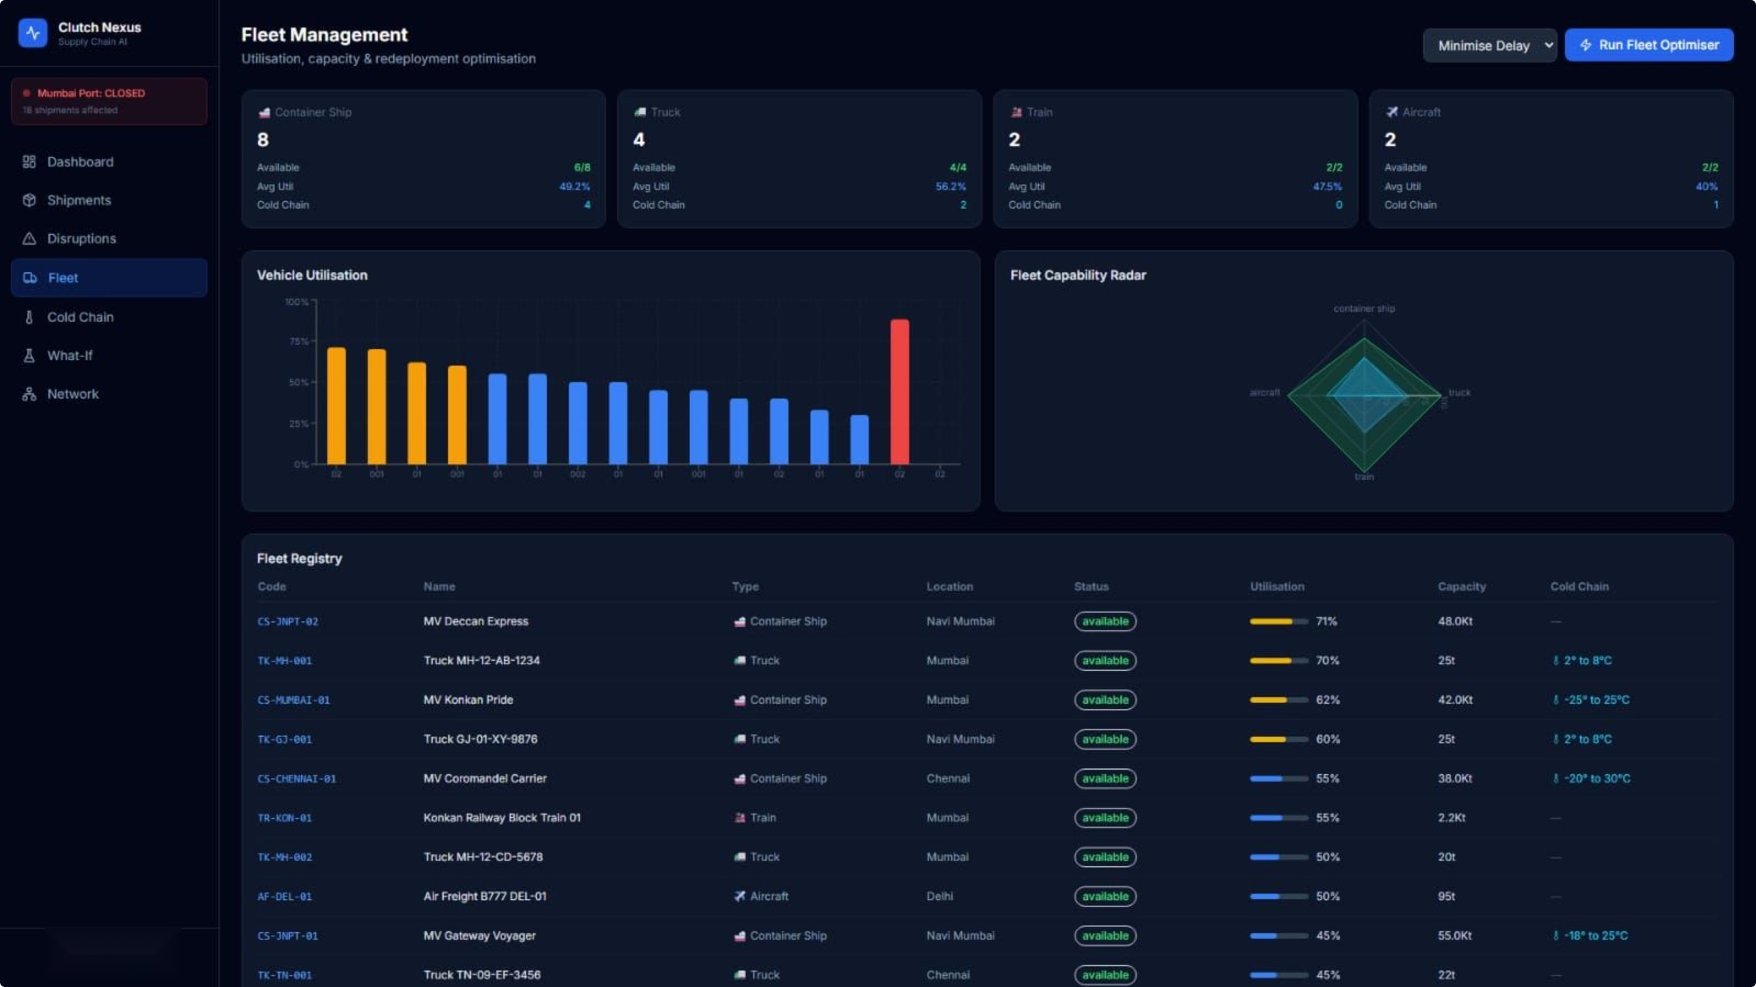
One Disruption. Complete Operational Visibility.
Impact Cascade Engine
Fleet Optimisation
Cold-Chain Monitoring
Maps the full chain reaction: Disruption → Shipments → Routes → Fleet → Cold Chain → Financial Impact
Google OR-Tools CP-SAT evaluates available capacity and constraints to generate fleet redeployment recommendations.
Identifies simulated temperature excursions for temperature-sensitive shipments.
What-If Simulator
Multimodal Network
Tests alternative recovery strategies and compares delay, shipments recovered, risk reduction, and additional recovery cost.
Interactive Leaflet map showing network nodes, connections and disruption locations.
Bottom line: From "What happened?" to "What should we do next?"

Slide 6

Built with IBM Bob + AI-Assisted Engineering
IBM Bob
Core Intelligence
IBM Bob was used throughout development to accelerate application architecture, frontend and backend implementation, feature development, testing and debugging, documentation, and deployment preparation.
Impact Cascade Engine
OR-Tools CP-SAT
Constraint-based fleet optimisation · Capacity allocation · Priority-aware recovery · Operational recommendations
Deterministic dependency mapping · Shipment impact analysis · Network propagation · Financial exposure calculation
AI-Assisted Development
The solution was developed through an AI-assisted software engineering workflow, while keeping the core operational calculations deterministic and explainable.
The innovation is not just detecting a disruption — it is connecting the disruption to its cascading operational impact and recovery decisions.

Slide 7

From Disruption to Recovery Decisions
Prototype Dataset
Demonstrated Recovery Scenario: Mumbai Port Partial Closure
30
Metric | Baseline | JNPT Reroute
Average Delay | 108h | 36h
Shipments Recovered | — | 12
Risk Reduction | — | 42% lower
Additional Cost | — | +$1.2M
Shipments
16
Network Nodes
Key Message: The What-If engine makes recovery trade-offs visible before an operational decision is made.
3
All figures shown are from a deterministic synthetic prototype dataset and are not live operational/customer data.
Active Disruptions
52.9%
Baseline Fleet Utilisation
$78.8M
Cargo Value at Risk
$127M
Estimated Total Impact

Slide 8
Clutch Nexus
Our Vision
Build a connected control tower that helps supply-chain teams move from disruption detection to coordinated recovery decisions.
Detect
Understand
Optimise
Supply-chain disruptions
Cascading operational impact
Fleet recovery with OR-Tools
Protect
Compare
Cold-chain shipments
Recovery strategies through What-If simulation
Built with IBM Bob
When disruption happens, Clutch Nexus shows what breaks — and what can be recovered.
Bhargav Zalariya · Prey Patel · Himesh Male · Kanan Sharma

