Slide 1

SMART INDIA HACKATHON 2026
TITLE PAGE
TULA Unified Digital Lifecycle Platform for Legal Metrology
Problem Statement ID – 26036
Problem Statement Title – Development of an Online Verification System for Weighing and Measuring Instruments
Theme – Miscellaneous
PS Category – Software
Team ID – 182718
Team Name – FriendlyFire
One instrument → one digital ID → one certificate anyone can check
Live prototype: tula-legal-metrology.vercel.app
Notes:
One line: scales and fuel pumps are verified on paper today and a buyer cannot tell a real stamp from a fake. TULA gives every instrument one digital ID, runs its verification online, and issues a signed QR certificate anyone can check.

Slide 2
TULA: ONE INSTRUMENT, ONE DIGITAL ID
Team
FriendlyFire
PROPOSED SOLUTION
A live web + mobile platform: every instrument gets a permanent Digital ID, and application, scrutiny, field inspection (works offline), signed QR certificate, reminders and enforcement all attach to it.
DETAILED EXPLANATION: the life of one instrument (built and running)
1
2
3
4
5
6
7
8
Register
account + Digital ID
Apply
docs, fee from State Schedule IX
Scrutiny
approval mark vs DoCA register
Assign
district + workload
Inspect
phone app, offline
Decide
readings vs MPE
Certificate
ECDSA-signed QR
Verify
any phone, no login
no network OK
Reminders at 30, 15, 7, 1 days → re-verification on the same Digital ID
HOW IT ADDRESSES THE PROBLEM
Paper records in isolated systems
→ One live register per State, same system everywhere
Manual scheduling, pendency
→ Enforced workflow + pendency dashboard
Fake or copied certificates
→ Signed QR: edits fail, copies show the real serial
Missed re-verification dates
→ Automatic reminders before expiry
INNOVATION AND UNIQUENESS
Tamper-proof QR
Server-signed (ECDSA P-256). Signature checks offline on any phone; revocation checks when online. A copied QR shows the original serial
Offline field app
Installable app. Inspection saves on the phone and syncs, signs and notifies on reconnect
Computed verdict
Readings are checked against the error limits in the LM (General) Rules 2011. PASS only when every reading is within the limit
Multi-State by design
Each State's gazetted fees and rules are data (Delhi, Gujarat loaded). Database rules isolate each State
Government data, linked
Approval marks checked against DoCA's 10,360-entry register; fees, dates and forms from gazettes, each linked. Demo data is labelled demo
Notes:
Walk one Delhi shop scale through the 8 steps. Point out: step 5 works with no network, step 6 is calculated not typed, step 7 is signed on the server, step 8 needs no login or internet. The green loop is re-verification with reminders.

Slide 3
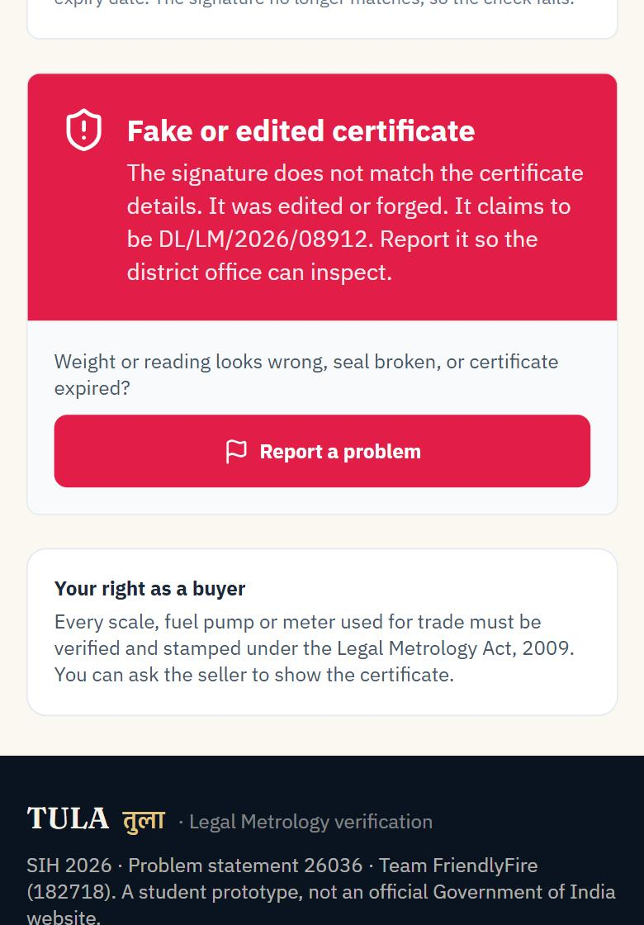
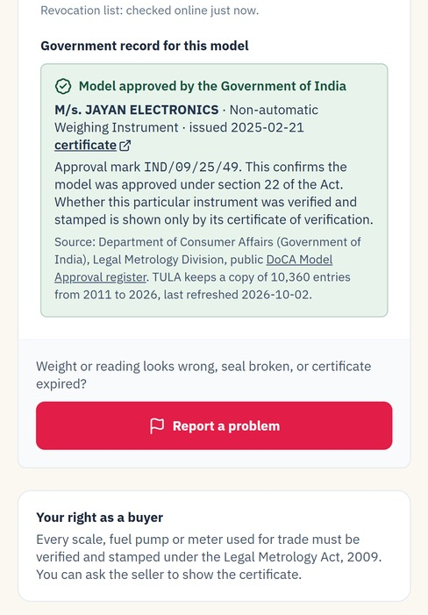

TECHNICAL APPROACH
Team
FriendlyFire
METHODOLOGY AND PROCESS FOR IMPLEMENTATION (as deployed)
TECHNOLOGIES TO BE USED
USERS
Trader
apply, pay, track
LMO / GATC
phone, offline
Controller
scrutiny, assign
Admins
State + central
Citizen
scan QR, no login
React 19 · TypeScript · Vite · Tailwind installable, mobile-first
Service worker · local store · sync queue offline work, auto sync
APP
React PWA on Vercel · installable, opens offline · local copy + sync queue · realtime updates
Supabase Postgres · RLS · Auth · Realtime live, per State
Vercel functions · ECDSA P-256 · jsQR server signs, phone checks
SERVER
Vercel functions (keys stay here)
/api/sign ECDSA private key, checks officer
/api/gemini · /api/notify (email, SMS)
Supabase
Auth · row-level security · realtime
guard triggers · public check RPC
Google Gemini (Flash) application checks, help chat
Resend · Twilio · jsPDF email, SMS (keys pending), PDF
ON A PHONE, FROM THE LIVE PROTOTYPE
DATA
Postgres
instruments, applications, certificates
Append-only audit log
who, what, when
Rules per State
fees, validity, officers
WHAT ANY SCAN SHOWS (NEVER A MADE-UP ANSWER)
TULA certificate
signature checked + DoCA's record for the model
Edited copy
rejected: signature fails
Expired / revoked
says so, with the date
Approval mark
DoCA's register entry, linked
Unknown number
not in TULA's registry, and why
Any other QR
nothing to check, and why
OFFLINE FIELD INSPECTION
No network
app opens from cache
Inspect
draft autosaves
Save
queued on phone
Back online
queue syncs
Certificate
issued + signed
Owner told
in-app; SMS via gateway
A fake: rejected
Real DoCA record
Over the limit: FAIL
Notes:
Everything in the diagram is deployed and running. Secrets (signing key, Gemini key, SMS keys) live only in the server functions. The database enforces who sees what, and blocks illegal changes: an owner cannot mark their own scale verified. Fake QR: the certificate details travel inside the QR with a signature; change one character and the phone rejects it. The database itself refuses a certificate unless the inspecting officer recorded a pass with every reading inside the limit. The two screenshots are the live site on a phone.

Slide 4

FEASIBILITY AND VIABILITY
Team
FriendlyFire
ANALYSIS OF THE FEASIBILITY OF THE IDEA: what is built vs planned
POTENTIAL CHALLENGES AND RISKS
STRATEGIES FOR OVERCOMING THESE CHALLENGES
PS requirement
Live today
Next
No network at site
Offline app; syncs, signs and notifies later
Registration, profiles, secure login
✔ real accounts, 6 roles
e-Pramaan, phone OTP
Apply for (re-)verification
✔ docs, fee, DoCA approval check
treasury payment
Fake / copied QR
Signed QR + revocation list; serial shown on scan
Scheduling, allocation LMO / GATC
✔ district + workload
officer calendars
Rules differ by State
Fees and validity are data per State
Inspection results recorded
✔ MPE computed, photos, GPS
cloud photo storage
QR certificate + authentication
✔ signed QR, revocation
HSM-held key
Data privacy (DPDP 2023)
Row-level security; AI sees no personal data; production on NIC cloud
Validity tracking, alerts
✔ 30/15/7/1-day reminders, in-app
nightly server job
SMS / email updates
◐ in-app; SMS / email keys pending
NIC SMS gateway
AI mistakes
Advisory only; officer decides; logged
Dashboards: pending, inspections
✔ stage, ageing, district
state-wide wallboard
Officer adoption
Field trial first; plain home screen per role; larger text option, Hindi
Search, export, print
✔ search, PDF, CSV
bulk audit export
Mobile app for field officers
✔ installable, offline
Android package
HOW WE TEST WITH REAL OFFICERS, THEN SCALE
Complete live demo
Scan for the guided demo: register → apply → officer inspects (try offline) → signed certificate → scan the QR on another phone. Each step ticks itself.
One-tap evaluator sign-in on the site
tula-legal-metrology.vercel.app/demo
1 · Field trial
5 LMOs + 1 GATC, 10 inspections each; go ahead only if usability (SUS) ≥ 70
2 · District pilot
All instruments of one district, vs the paper register
3 · State rollout
State loads fees and officers; NIC SMS, treasury, e-Pramaan
4 · Multi-State
DoCA offers it to States: shared platform or State cloud
VIABILITY: HOW IT GROWS, SURVIVES AND IS FUNDED
Grow in the market
DoCA is building a National Legal Metrology Portal with NIC, incl. State verification (Annual Report 2024-25, para 9.13). TULA prototypes that module.
Survive
Hosting about US$45 a month per State at list prices (Supabase Pro $25 + Vercel Pro $20, 2 Oct 2026). SMS at the State gateway rate. Moves to NIC cloud.
Get funded
SIH award and incubation first, then Startup India Seed Fund or MeitY Startup Hub grants to reach the pilot; State e-governance budgets pay for rollout as a work order.
Notes:
Table is honest: tick = works on the live site now, half = wired but needs a provider key. Before the final build we test with 5 LMOs and 1 GATC in one district and only proceed if the usability score is at least 70. Viability: the customer is the government; traders and citizens never pay. Running cost is small (pay-per-use cloud, no licence fee) and fits in the service charge States already collect. Funding path: SIH award and incubation, then Startup India Seed Fund or MeitY Startup Hub, then State e-governance budgets.

Slide 5




IMPACT AND BENEFITS
Team
FriendlyFire
POTENTIAL IMPACT ON THE TARGET AUDIENCE
LMOs & GATCs
Businesses
Consumers
Government
• Assigned inspections, even offline
• Pass / fail computed automatically
• Certificate issued on site
• Apply and pay without a visit
• Updates at every step
• Reminder before a stamp expires
• Every scan gets an honest answer
• Fakes and edits are rejected
• Report a problem in two taps
• Pending by stage, age, district
• Inspections due and overdue
• Full audit trail per instrument
MEASURED ON THE LIVE SYSTEM (30 Sep 2026, scripted end-to-end run on the production database)
2 min 51 s
application filed → signed certificate (system time, 3 people, no paper)
6 s
certificate issued → signed copy back on the phone (incl. network)
6 / 6
forged or edited QR copies rejected (automated tests)
0
paper forms and office visits in the run
PILOT TARGETS (to be compared with the pilot district's paper register)
≤ 7 days
application → certificate (median)
< 3 s
certificate check by QR scan
100%
due instruments reminded 30 days early
0
paper certificates in the pilot district
BENEFITS OF THE SOLUTION (SOCIAL, ECONOMIC, ENVIRONMENTAL, ETC.)
Social
Fair weight at shops, pumps and mandis. Buyers can check.
Economic
Fewer visits and faster renewals for traders and MSMEs.
Environmental
Paperless forms, certificates and records.
Governance
One auditable trail from application to enforcement.
Notes:
Green numbers were measured on the live system on 30 Sep 2026; they measure the software, not the physical test time on site. Blue numbers are pilot targets we will measure against the district's paper register. Dashboards for pending applications and inspections are live in the Pendency & Impact screen.

Slide 6

RESEARCH AND REFERENCES
Team
FriendlyFire
DETAILS / LINKS OF THE REFERENCE AND RESEARCH WORK
RESEARCH FINDING
DESIGN DECISION IN TULA
References (official, click to open)
Sec. 24: every instrument used in trade is verified and stamped. GATC Rules 2013 let approved test centres verify some.
One workflow for LMO and GATC, routed by district and equipment
1. Legal Metrology Act, 2009
2. Delhi LM (Enforcement) Rules 2011: Sch. VIII, IX · Sch. XI (2026)
3. Gujarat fee schedule (Schedule IX)
4. Rule 27 re-verification periods (Govt. of Assam)
5. DoCA Model Approval register (10,360 entries)
6. General Rules specs (DoCA) · OIML R 76-1 · R 117-1
7. DoCA Annual Report 2024-25 (para 9.13)
8. All sources, with what each is used for
1
States publish the fees (Sch. IX), on-site and late fees (rule 16), validity (rule 27) and the certificate form (Sch. VIII).
Loaded as data; every fee, date and form cites and links its source
2
DoCA is building a National Legal Metrology Portal with NIC for State services, incl. verification (Annual Report 2024-25, para 9.13).
TULA is a working prototype of that verification module, built to hand over
3
COMPARED WITH TODAY
Paper
Typical State portal
TULA
Certificate
copyable paper
editable PDF
signed QR
DoCA publishes 10,360 model approvals since 2011, but no register of individual verified instruments.
Approval mark checked against the DoCA register; TULA adds the missing per-instrument record
Buyer can check
no
rarely
any phone, offline
4
Field record
register
typed later
phone, offline
Pass / fail
judgement
typed
computed vs MPE
Error limits are set by the LM (General) Rules 2011 (Seventh and Eighth Schedules), based on OIML R 76 and R 117.
Pass / fail computed from recorded readings against those limits, not typed
Across States
separate
one per State
one platform
5
Scan: a live certificate
DL/LM/2026/08913, a demo certificate signed on the live system. Your phone checks the signature, then shows DoCA's real record for the model.
Code: github.com/prerak2507/tula-legal-metrology
A buyer cannot tell a genuine stamp from a fake; field sites often have no network.
Signed QR anyone can check, offline; officer app works offline
6
Notes:
Each decision traces to a published rule; every reference is a clickable official document, checked on 1 Oct 2026. Invite the judges to scan the green QR: it opens a certificate we issued and signed on the live system during testing.

