Slide 1

SMART INDIA HACKATHON 2026
TITLE PAGE
TULA Unified Digital Lifecycle Platform for Legal Metrology
Problem Statement ID – 26036
Problem Statement Title – Development of an Online Verification System for Weighing and Measuring Instruments
Theme – Miscellaneous
PS Category – Software
Team ID – _______
Team Name – FriendlyFire
One instrument → one digital ID → one certificate anyone can check
Live prototype: tula-legal-metrology.vercel.app
Notes:
One line: scales and fuel pumps are verified on paper today and a buyer cannot tell a real stamp from a fake. TULA gives every instrument one digital ID, runs its verification online, and issues a signed QR certificate anyone can check. Fill Team ID before exporting.

Slide 2
TULA: ONE INSTRUMENT, ONE DIGITAL ID
Team
FriendlyFire
PROPOSED SOLUTION
A live web + mobile platform: every instrument gets a permanent Digital ID, and application, scrutiny, field inspection (works offline), signed QR certificate, reminders and enforcement all attach to it.
DETAILED EXPLANATION: the life of one instrument (built and running)
1
2
3
4
5
6
7
8
Register
account + Digital ID
Apply
upload docs, fee by State rule
Scrutiny
officer checks, AI flags
Assign
district + workload
Inspect
phone app, offline
Decide
readings vs MPE
Certificate
ECDSA-signed QR
Verify
any phone, no login
SMS / email reminders at 30, 15, 7, 1 days → re-verification on the same Digital ID
no network OK
HOW IT ADDRESSES THE PROBLEM
Paper records in isolated systems
→ One live database for every State
Manual scheduling, pendency
→ Enforced workflow + pendency dashboard
Fake or copied certificates
→ Signed QR: edited copies fail the scan
Missed re-verification dates
→ Automatic SMS / email reminders
INNOVATION AND UNIQUENESS
Unfakeable QR
Server-signed (ECDSA P-256). Checked on any phone, even offline, plus a live revocation list
Offline field app
Installable app. Inspection saves on the phone and syncs, signs and notifies on reconnect
Computed verdict
Readings are checked against OIML MPE limits. PASS is impossible unless every check passes
Multi-State by design
Fees, validity and officers are data per State. Database rules isolate each State
AI copilot, human decides
Gemini flags odd documents. It never approves, prices or passes anything
Notes:
Walk one Delhi shop scale through the 8 steps. Point out: step 5 works with no network, step 6 is calculated not typed, step 7 is signed on the server, step 8 needs no login or internet. The green loop is re-verification with reminders.

Slide 3
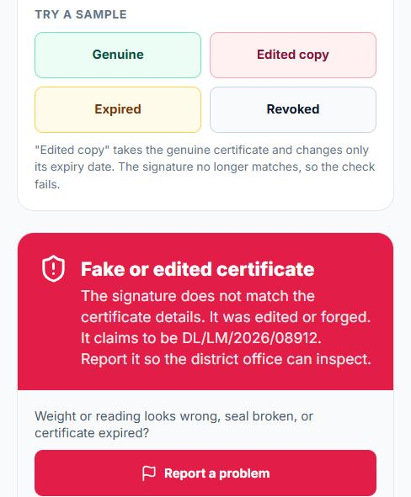
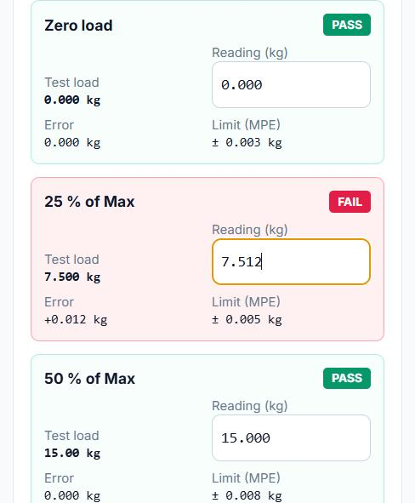
TECHNICAL APPROACH
Team
FriendlyFire
METHODOLOGY AND PROCESS FOR IMPLEMENTATION (as deployed)
TECHNOLOGIES USED
USERS
Trader
apply, pay, track
LMO / GATC
phone, offline
Controller
scrutiny, assign
State admin
fees, rules
Citizen
scan QR, no login
React 19 · TypeScript · Vite · Tailwind installable, mobile-first
Service worker · local store · sync queue offline work, auto sync
APP
React PWA on Vercel · installable, opens offline · local copy + sync queue · realtime updates
Supabase Postgres · RLS · Auth · Realtime live, per State
Vercel functions · ECDSA P-256 · jsQR sign on server, check on phone
SERVER
Vercel functions (keys stay here)
/api/sign ECDSA private key, checks officer
/api/gemini · /api/notify (email, SMS)
Supabase
Auth · row-level security · realtime
guard triggers · public check RPC
Google Gemini (Flash) document flags, help chat
Resend · Twilio · jsPDF email, SMS, certificate PDF
ON A PHONE, FROM THE LIVE PROTOTYPE
DATA
Postgres
instruments, applications, certificates
Append-only audit log
who, what, when
Rules per State
fees, validity, officers
HOW A FAKE QR IS CAUGHT
Officer passes
readings all within MPE
Server checks
officer sign-in + record
Signs
private key, never in app
QR carries
details + signature
Any phone checks
public key, offline
Result
genuine / edited / revoked
OFFLINE FIELD INSPECTION
No network
app opens from cache
Inspect
draft autosaves
Save
queued on phone
Back online
queue syncs
Certificate
issued + signed
Owner told
SMS / email
Buyer scans an edited copy: rejected
Over the legal limit: flagged at once
Notes:
Everything in the diagram is deployed and running. Secrets (signing key, Gemini key, SMS keys) live only in the server functions. The database enforces who sees what, and blocks illegal changes: an owner cannot mark their own scale verified. Fake QR: the certificate details travel inside the QR with a signature; change one character and the phone rejects it. The database itself refuses a certificate unless the inspecting officer recorded a pass with every reading inside the limit. The two screenshots are the live site on a phone.

Slide 4

FEASIBILITY AND VIABILITY
Team
FriendlyFire
ANALYSIS OF THE FEASIBILITY OF THE IDEA: what is built vs planned
POTENTIAL CHALLENGES AND RISKS → STRATEGIES
PS requirement
Live today
Next
No network at site
Offline app; syncs, signs and notifies later
Registration, profiles, secure login
✔ real accounts, 6 roles
e-Pramaan, phone OTP
Apply for (re-)verification
✔ own instruments, docs, fee
treasury payment
Fake / copied QR
Signed QR + revocation list; serial shown on scan
Scheduling, allocation LMO / GATC
✔ district + workload
officer calendars
Rules differ by State
Fees and validity are data per State
Inspection results recorded
✔ MPE computed, photos, GPS
cloud photo storage
QR certificate + authentication
✔ signed QR, revocation
HSM-held key
Data privacy (DPDP 2023)
Row-level security, minimal public fields
Validity tracking, alerts
✔ 30/15/7/1-day reminders
nightly server job
SMS / email updates
◐ email + SMS wired, keys pending
NIC SMS gateway
AI mistakes
Advisory only; officer decides; logged
Dashboards: pending, inspections
✔ stage, ageing, district
state-wide wallboard
Officer adoption
Field trial first, few-tap phone flow
Search, export, print
✔ search, PDF, CSV
bulk audit export
Mobile app for field officers
✔ installable, offline
Android package
HOW WE TEST WITH REAL OFFICERS, THEN SCALE
Complete live demo
Scan for the guided demo: register → apply → officer inspects (try offline) → signed certificate → scan the QR on another phone. Each step ticks itself.
Evaluator password: TulaDemo@2026
tula-legal-metrology.vercel.app/demo
1 · Field trial
5 LMOs + 1 GATC, 10 inspections each; go ahead only if usability (SUS) ≥ 70
2 · District pilot
All instruments of one district, vs the paper register
3 · State rollout
State loads fees and officers; NIC SMS, treasury, e-Pramaan
4 · Multi-State
DoCA offers it to States: shared platform or State cloud
VIABILITY: HOW IT GROWS, SURVIVES AND IS FUNDED
Grow in the market
Buyers are DoCA and the 36 State / UT Legal Metrology departments; traders and citizens use it free. Each State that adopts is the reference for the next.
Survive
Open-source, pay-per-use cloud, no licence fees. Running cost fits in the service charge States already add to verification fees. No lock-in: standard Postgres, can move to State cloud.
Get funded
SIH award and incubation first, then Startup India Seed Fund or MeitY Startup Hub grants to reach the pilot; State e-governance budgets pay for rollout as a work order.
Notes:
Table is honest: tick = works on the live site now, half = wired but needs a provider key. Before the final build we test with 5 LMOs and 1 GATC in one district and only proceed if the usability score is at least 70. Viability: the customer is the government; traders and citizens never pay. Running cost is small (pay-per-use cloud, open source) and fits in the service charge States already collect. Funding path: SIH award and incubation, then Startup India Seed Fund or MeitY Startup Hub, then State e-governance budgets.

Slide 5




IMPACT AND BENEFITS
Team
FriendlyFire
POTENTIAL IMPACT ON THE TARGET AUDIENCE
LMOs & GATCs
Businesses
Consumers
Government
• Jobs on the phone, even offline
• Pass / fail calculated for them
• Certificate issued on site
• Apply and pay without a visit
• SMS / email at every step
• Reminder before a stamp expires
• Scan any certificate QR
• Fakes and edits are rejected
• Report a problem in two taps
• Pending by stage, age, district
• Inspections due and overdue
• Full audit trail per instrument
MEASURED ON THE LIVE SYSTEM (30 Sep 2026, scripted end-to-end run on the production database)
2 min 51 s
application filed → signed certificate (system time, 3 people, no paper)
6 s
certificate issued → signed by the server
6 / 6
forged or edited QR copies rejected (automated tests)
0
paper forms and office visits in the run
PILOT TARGETS vs TODAY'S PAPER BASELINE (baseline measured from the pilot district's register)
≤ 7 days
application → certificate (median)
< 3 s
certificate check by QR scan
100%
due instruments reminded 30 days early
0
paper certificates in the pilot district
BENEFITS OF THE SOLUTION (SOCIAL, ECONOMIC, ENVIRONMENTAL, ETC.)
Social
Fair weight at shops, pumps and mandis. Buyers can check.
Economic
Fewer visits and faster renewals for traders and MSMEs.
Environmental
Paperless forms, certificates and records.
Governance
One auditable trail from application to enforcement.
Notes:
Green numbers were measured on the live system on 30 Sep 2026; they measure the software, not the physical test time on site. Blue numbers are pilot targets we will measure against the district's paper register. Dashboards for pending applications and inspections are live in the Pendency & Impact screen.

Slide 6

RESEARCH AND REFERENCES
Team
FriendlyFire
DETAILS / LINKS OF THE REFERENCE AND RESEARCH WORK
RESEARCH FINDING
DESIGN DECISION IN TULA
References & Links
Sec. 24 of the Act needs verification and stamping. GATC Rules 2013 add approved test centres.
One workflow for LMO and GATC, routed by district and equipment
1. LM Act 2009; LM (General) Rules 2011 · consumeraffairs.gov.in
2. LM (GATC) Rules 2013; State Enforcement Rules
3. OIML R 76-1 (scales), R 117-1 (dispensers) · oiml.org
4. IT Act 2000, DPDP Act 2023
5. Supabase, Vercel and Gemini API docs
1
Fees and validity differ across State Enforcement Rules.
Rules stored as data per State; database isolates each State
2
MPE limits come from OIML R 76 (scales) and R 117 (fuel dispensers).
Pass / fail computed from recorded readings, not typed
COMPARED WITH TODAY
3
Paper
Typical State portal
TULA
Certificate
copyable paper
editable PDF
signed QR
Buyer can check
no
rarely
any phone, offline
Field record
register
typed later
phone, offline
Field sites (mandis, highways) often have weak networks.
Installable offline app with a sync queue
Pass / fail
judgement
typed
computed vs MPE
4
Across States
separate
one per State
one platform
Scan: a real certificate
DL/LM/2026/08913, issued and signed on the live system on 30 Sep 2026. Your phone checks the signature.
Code: github.com/prerak2507/tula-legal-metrology
A buyer cannot tell a genuine stamp from a fake.
Signed QR anyone can check, no login, even offline
5
Notes:
Each decision traces to a rule or a field reality. Invite the judges to scan the green QR: it opens a certificate we issued and signed on the live system during testing.

