Slide 1

Autism Spectrum Disorder In Toddlers
PRERAK JAIN
Guided by – prof. Rithik Raj Vaishya

Slide 2
INTRODUCTION
Autism Spectrum Disorder (ASD) is a neurodevelopmental disorder characterized by challenges in social communication, repetitive behaviors, and restricted interests.
There have been a constant rise in ASD in toddlers over the years, making it a significant public health concern.
ASD is a spectrum disorder, meaning individuals with ASD can have a wide range of symptoms, severity levels, and abilities.
ASD manifests heterogeneously, with each individual displaying a unique combination of characteristics.
ASD is a disorder one possess by birth.

Slide 3
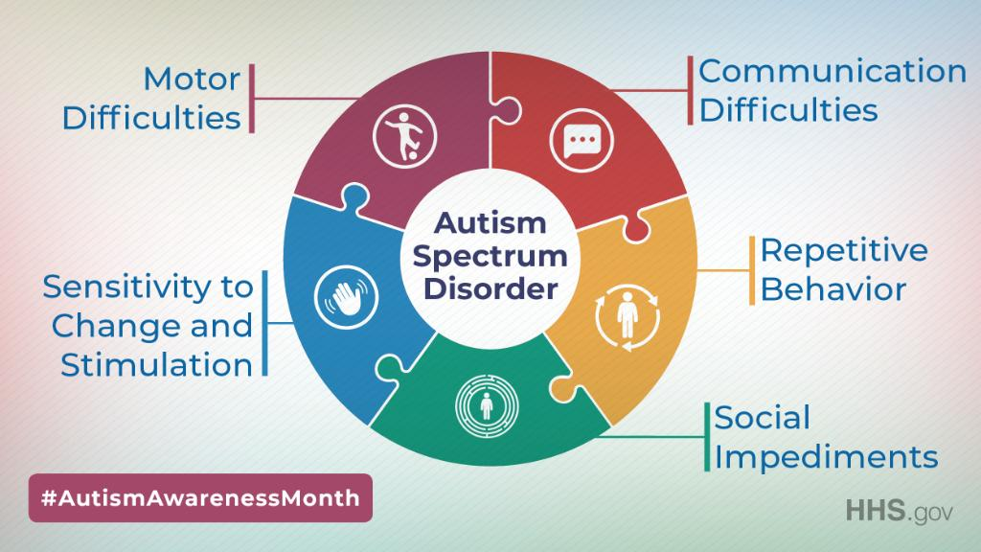
Diagnosis of ASD
Diagnosis is typically based on behavioral observations, developmental history, and standardized assessments. It is often challenging and may occur later than desirable.
Early intervention services, including behavioral therapies and educational support, can significantly improve outcomes for individuals with ASD.
Ongoing research, coupled with technological advancements such as machine learning, is enhancing our understanding of ASD, improving early detection, and informing personalized interventions.

Slide 4
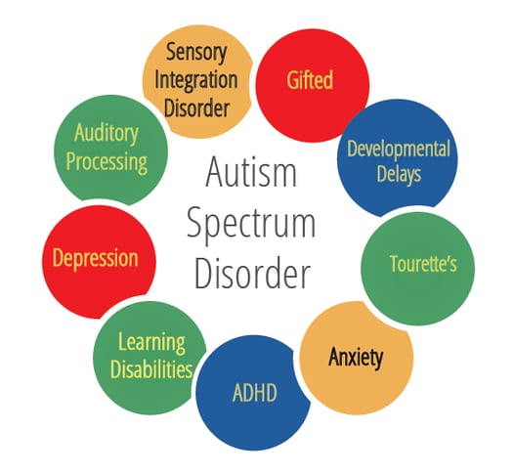
AIM
The primary aim of this project is to leverage machine learning techniques to advance the understanding, early detection, and personalized intervention strategies for Autism Spectrum Disorder (ASD).
OBJECTIVE
To develop a predictive model showcasing evaluation metrics that can effectively explain how well the model classify an infant with or without ASD traits.

Slide 5
DATASET OVERVIEW
The dataset was developed by Dr Fadi Fayez Thabtah using a mobile app called ASDTests to screen autism in toddlers.
It gives information for approximately 1054 infants, including both male and female of different age categories ranging from 1 to 3 years.
It gives the details about 19 different features that relates to autism spectrum disorder such as age, Qchat score, jaundice, ethnicity, ASD traits etc.
Children from different ethnicity such as Hispanic, Black, White European etc. are observed for autistic behaviours over a range of tests.
It consist of 6 categorical columns and 13 numerical columns.

Slide 6
METHODOLOGY
It gives description of dependency of target variable on independent variables using logistic regression model to analyse autism spectrum disorder.
The dependent variable is ‘ASD traits’ whereas independent variables include age, Qchat score, jaundice, ethnicity, sex,etc.
Data Collection
Data Preprocessing
EDA
Results
Tuning
Logistic Regression
Outlier Treatment

Slide 7
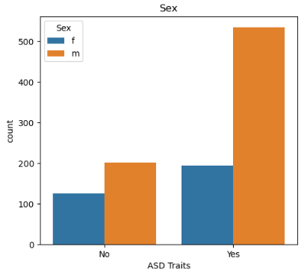
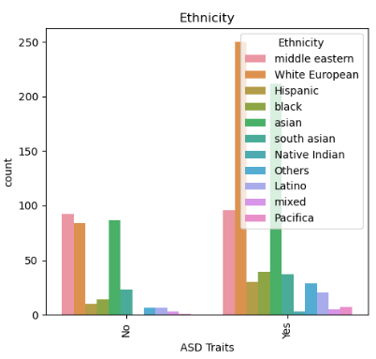
Data Visualization

Slide 8
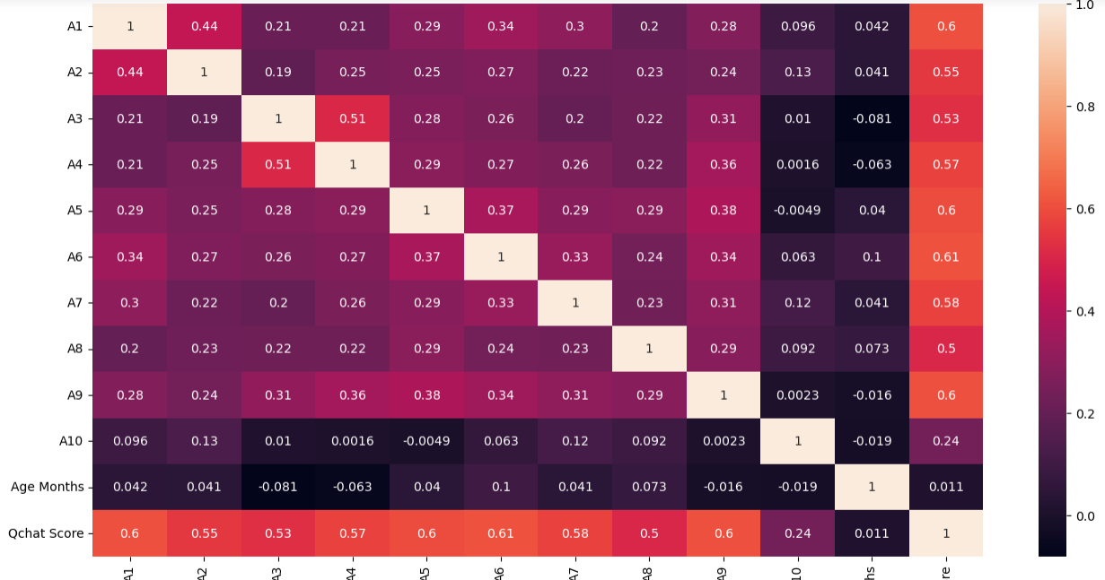
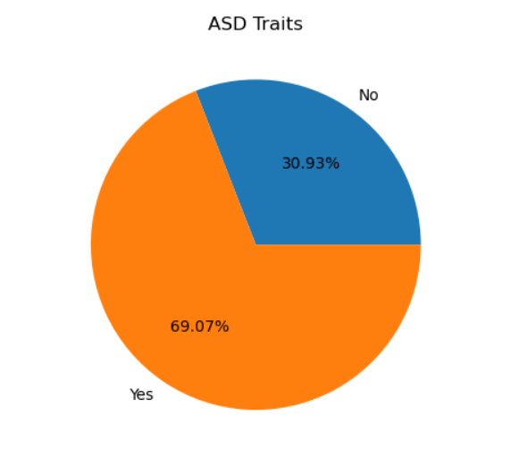
Data Visualization

Slide 9
RESULTS
Algorithms | Accuracy
Logistic Regression | 95
SVM | 94
Decision Tree | 90
Random Forest | 93

Slide 10
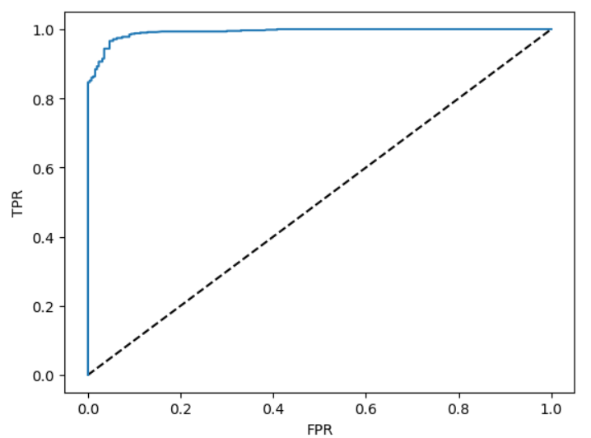
RESULTS
Parameters | Logistic Regression | GridSearchCV | RandmoizedSearchCV
Accuracy | 95 | 95 | 95
Precision | 94 | 94 | 94
Recall | 95 | 95 | 95
F1-score | 95 | 95 | 95

Slide 11
CONCLUSION
The logistic regression model utilized for predicting Autism Spectrum Disorder demonstrates exceptional performance, with high accuracy, precision, recall, and F1 score.
We can see that the model accuracy is 95% before tuning and 95% after tuning. Indicating the goodness of fit being strong.
These results suggest that the model is robust and well-balanced, successfully capturing both positive and negative instances with a high level of accuracy.
The findings instill confidence in the model's ability to serve as a reliable tool for ASD prediction, with potential applications in early detection and intervention strategies

Slide 12
THANK YOU

