Slide 1
PREDICTIVE MAINTENANCE OF MACHINE
PRERAK JAIN

Slide 2
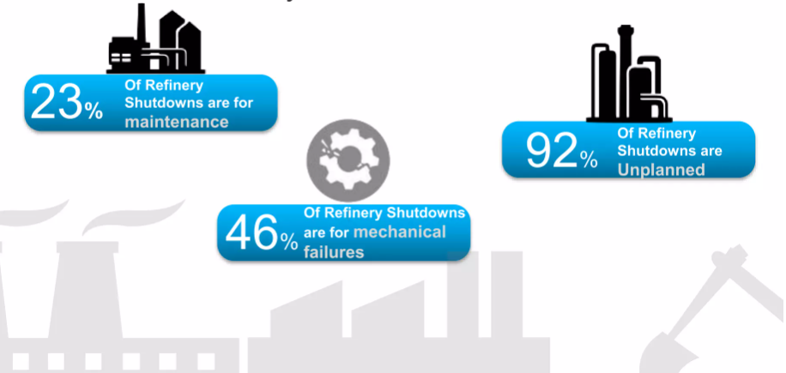
INTRODUCTION
Maintenance refers to the process of ensuring that equipment, machinery, infrastructure, or other assets are kept in good working condition and are able to perform their intended functions.
Types of maintenance –
Preventive maintenance
Corrective maintenance
Predictive maintenance

Slide 3
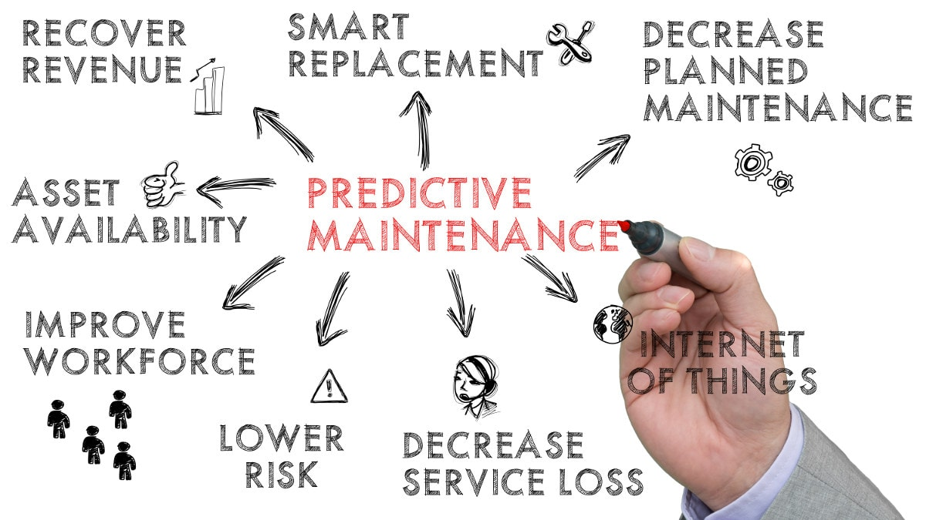
AIM
To use regression and classification algorithms for Predictive maintenance modeling of a machine, in order to understand and predict the factors that influence whether a machine needs maintenance or not.
OBJECTIVE
To develop predictive models showcasing performance measures and evaluation metrics that can effectively explain how well the different models classify a case into two categories: machine failure and no machine failure.

Slide 4
DATASET OVERVIEW
The data is collected on a milling machine by using different types of sensors and probes which gives us values of various attributes such as temperature, speed etc.
It gives information of 10,000 observations in which machine either failed or ran successfully.
It gives details about 11 different features that relates to the machine failure such as air temperature, process temperature, torque, tool wear, rotational speed etc.
The machine failure consist of five independent modes namely TWF, HDF, PWF, OSF, RNF if either of the failure mode occurs it is counted towards whole machine failure.
Three different types of materials are used for machining low quality, medium quality and high quality

Slide 5
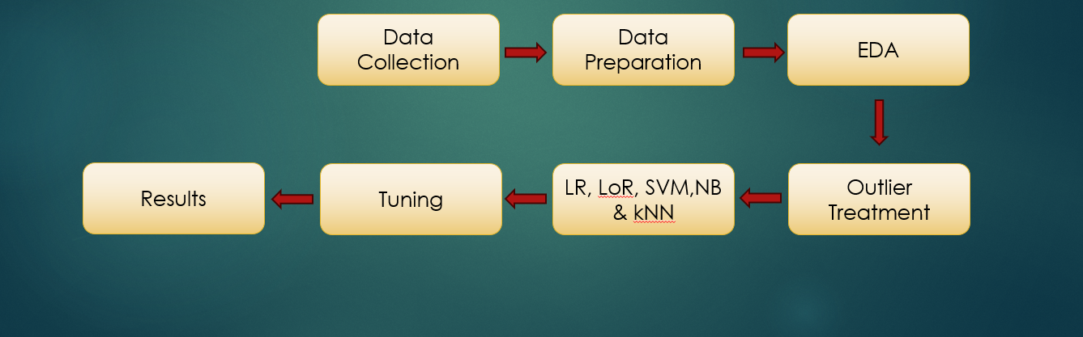
METHODOLOGY
It gives description of dependency of target variable on independent variables using regression and classification models to analyse machine failure.
The dependent variable is ‘Machine failure’ whereas independent variables include ‘torque’, ‘air temperature’, ‘rotational speed’ etc.

Slide 6
RESULT
Before Tuning | Before Tuning
Parameters | LR | LoR | SVM | NB | kNN
Accuracy | 0.0427 | 0.92 | 0.92 | 0.84 | 0.98
Precision | - | 0.85,1.00 | 0.87,1.00 | 0.85,0.84 | 1.00,0.98
Recall | - | 1.00,0.83 | 1.00,0.85 | 0.83,0.85 | 0.98,1.00
F1score | - | 0.92,0.91 | 0.93,0.92 | 0.84,0.84 | 0.99,0.99

Slide 7
RESULT
GridSearchCV Tuning | Before Tuning
Parameters | LR | LoR | SVM | NB | kNN
Accuracy | 0.4277(lasso) | 0.91 | - | 0.84 | 0.98
Precision | - | 0.85,1.00 | - | 0.85,0.84 | 1.00,0.99
Recall | - | 1.00,0.83 | - | 0.83,0.85 | 0.99,1.00
F1score | - | 0.92,0.91 | - | 0.84,0.84 | 0.99,0.99

Slide 8
RESULT
RandomizedSearchCV Tuning | Before Tuning
Parameters | LR | LoR | SVM | NB | kNN
Accuracy | 0.427(Ridge) | 0.91 | 0.92 | 0.84 | -
Precision | - | 0.85,1.00 | 0.87,1.00 | 0.85,0.84 | -
Recall | - | 1.00,0.83 | 1.00,0.85 | 0.83,0.85 | -
F1score | - | 0.92,0.91 | 0.93,0.92 | 0.84,0.84 | -

Slide 9
CONCLUSION
After performing different types of algorithm on the predictive maintenance of machine dataset we could see that each algorithm's model perform differently in order to classify the data and providing accuracy of doing the same.
From the result above we can clearly conclude that the linear regression model is not performing well on the dataset giving us accuracy of 4.2 % only which shows how poorly it gives the relation between dependent and independent variables.
In classification models however the accuracies of all the models i.e. logistic, SVM, naive bayes, kNN are all above 80% showing that their ability to classify the data is well, but if we want to choose one model out of these we would go for kNN as its accuracy is highest.

Slide 10
THANK YOU

