Slide 1
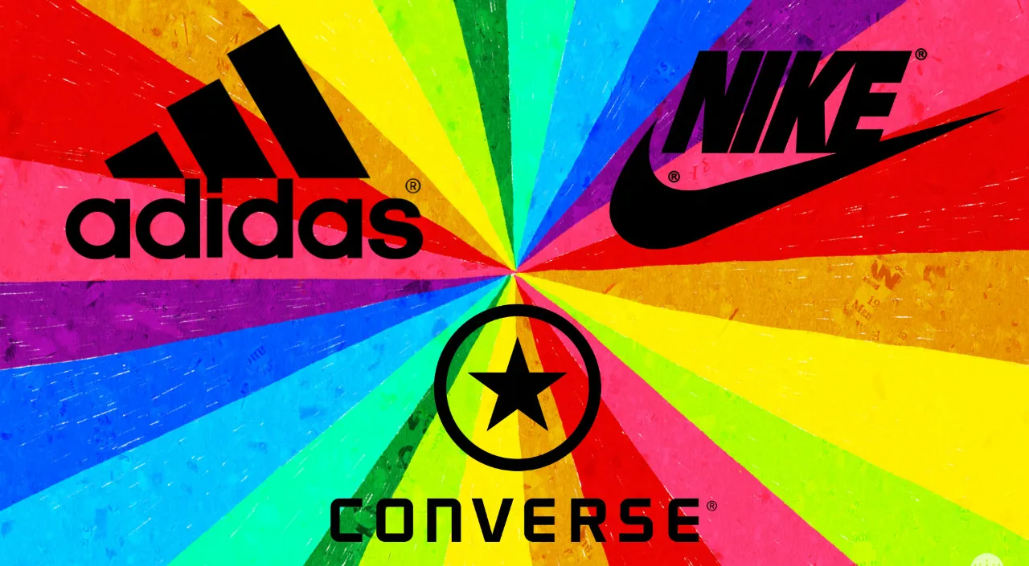
SHOE BRAND CLASSIFICATION
PRERAK JAIN
Guided by – TRAINER Rithik Raj Vaishya

Slide 2
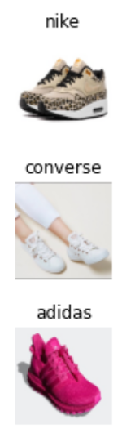
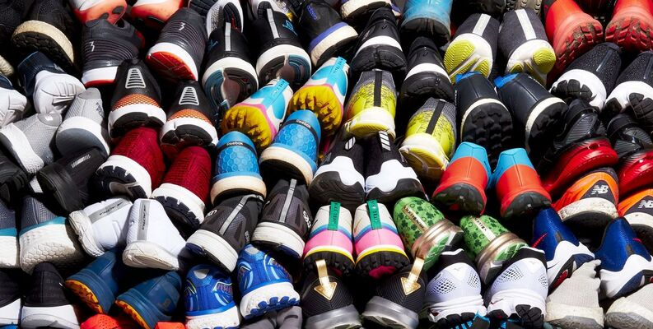
PRIMARY GOAL
The primary goal of this project is to categorize images of shoes into three distinct brands: Nike, Adidas, and Converse by employing transfer learning with the InceptionV3 model, a deep convolutional neural network (CNN) architecture developed by Google's research team, which is primarily designed for image classification and object recognition tasks.
Model
Model

Slide 3



Data Overview
The dataset is structured into two folders, one for test data and the other for training data, with a test-train-split ratio of 0.14. The test dataset comprises 114 images, while the training dataset consists of 711 images. All images are in RGB color format and have a resolution of 240x240 pixels.
This dataset was acquired by downloading images from Google Images in .webp format than they were converted to .jpg format. Subsequently, the images were randomly shuffled and resized to ensure a consistent resolution of 240x240 pixels for all samples.

Slide 4
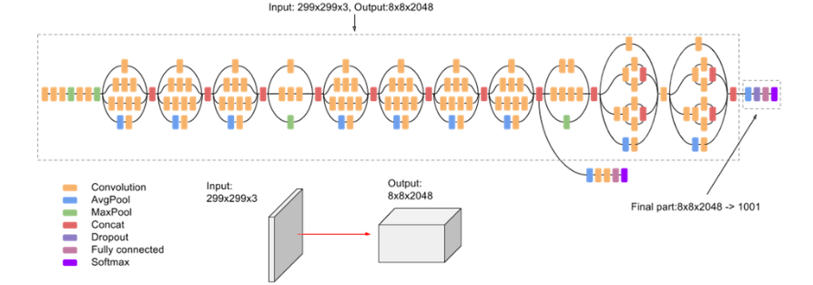
TECHNIQUES USED
Transfer Learning
InceptionV3 architecture
Convolution Neural Network
KNN
Random Forest
InceptionV3 Architecture

Slide 5
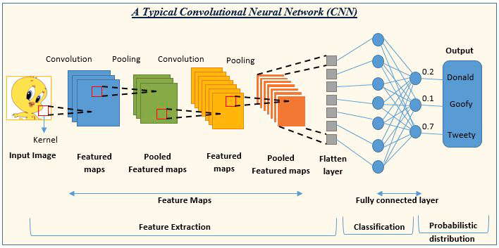
METHODOLOGY
Data Collection
Data Preprocessing
Model
Results

Slide 6
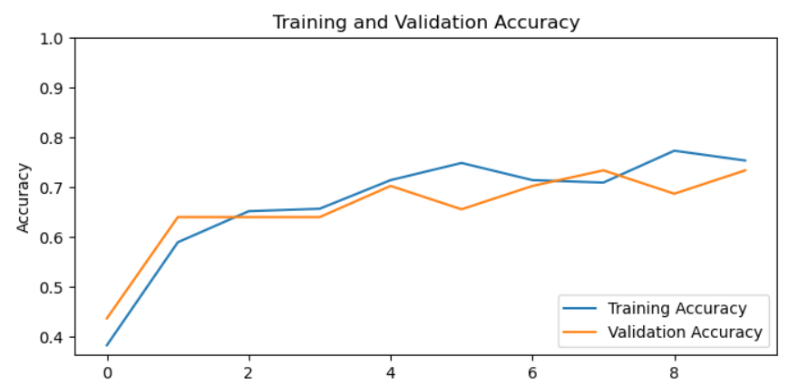
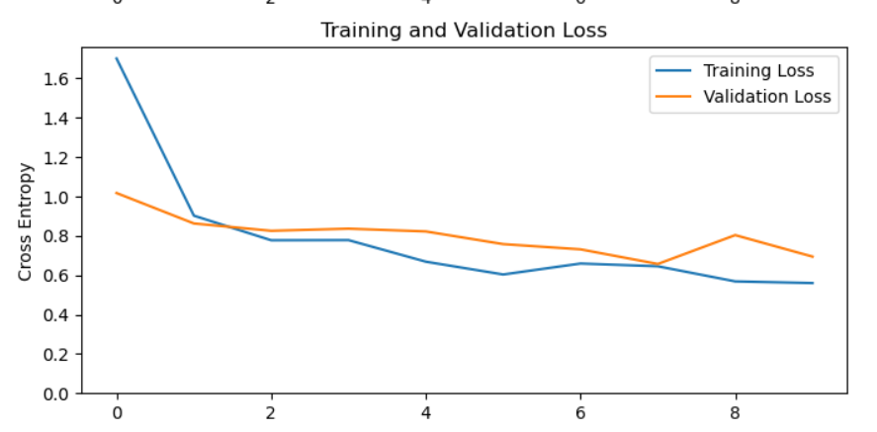
VISUALIZATIONS

Slide 7
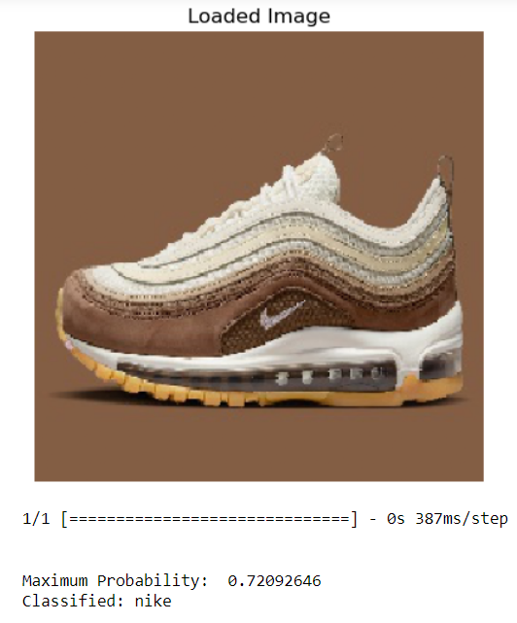
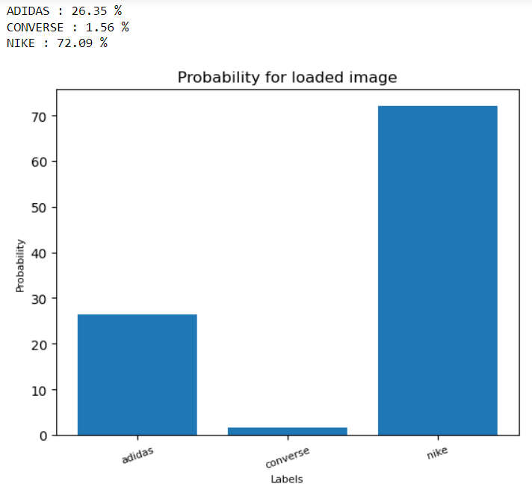
RESULTS

Slide 8
CONCLUSION
Task: Image classification for shoe brands (Adidas, Converse, Nike).
Model: Deep learning based on InceptionV3 architecture.
Results: Achieved 75.36% test accuracy, demonstrating generalization.
Practical Applicability
Successful classification of brand logos.
Model's relevance in real-world scenarios.

Slide 9
Future Improvements
Data Augmentation
Fine-Tuning
Hyperparameter Tuning
Regularization
Ensemble Learning
Interpretability
Continuous Monitoring

Slide 10
THANK YOU

