Slide 1
MGMT-571 KAGGLE COMPETITION PRESENTATION
Team Data Drillers

Slide 2



Our Team: Data Drillers
Mohinder Pal Goyal
Maharshi Dutta
Zaid Ahmed

Slide 3
COMPETITION BACKGROUND:
Problem Statement: To develop a predictive model that combines various econometric measures to foresee a financial condition (Bankruptcy or not) of a firm.
Data Description:
Training Data- 10000 observations
Test Data – 5000 observations

Slide 4
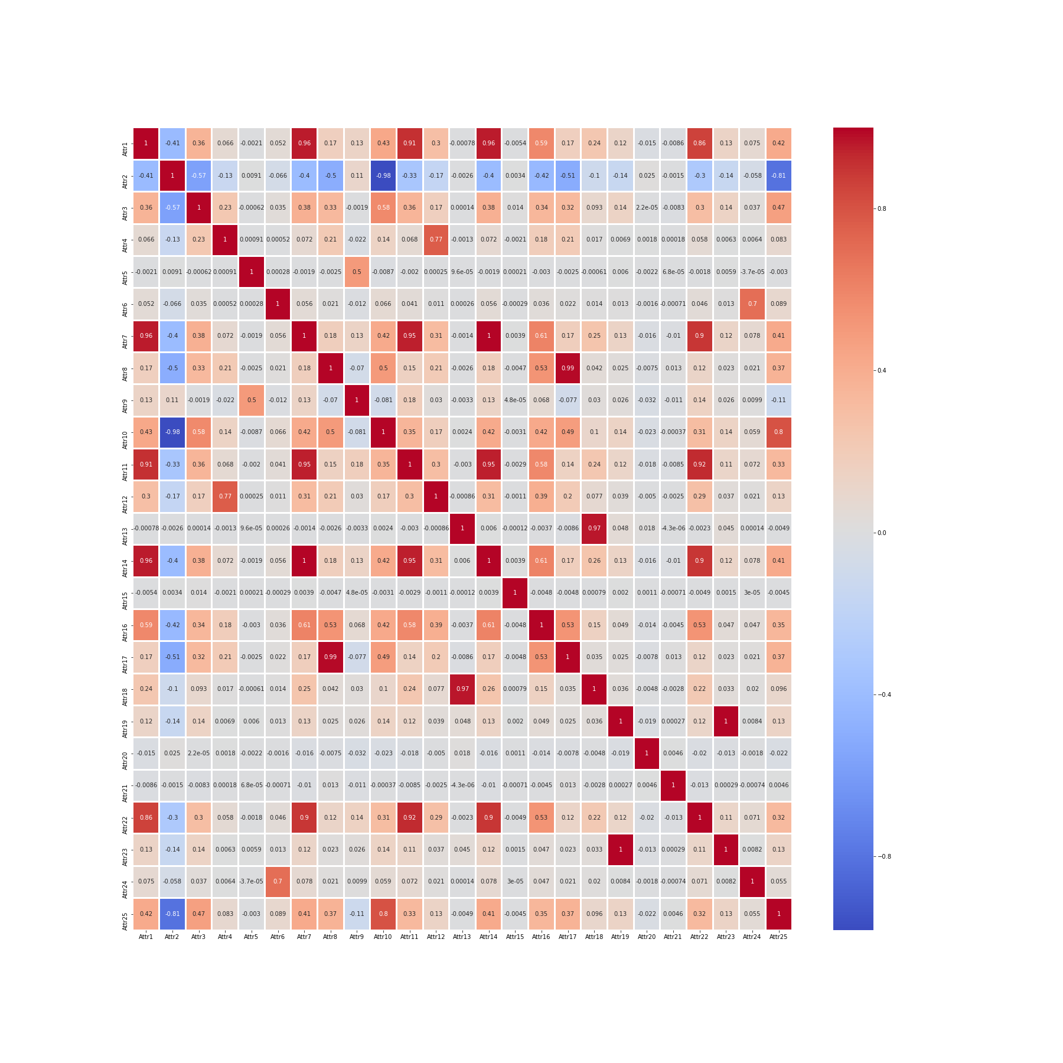
DATA DESCRIPTION:
64 Attributes
High correlation was expected

Slide 5
EDA: Imbalance Data

Slide 6
EDA: Imbalance Data
Problem: The Train Data provided to us was highly skewed.
>99%
<1%
*Source: Data Provided

Slide 7
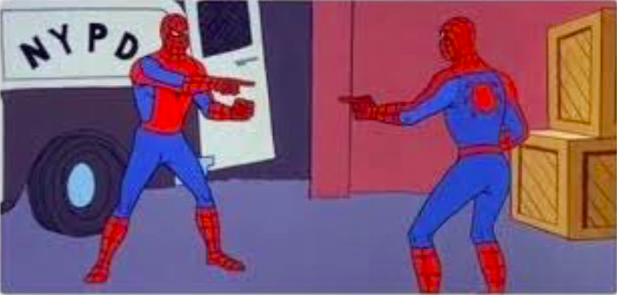
EDA: Row Duplication
Surprisingly there were multiple duplication of rows in our train data set.
We used drop_duplicate to clean up the data.

Slide 8
MODELS USED:
01
Enterprise Miner
Neural Networks
Decision Tree
Gradient Boosting
Logistic Regression
LARS - Lasso
Decision Tree
LARS- Adaptive Lasso
HP SVM
HP Tree

Slide 9
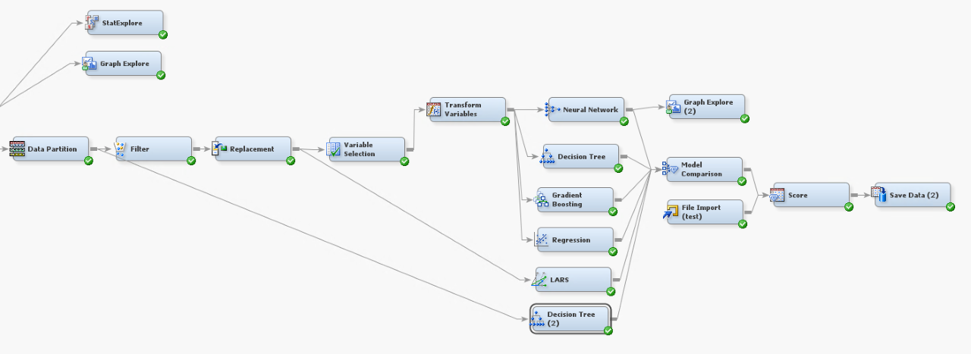
ENTERPRISE MINER - 1

Slide 10
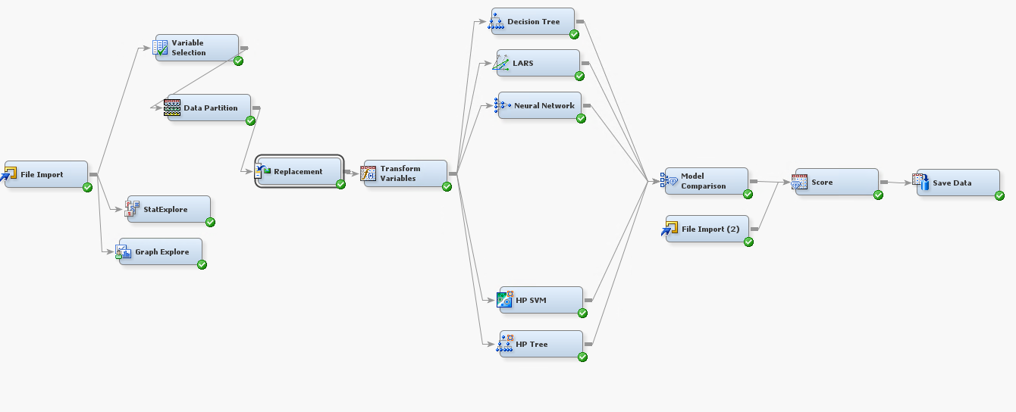
ENTERPRISE MINER - 2

Slide 11
MODELS USED:
01
Enterprise Miner
02
R-Studio: H2O
Neural Networks
Decision Tree
Gradient Boosting
Logistic Regression
LARS - Lasso
Decision Tree
LARS- Adaptive Lasso
HP SVM
HP Tree
Deep Learning
Random Forest
Gradient Boosting
H20- Auto ML

Slide 12


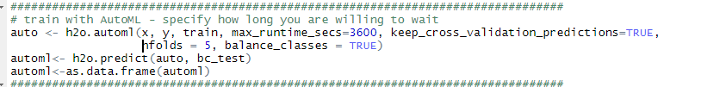
R-Studio: H20

Slide 13
MODELS USED:
01
Enterprise Miner
02
R-Studio: H2O
Neural Networks
Decision Tree
Gradient Boosting
Logistic Regression
LARS - Lasso
Decision Tree
LARS- Adaptive Lasso
HP SVM
HP Tree
Deep Learning
Random Forest
Gradient Boosting
H20- Auto ML
03
Python: AutoML & PCA
Auto ML
PCA

Slide 14
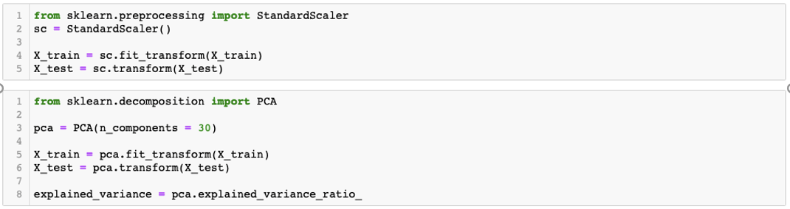
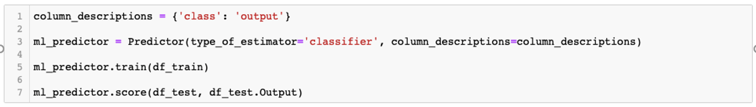
Python: AutoML + PCA

Slide 15
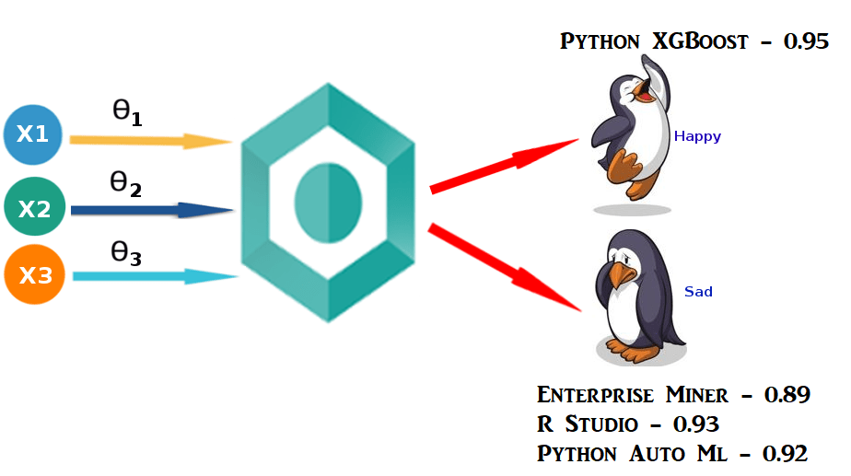
Result Summary:
USED

Slide 16
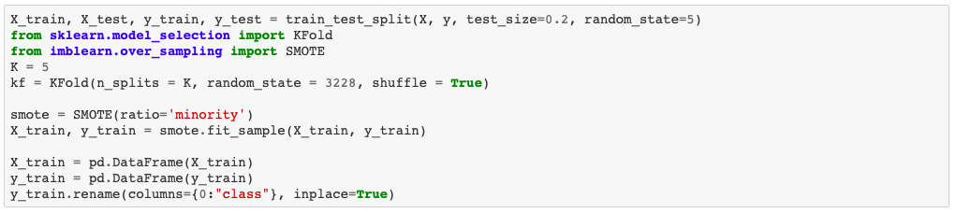
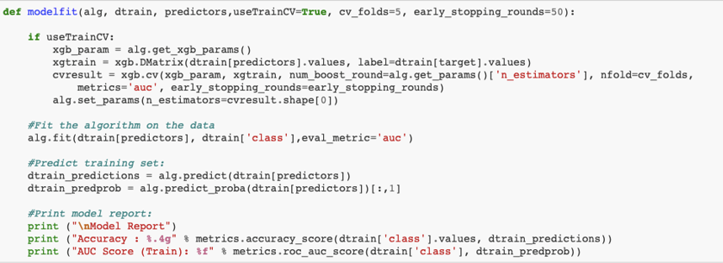
Python: XGBoost + Smote + Hyperparameter

Slide 17
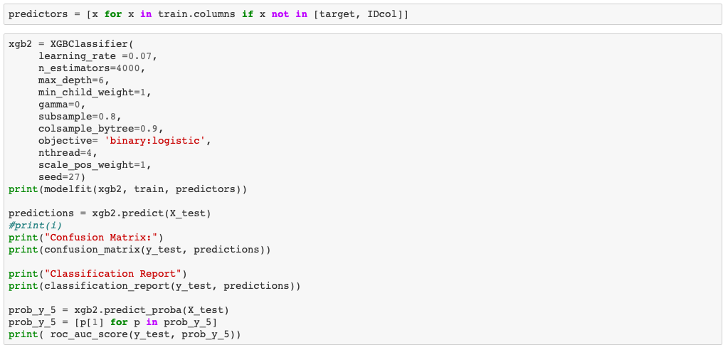
Python: XGBoost + Smote + Hyperparameter

Slide 18
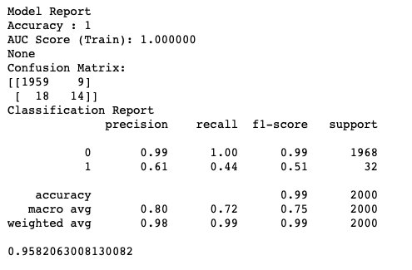
Output of Final Model

Slide 19
THANK YOU!
dutta33@purdue.edu
goyal52@purdue.edu
ahmed152@purdue.edu
Do you have any feedback or suggestions?

Slide 20
Appendix:
References:
https://www.analyticsvidhya.com
https://towardsdatascience.com
https://elitedatascience.com

