Slide 1
MGMT 590 Machine Learning
Twitter Sentiment Analysis for Bitcoin Trading Strategy
Kshama Sharma
Prerak Patel

Slide 2
Agenda
04
01
02
03
Project Backdrop
Data Exploration
Natural Language Processing
05
Modelling
Recommendations

Slide 3
01
Project Backdrop

Slide 4

Bitcoin Market
Decentralized digital currency without a central bank or single administrator
Market Cap
$625,665,617,673
As on 7/7/21
(coinmarketcap.com)
Number of bitcoins that can ever exist 21 million
18.5 million Bitcoin in existence

Slide 5
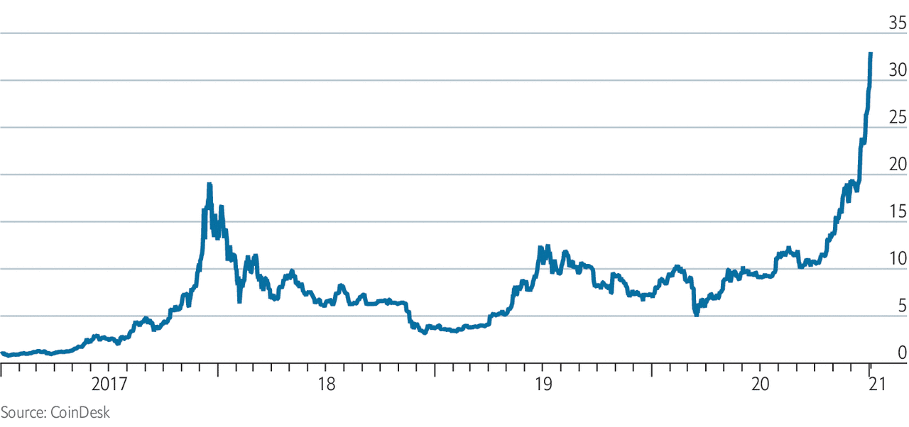
Bitcoin price over years (USD)

Slide 6
Project Objectives
Twitter
Modelling
Understanding general sentiment of Twitter users regarding BTC (at hourly basis)
Translating the sentiment score into an actionable insight to device a BTC trading strategy

Slide 7
02
Data Analysis

Slide 8
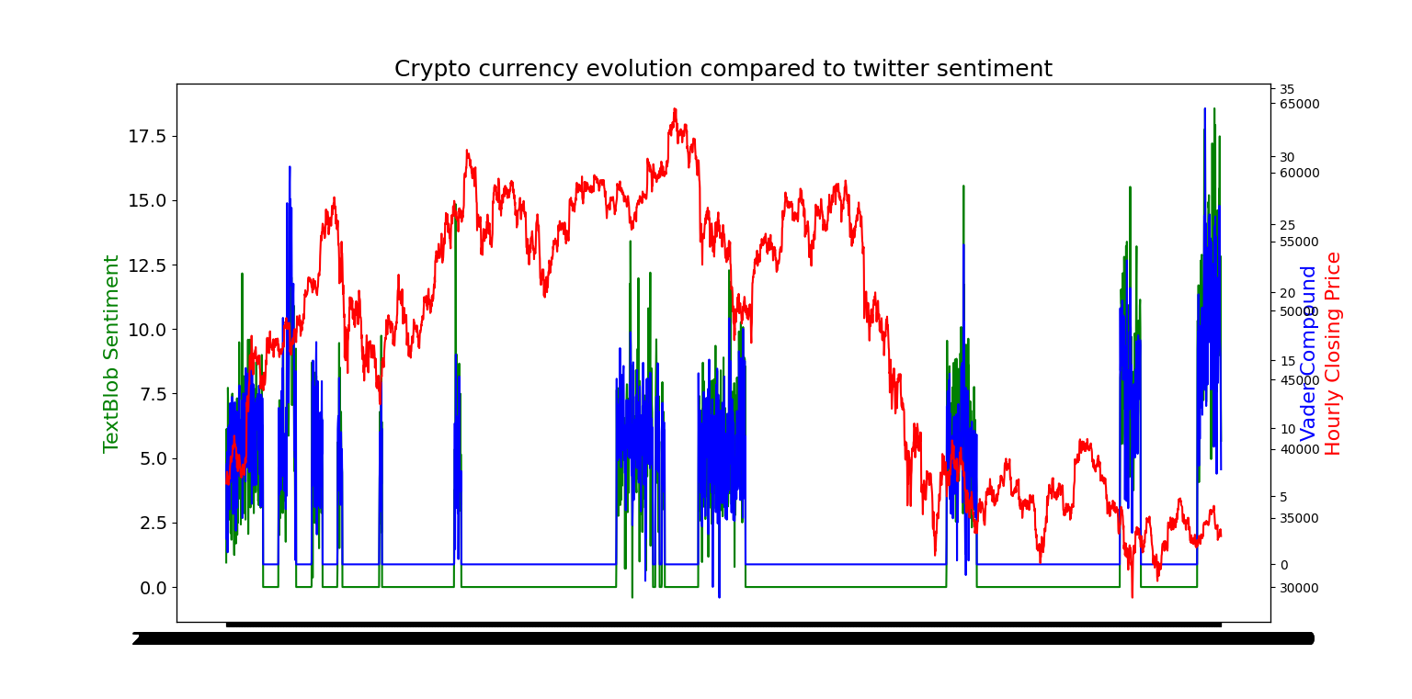

Slide 9
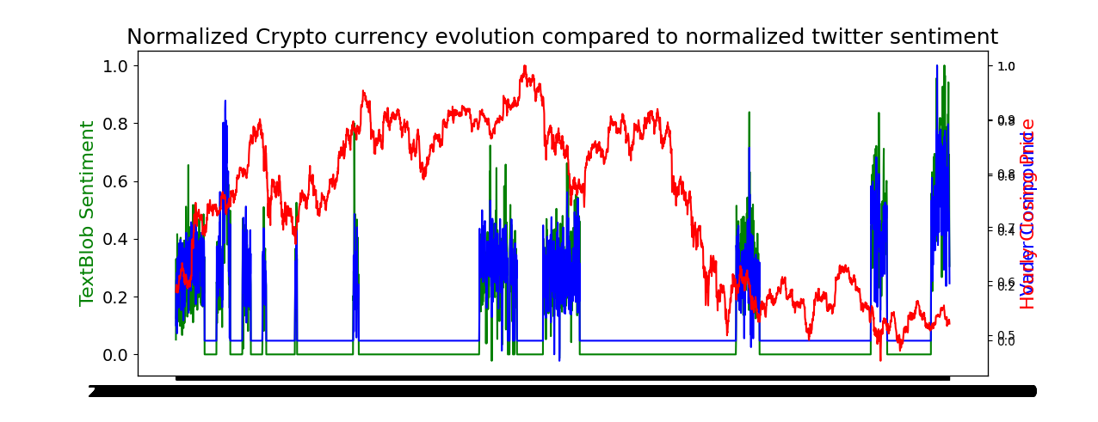

Slide 10
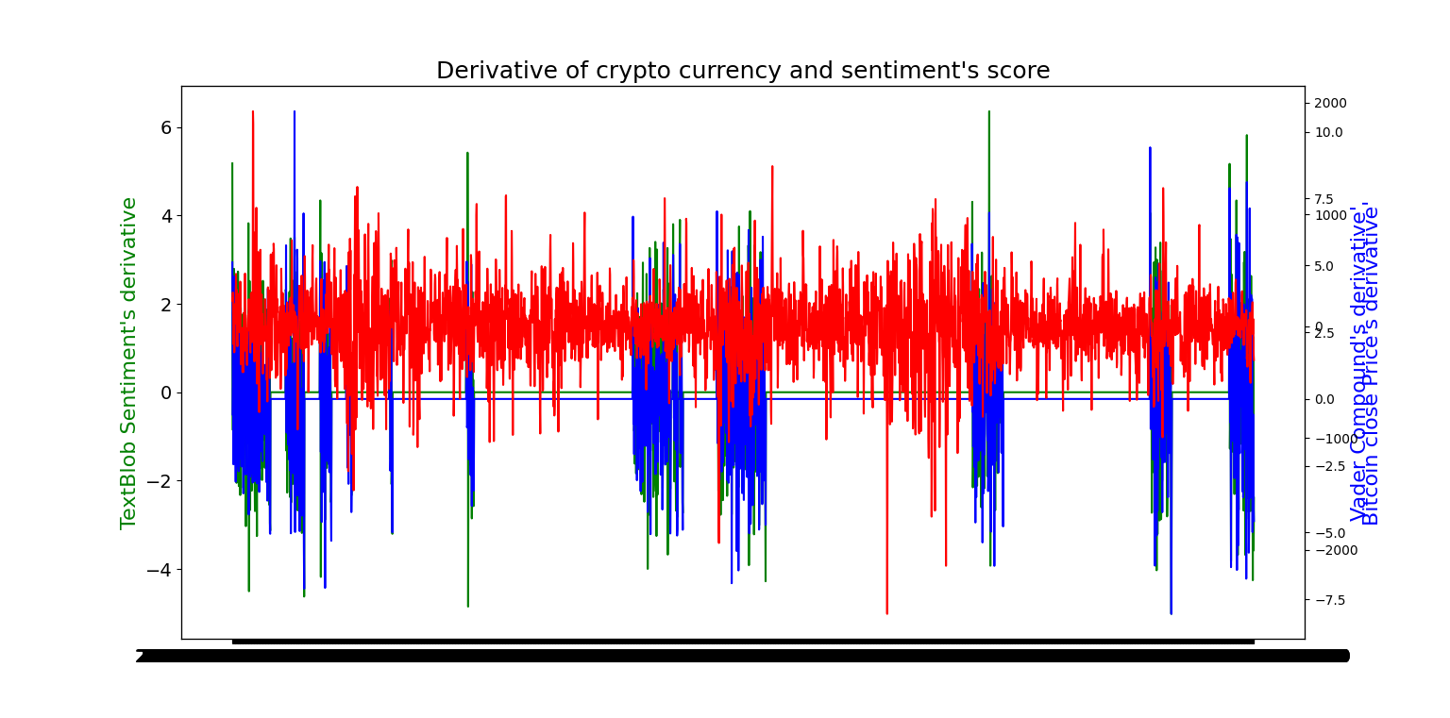

Slide 11
03
Natural Language Processing

Slide 12



TextBlob VaderSentiment
NLP Models
Positive
Tweets
Negative

Slide 13
04
Modelling

Slide 14
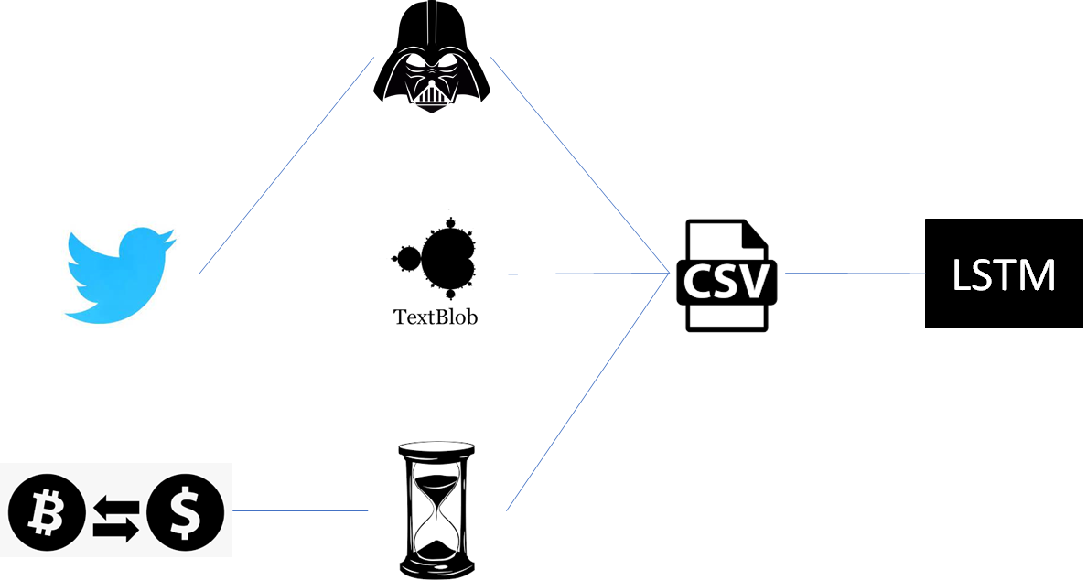

Slide 15

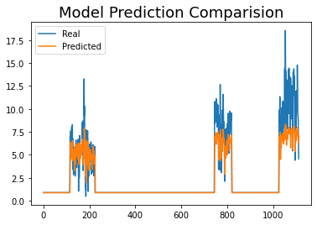
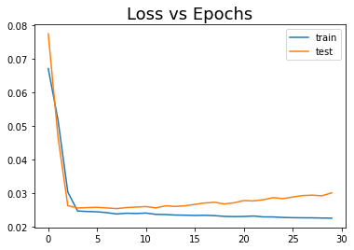
LSTM Model
10.2%
MAPE

Slide 16
05 Recommendations

Slide 17



ARIMA Time-series Forecast
Likes / Re-tweet weighted Sentiment Score
Multi-lingual NLP using M-BERT
Ensemble model for influential account

Slide 18
Thank You

