Slide 1
HEALTHCARE GRIEVANCE SYSTEM (HGS)
Resolve Complaints. Improve Care
MAJOR PROBLEM IN THIS AREA :
Manual/Paper-Based Systems: Many hospitals still rely on paper forms, fax, email inboxes, or sticky notes to capture complaints. This makes tracking, sorting, and reporting incredibly difficult.
Slow Routing and Assignment: It takes too long to get a complaint from the initial submission to the correct staff member who can actually resolve it. This prolongs resolution time and increases patient frustration.
No Feedback Loop: The organization rarely collects formal satisfaction ratings on how well a complaint was resolved, meaning they don't know if their resolution process actually satisfied the patient.
Inconsistent Communication: Different staff members may provide different updates or use varying internal processes, leading to confusion and eroding patient trust.

Slide 2
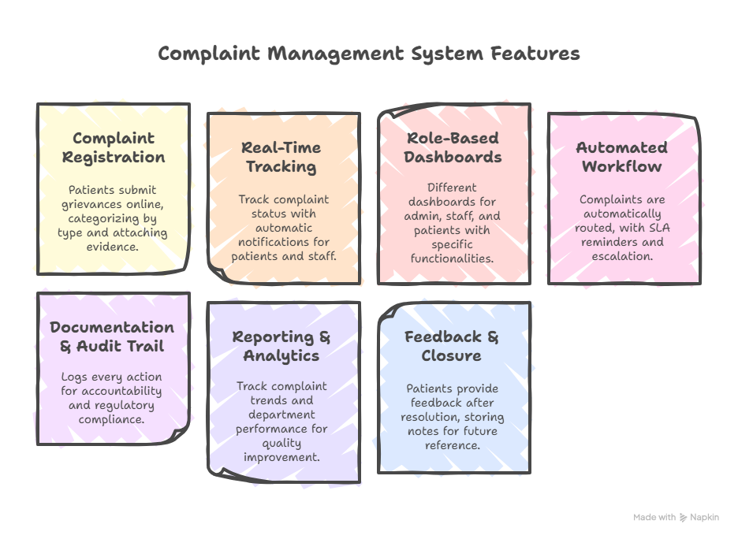
HEALTHCARE GRIEVANCE SYSTEM (HGS)
Resolve Complaints. Improve Care

Slide 3
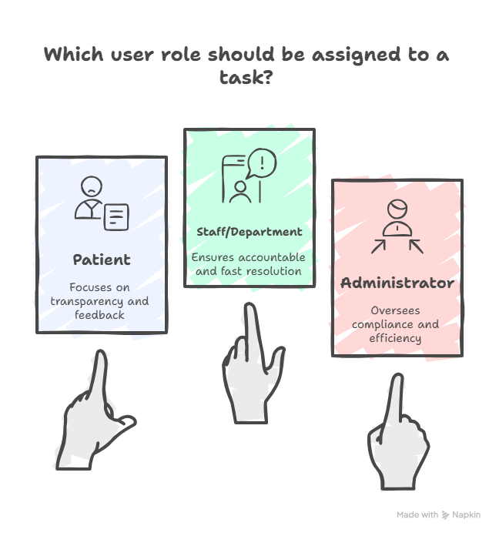
Key User Roles in HGS

Slide 4
Tech Stack
Layer | Technology
Front-End | HTML , CSS , JS
Back-End | Java with Spring Boot
Database | MySQL
Styling/UI | Tailwind CSS (or pure CSS/SASS) | .

Slide 5
TOOLS
Component | Tool/Service
API Testing | Postman
Version Control | Git & GitHub
Deployment | Vercel / Netlify (Front-End) & AWS / DigitalOcean / Render (Back-End/DB)

Slide 6
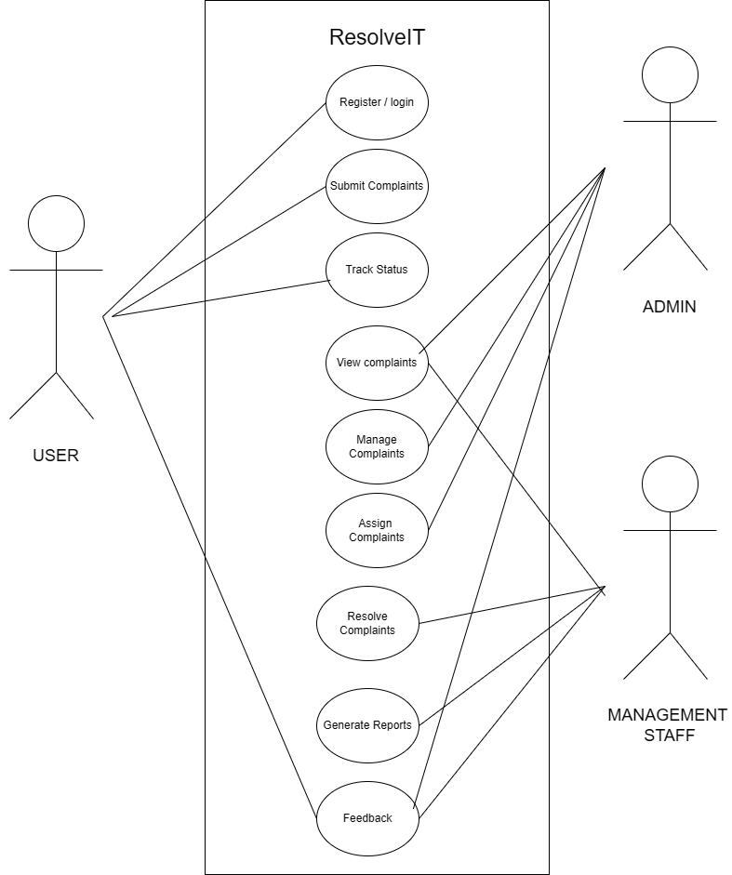
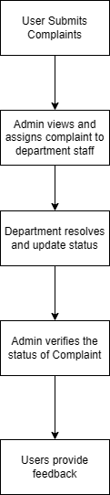
Use Case Diagram and flow diagram

Slide 7
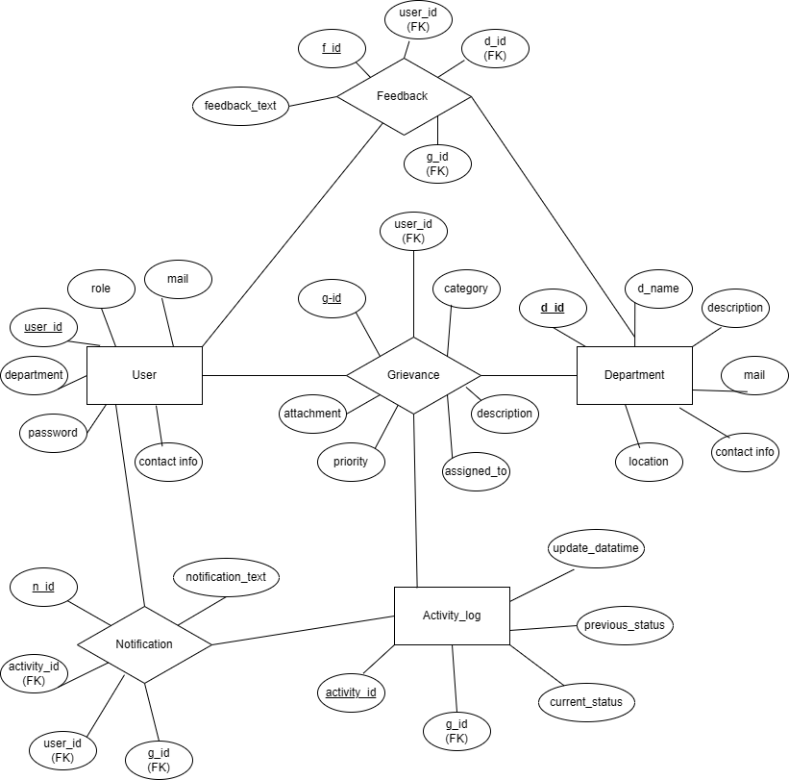
Entity Relationship Diagrams

Slide 8
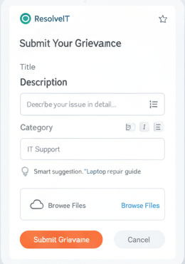
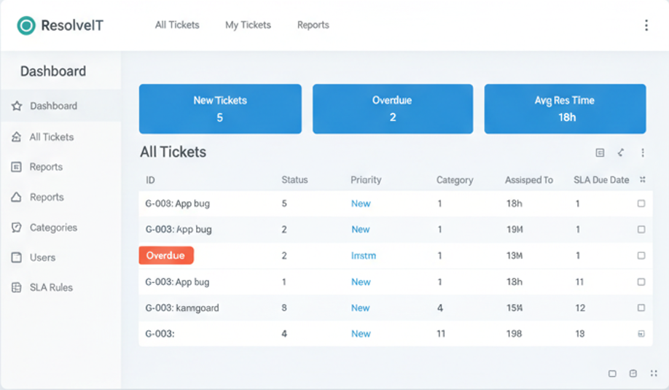
User interface

Slide 9
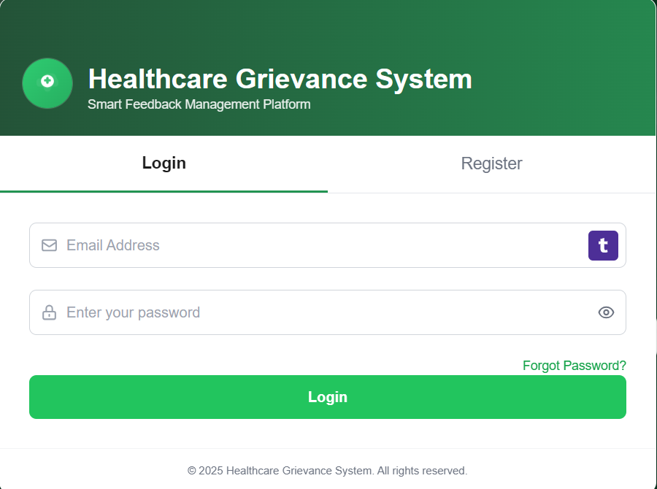
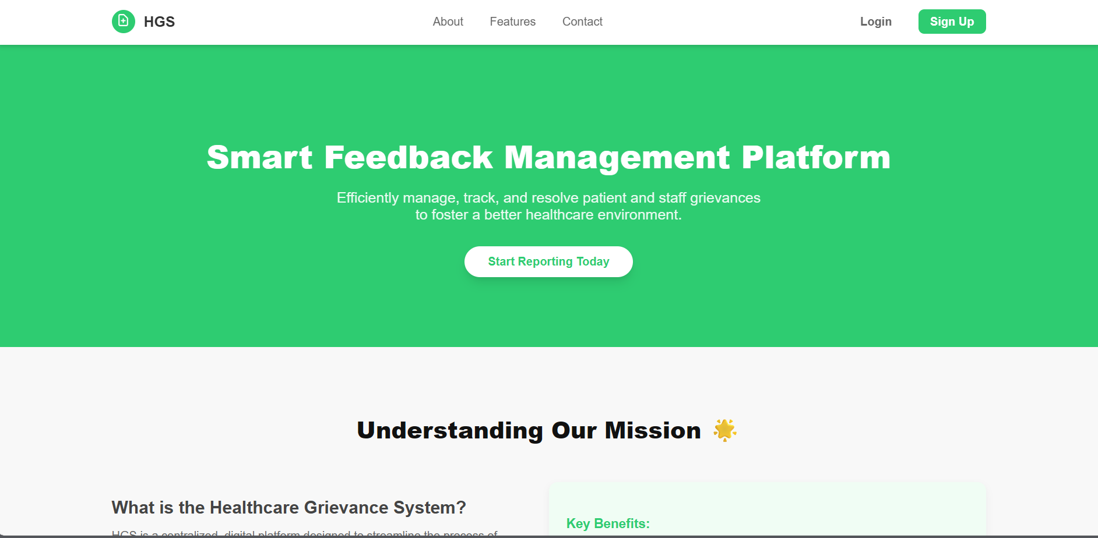
User interface

Slide 10
To do list
Phase 1: Front-End Core & Structure (UI/UX)
 | Task Description | Status
 | Finalize Login/Register UI | Done
 | Complete Home Page | Done
 | Complete Patient Dashboard UI | Done
 | Complete Admin Dashboard UI | Done
 | Design Staff Dashboard UI (similar structure to Admin) | Done

Slide 11
TO DO LIST
Phase 2: Back-End Setup & Data Handling (Server-Side)
 | Task Description | Status | Target Technology
 | Set up Back-End Framework (e.g., Node.js, Python/Django, PHP/Laravel) | TO BE DONE | Server
 | Design and Implement Database Schema (Tables for Users, Grievances, Feedback, Categories). | TO BE DONE | Database (SQL)
 | Develop User Authentication API (Login/Logout/Registration endpoints). | TO BE DONE | Back-End API
 | Implement Role-Based Access Control (RBAC) to distinguish Admin, Staff, and Patient users. | TO BE DONE | Back-End Logic
 | Configure Postman Collections for all core API endpoints (Test environment). | TO BE DONE | Postman

Slide 12
Future Scope
Mobile App: Create a dedicated mobile application for patients to submit
feedback and track their grievance status instantly.
Real-Time Chat: Add a secure chat feature allowing direct, instant communication
between the reporter (Patient) and the assigned staff member for fast clarification.
Multi-Lingual Support: Implement features for automated language translation to better
serve diverse user groups.

