Slide 1
Pos tagging with HMM & SVM
Cognitive Robotics – D’ Amicis & Romeo

Slide 2
Dataset
1
Cognitive Robotics – D’ Amicis & Romeo

Slide 3
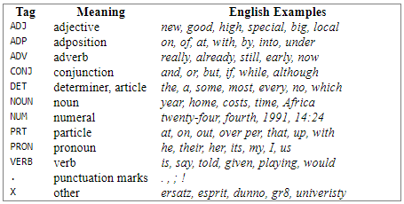
Brown Corpus
500 samples of English-language text from works published in the United States in 1961
1’100’000 million words
56’000 different words
Universal Tagset
Twelve universal part-of speech categories
Cognitive Robotics – D’ Amicis & Romeo

Slide 4
Brown Corpus
Accuracy achieved on the brown corpus (considering 80% train set and 20% test set on the entire corpus):
Corpus | Default (%) | Regex (%) | Unigram (%) | Bigram (%) | Trigram (%) | Comb. Of Taggers (%)
Brown | 10.99 | 25.78 | 87.70 | 33.88 | 19.20 | 91.33
Reference: https://file.scirp.org/pdf/JCC_2014031816034234.pdf
Cognitive Robotics – D’ Amicis & Romeo

Slide 5
HMM Pos Tagger
2
Cognitive Robotics – D’ Amicis & Romeo

Slide 6
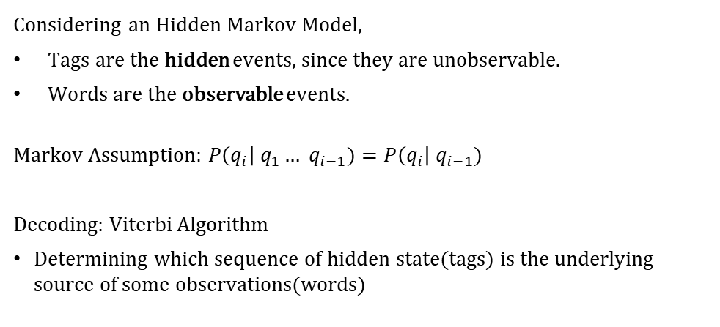
HMM
Considering an Hidden Markov Model,
Tags are the hidden events, since they are unobservable.
Words are the observable events.
Markov Assumption: $P\left(q_{i}\right| q_{1}… q_{i−1})=P\left(q_{i}\right| q_{i−1})$
Decoding: Viterbi Algorithm
Determining which sequence of hidden state(tags) is the underlying source of some observations(words)
Cognitive Robotics – D’ Amicis & Romeo

Slide 7
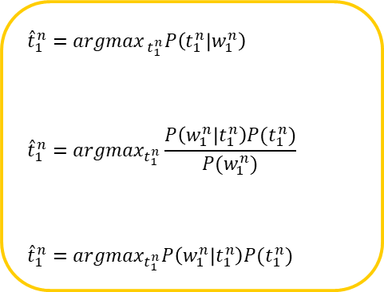

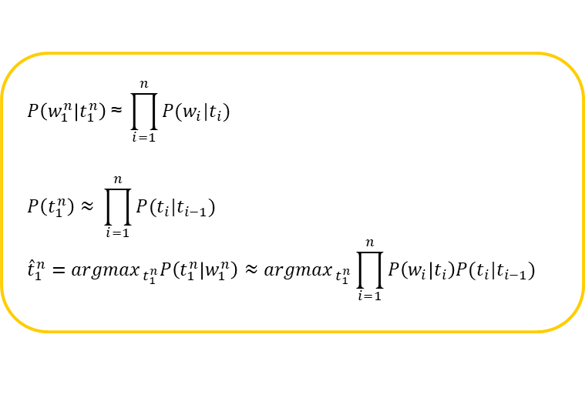
How does it work?
$${\hat{t}}_{1}^{n}={argmax}_{{ t}_{1}^{n}}P\left(t_{1}^{n} | w_{1}^{n}\right)$$
$${\hat{t}}_{1}^{n}={argmax}_{t_{1}^{n}}\frac{P\left(w_{1}^{n} | t_{1}^{n}\right)P(t_{1}^{n})}{P(w_{1}^{n})}$$
$${\hat{t}}_{1}^{n}={argmax}_{t_{1}^{n}}P\left(w_{1}^{n} | t_{1}^{n}\right)P(t_{1}^{n})$$
$$P\left(w_{1}^{n} | t_{1}^{n}\right) \text{≈} \prod_{i=1}^{n}{P(w_{i}|t_{i})}$$
$$P\left(t_{1}^{n}\right)≈ \prod_{i=1}^{n}{P(t_{i}|t_{i−1})}$$
$${\hat{t}}_{1}^{n}={argmax}_{{ t}_{1}^{n}}P\left(t_{1}^{n} | w_{1}^{n}\right)≈{argmax}_{{ t}_{1}^{n}}\prod_{i=1}^{n}{P\left(w_{i} | t_{i}\right)P(t_{i}|t_{i−1})}$$
$P\left(w_{i} | t_{i}\right)$ = Emission probability
$P(t_{i}|t_{i−1})$ = Transition probability
Cognitive Robotics – D’ Amicis & Romeo

Slide 8
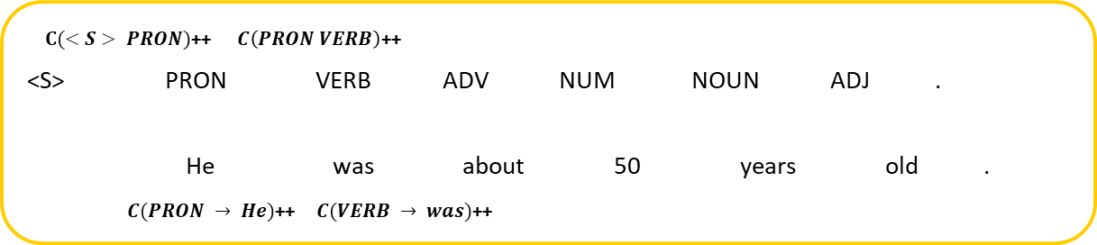
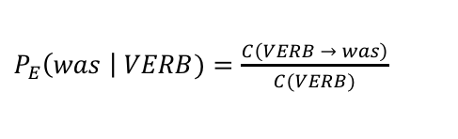
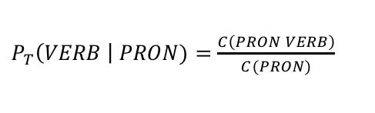
Learning Markov Models
Count the number of occurences in the corpus
Sentence: ”He was about 50 years old.”
$C(<S> PRON)$++ $C\left(PRON VERB\right)$++
<S> PRON VERB ADV NUM NOUN ADJ .
He was about 50 years old .
$C(PRON → He)$++ $C(VERB → was)$++
Divide by the context to get probability
$P_{T}\left(VERB \right| PRON)=\frac{C\left(PRON VERB\right)}{C(PRON)}$
$P_{E}\left(was \right| VERB)=\frac{C\left(VERB → was\right)}{C(VERB)}$
Cognitive Robotics – D’ Amicis & Romeo

Slide 9












Viterbi decoding
He was about 50 years old .
<S>
PRON
VERB
PRT
NUM
X
ADJ
.
$$0.002$$
$$7.3e−04$$
$$3.5e−08$$
$$1.3e−10$$
$$1.4e−17$$
$$1.3e−17$$
$$4.2e−19$$
X
X
NOUN
$$7.6e−07$$
$$9.8e−11$$
$$1.7e−13$$
ADP
$$9.9e−07$$
ADV
$$7.1e−07$$
Cognitive Robotics – D’ Amicis & Romeo

Slide 10
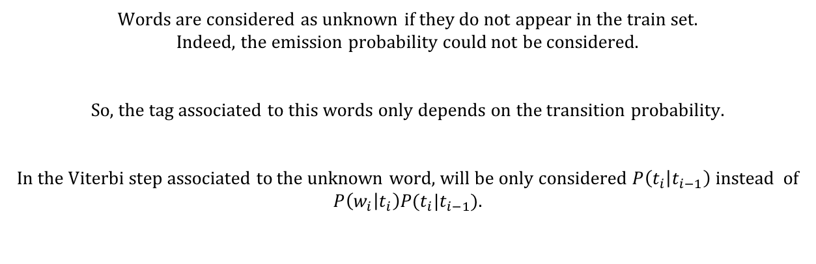
Unknown words
Words are considered as unknown if they do not appear in the train set.
Indeed, the emission probability could not be considered.
So, the tag associated to this words only depends on the transition probability.
In the Viterbi step associated to the unknown word, will be only considered $P\left(t_{i} | t_{i−1}\right)$ instead of $P\left(w_{i} | t_{i}\right)P(t_{i}|t_{i−1})$.
Cognitive Robotics – D’ Amicis & Romeo

Slide 11
Accuracy
93.2%
Train set length: 51606 sentences
Test set length: 5734
Precision: 93.3%
Recall: 93.2%
F-Measure: 93.2%
Cognitive Robotics – D’ Amicis & Romeo

Slide 12
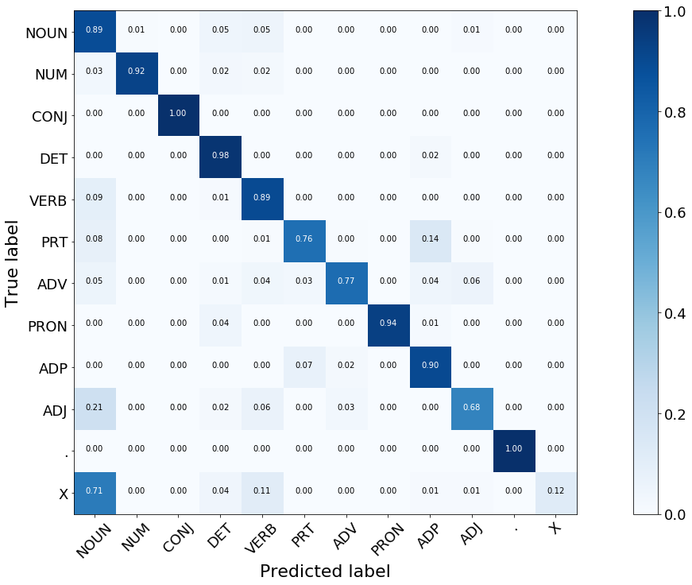
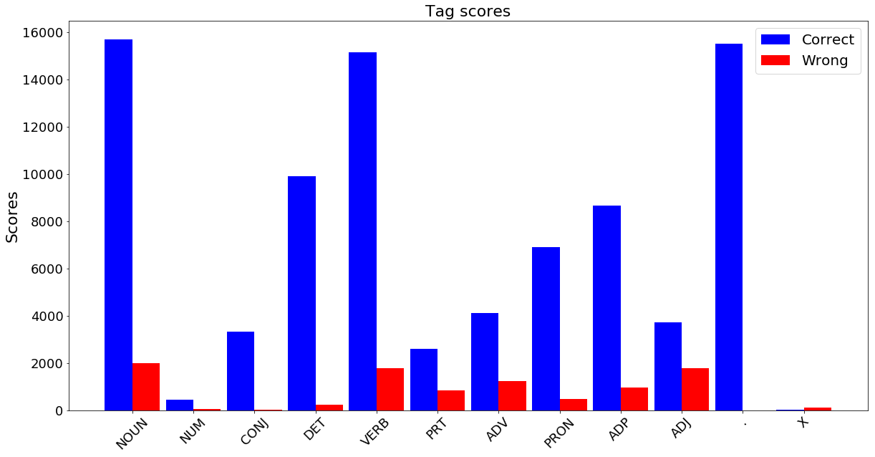
Results
Cognitive Robotics – D’ Amicis & Romeo

Slide 13
Accuracy
90.1%
Train set length: 5000 sentences
Test set length: 5734
Precision: 90.3%
F-Measure: 90%
Cognitive Robotics – D’ Amicis & Romeo

Slide 14
SVM Pos Tagger
3
Cognitive Robotics – D’ Amicis & Romeo

Slide 15
How does it work?
SVM training:
Each training sample is the so-called “word context”.
The “word context” is a set of features defined on/around the interested word ( previous/successive words, tags, suffixes)
Kernel: RBF
Also different kernels has been tried: Linear, sigmoidal and polynomials kernels provided really bad result in term of Accuracy
Cognitive Robotics – D’ Amicis & Romeo

Slide 16
Problem SVM features
The greatest problem has been the mapping between words and vector (also known as Word Embedding) for which different solution has been tried:
One hot
Each word is encoded as a 1-hot vector (where all the elements are 0 except one, which is 1).
Too high-dimensional space, for which the training time was not feasible
Incremental
An incremental number assigned to each word.
Meaningless space representation
Word2Vec
Produce a vector space, with each unique word in the corpus being assigned a corresponding vector in the space (10 dimensions).
Cognitive Robotics – D’ Amicis & Romeo

Slide 17
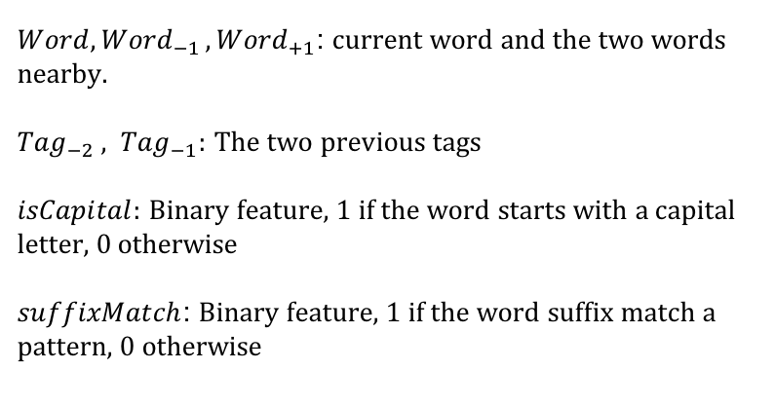
Features Vector
$$[{Word}_{−1} Word{ Word}_{+1} {Tag}_{−2} {Tag}_{−1} isCapital suffixMatch ]$$
$Word, {Word}_{−1 },{Word}_{+1}$: current word and the two words nearby.
${Tag}_{−2} , {Tag}_{−1}:$ The two previous tags
$isCapital:$ Binary feature, 1 if the word starts with a capital letter, 0 otherwise
$suffixMatch$: Binary feature, 1 if the word suffix match a pattern, 0 otherwise
Cognitive Robotics – D’ Amicis & Romeo

Slide 18
Accuracy
88.1%
Train set length: 5000 sentences
Test set length: 5734
Precision: 88.2%
F-Measure: 87.7%
Cognitive Robotics – D’ Amicis & Romeo

Slide 19
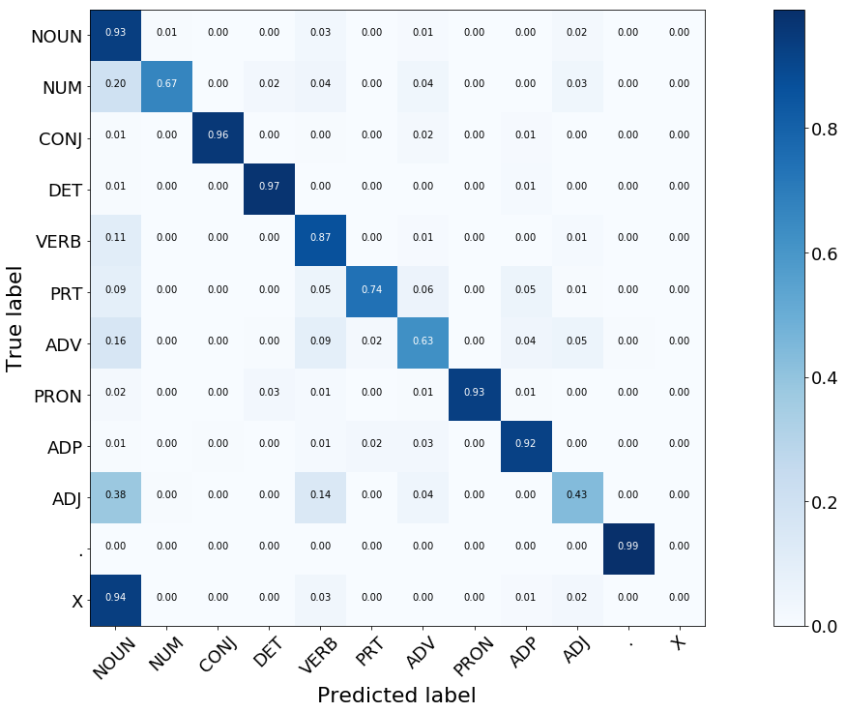
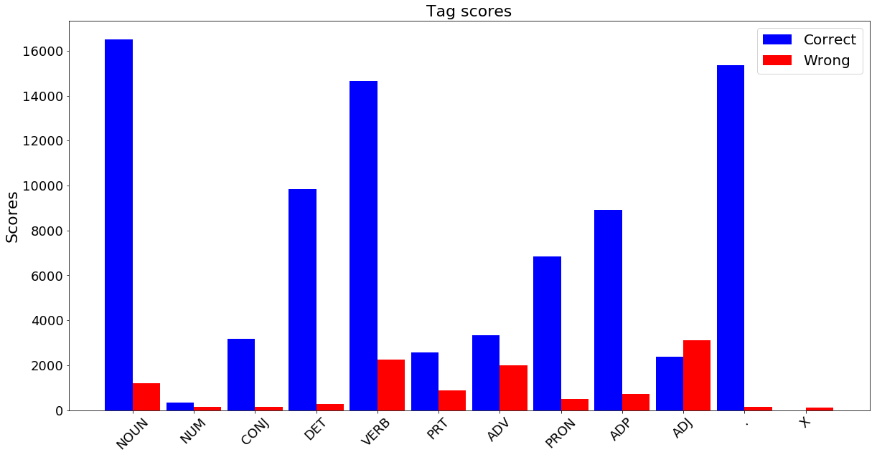
Results
Cognitive Robotics – D’ Amicis & Romeo

Slide 20
Comparison
4
Cognitive Robotics – D’ Amicis & Romeo

Slide 21
Comparison
PROs |  | CONs
HMM | SVM | HMM | SVM
Interpretability Computationally low cost | Addition of right features lead to better results Space representation provide a better unknowns handling | Limitation due to its structure Unknown words handling Out of the ordinary sentences bad predicted | Interpretability Computationally expensive
Cognitive Robotics – D’ Amicis & Romeo

Slide 22
Thanks!
D’Amicis - Romeo
Cognitive Robotic Project – A.A. 2016-2017

