Slide 1
Detecting Phishing URLs using ML
By: Prerana M

Slide 2

Phishing
Attackers deceive users
Attackers impersonate real entities
PHISHING URLs: First point of interaction in phishing attacks
Notes:
Cyberattack
Obtain sensitive information with fraudulent links
attacker lures victims to a counterfeit website where they are persuaded to enter confidential information.

Slide 3
How Phishing URLs work
Fake domains mimicking legitimate one
Overuse of special characters
Long URL lengths
PROBLEM STATEMENT To identify phishing URLs using machine learning and improve detection rates
Legitimate | Phishing
https://www.sbi.co.in/ | https://www.sbi-banking-secure.co.in/
Notes:
Add example of legitimate vs phishing

Slide 4
Dataset Overview
89 features including - url - length_url - nb_dots - nb_hyphens - nb_qm - ip
Target Column: status (Binary classification: Legitimate/Phishing)
Notes:
11k+ rows

Slide 5
Dataset Pre-processing
Removed null/missing values to ensure data integrity
Encoded the target feature: status: 0 (legitimate), 1 (phishing)
IMPORTANCE:
Better model performance
Encoding ensures compatibility

Slide 6
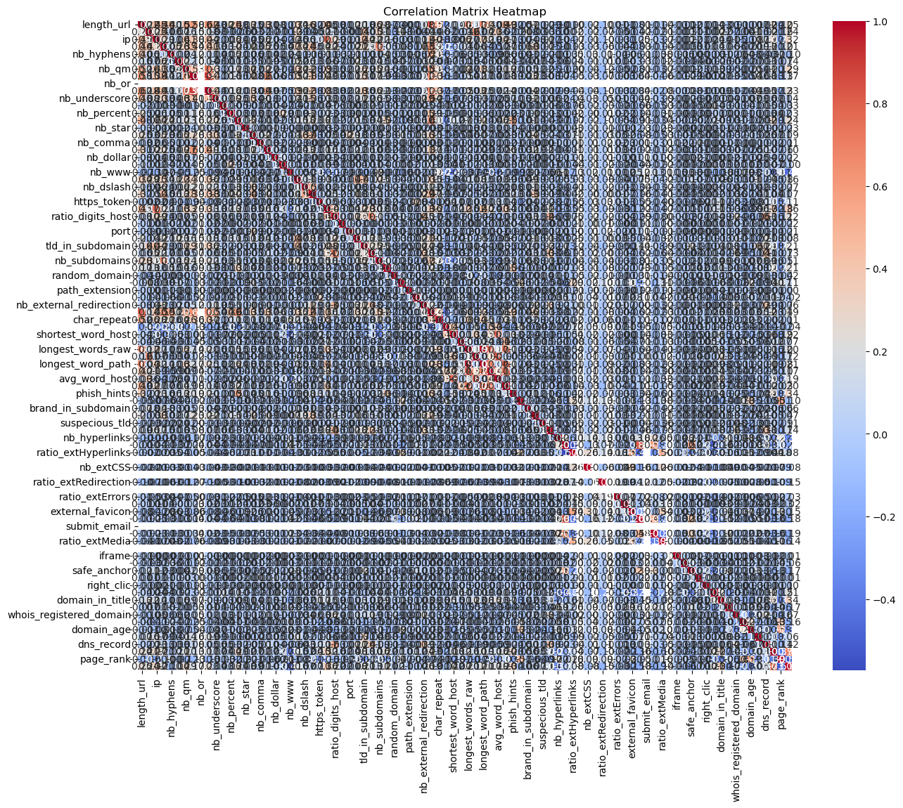
Feature Selection
Correlation Analysis (Features with Target column)
Threshold set: 0.2
Reduced dataset from 89 features to 23 features

Slide 7
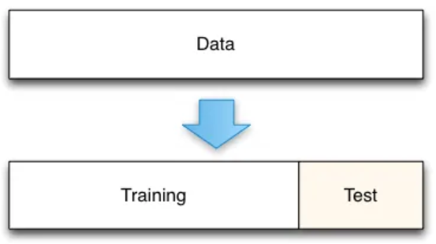
Data Splitting
Training Set: 80% of the dataset
Testing Set: 20% of the dataset

Slide 8
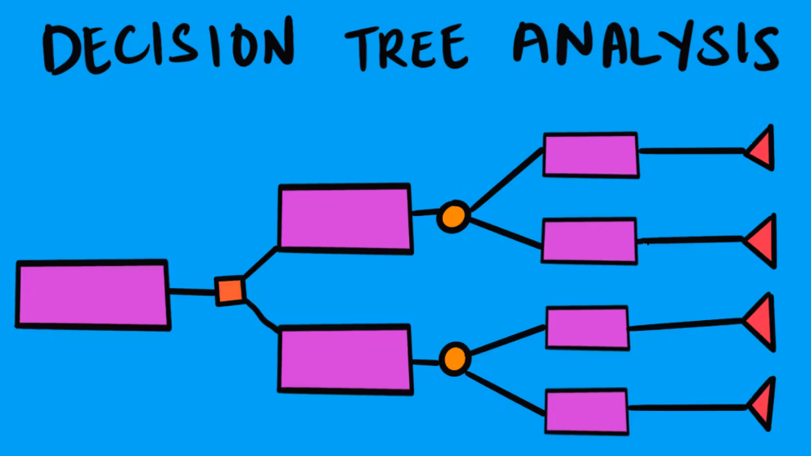
ML Models 1. Decision Tree
Notes:
Simple tree-based model.
Prone to overfitting on complex datasets.
Vacation example: beach/mountains beach- goa, andanman, etc mountains- himachal, leh-ladakh etc at each stage, u narrow the options until u find a destination

Slide 9
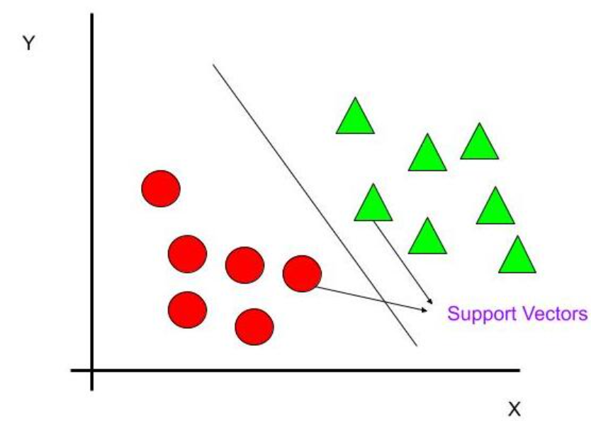
ML Models 2. SVM
Notes:
Effective for smaller datasets.
Computationally intensive.

Slide 10
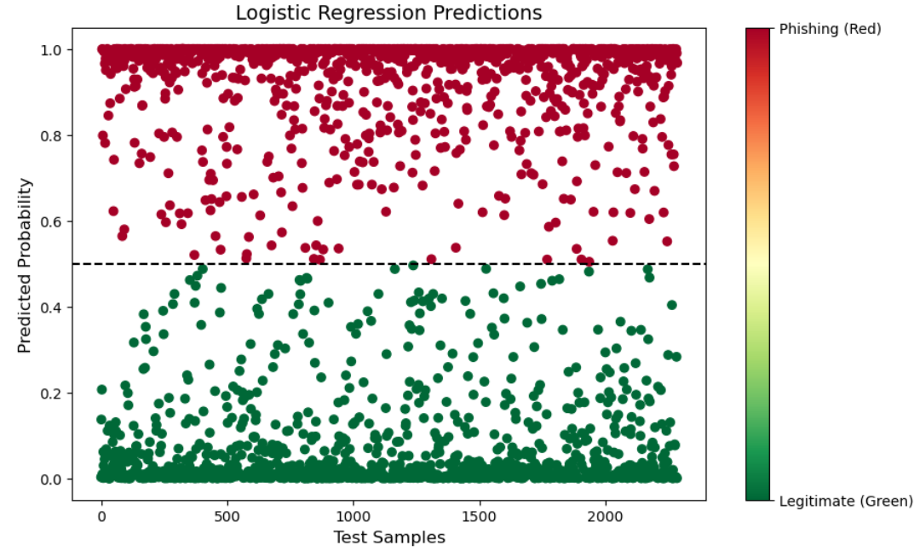
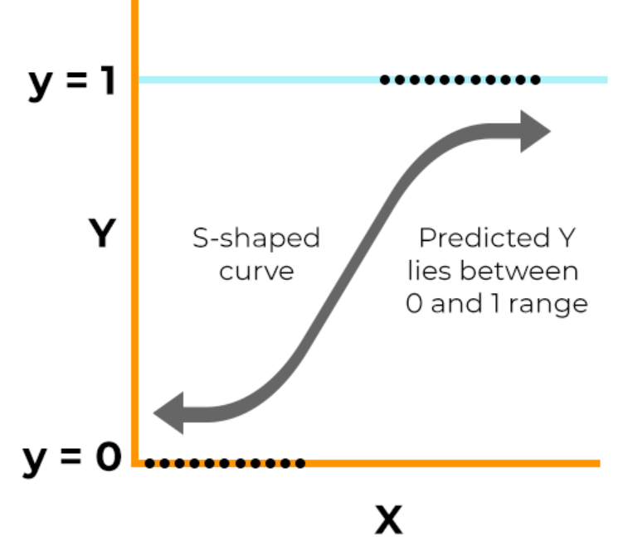
ML Models 3. Logistic Regression
Notes:
Linear model.
Provides interpretable results.

Slide 11
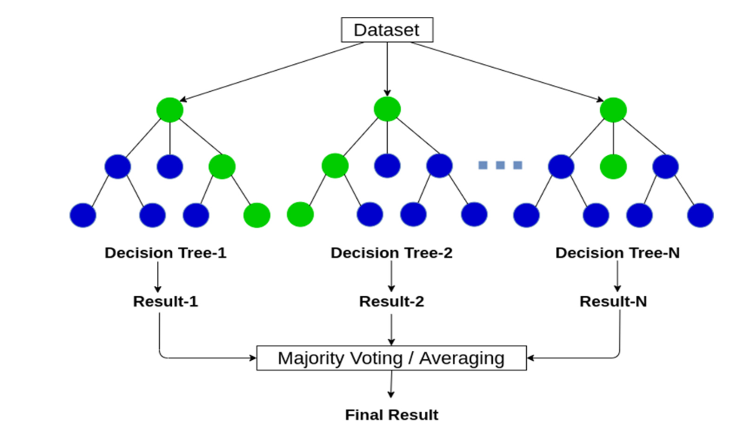
ML Models 4. Random Forest
Notes:
Ensemble-based model.
Handles feature importance well.
.

Slide 12
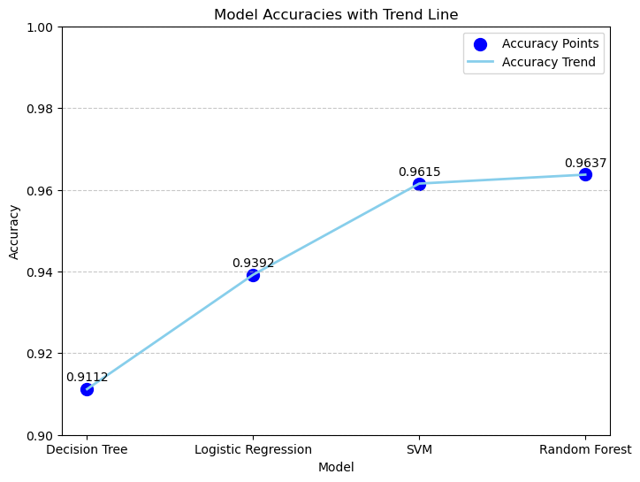
Results

Slide 13
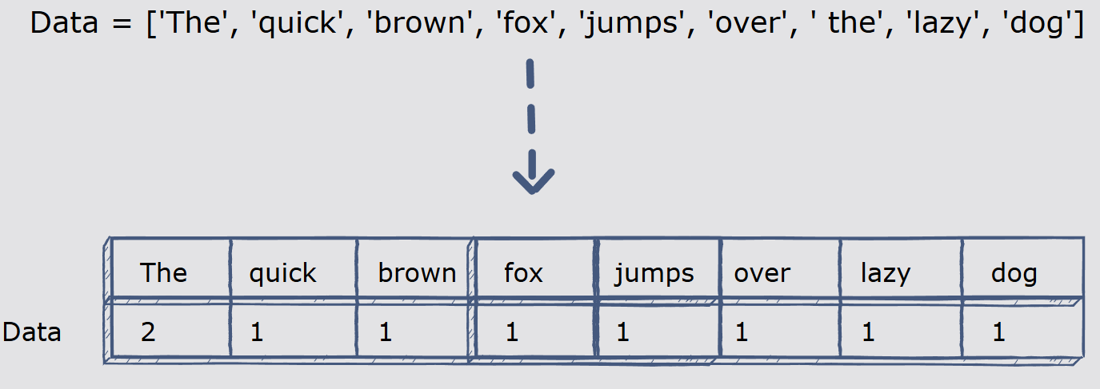
Focus on URL
Count Vectorizer to tokenize and analyze URL text
Trained and tested on Random Forest
ACCURACY = 93%

Slide 14
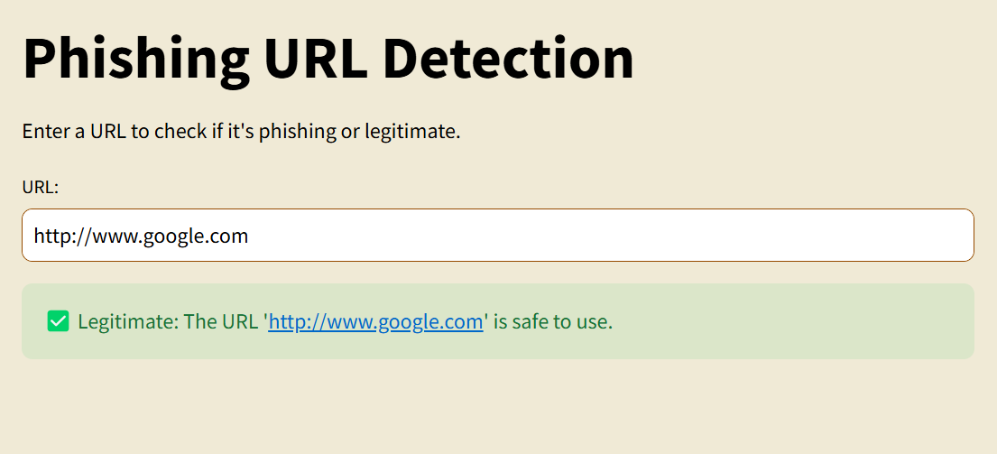
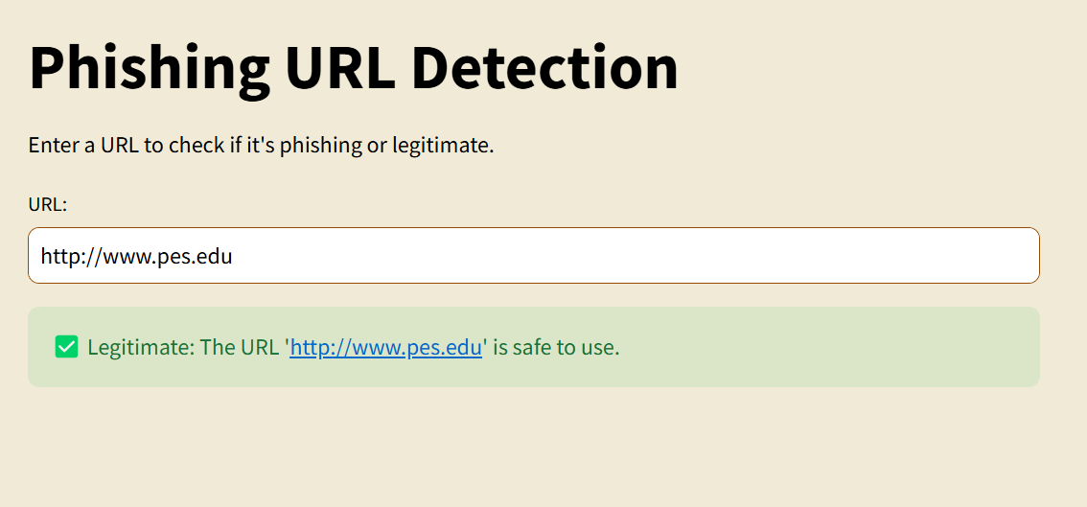
Frontend

Slide 15
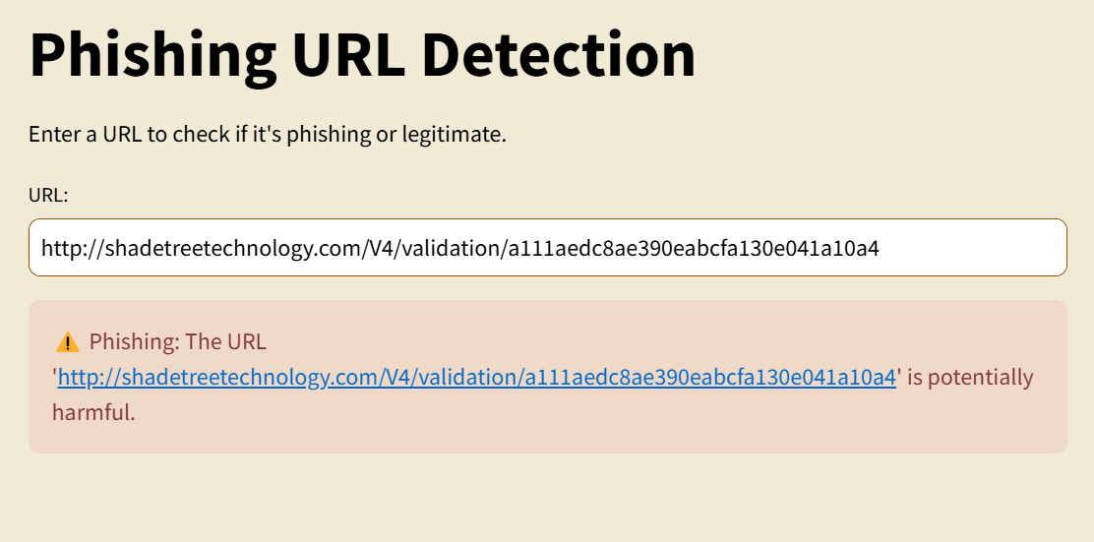
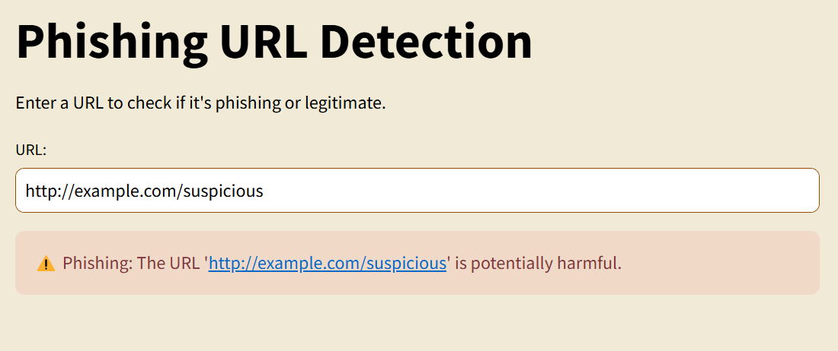
Frontend

Slide 16
THANK YOU

