Slide 1

Cascading Failure Prediction
in Microservices
Pavitra S V 4NI23CS137
Poornima Devangamath 4NI23CS141
Prerana M D 4NI23CS155
Sakshi Rajesh Naik 4NI23CS181
Guide:
Dr. Anitha Raghavendra,
Professor,
Dept. of CS&E, NIE

Slide 2
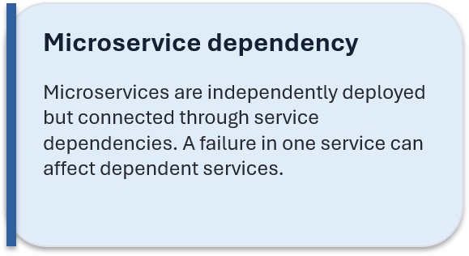
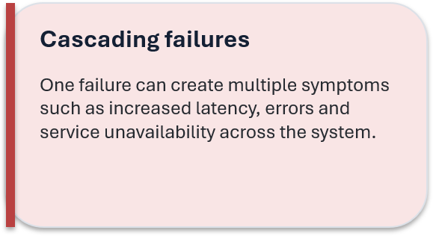
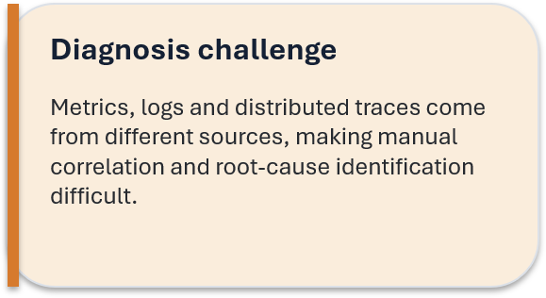
Problem Statement
& Motivation
Need an integrated analysis flow that correlates telemetry and service dependencies.
Identify probable root causes using multiple pieces of evidence.
Understand how the failure can propagate and which services may be affected.
Provide evidence-based recommendations through a unified dashboard

Slide 3
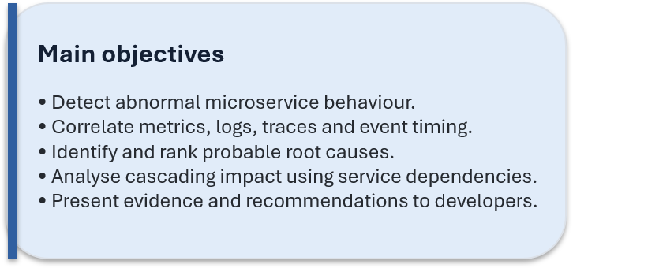
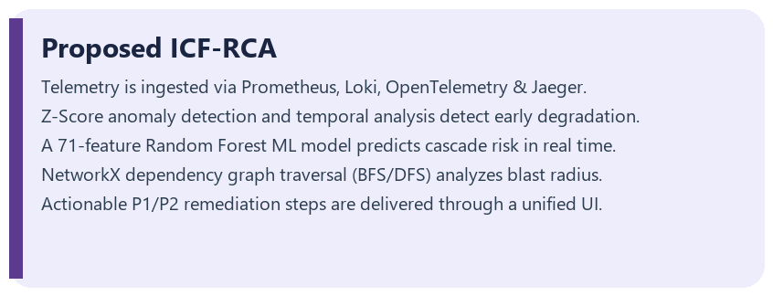
Objectives &
Proposed System

Slide 4
Literature Survey
Paper (Author, Year) | Brief Introduction | Research Gap
Lin et al. (2024) Root Cause Analysis Using Neural Granger Causal Discovery | Identifies the main cause of failures in microservices by analyzing relationships between metrics. | Does not fully analyze how failures spread to other services or provide recovery suggestions.
Pham et al. (2024) – BARO | Detects unusual behavior and identifies possible failure causes using multiple performance metrics. | Limited analysis of how failures affect connected microservices.
Pham et al. (2024) – Causal Inference Review | Studies different methods used to find the causes of failures in microservices. | Does not provide a complete system for failure prediction, impact analysis, and recommendations.
Zhang et al. (2024) Failure Diagnosis in Microservice Systems | Reviews existing failure detection methods, tools, datasets, and techniques. | Does not implement a single system combining failure detection, impact analysis, and recommendations.
Soldani et al. (2025) Explaining Microservices' Cascading Failures From Their Logs | Uses logs to understand how failures occur and spread between microservices. | Mainly depends on logs and does not fully combine metrics, service dependencies, and event timelines.
Zhang et al. (2026) – MHP-RCA | Uses performance metrics and logs to identify the root cause of failures. | Focuses mainly on finding the failure source rather than predicting its impact and suggesting solutions.

Slide 5
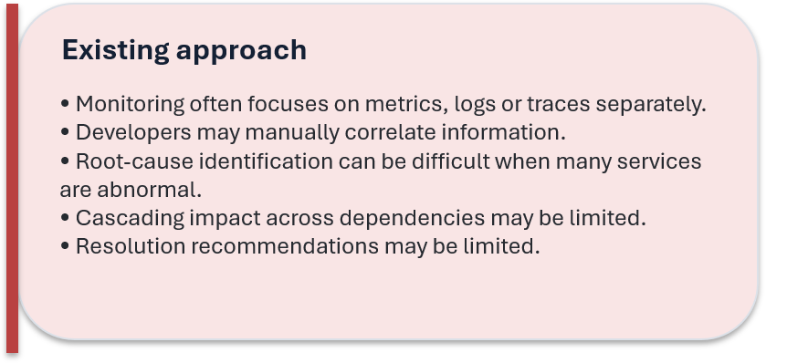
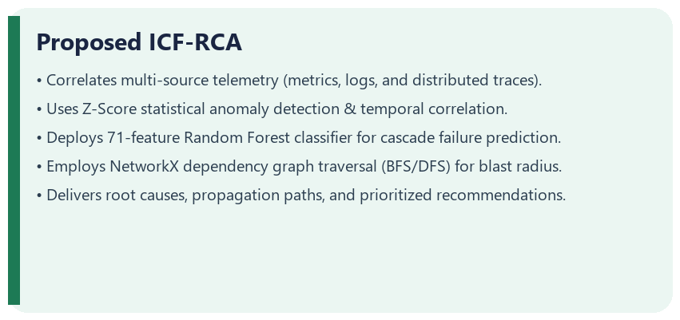
Existing System
vs ProposedSystem

Slide 6
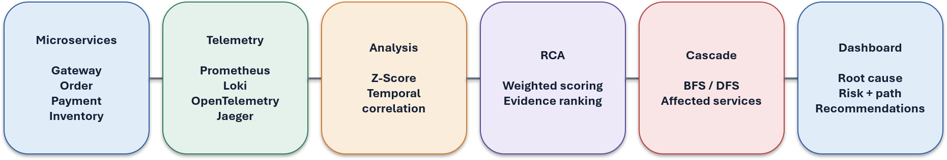
Implementation Architecture & Modules
Frontend: React.js, Vite, TailwindCSS (Developer Dashboard & Client Apps)
Backend Services: Java 21, Spring Boot 3.x REST Microservices, Spring Cloud Gateway
Observability Stack: Prometheus (Metrics), Loki (Logs), OpenTelemetry & Jaeger (Traces)
Storage Layer: MongoDB 7.0 & Local / In-Memory State Cache
Machine Learning & Analytics: Python 3.12, Scikit-Learn (Random Forest, 71 Features), NetworkX
Resilience & Testing: Chaos Fault Lab, JUnit 5, Python unittest (46/46 Automated Tests Passing)
Deployment & Simulation: Docker & Docker Compose Container Stack

Slide 7
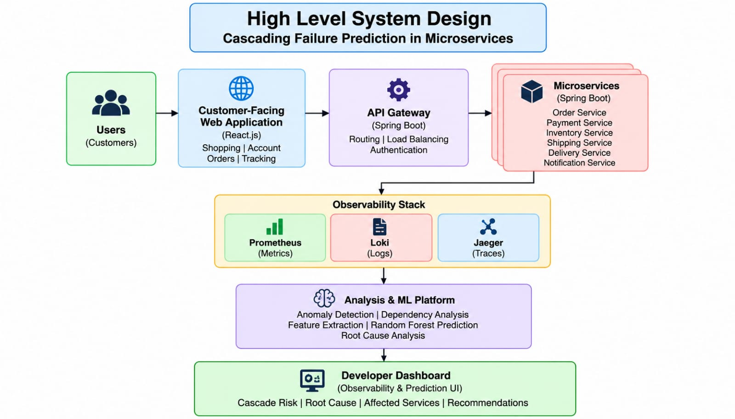

Slide 8
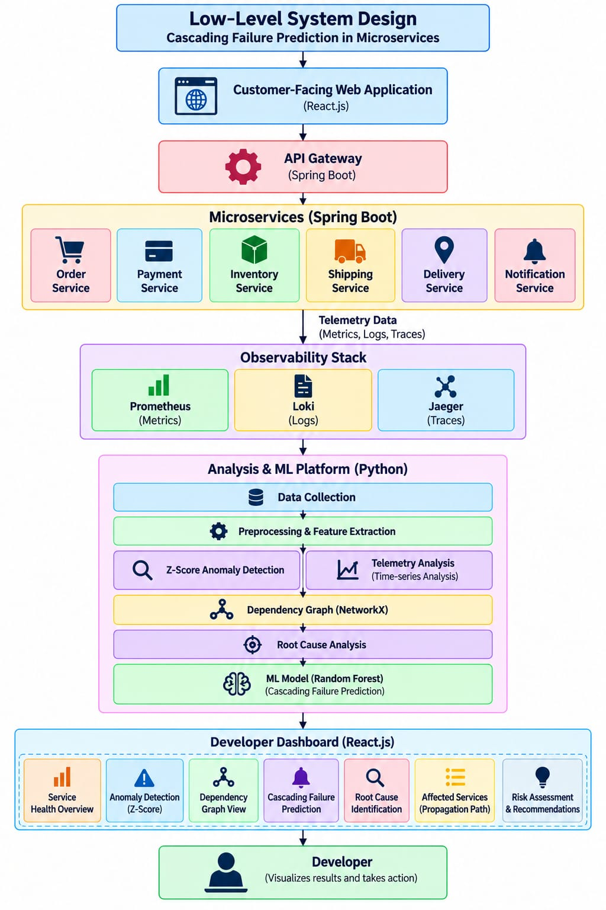

Slide 9
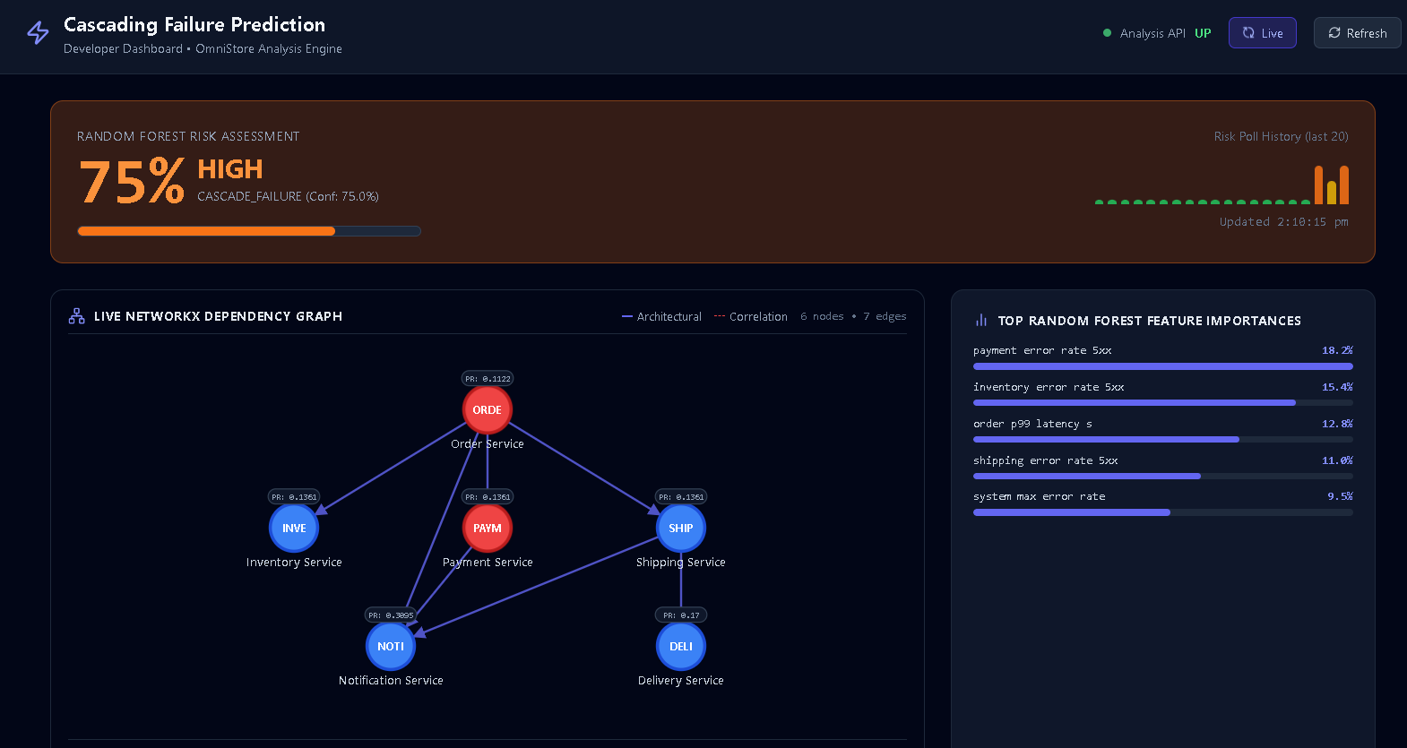
System Demonstration: Real-Time Cascade Risk & Topology
Live NetworkX Topology Graph & Random Forest 75% Critical Risk Assessment

Slide 10
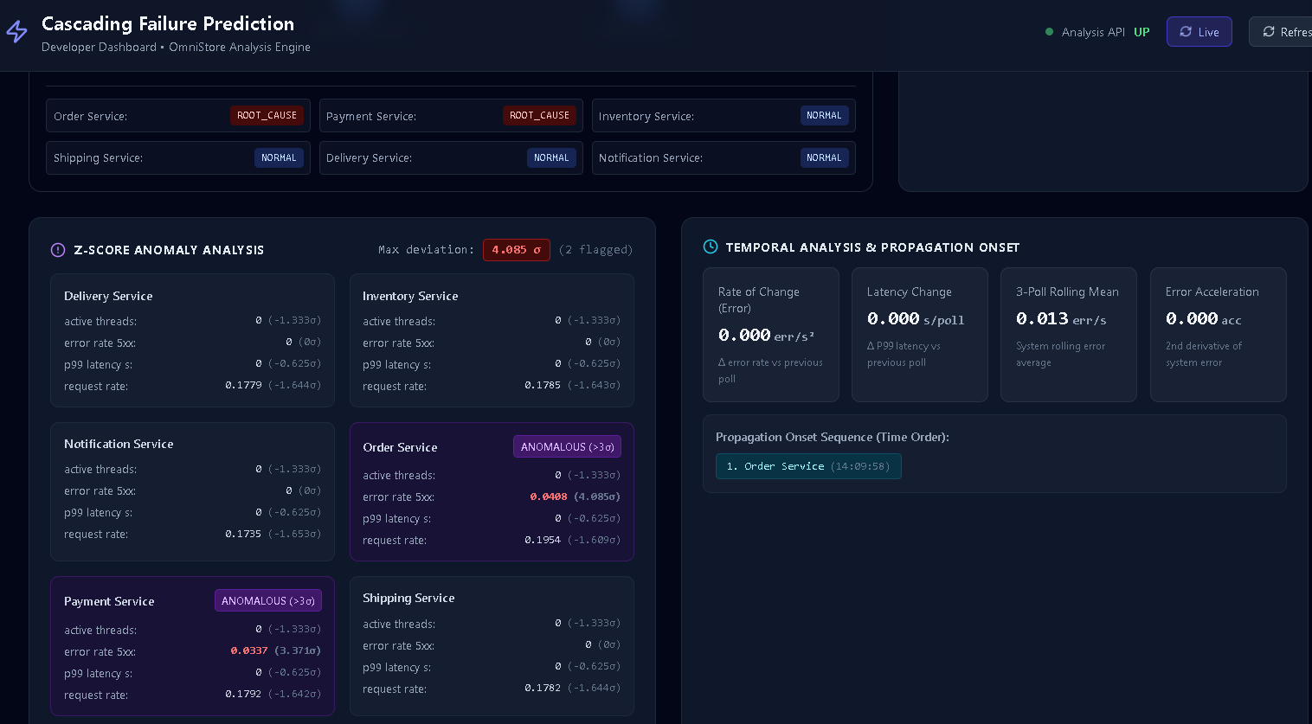
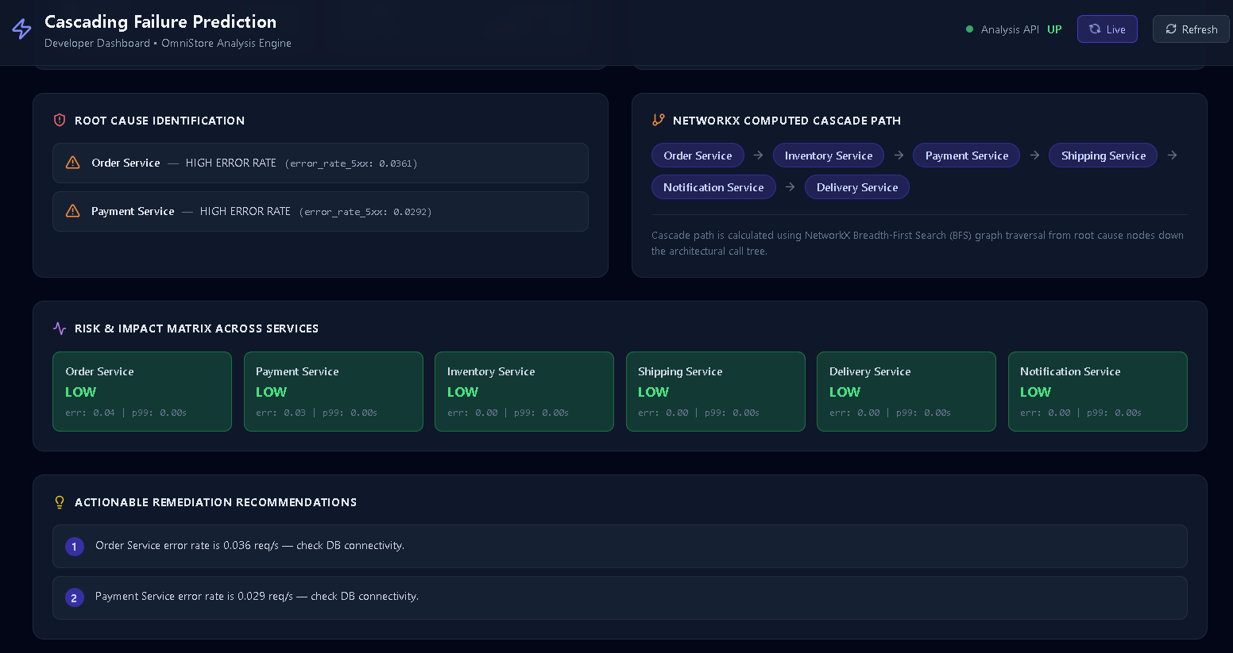
System Demonstration: Anomaly Detection & Remediation
Z-Score Statistical Detection, Computed Blast Radius & Prioritized Actionable Guidance

Slide 11
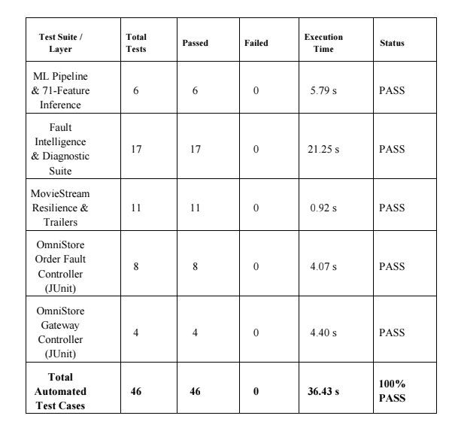
System Verification & Automated Testing Suite
Dual-Workload Validation: OmniStore (Spring Boot) & MovieStream (FastAPI) - 46/46 Tests Passing (100%)

Slide 12
Conclusion & Future Scope
Conclusion
The ICF-RCA platform successfully achieves real-time cascading failure prediction with 100% test accuracy using a 71-feature Random Forest model. Correlating metrics, logs, and distributed traces with NetworkX dependency graphs accurately detects anomalies, pinpoints root causes, and delivers prioritized remediation actions via an interactive developer dashboard.
Future scope
  Advanced machine-learning and causal-inference techniques
  Deep Learning Graph Neural Networks (GNNs) for multi-cluster environments
  Automated closed-loop remediation (auto-triggering circuit breakers)
  Support for larger and more complex microservice environments

Slide 13
References
  Lin et al., “Root Cause Analysis in Microservice Using Neural Granger Causal Discovery,” AAAI Publications, 2024.
  Pham et al., “BARO: Robust Root Cause Analysis for Microservices via Multivariate Bayesian Online Change Point Detection,” 2024.
  Pham et al., “Root Cause Analysis for Microservice System Based on Causal Inference: How Far Are We?”, 2024.
  Zhang et al., “Failure Diagnosis in Microservice Systems: A Comprehensive Survey and Analysis,” 2024.
  Soldani et al., “Explaining Microservices' Cascading Failures From Their Logs,” 2025.
  Zhang et al., “MHP-RCA: Multivariate Hawkes Process-based Root Cause Analysis in Microservice Systems,” 2026.

