Slide 1
A Data Driven YouTube Title Ranking System For Content Creators
Jagadish Gurram , Prerana Hadadi , Rohit Raju

Slide 2
Overview
Abstract
Introduction
Data Overview
Data Analysis
Data pre-processing for hypothesis testing
Hypothesis Testing
Data pre-processing for model building
Model Building
Model Evaluation
Future Scope and Conclusion

Slide 3
Abstract
The ever-growing landscape of YouTube demands content creators to constantly innovate and optimize their content for maximum reach and engagement.
This research investigates the relationship between video titles and views, aiming to develop a recommendation system that assists creators in crafting compelling titles.
Facilitating increased engagement through effective titles.
Contributing to the overall success of content creators on YouTube.
Abstract encapsulates a powerful tool for discoverability and engagement.

Slide 4
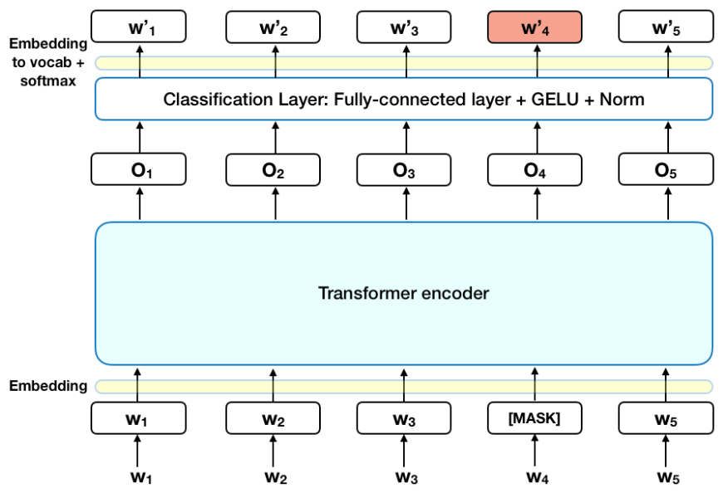
Introduction
YouTube's dynamic nature emphasizes visibility as a key to success in digital content creation.
The system analyzes titles across genres, classifying them as ‘Weak’, ‘Could Be Better’, ‘Strong’, or ‘Very Strong’.
Large language architectures, including BERT, are employed for title analysis
BERT is trained for tasks like sentence completion, text insertion, deletion, correction, and classification.
Elastic Net Regression model is also being used for predicting views based on titles.

Slide 5
Data Overview
Employed advanced web scraping techniques for meticulous data collection.
Comprehensive data collection across diverse YouTube genres: News & Current Events, Gaming, Comedy, Film, Entertainment & Music, Education, and Family/Lifestyle.
Focused on unraveling view count patterns, categorized into 0-500, 500-1000, 1000-10k, 10k-50k, and 50k-300k.
Collected data from 50,000 videos spanning the past two years, excluding the last three months for dataset integrity.
Ensured a strategic exclusion period to maintain the validity of the analysis.
Data features include title, channel ID, Video ID, title name, publishing data, views, and video category.

Slide 6
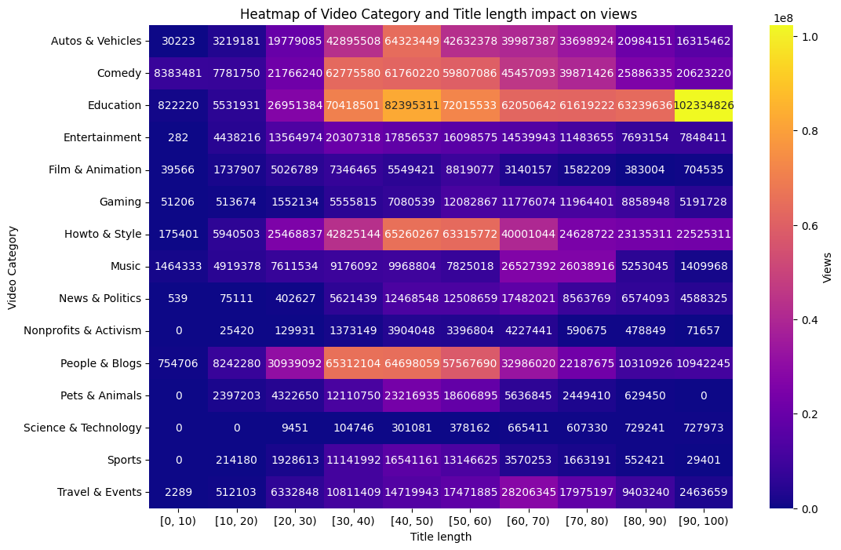
Data Analysis
The YouTube data underwent thorough cleaning during the collection process, eliminating the need for additional data cleaning steps.
The heatmap suggests that as the title length increases, there appears to be a corresponding increase in the number of views across various categories of videos in the sample data.
Specifically, videos categorized as 'Entertainment' and 'Comedy' seem to receive significantly more views than videos in other categories.

Slide 7
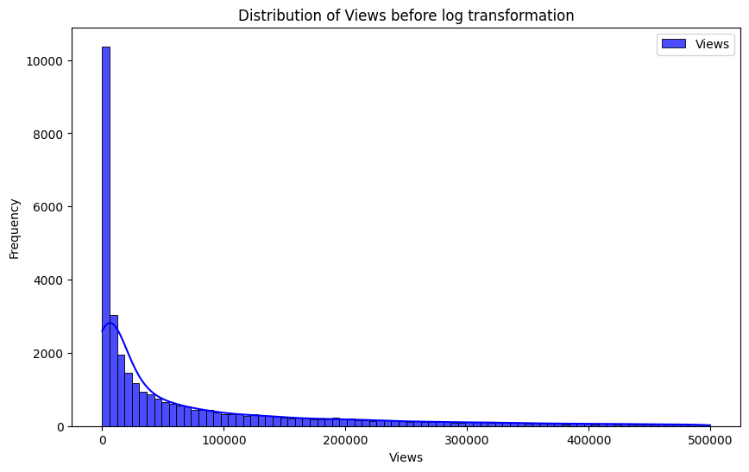
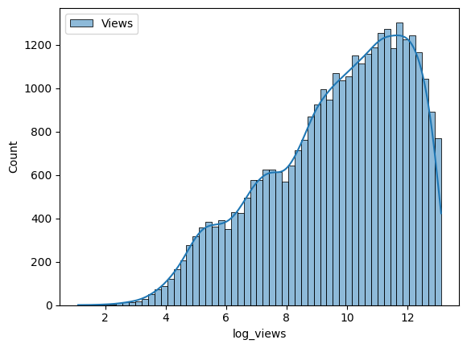
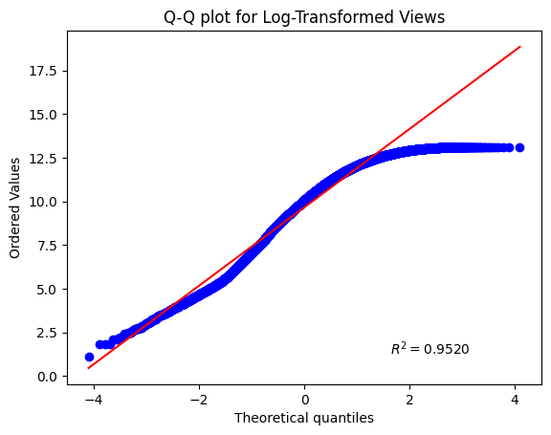
Data pre-processing for hypothesis testing
For hypothesis testing, normalizing the data and ensuring approximate equal variance between classes is crucial. The log transformation of the 'views' column was performed to address the right-skewed distribution and achieve these requirements, as shown in the figure .

Slide 8
Hypothesis Testing
Hypothesis:
Null Hypothesis (H0): The mean views of videos with title lengths less than 50 characters is equal to the mean views of videos with title lengths greater than 50 characters.
Alternative Hypothesis (H1): The mean views of videos with title lengths less than 50 characters are not equal to the mean views of videos with title lengths greater than 50 characters.
Conducted T test and the results are as follows,
Hypothesis | t-value | p-value
Hypothesis | 19.73 | 6.8*e^-25

Slide 9
Model Building
Initially aimed to construct a regression-based large language model for predicting video views.
Used models like Elastic Net regression on BERT embeddings with Z scale normalization and Elastic Net regression on BERT embeddings with Min-Max normalization for this purpose.
Due to limited literature on regression with Large Language Models, shifted focus to a classification problem.
Utilized BERT Large Language Model to classify titles into these view categories.
Classification based on inherent patterns identified in the titles.

Slide 10
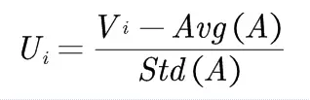
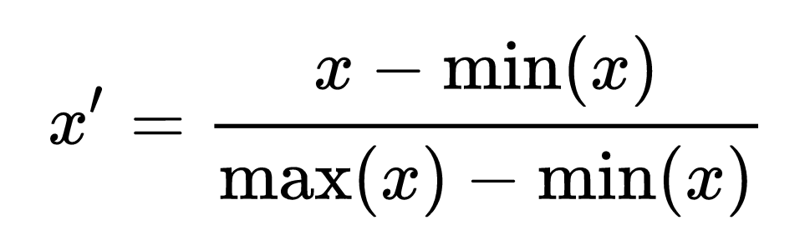
Data pre-processing for model building
Z Scaled normalization: Values in the range of [-1,1]
Min-Max Normalization: Values in the range of [0,1]

Slide 11
Data pre-processing for model building
3. View category introduction
The 'Views' feature of the data is categorized into various classes for training classification models. These classes include:
Weak title (0-1,000 views): Titles scoring views in the range of 0-1,000.
Could be better (1,000-10,000): Titles scoring views in the range of 1,000-10,000.
Strong title (10,000-100,000): Titles scoring views in the range of 10,000-100,000.
Very strong title (100,000-300,000): Titles scoring views in the range of 100,000-500,000.

Slide 12
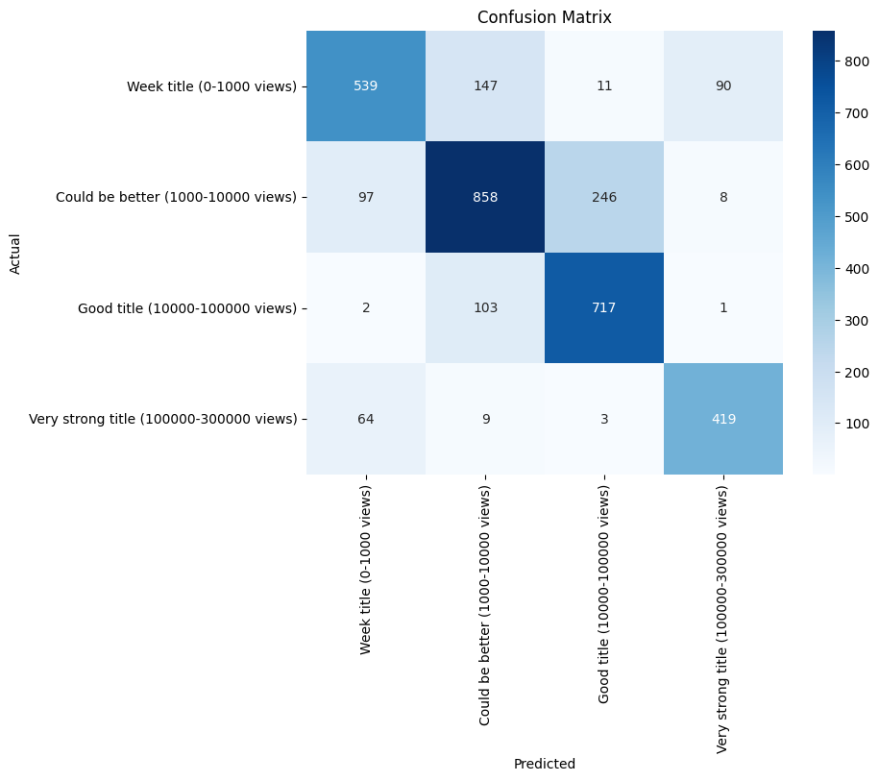
Model Evaluation
Models | Mean Squared Error (MSE)
Elastic net regression model (BERT encoding, Z scaled normalization) | 0.925
Elastic net regression model (BERT encoding, Min-Max normalization ) | 0.684
Models | Accuracy | Precision | Recall | F1 score
BERT with bert-base-uncased (classification) | 35% | 36% | 35% | 35%
BERT with bert-large-cased (classification) | 76% | 75% | 76% | 75%

Slide 13
Future scope and Conclusion
Future studies will prioritize feature selection, considering the incorporation of additional features like thumbnails, click rates, and impressions to enhance model robustness.
The exploration of more powerful Large Language Models (LLMs) beyond BERT is recommended for refining and improving the classification capabilities, broadening the scope of the research beyond title analysis.
The research, initiated with web scraping for YouTube video details, underscores the impactful role of titles in influencing views.
In conclusion, it is observed that powerful classification architectures have the capability to derive the patterns from titles to classify them based on views.

Slide 14
References
[1] Devlin, J., Chang, M.-W., Lee, K., & Toutanova, K. (2019, May 24). Bert: Pre-training of deep bidirectional Transformers for language understanding. arXiv.org. https://arxiv.org/abs/1810.04805
[2] Al-Jawarneh, A. S., Ismail, M. T., Awajan, A. M., & Alsayed, A. R. (2020). Improving accuracy models using elastic net regression approach based on empirical mode decomposition. Communications in Statistics - Simulation and Computation, 51(7), 4006–4025. https://doi.org/10.1080/03610918.2020.1728319
[3] V. Singrodia, A. Mitra and S. Paul, "A Review on Web Scraping and its Applications," 2019 International Conference on Computer Communication and Informatics (ICCCI), Coimbatore, India, 2019, pp. 1-6, doi: 10.1109/ICCCI.2019.8821809.
[4] Google. (n.d.). Google. https://developers.google.com/
[5] YouTube. (n.d.). YouTube. https://www.youtube.com/
[6] Mishra, P., Singh, U., Pandey, C. M., Mishra, P., & Pandey, G. (2019). Application of student’s t-test, analysis of variance, and covariance. Annals of cardiac anaesthesia. https://www.ncbi.nlm.nih.gov/pmc/articles/PMC6813708/

Slide 15
[7] X. Cheng, C. Dale and J. Liu, "Statistics and Social Network of YouTube Videos," 2008 16th International Workshop on Quality of Service, Enschede, Netherlands, 2008, pp. 229-238, doi: 10.1109/IWQOS.2008.32.
[8] M. Brbić, E. Rožić and I. Podnar Žarko, "Recommendation of YouTube Videos," 2012 Proceedings of the 35th International Convention MIPRO, Opatija, Croatia, 2012, pp. 1775-1779.
[9] M. Lewis et al., “BART: Denoising Sequence-to-Sequence Pre-training for Natural Language Generation, Translation, and Comprehension,” arXiv.org, Oct. 29, 2019. https://arxiv.org/abs/1910.13461v1
[10] I. Sutskever, O. Vinyals, and Q. V. Le, “Sequence to Sequence Learning with Neural Networks,” arXiv.org, Sep. 10, 2014. https://arxiv.org/abs/1409.3215v3
[11] Transformers: simpletransformers.ai/docs/usage/ [attention] A. Sojasingarayar, “Seq2Seq AI Chatbot with Attention Mechanism,” arXiv.org, Jun. 04, 2020. https://arxiv.org/abs/2006.02767v1

Slide 16
Thank you !
Link to code: Code
Link to report: Report

