Slide 1





RAJIV GANDHI UNIVERSITY OF KNOWLEDGE TECHNOLOGIES
DEPARTMENT OF COMPUTER SCIENCE AND ENGINEERING
DRIVER DROWSINESS DETECTION
Team Details
P. Aishwarya
M. Prerana Reddy
G. Lahari
fd
Guided by
Mrs. G. Srujana
Asst. prof.CSE, RGUKT Basar.
B192045 B192082 B192039

Slide 2
ABSTRACT
Driver Drowsiness has become one of the main reasons for large number of road accidents.
The main aim of this project is to overcome the problem of road accidents which are related to drivers experiencing tiredness leads to a need arises to design a system that keeps the driver focused on the road.
With the evolution and improvement in computer vision technologies, smart/intelligent cameras are developed to predict drowsiness in drivers, thereby alerting drivers which in turn reduce accidents when they are feeling drowsy.

Slide 3
INTRODUCTION & LITERATURE OVERVIEW
Most of the accidents in India happen due to lack of concentration of the driver. Performance of the driver gradually deteriorates owing to drowsiness.
This system captures images as a video stream through a cameras, detects the face and localizes the eyes and mouth.
The eyes are then analyzed for drowsiness detection using EAR(eye aspect ratio) and mouth using MAR(mouth aspect ratio).
Based on the result, the driver is alerted for drowsiness through an alarm system.

Slide 4
PROBLEM STATEMENT
Most drowsiness detection methods are intrusive, expensive, or lack real-time intervention, making them impractical for personal or widespread use.
There is a need for a lightweight, real-time driver drowsiness detection system using a standard camera and open-source tools to monitor eye behavior and alert the driver when fatigue is detected.
OBJECTIVES
To build a Python-based driver drowsiness detection system with core features like real-time facial landmark detection, EAR and MAR monitoring and audio alerts.
To offer an open-source, easily extendable solution that demonstrates real-time fatigue detection with minimal resources – ideal for learning and experimentation.

Slide 5
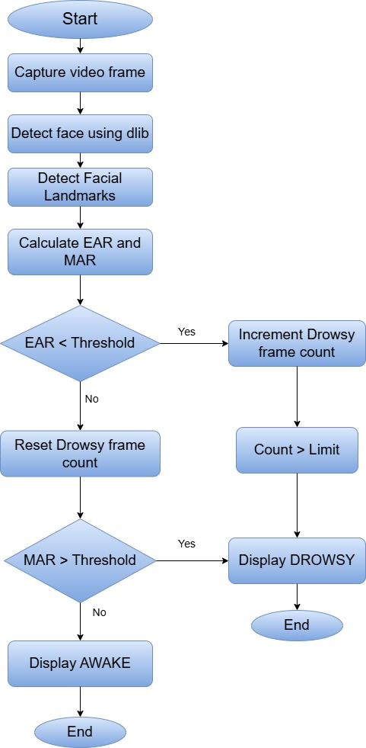
WORK FLOW DIAGRAM

Slide 6
IMPLEMENTATION
OpenCV – live video capture and image processing
dlib– facial‑landmark detection and head‑pose estimation.
NumPy / SciPy – fast numerical operations for EAR & MAR calculations
python‑vlc / playsound – local audio alerts prompting the driver to refocus

Slide 7
IMPLEMENTATION
)
Capture real-time video frames from the webcam.
Use Dlib to detect faces in each frame.
Identify facial landmarks (eyes, mouth, etc.)
Calculate:
EAR (Eye Aspect Ratio) – for eye closure.
MAR (Mouth Aspect Ratio) – for yawning detection.
If EAR < threshold:
Increment drowsy frame count (possible eye closure).
If EAR >= threshold:
Reset drowsy counter(eyes likely open).
If MAR > threshold:
Detect yawning → Display “DROWSY” alert.
Else → Display “AWAKE” (driver is alert)

Slide 8
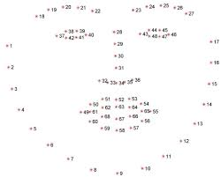
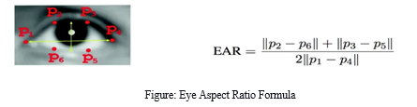
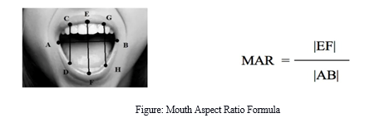
IMPLEMENTATION
)

Slide 9
RESULT AND ANALYSIS
System captures real-time video from webcam.
Achieves over 90% accuracy in detecting drowsiness in controlled (quiet) environments.
Successfully triggers “DROWSY” or “AWAKE” alerts based on EAR and MAR thresholds.
Tested with multiple users and lighting conditions, maintaining reliable performance.

Slide 10
COMPARISION WITH EXISTING METHODS
Current drowsiness detection systems monitoring the driver's condition requires complex computation and expensive equipment, not comfortable to wear during driving and is not suitable for driving conditions.
For example, Electroencephalography (EEG) and Electrocardiography (ECG), i. e, detecting the brain frequency and measuring the rhythm of heart, respectively.
A drowsiness detection system which use a camera is more suitable to be use but the physical signs that will indicate drowsiness need to be located first in order to come up with a drowsiness detection algorithm that is reliable and accurate.

Slide 11
APPLICATION & FUTURE SCOPE
Enhances driver safety by detecting signs of drowsiness in real time.
Can be integrated into vehicles, especially in long-distance transport or commercial fleets.
Integration with voice assistants for hands-free alerts and responses.
Extendable to include real-time alerts to emergency contacts or fleet managers.
Potential for smart vehicle systems or IoT-based embedded integration

Slide 12
CONCLUSION & REFERENCES
The Driver Drowsiness Detection system effectively identifies fatigue using facial landmarks and real-time video. By analyzing EAR and MAR values, it detects signs like eye closure and yawning with high accuracy. The system runs efficiently on low-end devices, making it suitable for integration into vehicles to enhance road safety.
Soukupová, T., & Čech, J. (2016). Real-Time Eye Blink Detection using Facial Landmarks.
Dlib Library – http://dlib.net
OpenCV Library – https://opencv.org
Python – https://www.python.org

Slide 13



Thank You

