Slide 1
CS470
Computer Networking Protocols
12. Transmission Control Protocol 4
Huiping Guo
Department of Computer Science
California State University, Los Angeles

Slide 2
MSS
Maximum segment size (MSS)
  The maximum amount of application data (in bytes) that can be put in a TCP segment
    Set based on the path MTU (Maximum Transmission Unit, link layer)
    Path MTU: the largest link layer frame that can be sent on all links from the source to destination
Why MSS?
  Ensure that a single TCP segment (encapsulated in an IP datagram) can fit into a single link layer frame
  IP datagram fragmentation
    Fragment the data in the IP datagram into two or more smaller IP datagrams
  TCP prevents a segment from being fragmented by IP
12. TCP 4 CS470_S14
12-<number>

Slide 3
Congestion
Network congestion
  The number of packets sent to the network is greater than the number of packets a network can handle
How congestion happens
  Each interface of a router has an input and output buffer
  Input buffer overflow
    Arrival rate > processing rate
  Output buffer overflow
    Processing rate > departure rate
12. TCP 4 CS470_S14
12-<number>

Slide 4
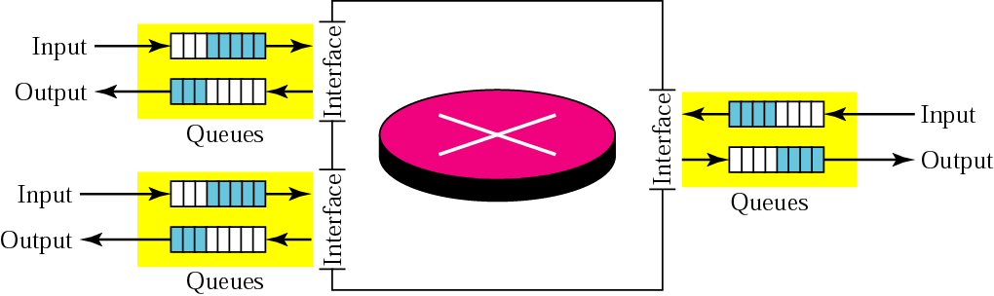
Router queues
12. TCP 4 CS470_S14
12-<number>

Slide 5
Congestion Control
What is congestion control
  Prevent congestion before it happens
  Remove congestion after it has happened
How?
  Adjust the congestion window size: cwnd
Let’s now ignore recWindow
12. TCP 4 CS470_S14
12-<number>

Slide 6
TCP Congestion Control
Three phases
  Slow start
  Congestion avoidance
  Congestion detection
The algorithms in each phase are independent
Some important variables
  Cwnd
  Threshold
12. TCP 4 CS470_S14
12-<number>

Slide 7
Slow start algorithm
The slow start phase is the phase right after the connection is established.
The algorithm
  Cwnd starts with 1MSS
  Each time one new segment is acknowledged, cwnd is increased by 1MSS
  Cwnd keeps growing until
    Cwnd reaches threshold
    Or congestion occurs
Cwnd starts slowly, but grows exponentially
12. TCP 4 CS470_S14
12-<number>

Slide 8
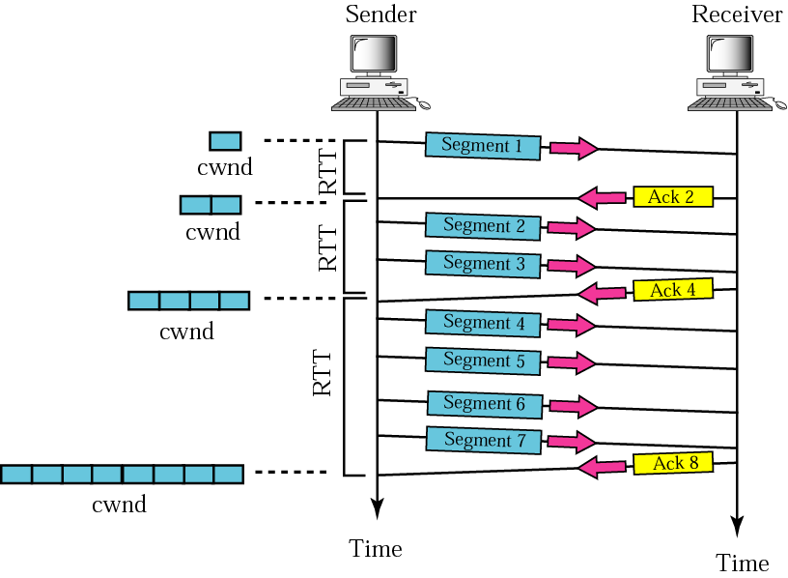
TCP Slow Start
12. TCP 4 CS470_S14
12-<number>

Slide 9
Congestion avoidance
The phase after the slow start phase
  Slow down the exponential growth
  Avoid congestion before it happens
When congestion avoidance phase starts?
  cwnd >= Threshold
The algorithm
  Each time the WHOLE WINDOW of packets is acknowledged, Cwin is increased by 1MSS
    cwnd is increased by 1/cwnd for each acknowledged segment (Additive increase)
  Cwin keeps growing LINEALLY until congestion happens
12. TCP 4 CS470_S14
12-<number>

Slide 10
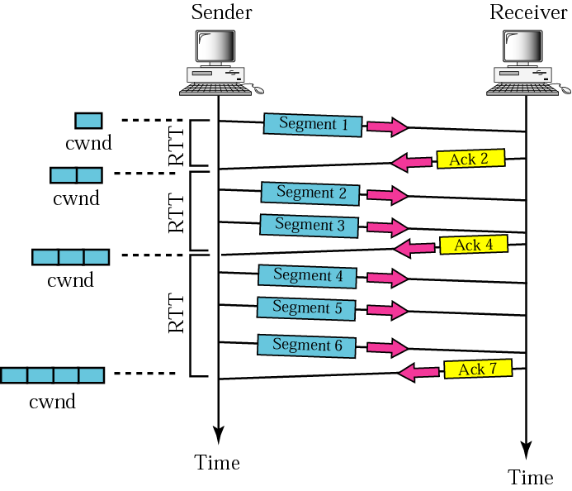
Congestion avoidance
12. TCP 4 CS470_S14
12-<number>

Slide 11
Congestion detection
Timeout
  Strong possibility of congestion
  A segment has probably been dropped
  No news about following segments
  TCP reacts strongly
3 duplicate ACKs
  Weaker possibility of congestion
  A segment may have been dropped
  Some segments after that may have arrived safely
  TCP applies fast recovery algorithm
12. TCP 4 CS470_S14
12-<number>

Slide 12
Timeout
Retransmit the lost packet
Threshold = ½ cwnd
  NOT threshold = ½ threshold!
Cwnd = 1
Starts the slow start phase
12. TCP 4 CS470_S14
12-<number>

Slide 13
Fast recovery (three duplicate ACKs)
Retransmit the packet
Threshold = ½ cwnd
Cwnd = threshold (multiplicative decrease)
Starts the congestion avoidance phase
12. TCP 4 CS470_S14
12-<number>

Slide 14
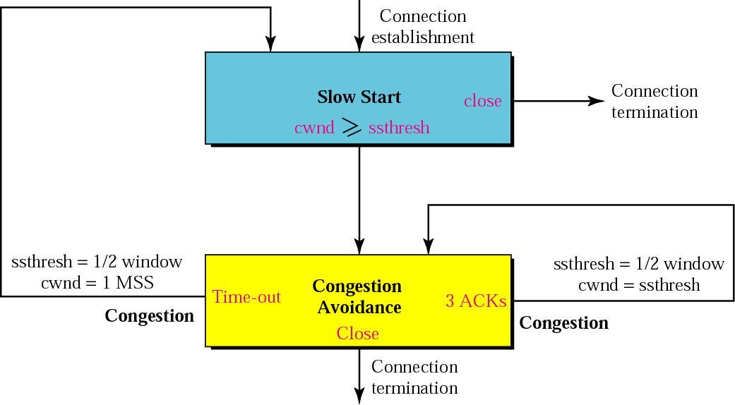
Summary: TCP Congestion Control
3 dup
ACKs
12. TCP 4 CS470_S14
12-<number>

Slide 15
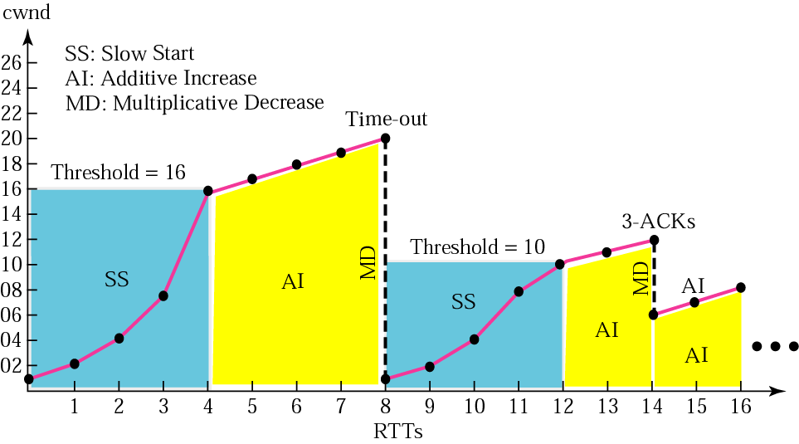
Congestion control example
12. TCP 4 CS470_S14
12-<number>

Slide 16
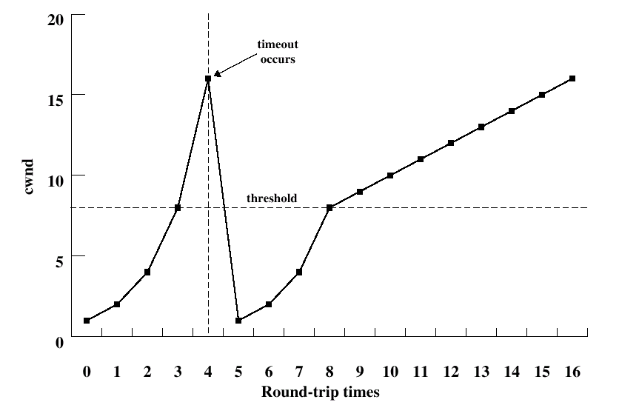
Exercise
12. TCP 4 CS470_S14
12-<number>

Slide 17
Exercise
Slow start time intervals
Congestion avoidance interval
At time 4, what happened? At time 4, if 3 duplicate acks are received, what’s the value of cwnd, threshold?
12. TCP 4 CS470_S14
12-<number>
Notes:
Slow start time intervals
0-4, 5-8
Congestion avoidance interval
8-
At time 4, what happened? Timeout or 3 duplicate acks are received?
At time 4, if 3 duplicate acks are received, the value of cwnd, threshold?
Cwnd=8, threshold=8

Slide 18
Exercise 2 (segment level)
Router queue
TCP
Sender
TCP
Receiver
The router link shown takes D seconds to transmit a segment and maximum buffer capacity of 3 segment .
This link is the sole bottleneck of the TCP connection (i.e., the roundtrip time (rtt) equals the delay encountered in this link and overflow at the link buffer is the only cause of segment loss). No other traffic uses the link. The link buffer is initially empty.
The timeout interval is 3D seconds.
Segment payload is 1 KB.
The initial cwnd(cw) is 1 and the initial threshold(sst) is 6 segment.
The receiver sends an ack for every segment received. It can buffer an unlimited number of segment .
12. TCP 4 CS470_S14
12-<number>

Slide 19
Congestion example 2 (segment level)
Complete the table for a 10 KB file transfer, assuming the file consists of packets 0,1,…9.
The row at time jD, for j = 0,1… should indicate just after this time the values of bw(base window), cw, sst, rb (segments the receiver buffered) the 1KB segment sent, and the segments in the queue.
Also indicate the time when the transfer is completed (fully acked at the source).
time | Ack | bw | cw | sst | Packets send | queue | rb
0 | - | 0 | 1 | 6 | 0 | 0 | 0
12. TCP 4 CS470_S14
12-<number>

Slide 20
Congestion example 2 (segment level)
time | ack | bw | cw | sst | Packets send | queue | rb
0 | - | 0 | 1 | 6 | 0 | 0 | 0
1D | 1 | 1 | 2 | 6 | 1,2 | 1,2 | 1
2D | 2 | 2 | 3 | 6 | 3,4 | 2,3,4 | 2
3D | 3 | 3 | 4 | 6 | 5,6 | 3,4,5 (6 lost) | 3
4D | 4 | 4 | 5 | 6 | 7,8 | 4,5,7 (8 lost) | 4
5D | 5 | 5 | 6 | 6 | 9 | 5,7,9 | 5
6D | 6 | 6 | 6+1/6 | 6 | - | 7,9 | (7)
7D | 6 | 6 | 6+1/6 | 6 | - | 9 | (7,9)
8D | 6 | 6 | 6+1/6 | 6 | - |  | (7,9)
9D | - | 6 | 1 | 3 | 6 | 6 | 6,7,(9)
10D | 8 | 8 | 3 | 3 | - | - | -
13D | - | 8 | 1 | 1 | 8 | 8 | 8
14D | 10
12. TCP 4 CS470_S14
12-<number>

