Slide 1

Title – Voice Based Hot and Cold-Water dispenser Using ESP8266
Group Members :
1.Badadhe Sakshi : EN3003
2.Bangar Pravin Rajendra : EN3004
3.Biradar Prerana Vibhadra : EN3006
4.Dhotekar Asra Arif : EN3012
5.Shriwas Neha Lavlesh Kumar : EN3048
6.Kate Ranjit Balbhim : EN3062
UNDER THE GUIDANCE OF:
Prof.Pranjali Deshmukh
Project Coordinator:
Dr. Shubhagi Handore

Slide 2
contents
Abstract
Introduction
Objective
Components
Block Diagram & Model
Application & Advantages
Future Scope
Conclusion

Slide 3

Abstract
This project presents an innovative IoT-based system for a voice-controlled hot and cold-water dispenser designed for diverse applications including residential, office, healthcare, and public environments. Utilizing an ESP8266 Wi-Fi microcontroller integrated with a dedicated voice recognition module, the system enables users to effortlessly command water dispensing via voice inputs. Relay-operated heating and cooling mechanisms are employed to precisely control water temperature, ensuring an energy-efficient and safe operation. By combining hands-free interaction with automated temperature regulation, the dispenser offers a user-friendly solution that enhances convenience and promotes hygienic practices while optimizing energy usage

Slide 4
introduction
This project introduces a smart, voice-controlled water dispenser that leverages IoT technology to enhance user convenience. Utilizing an ESP8266 microcontroller paired with a voice recognition module, the system interprets user commands to control a relay-operated mechanism for heating or cooling water. Designed to be compact, efficient, and cost-effective, this solution is particularly beneficial for elderly and differently-abled individuals, as it eliminates the need for manual operation while promoting hygiene and ease of use.

Slide 5
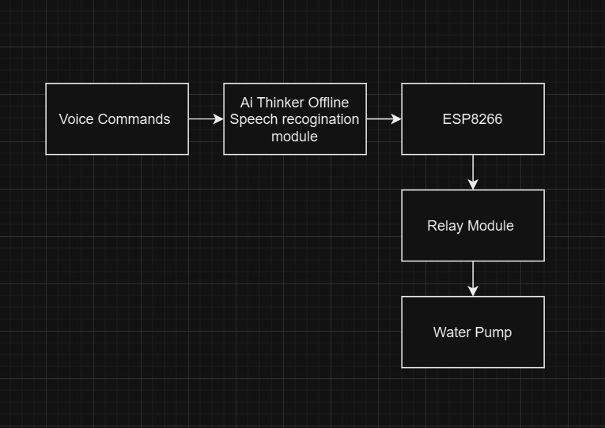
Block diagram

Slide 6
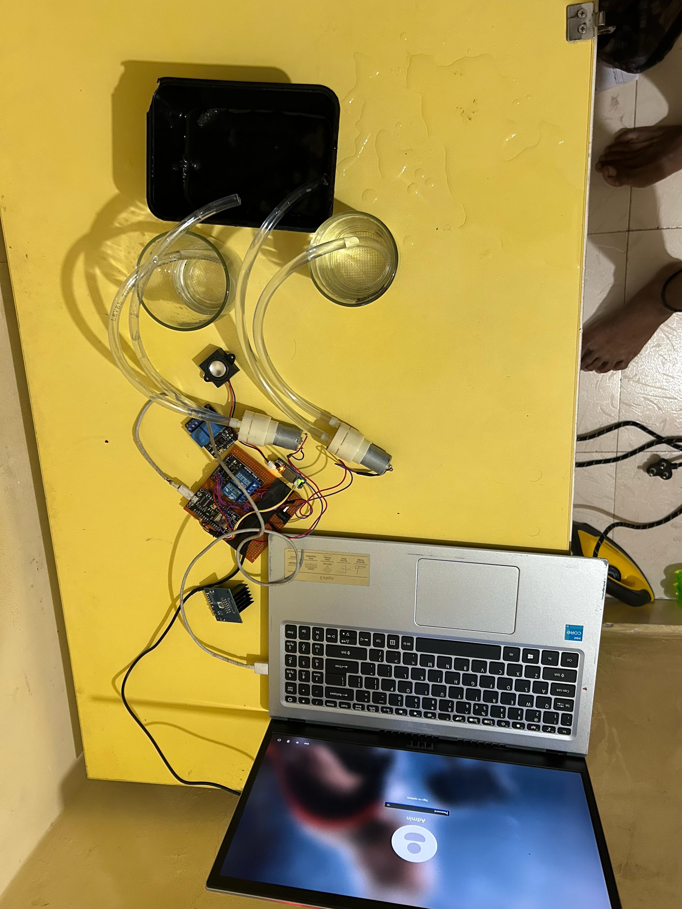

Slide 7
Working principle
Voice Recognition Technology : The system employs voice recognition to provide a user-friendly interface. This hands-free approach is particularly advantageous in environments where hygiene and ease of access are critical.
Microcontroller-Based Control : The ESP8266 microcontroller serves as the central unit for processing commands and managing the dispensing process. Its Wi-Fi capabilities also allow for potential IoT integration, enabling remote monitoring or control.
Relay-Operated Switching : Relays act as electrically operated switches in the system. They provide a safe and effective method to control high-power circuits (such as the water solenoid valves) using low-power signals from the microcontroller.
Dual Water Storage System : By utilizing two separate water tanks—one for hot water and one for cold water—the system ensures that each water type is maintained at its optimal temperature. Preheating and pre-cooling are managed externally, so the dispenser can deliver water quickly without dela

Slide 8
Objectives
Hands-Free Operation: Enable users to control the water dispenser using voice commands, eliminating the need for manual operation.
Efficient Temperature Control: Integrate relay-operated heating and cooling mechanisms to dispense water at the desired temperature reliably and safely.
Energy Efficiency: Design the system to operate with minimal energy consumption while maintaining optimal performance.
Cost-Effective Design: Develop a compact and affordable solution that can be widely deployed in various settings such as homes, offices, healthcare centers, and public spaces

Slide 9
Outcomes
Voice Control Implementation :Successfully integrated voice commands for both hot and cold water dispensing.
Seamless IoT Connectivity :Achieved robust remote control using the ESP8266 module.
Enhanced Hygiene & Convenience : Touchless operation minimizes physical contact.
Verified Temperature Regulation : Ensures safe and energy-efficient heating and cooling.
Glass Detection Sensor : Automatically senses if a glass is in place, preventing accidental spills.
Adaptive Temperature Conversion : Automatically heats cold water to the desired hot temperature when required.

Slide 10
Advantages
Enhanced Hygiene : By eliminating the need for manual intervention, the system minimizes the risk of germ transmission, making it particularly valuable in environments that demand high sanitary standards.
Energy Efficiency : The relay-operated heating and cooling mechanisms are designed to consume minimal energy while maintaining effective water temperature control.
Cost-Effective : Utilizing affordable components like the ESP8266 microcontroller, the project offers a budget-friendly solution without compromising functionality.
User-Friendly : With a simple voice command interface, the system is accessible to a wide range of users, including those with physical limitations, ensuring a seamless and intuitive user experience.

Slide 11
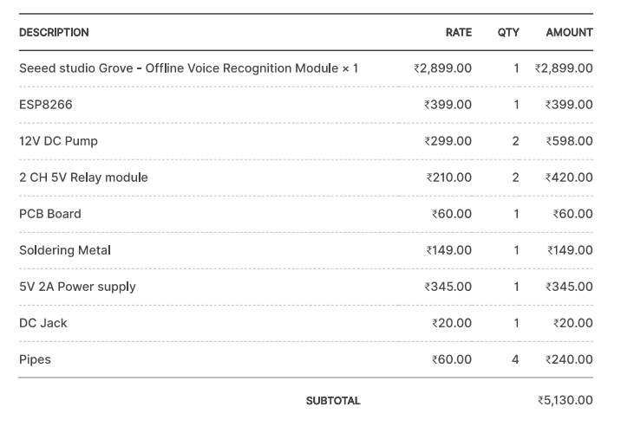
Components & expenditure

Slide 12
Application
Residential Use : Enhances convenience in smart homes by offering voice-controlled water dispensing, making it especially useful for elderly and differently-abled individuals.
Commercial Settings : Suitable for offices, restaurants, and cafeterias where high hygiene standards and ease of use are prioritized.
Healthcare Facilities : Provides a touch-free solution in hospitals and clinics, reducing cross-contamination risks and supporting accessibility for patients and staff.
Public Spaces : Ideal for installation in libraries, airports, and other public areas where hands-free operations can improve user safety and overall convenience

Slide 13
Future scope
AI-Powered Maintenance: Predicts faults and ensures long-term efficiency.
Mobile App Integration: Enables scheduling, monitoring, and remote control.
Solar-Powered Operation: Promotes sustainability and energy efficiency.
Multi-Language Voice Recognition: Expands accessibility for diverse users.
Smart Home Compatibility: Seamlessly integrates with IoT ecosystems for automation.
Advancing towards a smarter, eco-friendly, and globally accessible water dispensing solution!

Slide 14
Conclusion
Our voice-controlled hot and cold water dispenser is a step toward a smarter, safer, and more convenient future. By integrating ESP8266 for IoT connectivity, touchless operation, and smart safety mechanisms, we have created an innovative solution that enhances hygiene, accessibility, and energy efficiency. This project is not just an advancement in water dispensing it’s a step toward the future of seamless, automated, and intelligent home appliances.

Slide 15
Thank you...!
"Smart, Hygienic, and Efficient Water Dispensing with Just a Voice Command !”

