Slide 1
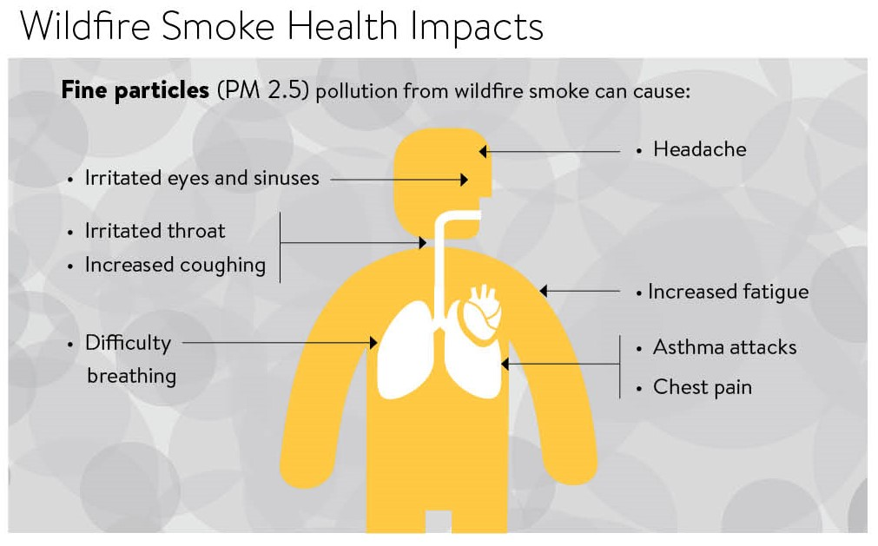
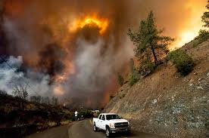
Impact Analysis of Smoke Fires on Public Health and Safety
Prerit Chaudhary

Slide 2
Project Motivation
It's important to study the effects of smoke fires because doing so helps us understand how they affect people's health, the environment, and overall safety
Air Quality Degradation : Smoke contains particulate matter, which can degrade air quality.
Respiratory Health Issues : Exposure to wildfire smoke can exacerbate respiratory conditions such as asthma, bronchitis, and chronic obstructive pulmonary disease (COPD)
Cardiovascular Effects : Fine particles in smoke can contribute to cardiovascular problems, potentially increasing the risk of heart attacks and other cardiovascular issues.
Visibility Reduction : Thick smoke can reduce visibility, posing hazards for drivers and increasing the risk of accidents on roads.

Slide 3
Research Questions
Mortality Rates for Respiratory Diseases, Cardiovascular Diseases and Road Accidents
Possible correlations between increase in smoke fires and mortality rates because of the diseases
Which respiratory diseases are shown to have a significant increase in mortality rates
Observe trends in road accidents at the time of smoke fires due to low visibility
Demographic Disparity
Identifying age groups or ethnicities most vulnerable or impacted by health conditions
Observe change in life expectancy across different demographics

Slide 4
Data Sources
Chronic Respiratory Disease Mortality Rates by County
Mortality rates for different counties in Kansas where mortality rate is deaths per 100,000 population
Data for following conditions :
Mortality Rates by Causes of Death and Life Expectancy by County, Race, and Ethnicity
Life expectancy and mortality rates due to respiratory conditions with columns such as Location, FIPS, Race, Sex, Age group due to respiratory infections and chronic respiratory conditions. The estimates are given in the following three columns :
Val - Estimate for that specific county
Lower - 2.5% percentile estimate
Upper - 97.5% percentile estimate
Chronic respiratory diseases
Chronic obstructive pulmonary
Pneumoconiosis
Silicosis
Asbestosis
Coal workers
Pneumoconiosis
Other pneumoconiosis
Asthma
Interstitial lung disease
Other chronic respiratory

Slide 5
Human Centered Approach
Reproducibility
The methodology is completed in a reproducible manner and only interpretable analysis are selected for the results
Biases in data
The data contains all the diverse representations for age and race across the county to ensure there is no misrepresentation of trends
Fairness , accountability, transparency and ethics (FATE)
The analysis is performed using explainable techniques to make the results intuitive and reliable

Slide 6
Methodology
Tests for Statistical Analysis
Pearson Correlation Coefficient and Spearman's Rank-Order Correlation
Statistical methods used to quantify the strength and direction of relationships between two variables
Analysis of Variance (ANOVA)
ANOVA is an extension of the t-test for more than two groups. It assesses whether there are any statistically significant differences in means among the groups.

Slide 7
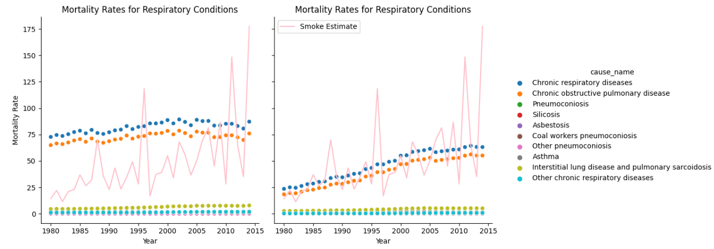
Visualization 1
Trend of mortality rate for respiratory diseases

Slide 8
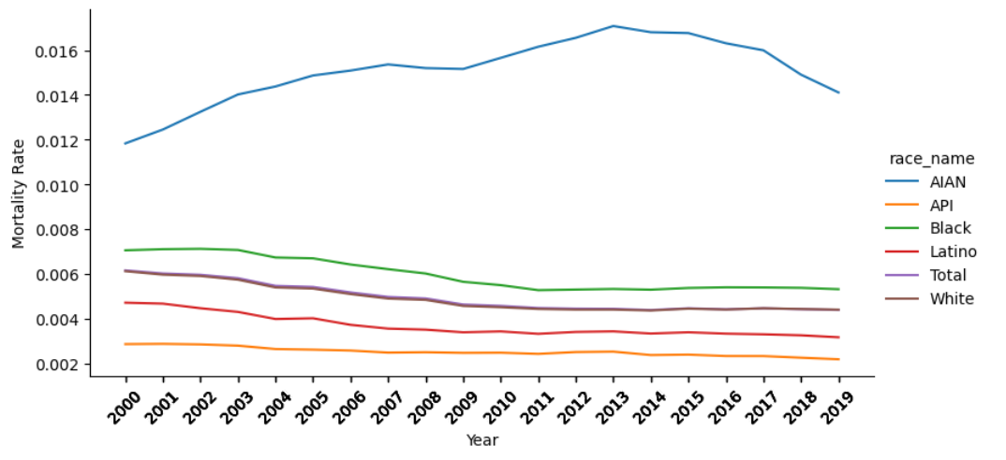
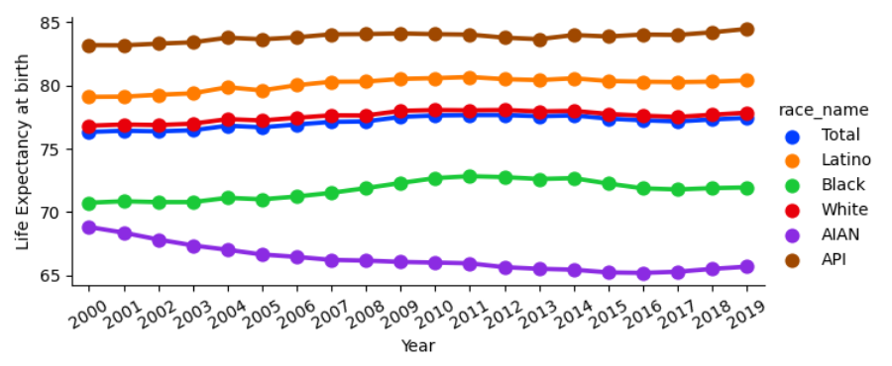
Visualization 2
Trend for cardiovascular diseases and life expectancy across ethnicity
Mortality Rates
Life Expectancy at birth

Slide 9
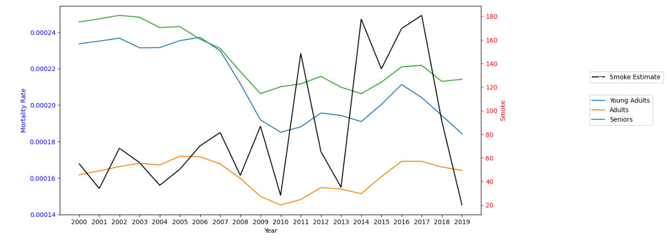
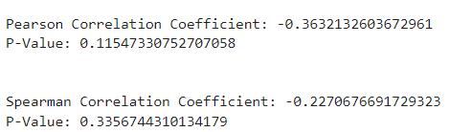
Visualization 3
Trend for road accidents across age groups

Slide 10
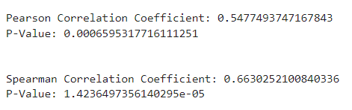
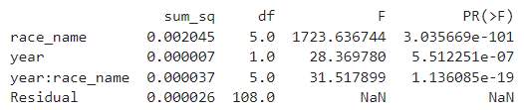
Results
Correlation between Smoke Fire Estimate and Increasing Mortality Rates in Females:
Null hypothesis : No true correlation between smoke fire and mortality rate
p-value is significant for both test even when there is no assumption on normality
ANOVA between mortality rate , race and year for cardiovascular disease
The interaction effect (race_name and year) is statistically significant (p < 0.05), indicating that there is evidence of an interaction effect

Slide 11
Insights and Recommendations
The results provide insights into how smoke fires affect various aspects, including respiratory conditions, cardiovascular diseases, and reduced visibility leading to road accidents.
The county should implement necessary measures to address the rising mortality rates related to respiratory conditions among females. Special attention is required for the AIAN ethnicity group, where life expectancy has shown a decline over the years
It is advisable to adjust driving guidelines, particularly during periods of increased smoke fires, to ensure road safety
* The following recommendations are based on the correlation and other statistical tests conducted on the data. These results do not imply causation. There are other confounding variables which would directly impact the trends and a more exhaustive analysis is necessary

