Slide 1

Medical Fraud Detection
Team Members: Neel Shah Sagnik Ghosal Prerit Chaudhary Ishank Vasania

Slide 2
Background and Use-case
Provider Fraud is one of the biggest problems facing Medicare. According to the government, the total Medicare spending increased exponentially due to frauds in Medicare claims. Healthcare fraud is an organized crime which involves peers of providers, physicians, beneficiaries acting together to make fraud claims.
We are trying to build an infrastructure for the Government to identify fraudulent providers and also get insights into frauds in specific facilities, by specific providers and in accordance with specific physicians. The Infrastructure will consists of 2 main parts:
Modelling - PyOD, sklearn, TensorFlow
Visualization - Dash, Bokeh

Slide 3
Python Package Choices (Modelling)
• Python Library Name: Scikit-learn
• Author: David Cournapeau
• Release Date: 2007
• Brief summary:
Open-source machine learning library with a diverse set of algorithms for classification, regression, clustering, and dimensionality reduction.
Provides data preprocessing, model selection, and evaluation tools.
Suitable for smaller datasets and models that do not require deep learning techniques.
Scikit-learn is simple to use and has a consistent API.

Slide 4
Python Package Choices (Modelling)
• Python Library Name: TensorFlow
• Release Date: 2017
• TensorFlow was developed and is maintained by the Google Brain team.
• Brief summary:
Provides a powerful and flexible platform for building and training various types of DL models
Has a rich set of low-level and high-level APIs allowing fine-grained control and ease of use.
Comprises a repository of pre-trained models that can be easily integrated into new projects.

Slide 5
Python Package Choices (Modelling)
• Python Library Name: PyOD (Python Outlier Detection)
• Authors: Yue Zhao, Zain Nasrullah, Zheng Li
• Release Date: 2019
• Brief summary:
Includes more than 40 anomaly detection algorithms, both supervised, and unsupervised
Highly flexible and customizable, with support for various data formats, feature types, and metrics.
Built on top of scikit-learn, and so it integrates seamlessly with scikit-learn's tools
Supports distributed computing, which allows users to scale to large and high-dimensional datasets
Is actively maintained and updated with new algorithms and features.

Slide 6
Package Comparison (Modelling)
Feature/Functionality | scikit-learn | TensorFlow | PyOD
Type of Machine Learning | Traditional ML | Deep Learning | Traditional ML + SOTA DL
Data Preprocessing | Yes | Yes | Yes
Feature Selection | Yes | Yes | Yes
Supervised Learning | Yes | Yes | Yes
Unsupervised Learning | Yes | Yes | Yes
Semi-Supervised Learning | Yes | Yes | Yes
Time Series Analysis | Yes | Yes | Yes
Anomaly Detection | Yes (less extensive) | Yes (limited to only DL models) | Yes (extensive - both ML and DL)
Distributed Computing | No | Yes | Yes

Slide 7
Choice (Modelling)
We have selected the PyOD package for the modelling aspect in our project.
Why:
PyOD provides a more extensive collection of anomaly detection models, including supervised, unsupervised, ML-based and DL-based.
The implementation is very easy (2-3 lines of code)

Slide 8
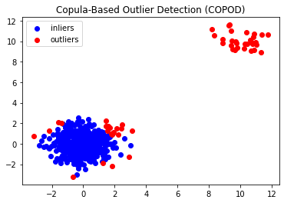
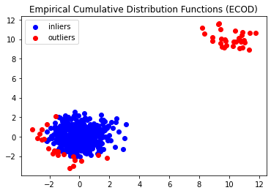
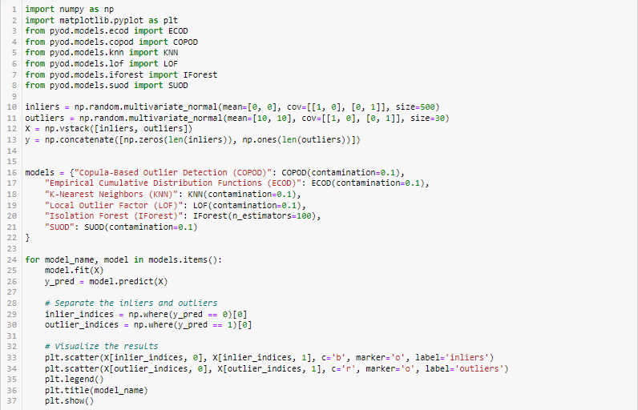
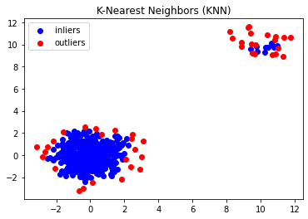
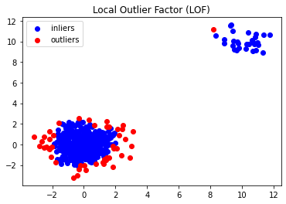


PyOD Demo

Slide 9
Drawbacks/Remaining Concerns (Modelling)
PyOD:
PyOD mainly relies on traditional ML techniques for anomaly detection. While it has a few neural network-based models, support for deep learning models is currently limited.
Some of the models in PyOD can be computationally expensive to train. This can be a disadvantage when dealing with large datasets.
PyOD is a relatively new library compared to more established machine learning libraries like scikit-learn. It may not have as much documentation or community support available, which can make it more challenging to use for beginners.

Slide 10
Python Package Choices (Visualization)
• Python Library Name: Bokeh
• Author and Release Date : Joseph Cottam and team (2014)
• Brief summary:
Bokeh is a Python interactive visualization library that targets modern web browsers for presentation providing elegant, concise construction of novel graphics with high-performance interactivity over very large or streaming datasets in a quick and easy way. Bokeh exposes different interface levels to the users:
Allows plotting centered around composing visual glyphs that provides the most flexibility to application developers.
Allows interface that can be used to build complex statistical plots as quickly and as simply as possible.

Slide 11
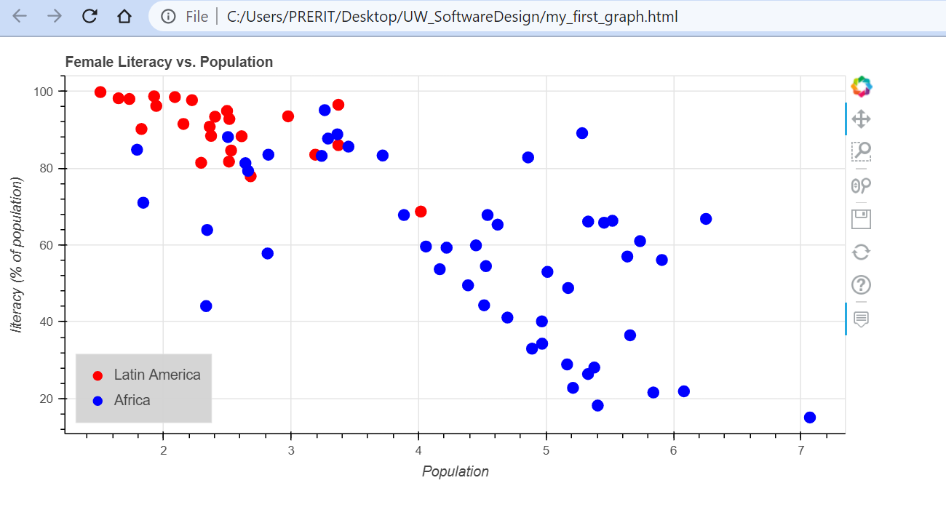
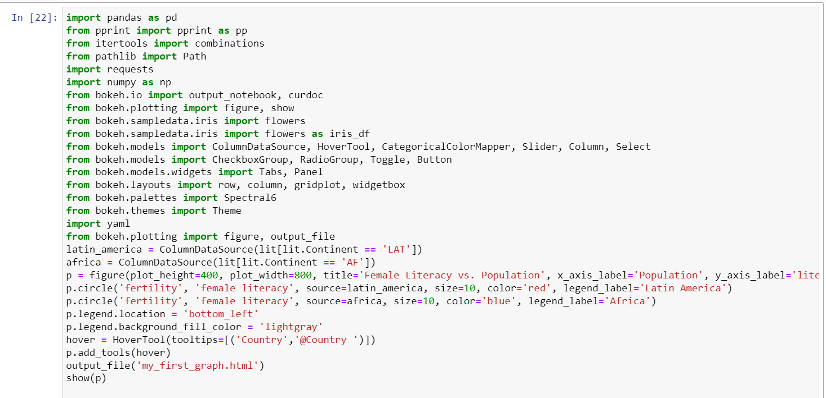
Bokeh Demo

Slide 12
Python Package Choices (Visualization)
• Python Library Name: Dash
• Author and Release Date: Chris Parmer and the team at Plotly (2017)
• Brief summary:
Dash is an open-source framework for building web applications with Python. It allows developers to create interactive, data-driven dashboards and web applications with minimal coding.
Dash is built on top of Flask, Plotly.js, and React.js, and provides a simple and flexible way to create and customize web applications. With Dash, developers can build dynamic, responsive, and real-time web applications that can display live data, interactive visualizations, and complex data workflows.

Slide 13
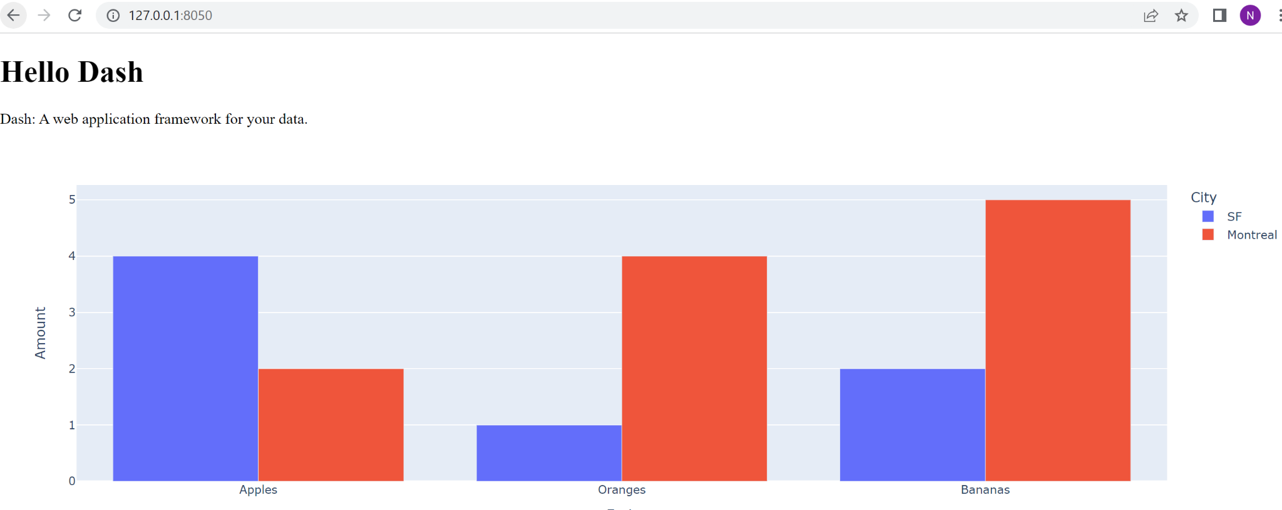
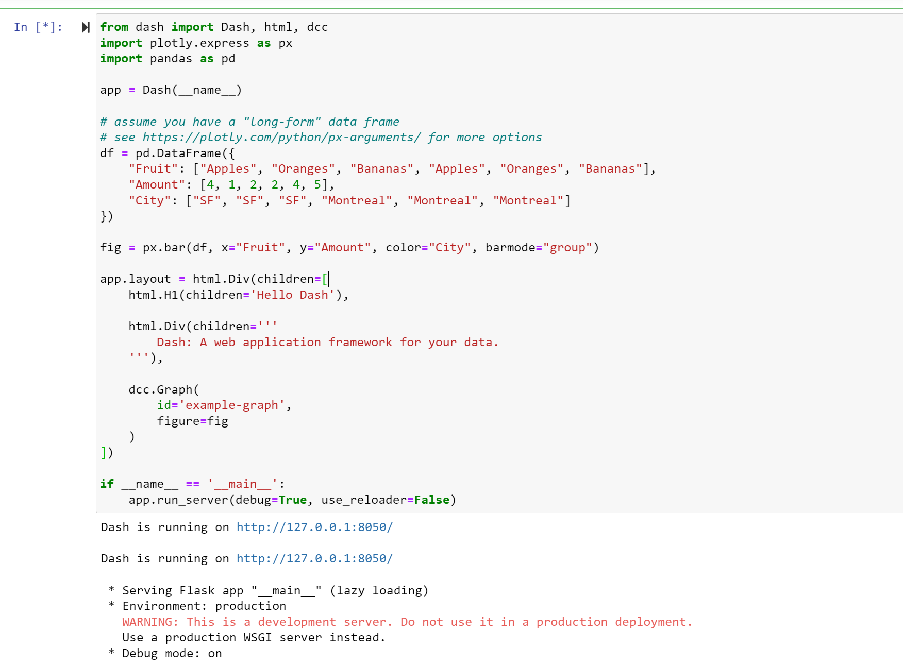
Dash Demo

Slide 14
Package Comparison (Visualization)
Feature | Bokeh | Dash
Main focus | Visualization | Web applications
Approach | Declarative | Imperative
Language | Python | Python
Interactive plotting | Yes | Yes
Dashboards | Yes | Yes
Tabular data support | Yes, with the DataTable widget | Yes, with the DataTable component
Integration with other libraries | Yes, can be used with Pandas and NumPy | Yes, can be used with Pandas and NumPy
Server requirements | Bokeh server required for some features | Dash can be used with any web server
Customization | Extensible with custom models | Customizable with Dash components and CSS
Learning curve | Moderate | Moderate

Slide 15
Choice (Visualization)
We have selected Bokeh over Dash and other libraries for the visualization aspect in our project.
Why:
Bokeh handles large datasets well as it has a custom storage class called ColumnDataSource which imitates the functionality between a pandas DataFrame and a dict. It can be passed to multiple graphs, which results in a shared dataset, linked between all visualisations.
It allows us to implement interactive visualizations and tools such as buttons, sliders, radio buttons, dropdowns, text input, tables.

Slide 16
Drawbacks/Remaining Concerns (Visualization)
Bokeh:
Bokeh is a library that somewhat has a middle-level interface, it often takes less code than Matplotlib but takes more code to produce the same plot as Seaborn, Altair, or Plotly.

Slide 17
References
PyOD - https://pyod.readthedocs.io/en/latest/
Sklearn - https://scikit-learn.org/stable/modules/outlier_detection.html
TensorFlow - https://www.tensorflow.org/
Bokeh - https://bokeh.org/
Dash - https://plotly.com/dash/

Slide 18
Questions?

Slide 19
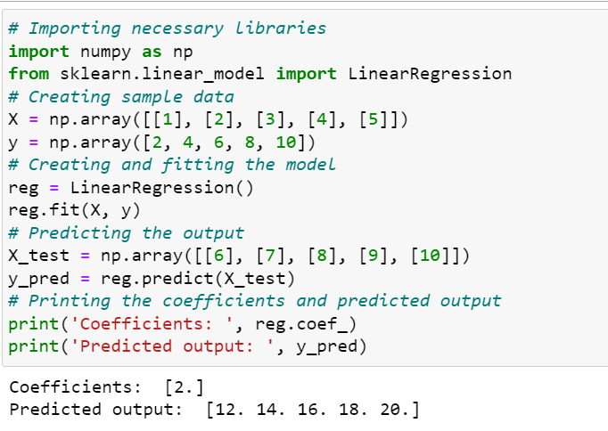
Sklearn Demo

