Slide 1
PREDICTIVE MAINTENANCE

Slide 2

Libraries
import pandas as pd
import numpy as np
import plotly.graph_objects as go
import plotly.express as px
from sklearn.svm import SVCfrom sklearn.model_selection import train_test_splitfrom sklearn.metrics import accuracy_score

Slide 3

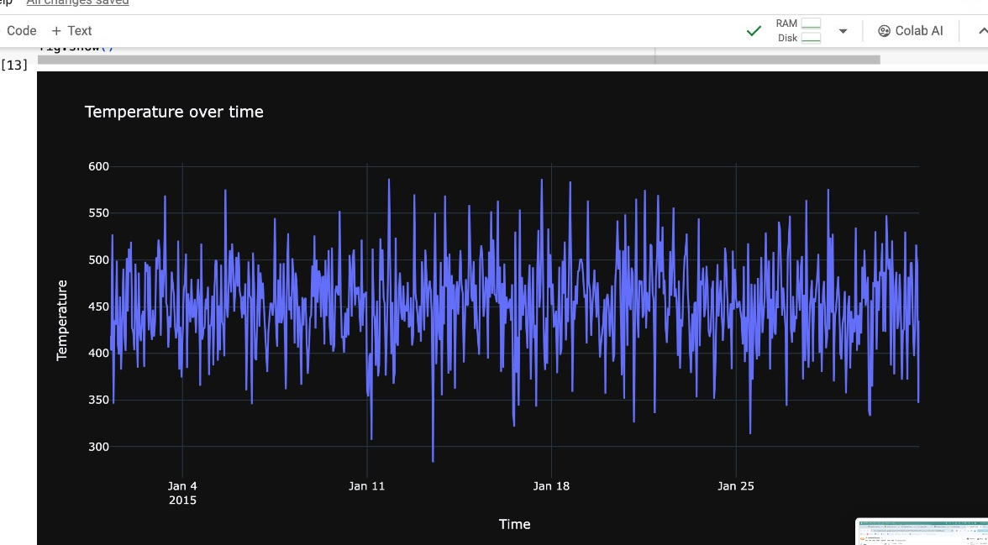
Graph

Slide 4
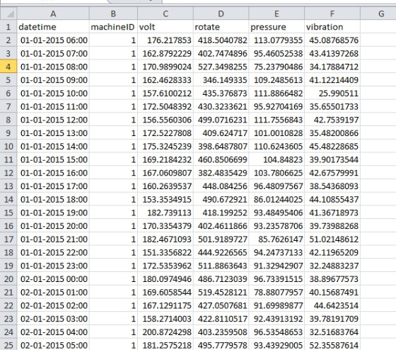
Dataset

Slide 5
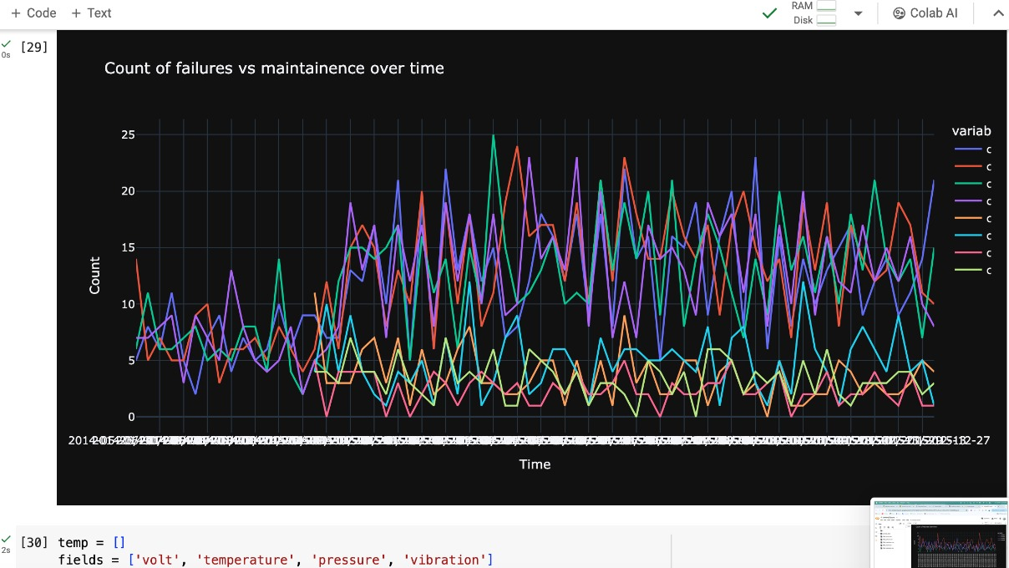
IMPLEMENTING PREDICTIVE MAINTENANCE Result

Slide 6
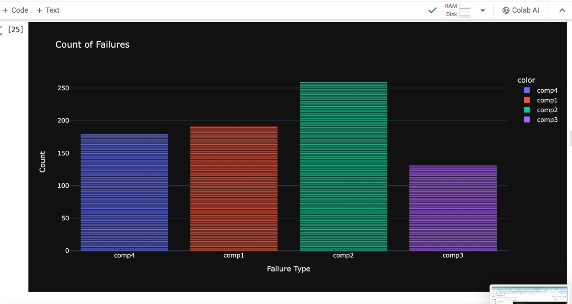
Count Failure

Slide 7
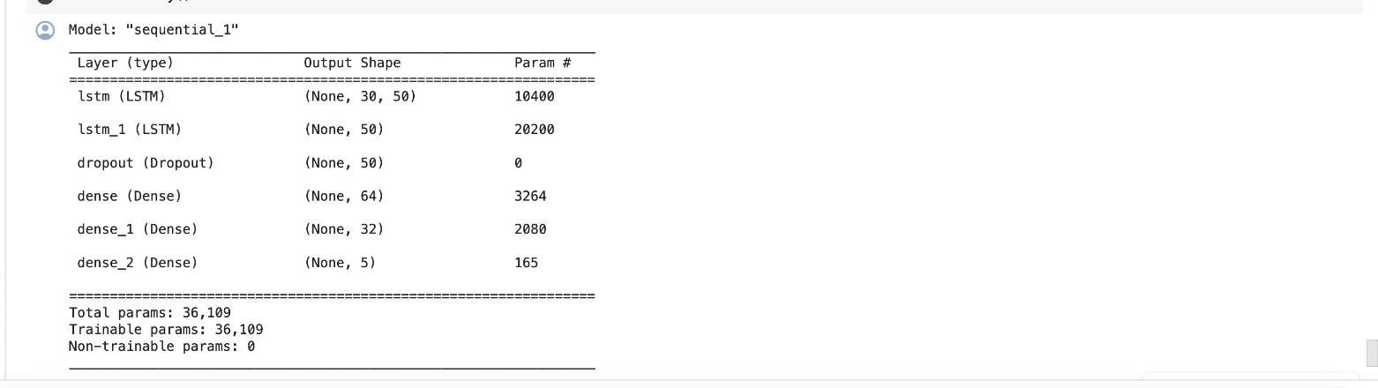
ACCURACY

Slide 8

Thanks!

