Slide 1

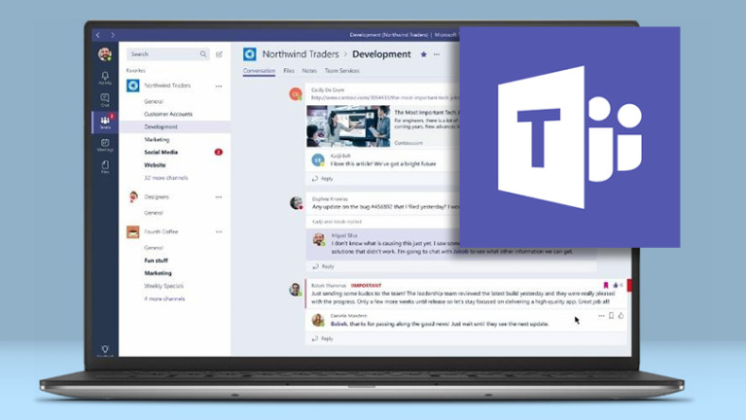
TOPIC: Microsoft Teams Clone
By: Prerna Khera

Slide 2
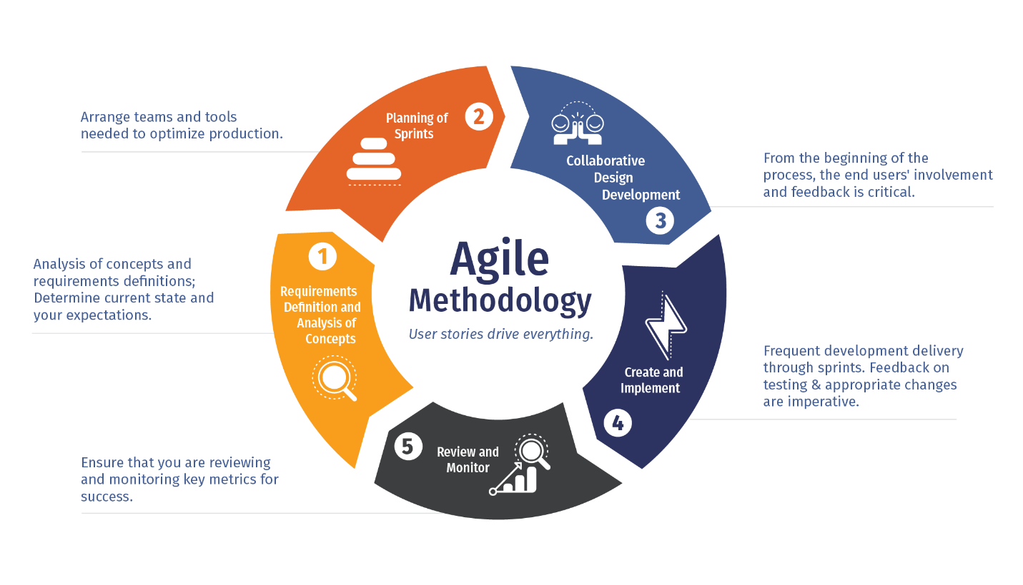

Slide 3
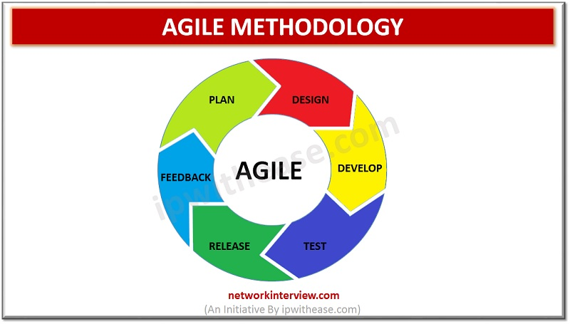
SPRINT 1
I explored my options of developing an android, iOS or web application.
I read about the potential packages that I could use (ended up using WebRTC, socket.io and Nodejs along with some HTML, CSS and JavaScript)
SPRINT 2
I designed a basic layout with HTML and CSS
I completed the backend using Nodejs and Socket.io.
I faced a lot of errors but managed to resolve them anyway.

Slide 4
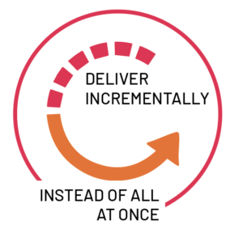
SPRINT 3
During the 3rd sprint I completed my frontend using HTML, CSS and JavaScript.
I integrated my backend in the frontend to make the application work using Socket.io.
I was able to have real-time communication in my web app by using WebRTC.
SPRINT 4
In the final sprint, I introduced more features in my app like chat functionality, screen sharing, recording etc.
I fixed all the errors I got.
Then finally, I deployed my web application on Heroku.

Slide 5
THANK YOU
MICROSOFT

