Slide 1
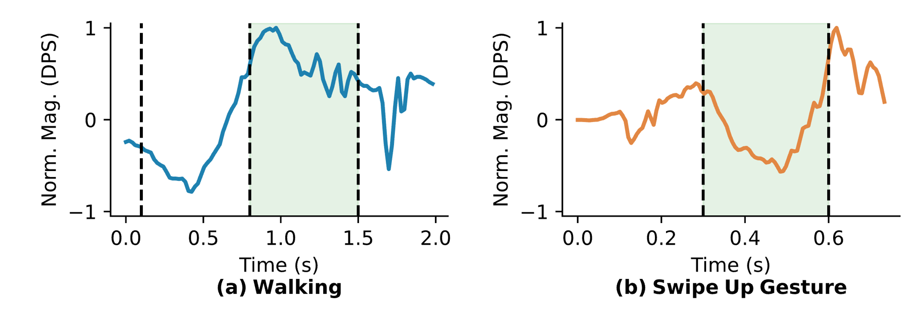
Heel-off
Toe-off
Heel-strike
Pre-stroke
Post-stroke
Swing
Nucleus

