Slide 1
Web Scraping Project
Formula 1 Racing Data
Prerna Roy & Gabriel Reganit
Notes:
Hahahah love it

Slide 2
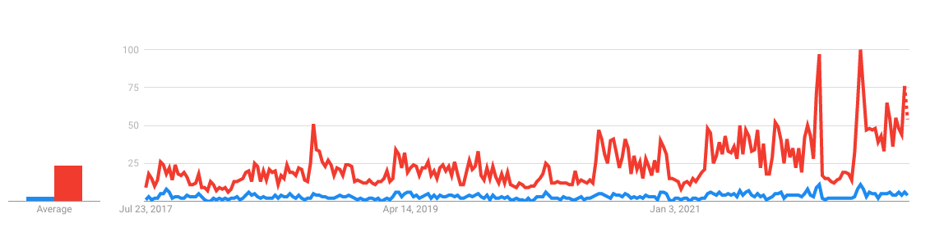

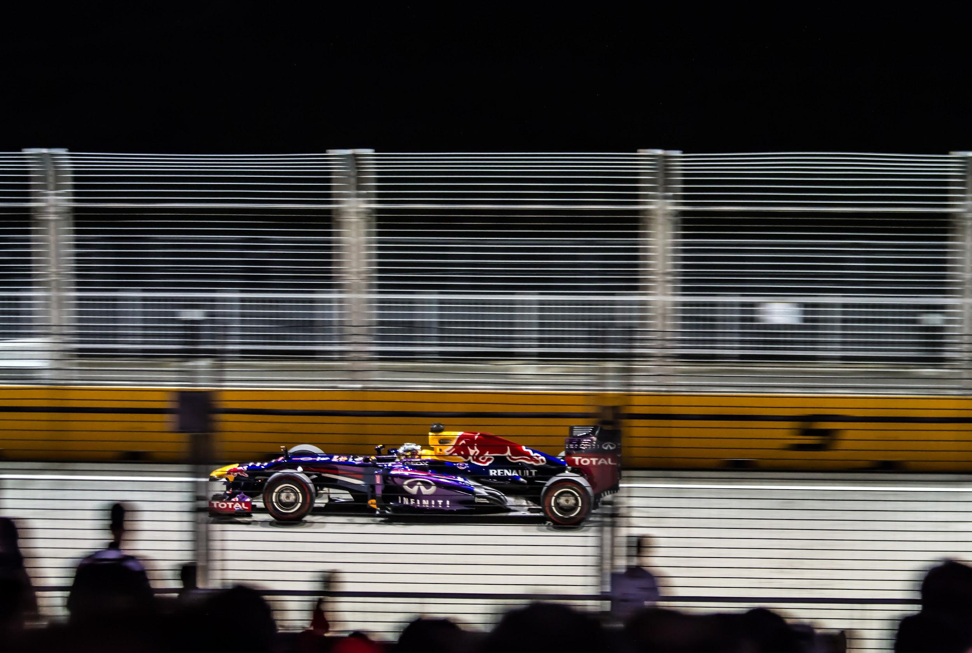
Aim
Formula 1 is a decades-old motorsport championship with a long history of innovation within motorsport. With the release of Netflix’s ‘Drive To Survive’, the past 5 years has seen as growing interest in the sport.
It is known that there are many factors that determine the outcome of every race. Our aim is to provide insight on some factors that have strong influences on race outcomes.

Slide 3
Business Value
01
Find which teams would yield highest ROI
Find which teams perform most consistently for long-term investment
Team Investors
02
Find which driver/team would have the potential to increase their brand awareness
Sponsorships
03
Find out which driver would most likely win or place in the top 3 in a Grand Prix
Find out which team/driver would win championship
Betting

Slide 4
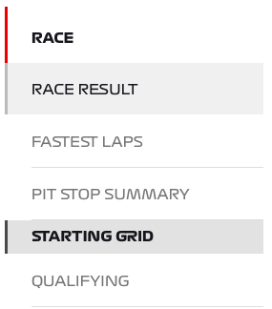
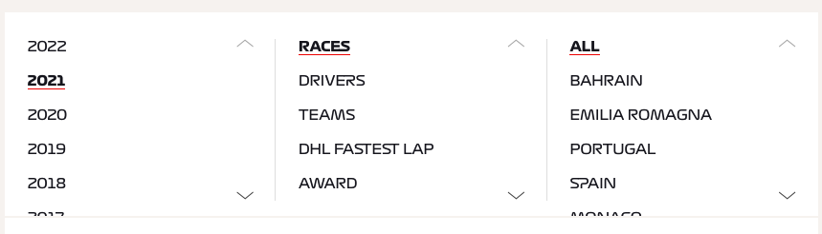
Scraping Process
Step 1
Step 2
Step 3
Collect all links for race results and starting grid per year per country.
Loop through each race result for per year and country.
Loop through each starting grid per year and country.
Libraries:
Beautiful Soup
Matplotlib
Seaborn
Numpy
Pandas
Requests
Python

Slide 5
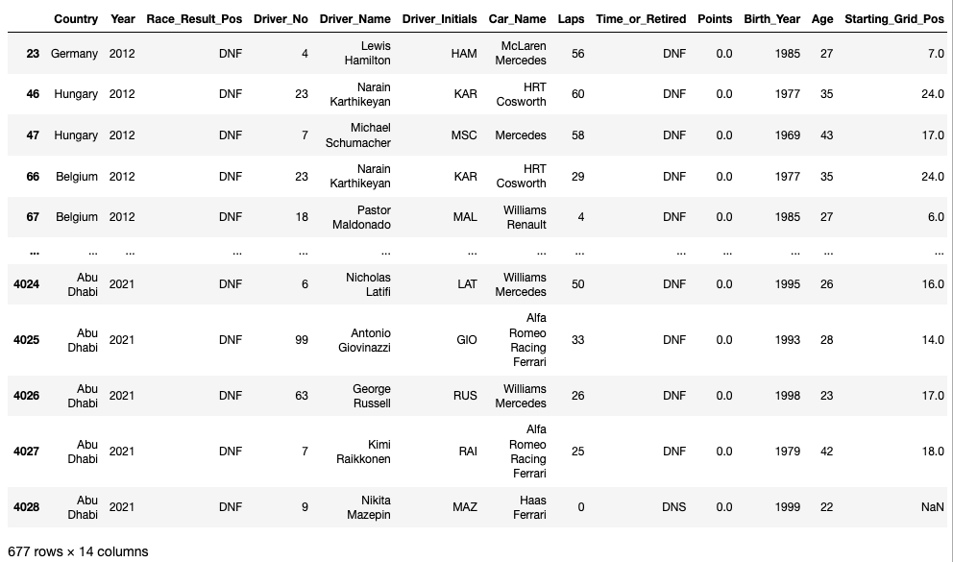
Data Preprocessing and Cleaning
Change Driver Names
Add last sprint results for 2021 Brazil, Italy, and UK into starting grid dataframe.
Change Driver_No, Starting_Grid_Pos, Race_Result_Pos, Age, Points, Laps into integer types.
Replace NC, EX, and DQ to DNF in Race_Results_Pos
Replace ‘70th Anniv’ Country to Great Britain, ‘Europe’ to Spain, and ‘Eifel’ to Germany.
Merge starting grid dataframe with race result dataframe (outer merge on common columns).
Remove ‘DNF’ and NaN values from Race_Results_Pos and Starting_Grid_Pos in merged dataframe.

Slide 6
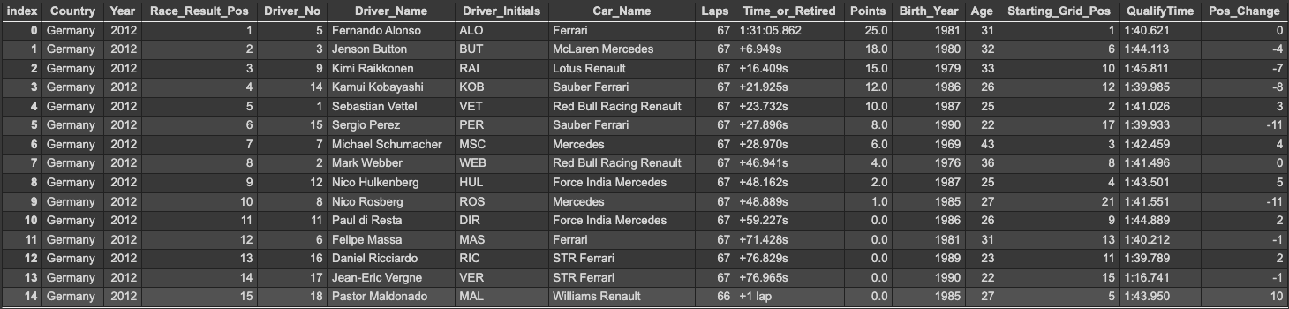
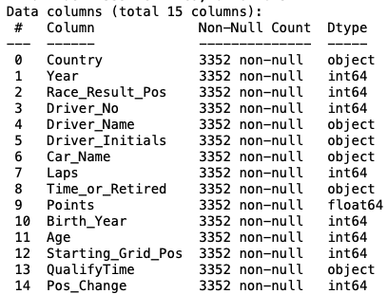
Final Dataframe
15 columns, 3352 rows after removal of NaN and DNF values from race result position and starting grid position.

Slide 7
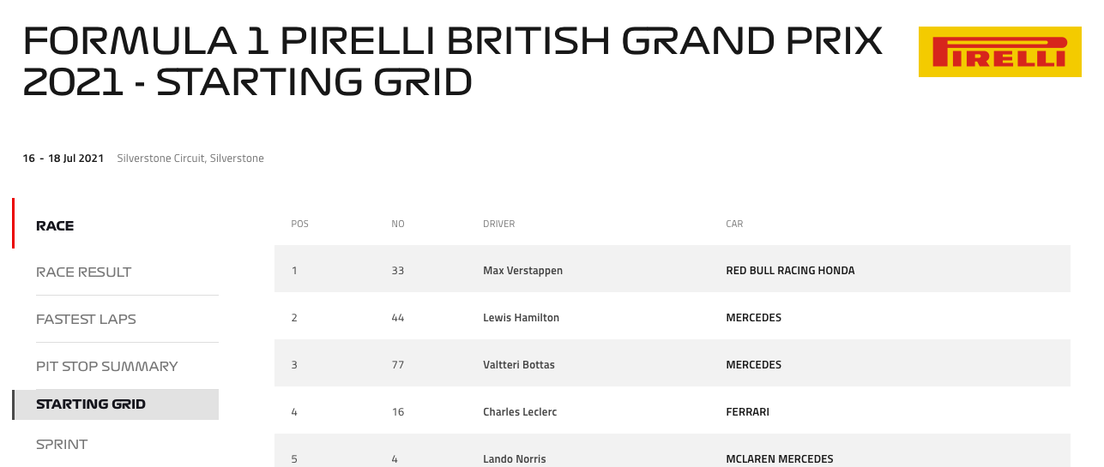
Challenges
2021 had 3 sprint races in lieu of the traditional qualifying round; data could not be web scraped automatically as previous years.
∴ Brazil, Great Britain, and Italy have missing starting grid times
Constant changing teams, team names, and drivers. Teams enter/leave the competition, drivers retire, new drivers join, etc.
Converting Time_or_Retired laps to seconds
Missing data
No qualifying time data for starting grid

Slide 8
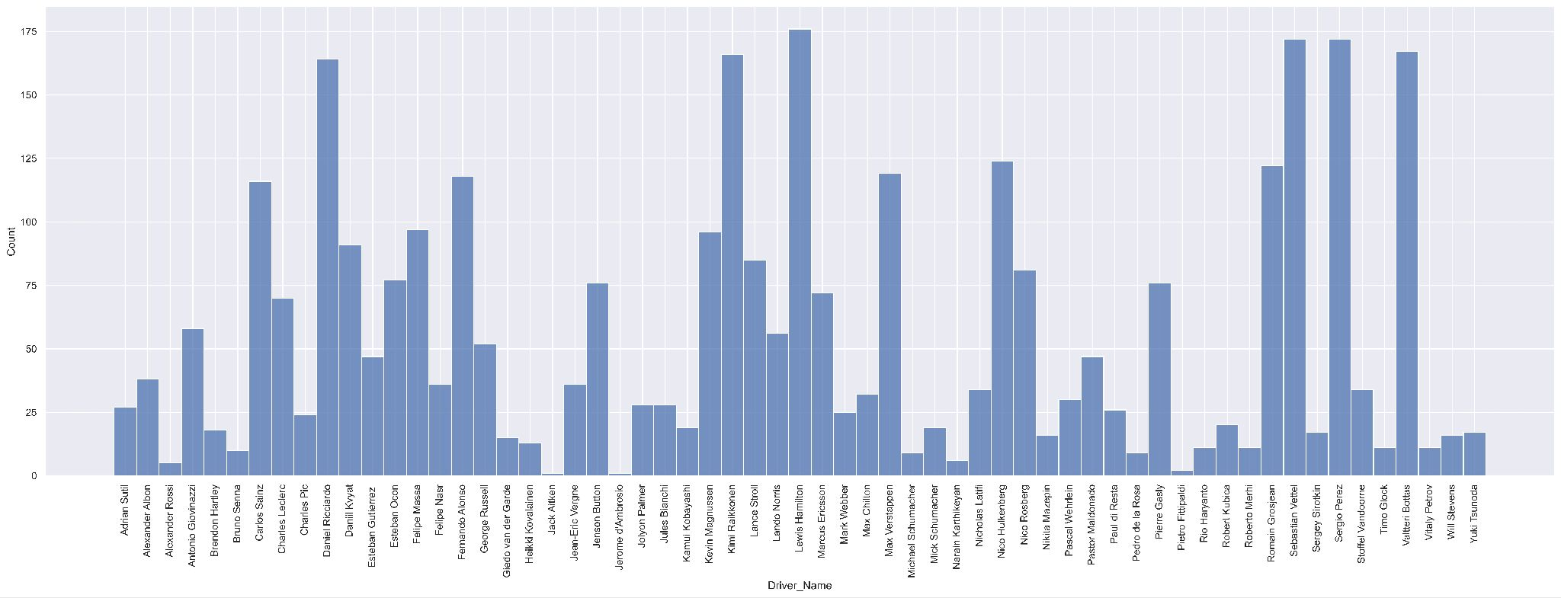
Driver Distribution across 2012 to 2021
Driver distribution is not uniform; some have competed much more between 2012 - 2021 than others.
Possibility of data being biased toward/against drivers that have participated more/less, respectively.
Notes:
Distribution of drivers from 2012 - 2021
Driver age distribution
Distribution of grid positions in dataset
Normally just 20 positions, a few years had more
Points to note:
Likely to skew in favour of drivers that have appeared regularly between 2012 - 2021
Drivers have retired, changed teams, passed away, or just entered F1
Even per race, drivers can change (reserve drivers used, sick, etc)

Slide 9
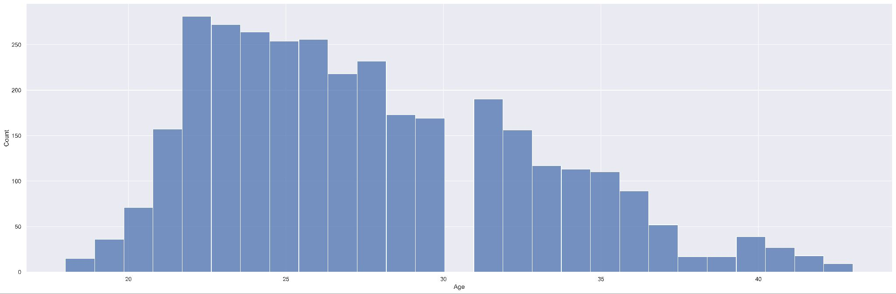
Age of driver distribution
Distribution is not perfectly normal, and has a slight skew toward younger drivers.
Notes:
Distribution of drivers from 2012 - 2021
Driver age distribution
Distribution of grid positions in dataset
Normally just 20 positions, a few years had more
Points to note:
Likely to skew in favour of drivers that have appeared regularly between 2012 - 2021
Drivers have retired, changed teams, passed away, or just entered F1
Even per race, drivers can change (reserve drivers used, sick, etc)

Slide 10
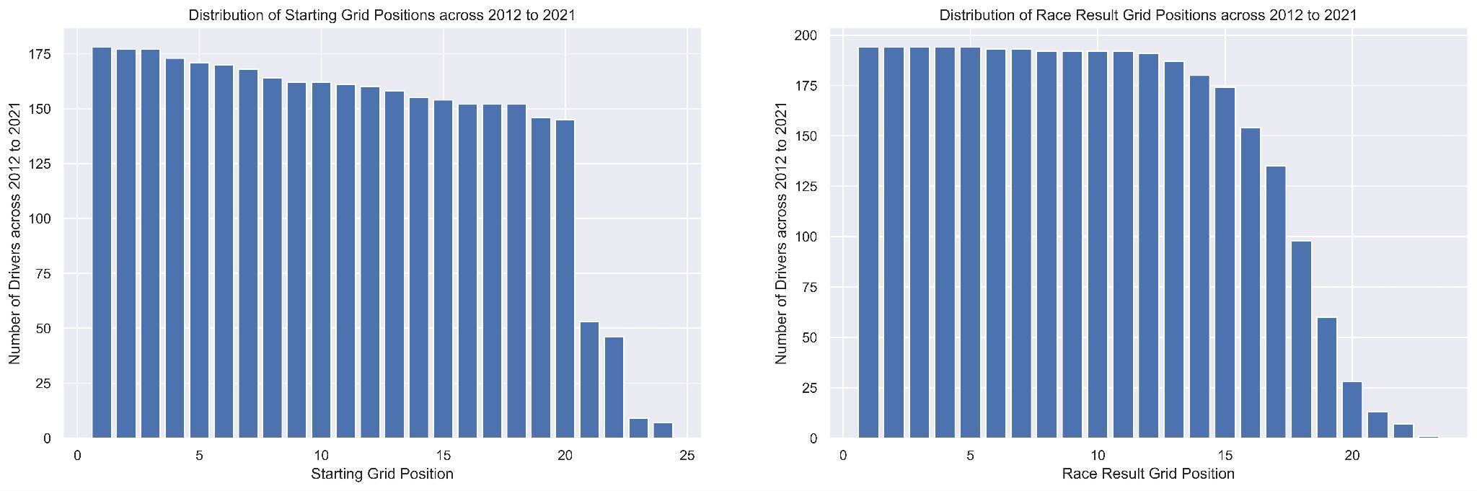
Distribution of data
Typically, there are only 20 cars racing. Occasionally, there are more than 20. As seen from the starting grid and race result distributions, the value counts of positions > 20 taper off.
Often there are failures/accidents/events during the race that reduces that total number of cars racing; this leads to fewer positions in race result grid positions and explains why there is a drastic reduction in value counts. The sample of data we have collected and cleans seems to accurately reflect this.
Notes:
Distribution of drivers from 2012 - 2021
Driver age distribution
Distribution of grid positions in dataset
Normally just 20 positions, a few years had more
Points to note:
Likely to skew in favour of drivers that have appeared regularly between 2012 - 2021
Drivers have retired, changed teams, passed away, or just entered F1
Even per race, drivers can change (reserve drivers used, sick, etc)

Slide 11
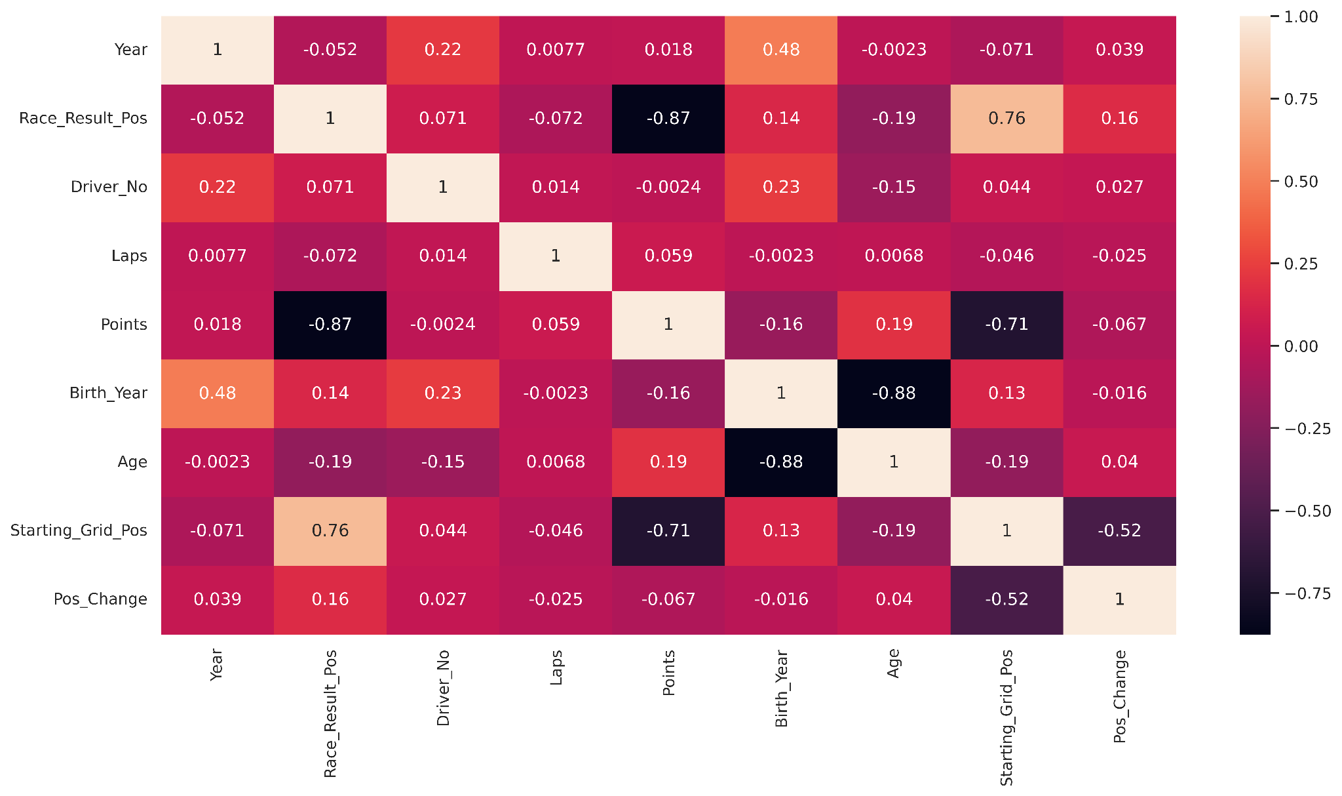
Heatmap correlation across numerical variables
Strong positive correlation between race result position and starting grid position (r = 0.76). Correlation between points and race result position and starting grid position (lower on the grid results in fewer points).

Slide 12
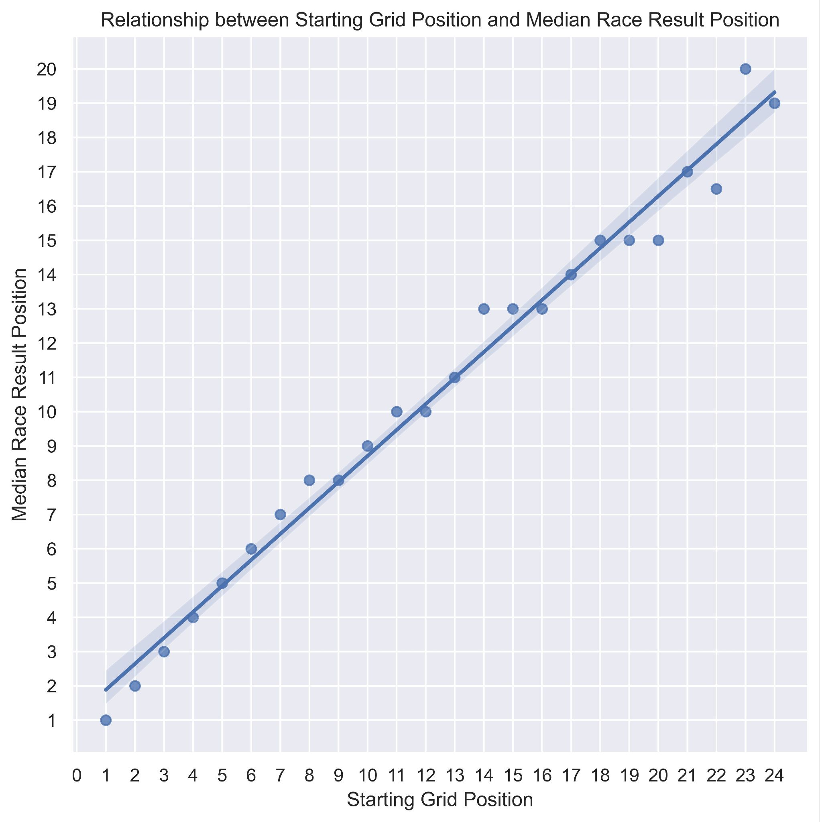
Starting Grid Position and Race Result Position
From the heatmap, a strong positive correlation between race result position and starting grid position (r = 0.76) was found.
The median race result position for each starting grid position demonstrates a strong correlation between the starting and ending positions of the drivers.
This can be an important metric to know for betting, and for teams to determine their racing strategy.

Slide 13
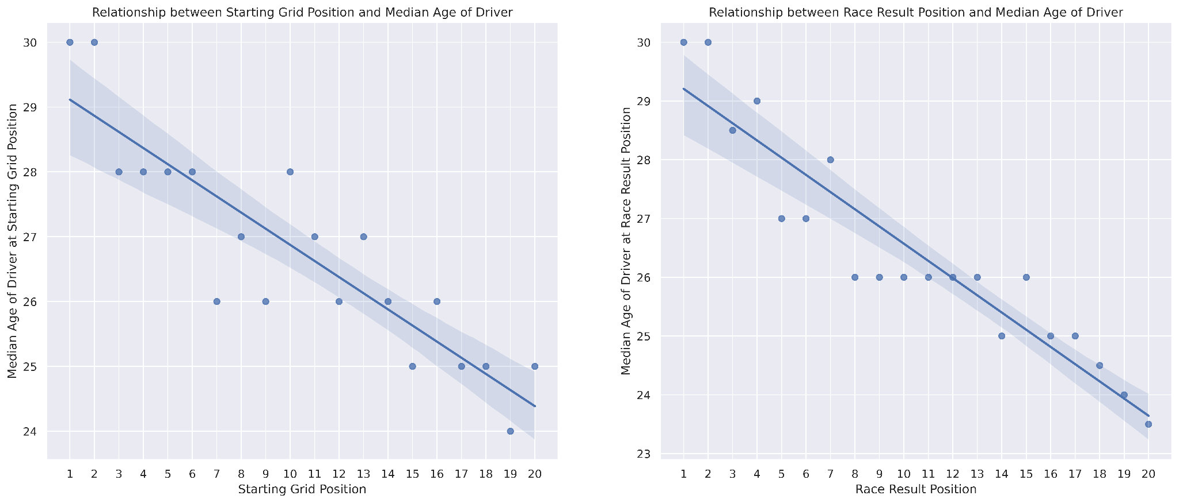
Median age of driver and grid position
There is also a moderate negative correlation between the median age of drivers and their starting/ending positions. This indicates that older drivers often start higher on the grid (closer to 1), whilst younger drivers tend to start further down the grid (closer to 20).
Important for teams: contract renewals, taking on new/younger drivers could be riskier.

Slide 14
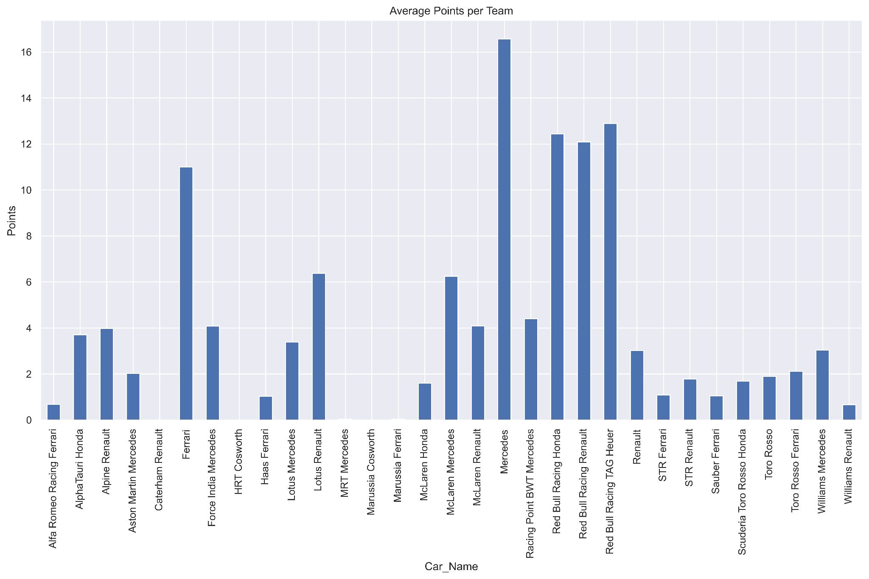
Driver and team performance (points)
From 2012 to 2021, Mercedes acquires the most points per race.
Following this is Red Bull Racing, Ferrari, Renault, and McLaren.
For investors looking for reliable performance, Mercedes is the best option.

Slide 15
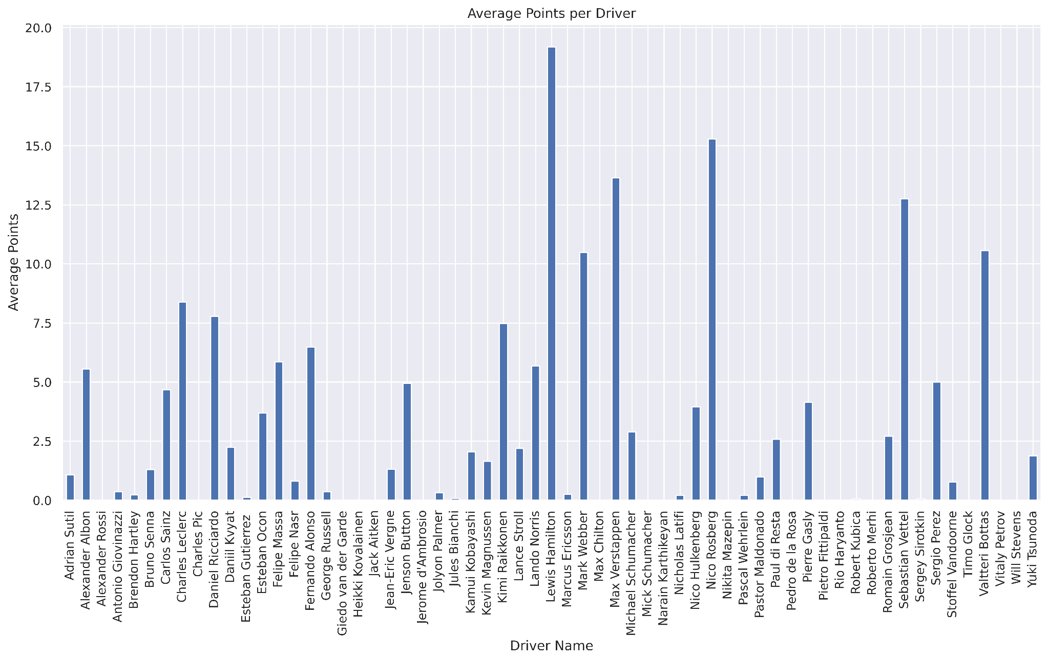
Driver and team performance (points)
For 2012 to 2021, Lewis Hamilton averages around 19 points per grand prix (out of 25 available points).
Highest scoring driver on average out of all drivers between 2012 to 2021.
You could expect him to be in the first or second position per race.
Note: 2012 to 2021 data could be biased toward Hamilton, as he participated every year whereas many others retired/joined during this time.

Slide 16
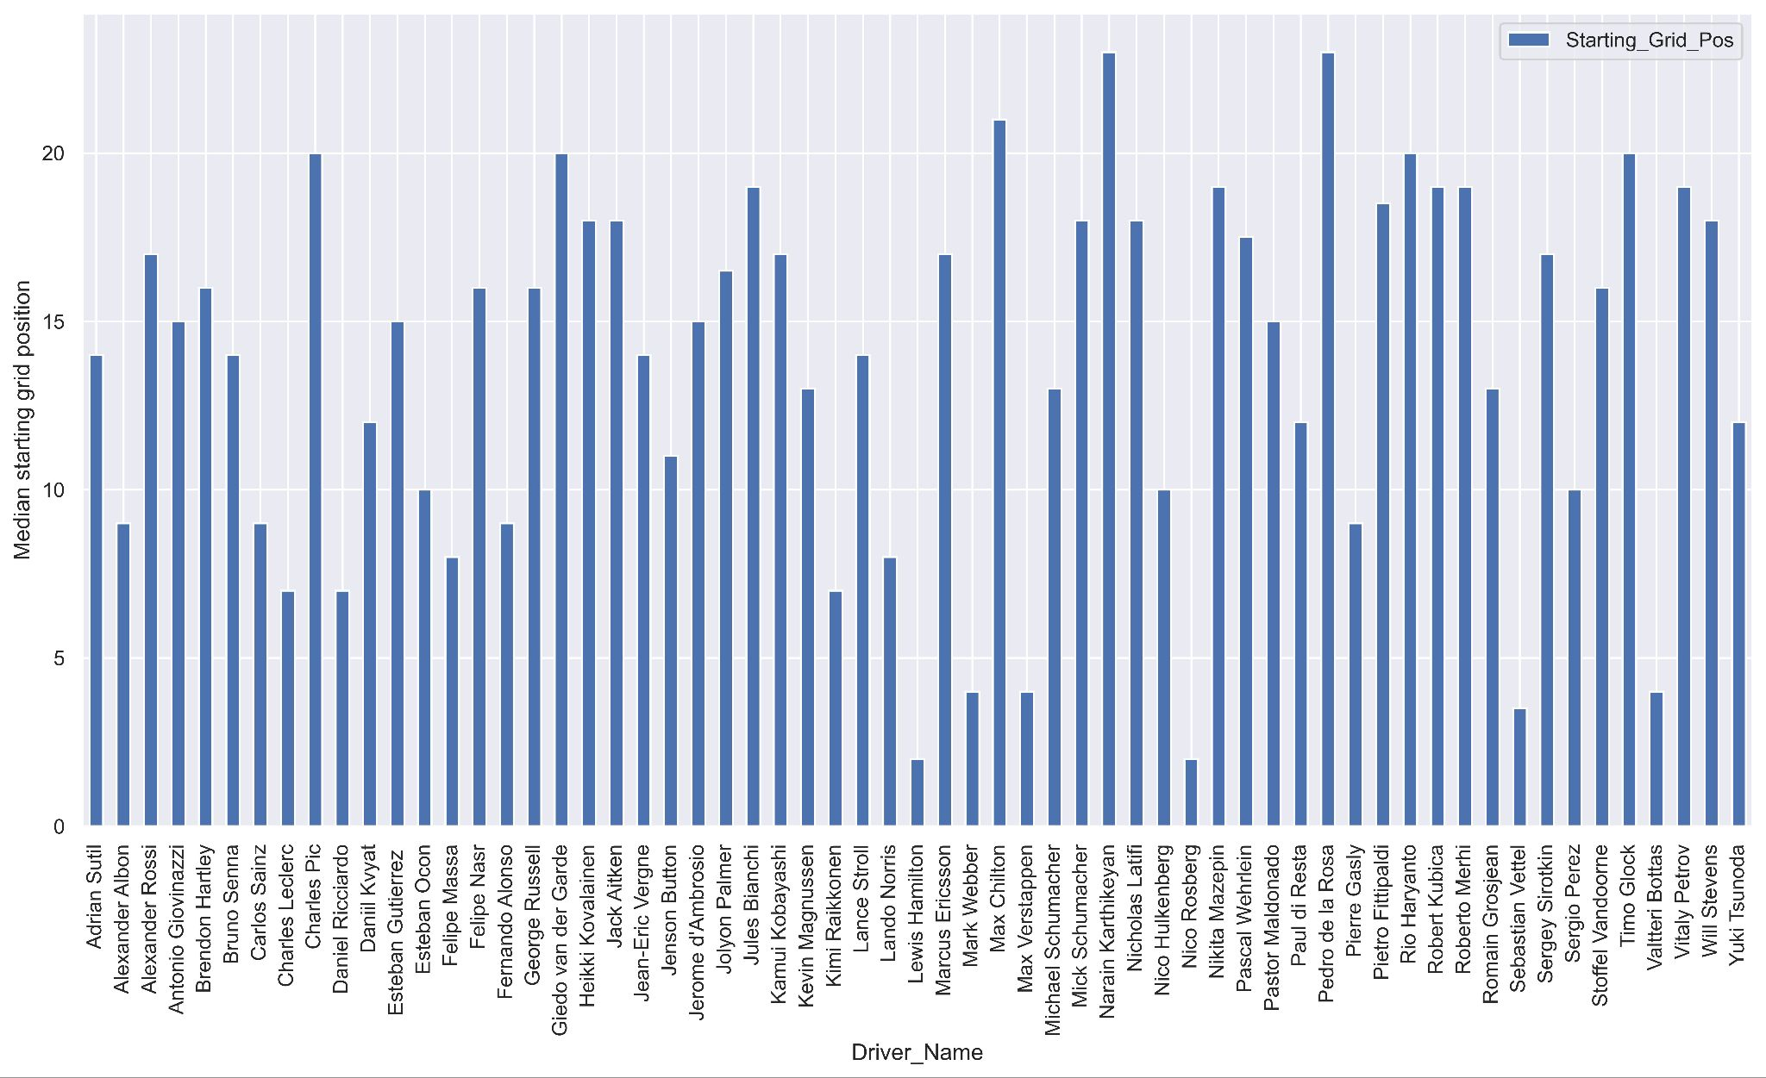
Median Starting Grid Position per Driver
*Drivers in the top 10 on average: Hamilton, Albon, Sainz, Leclerc, Ricciardo, Alonso, Raikkonen, Norris, Verstappen, Vettel, Perez, Bottas
*current 2022 drivers

Slide 17
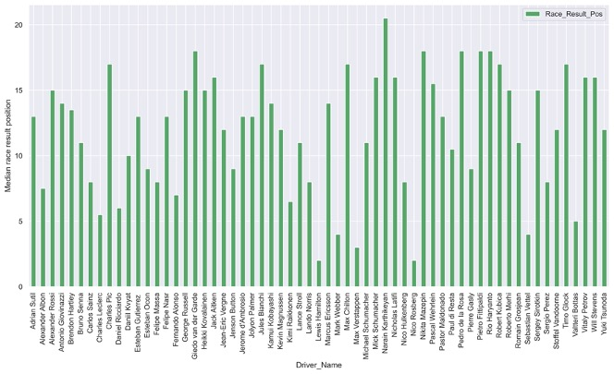
Median Race Result Position per Driver
*Drivers in the top 10 on average: Hamilton, Albon, Sainz, Leclerc, Ricciardo, Alonso, Raikkonen, Norris, Verstappen, Vettel, Bottas, Perez, and Ocon.
*current 2022 drivers

Slide 18
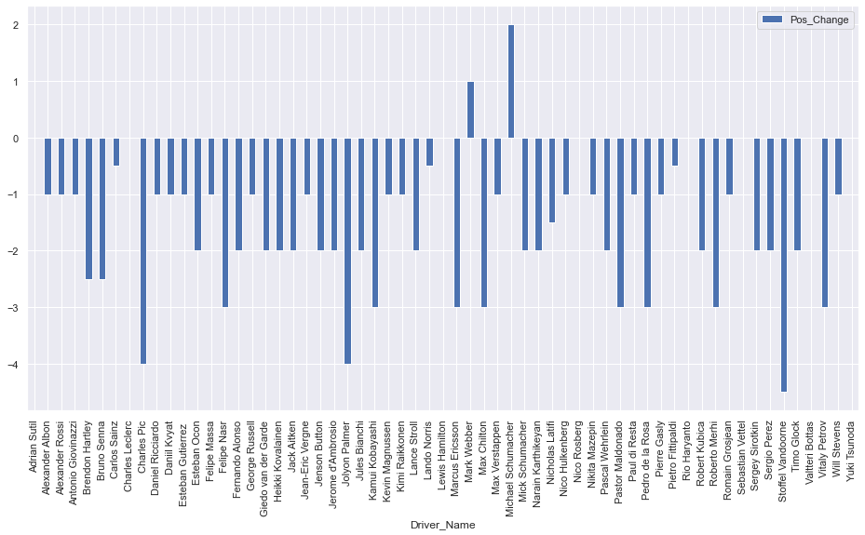
Driver performance (position)
Most drivers average losing their starting grid positions.
Hamilton, Bottas, Leclerc, Vettel, Sainz, and Tsunoda on average keep their position (consistent).
Mark Webber and Michael Schumacher tend to move up positions for the years still raced in (high performing).
Note: Webber and Schumacher did not participate in all years from 2012-2021.
Insights:

Slide 19
So who is…
Best Performing Driver | Lewis Hamilton
Best Performing Team | Mercedes
Most Consistent Driver | Lewis Hamilton
Most Consistent Team | Mercedes

Slide 20
Recommendations & Future Work
Compute for the performance of driver using their Time_or_Retired data
Convert all values to mm:ss
Replace +x laps (+1 lap, +2 laps) to the average time of the position 1 driver
Enrich dataset with engine name and check the performance based on the time and position finished
Predict the positions drivers will finish based on past results for each grand prix (country)

Slide 21
Q&A
Thank you!

