Slide 1
School of Computer Science and Information Technology
Devi Ahilya Vishwavidyalaya, Indore
INTELLIGENT AUTO-SCALING IN KUBERNETES:
A Machine Learning Based Predictive Approach
Guide Name:
Presented by:
Dr. Shraddha Masih
Prerna Tank
M.Tech(CS) | 2410512
Intelligent Auto-Scaling in Kubernetes: A Machine Learning Based Predictive Approach | Prerna Tank (2410512)

Slide 2
Agenda
01
02
Problem & Solution
4 Research Contributions
Reactive HPA limitations and our predictive ML approach
Multi-Metric LSTM, Drift Detection, Cost-Aware Scaling, Confidence Gate
03
04
System Architecture & DevOps
Technical Deep Dives
CI/CD pipeline, GitOps with ArgoCD, 3-node Kubernetes cluster
LSTM model, drift detection, cost tracking, confidence gating
05
06
Testing & Results
Conclusion & Future Work
21 unit tests, experimental comparison, related work gap analysis
Key findings, live demo, and future research directions
Intelligent Auto-Scaling in Kubernetes: A Machine Learning Based Predictive Approach | Prerna Tank (2410512)

Slide 3
Introduction
WHAT IS KUBERNETES AUTO-SCALING? - Automatically adjusts application replicas based on load
- Ensures high availability during traffic spikes
- Optimizes resource utilization and cost CURRENT LIMITATIONS: REACTIVE Scaling → Waits for metrics to cross threshold → Scaling happens AFTER load increases Performance Degradation → Users experience latency during scale-up Resource Wastage → Over-provisioning to compensate for lag → 20-30% cost inefficiency
OUR GOAL:
PROACTIVE Scaling using
Machine Learning
Predict load BEFORE it happens Scale up in advance
Intelligent Auto-Scaling in Kubernetes: A Machine Learning Based Predictive Approach | Prerna Tank (2410512)

Slide 4
Problem Statement
Kubernetes Horizontal Pod Autoscaler is fundamentally reactive
~120s
SLA
$$$
2 min
Scaling Delay
Violations During Spikes
Wasted Resources
User Impact
Reactive, Not Proactive
Cold Start Penalty
Over-Provisioning Waste
HPA only acts AFTER CPU exceeds threshold. By then, users are already experiencing degraded performance.
New pods need time to pull images, start containers, and warm up. This adds 60-120 seconds of delay.
To compensate, teams over-provision resources, leading to 30-50% wasted compute capacity.
Intelligent Auto-Scaling in Kubernetes: A Machine Learning Based Predictive Approach | Prerna Tank (2410512)

Slide 5
Proposed Solution
Predictive Auto-Scaling using LSTM Neural Networks
Traditional HPA (Reactive)
Our Approach (Predictive)
• Monitors current CPU utilization only • Scales AFTER threshold is breached • ~120 second delay before new pods are ready • Single metric (CPU) decision making • No awareness of cost implications
• Forecasts CPU load 30 minutes ahead using LSTM • Scales BEFORE load arrives (proactive) • Zero scaling delay for predicted traffic spikes • Multi-metric input (CPU + Memory + Network) • Cost tracking for every scaling decision
Predicted CPU(t+30min) = LSTM( CPU(t), Memory(t), Network(t) ) → Scale proactively
Intelligent Auto-Scaling in Kubernetes: A Machine Learning Based Predictive Approach | Prerna Tank (2410512)

Slide 6
Most Important
4 Unique Research Contributions
Not found together in any single prior work
Contribution 1
Contribution 2
Multi-Metric LSTM
Drift Detection
Uses CPU + Memory + Network I/O as input features instead of CPU alone. Network spikes precede CPU spikes by 1-2 intervals, enabling earlier prediction.
Monitors prediction accuracy using sliding window MAPE. Triggers automatic model retraining when accuracy drops below threshold, preventing stale predictions.
Contribution 3
Contribution 4
Cost-Aware Scaling
Confidence-Gated Self-Healing
Tracks dollar cost per scaling decision ($0.05/pod/hour). Records every scale event and calculates ROI, enabling cost-benefit analysis of ML predictions.
When prediction confidence drops below 70%, system falls back to traditional HPA. Safety net ensures uncertain ML predictions never cause wrong scaling.
Intelligent Auto-Scaling in Kubernetes: A Machine Learning Based Predictive Approach | Prerna Tank (2410512)

Slide 7
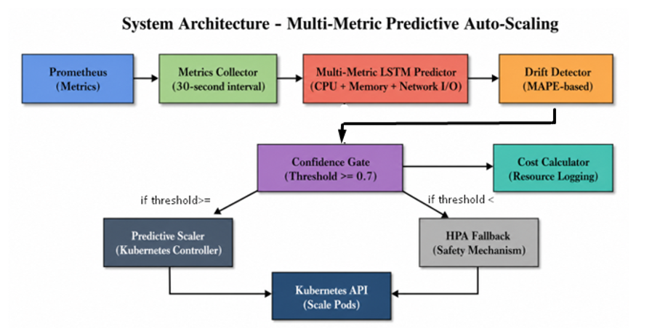
System Architecture
Predictive Scaling Loop
Prometheus Metrics Collection
ML Predictor LSTM Model
Predictive Scaler Decision Engine
K8s AI Scale Replicas
→
→
→
Prediction
Action
30-minute forecast with confidence scoring
Proactive scaling with cost tracking & drift check
Intelligent Auto-Scaling in Kubernetes: A Machine Learning Based Predictive Approach | Prerna Tank (2410512)

Slide 8
Multi-Metric LSTM Model
Architecture
Why Multi-Metric?
Input: (batch, seq_len, 3) ↓ LSTM Layer 1: 64 hidden units ↓ LSTM Layer 2: 64 hidden units ↓ Fully Connected: 64 → 1 ↓ Output: Predicted CPU (t+30min)
Input: (batch, seq_len, 3) ↓ LSTM Layer 1: 64 hidden units ↓ LSTM Layer 2: 64 hidden units ↓ Fully Connected: 64 → 1 ↓ Output: Predicted CPU (t+30min)
Network Precedes CPU
Network I/O spikes 1-2 intervals BEFORE CPU spikes. By including network data, the model gains early warning signals.
Network I/O spikes 1-2 intervals BEFORE CPU spikes. By including network data, the model gains early warning signals.
Memory Correlation
Memory Correlation
Memory usage patterns add context that helps distinguish between different types of workload increases.
Memory usage patterns add context that helps distinguish between different types of workload increases.
Training Configuration
Training Configuration
50 Epochs | Adam Optimizer | MSE Loss | 2 LSTM Layers
50 Epochs | Adam Optimizer | MSE Loss | 2 LSTM Layers
3 Features: CPU + Memory + Network I/O
Intelligent Auto-Scaling in Kubernetes: A Machine Learning Based Predictive Approach | Prerna Tank (2410512)

Slide 9
Drift Detection Mechanism
Auto-retrain when prediction accuracy degrades
How It Works
Why Drift Detection?
1. Maintain sliding window of last 20 prediction errors 2. Calculate MAPE (Mean Absolute Percentage Error) 3. Compare against threshold: 50% 4. If MAPE > 50% → Drift Detected! 5. Trigger emergency retrain
Traffic Patterns Change
User behavior evolves over time. A model trained on old patterns becomes inaccurate on new data.
Prevents Bad Decisions
A stale model making wrong predictions is worse than no model. Drift detection catches this early.
Automated Recovery
No manual intervention needed. System detects degradation and retrains autonomously.
MAPE = (1/n) × Σ |actual - predicted| / actual × 100
Intelligent Auto-Scaling in Kubernetes: A Machine Learning Based Predictive Approach | Prerna Tank (2410512)

Slide 10
Confidence-Gated Self-Healing
Safety net: fall back to HPA when ML is uncertain
Confidence = 1.0 - (training_loss × 100) | Threshold: 70%
Confidence ≥ 70%
Confidence < 70%
ML Prediction Active • Use LSTM predicted CPU value • Scale proactively before load • Track cost of scaling decision • Monitor for drift
Fallback to HPA • Disable ML-based scaling • Let Kubernetes HPA handle scaling • Log confidence failure event • Continue monitoring for recovery
Key Insight: An uncertain ML prediction causing wrong scaling is worse than reactive HPA. The confidence gate ensures the system never makes overconfident mistakes.
Intelligent Auto-Scaling in Kubernetes: A Machine Learning Based Predictive Approach | Prerna Tank (2410512)

Slide 11
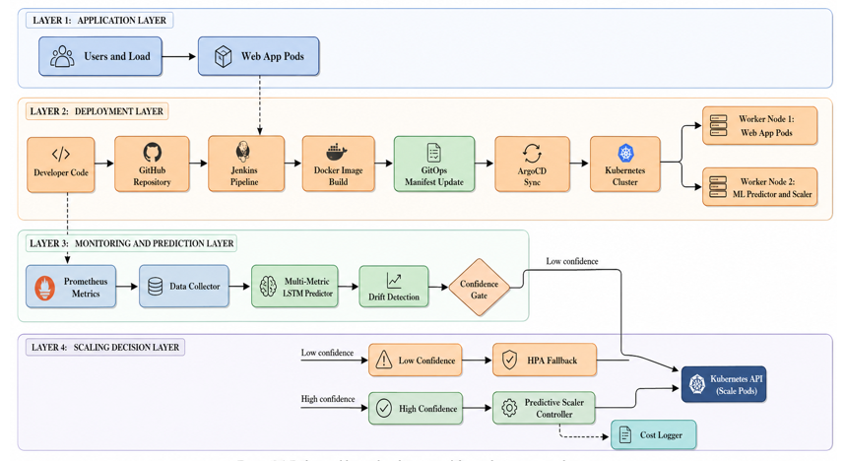
CI/CD Pipeline
Intelligent Auto-Scaling in Kubernetes: A Machine Learning Based Predictive Approach | Prerna Tank (2410512)

Slide 12
GitOps with ArgoCD
Declarative, version-controlled deployments
Developer
Git Push
GitHub Repo Source of Truth
ArgoCD Watches Repo
K8s Cluster Auto-Synced
→
→
→
→
Auto-Sync
Self-Healing
ArgoCD watches the GitHub repo. When Jenkins pushes new manifests, ArgoCD automatically syncs the cluster state.
If someone manually changes K8s resources, ArgoCD detects drift and reverts to the desired state in Git.
Declarative
Rollback
Desired state is defined in Git manifests. Actual state in Kubernetes is continuously reconciled to match.
Every deployment is a Git commit. Rolling back is as simple as reverting the commit. Full audit trail.
Intelligent Auto-Scaling in Kubernetes: A Machine Learning Based Predictive Approach | Prerna Tank (2410512)

Slide 13
3-Node Kubernetes Cluster
Production infrastructure on private cloud (VPC)
Master Node
Worker-App
Worker-Data
master-node
worker-app
worker-data
Control Plane Jenkins CI/CD ArgoCD
Web Application Predictive Scaler
ML Predictor Prometheus
K8s 1.30.14 | containerd | Traefik Ingress | Prometheus | ArgoCD
Dedicated node separation ensures ML workloads don't compete with application traffic, while the master node handles orchestration and CI/CD tooling.
Intelligent Auto-Scaling in Kubernetes: A Machine Learning Based Predictive Approach | Prerna Tank (2410512)

Slide 14
Experimental Setup
Real 3-node cluster — 6 ablation configurations — 412,341 requests
Hardware & Workload
Ablation Variants
Cluster
3-node Kubernetes v1.30.14
E1
Full System
Each node
4 vCPU | 8 GB RAM | 50–60 GB disk
All 4 contributions active simultaneously
Cloud VMs
Ubuntu 22.04 LTS
Uptime
49 days continuous at evaluation
BL
Baseline HPA
Default Kubernetes CPU-threshold scaling
Load tool
Custom Python requests client
E2
No Drift
Target
Traefik Ingress NodePort 30080
Static model — no automatic retraining
Rate
50 req/s per experiment
Duration
1800 seconds (30 minutes) per run
E3
No Confidence
Runs
6 experiments
LSTM always applied unconditionally
Total
412,341 HTTP requests (~3 hours)
E4
No Multi-Metric
Failures
Zero connection failures
CPU-only prediction — no memory/network
Metrics
SLA violations | Latency P95/P99
E5
No Cost
Prediction MAPE | Cost USD/day
No $ logging — scaling logic unchanged
Intelligent Auto-Scaling in Kubernetes: A Machine Learning Based Predictive Approach | Prerna Tank (2410512)
9

Slide 15
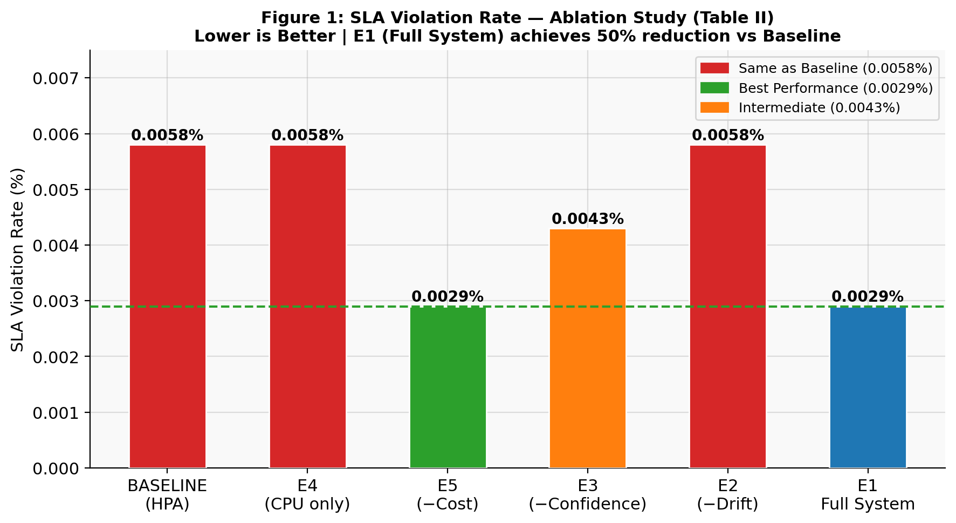
Results — SLA Violation Rate
E1 Full System achieves 50% reduction vs HPA baseline (0.0029% vs 0.0058%)
Key Findings
E1 Full System
0.0029% violations
50% reduction
vs HPA baseline
E2 No Drift
0.0058% — same as HPA
E4 CPU-only
0.0058% — same as HPA
E3 No Confidence
0.0043% — intermediate
E5 No Cost
0.0029% — equals E1
Intelligent Auto-Scaling in Kubernetes: A Machine Learning Based Predictive Approach | Prerna Tank (2410512)
10

Slide 16
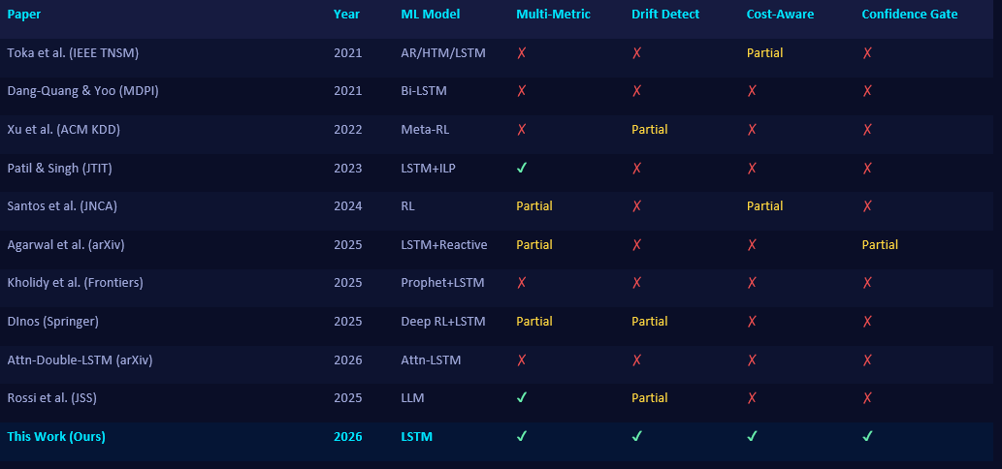
Related Work — Gap Analysis
10 recent papers (2021–2026) reviewed from IEEE, ACM, Springer, Elsevier, arXiv
Year
ML Model
Multi-Metric
Drift Detect
Cost-Aware
Confidence Gate
Toka et al. (IEEE TNSM)
2021
AR/HTM/LSTM
✗
✗
Partial
✗
Dang-Quang & Yoo (MDPI)
2021
Bi-LSTM
✗
✗
✗
✗
Xu et al. (ACM KDD)
2022
Meta-RL
✗
Partial
✗
✗
Patil & Singh (JTIT)
2023
LSTM+ILP
✓
✗
✗
✗
Santos et al. (JNCA)
2024
RL
Partial
✗
Partial
✗
Agarwal et al. (arXiv)
2025
LSTM+Reactive
Partial
✗
✗
Partial
Kholidy et al. (Frontiers)
2025
Prophet+LSTM
✗
✗
✗
✗
DInos (Springer)
2025
Deep RL+LSTM
Partial
Partial
✗
✗
Paper
Attn-Double-LSTM (arXiv)
2026
Attn-LSTM
✗
✗
✗
✗
Rossi et al. (JSS)
2025
LLM
✓
Partial
✗
✗
This Work (Ours)
2026
LSTM
✓
✓
✓
✓
Key Finding: No single paper combines all 4 contributions. Our work is the first to integrate all 4 + end-to-end DevOps pipeline.
Intelligent Auto-Scaling in Kubernetes: A Machine Learning Based Predictive Approach | Prerna Tank (2410512)

Slide 17
What's New in Our Research?
Why our paper is different from all 10 reviewed papers
1. Multi-Metric LSTM
2. Drift Detection + Auto-Retrain
Others: Most papers use single metric (CPU or HTTP requests) Patil 2023: Uses multi-metric BUT no drift/cost/confidence We added: CPU + Memory + Network as 3 correlated features. Network spikes predict CPU spikes 1-2 intervals ahead.
Others: No paper uses MAPE sliding window for drift DInos 2025: Transfer learning (different approach) We added: Sliding window of 20 errors, MAPE threshold > 50% triggers emergency retrain. Real-time accuracy monitoring.
3. Cost-Aware Scaling
4. Confidence-Gated HPA Fallback
Others: No paper tracks $ per scaling decision Gwydion 2024: Cost-aware rewards but no per-event $ tracking We added: Every scale-up/down logged with exact $/hr impact. Enables ROI analysis: ML predictions vs reactive HPA.
Others: No paper falls back to HPA based on confidence Agarwal 2025: Hybrid but threshold-based, not confidence-based We added: If model confidence < 70%, system falls back to Kubernetes HPA. Safety net prevents bad predictions.
Plus: Complete DevOps pipeline (Jenkins 9-stage CI/CD + ArgoCD GitOps + 3-node K8s cluster) — no research paper includes this.
Intelligent Auto-Scaling in Kubernetes: A Machine Learning Based Predictive Approach | Prerna Tank (2410512)

Slide 18
References
10 recent papers reviewed (2021–2026)
[1] Toka, L. et al. Machine Learning-Based Scaling Management for Kubernetes Edge Clusters. IEEE TNSM, Vol. 18, pp. 958-972, 2021.
[2] Dang-Quang, N.-M. & Yoo, M. Deep Learning-Based Autoscaling Using Bi-LSTM for Kubernetes. MDPI Applied Sciences, Vol. 11(9), 2021.
[3] Xu, Y. et al. A Meta Reinforcement Learning Approach for Predictive Autoscaling in the Cloud. ACM KDD, 2022.
[4] Patil, S. & Singh, D.G. ILP Optimized LSTM-based Autoscaling and Scheduling in Edge-Cloud. JTIT, 2023.
[5] Santos, J. et al. Gwydion: Efficient Auto-Scaling for Containerized Applications via RL. Elsevier JNCA, Vol. 234, 2024.
[6] Agarwal et al. A Hybrid Reactive-Proactive Auto-scaling for SLA-Constrained Edge Computing. arXiv:2512.14290, 2025.
[7] Kholidy et al. Time Series Forecasting-Based K8s Autoscaling Using Prophet and LSTM. Frontiers in Computer Science, 2025.
[8] DInos: Deep RL Approach to Generalizable Autoscaling in Stateless Cloud Apps. Springer, 2025.
[9] Mitigating Temporal Blindness in K8s Autoscaling: Attention-Double-LSTM Framework. arXiv:2603.28790, 2026.
[10] Rossi et al. From Reactive to Predictive: Pattern-Aware Framework with LLM Integration. Elsevier JSS, 2025.
Intelligent Auto-Scaling in Kubernetes: A Machine Learning Based Predictive Approach | Prerna Tank (2410512)

Slide 19
Live Cluster Verification via CLI
49 days running — real API responses
kubectl get nodes
/health endpoint
/predict endpoint
master-node Ready 49d v1.30.14
status: "ok"
max_predicted: 0.047 cores
worker-node-1 Ready 49d v1.30.14
model_type: "multi_metric_lstm"
horizon_minutes: 30
worker-node-2 Ready 49d v1.30.14
features: ["cpu","memory","network"]
features_used: cpu+memory+network
retrain_count: 5
model_loss: 0.085
/drift endpoint
Predictive Scaler log
kubectl top nodes
drift_detected: false
16:07:00 SCALE DOWN 4 → 2 replicas
master-node CPU: 8% MEM: 64%
mean_error: 13.5%
predicted_cpu = 0.047 cores
worker-node-1 CPU: 4% MEM: 58%
max_error: 48.5% (threshold=50%)
Scaled myapp/web → 2 replicas
worker-node-2 CPU: 5% MEM: 43%
total_retrains: 5
Automatic — zero manual action
All healthy — no overload
Intelligent Auto-Scaling in Kubernetes: A Machine Learning Based Predictive Approach | Prerna Tank (2410512)

Slide 20
Live Demo Infrastructure
Jenkins Pipeline
Unit Tests
Code Quality
All 9 stages completed successfully with green status indicators
21 pytest tests passing, verifying all components work correctly
flake8 analysis: 0 errors, full PEP 8 compliance
Web Application
ArgoCD Sync
K8s Pods
Running with student information, health checks passing
Auto-sync from GitHub triggered, cluster state reconciled
All pods running across 3-node cluster, services healthy
kubectl get pods → web-app ✓ | ml-predictor ✓ | predictive-scaler ✓
Intelligent Auto-Scaling in Kubernetes: A Machine Learning Based Predictive Approach | Prerna Tank (2410512)

Slide 21

Technology Stack
MACHINE LEARNING:
Python 3.9+
TensorFlow / PyTorch (Deep Learning)
Scikit-learn (ML algorithms)
Prophet (Time Series Forecasting)
Pandas, NumPy (Data Processing)
AUTOMATION & CICD:
ArgoCD (GitOps)
GitHub Actions / Jenkins (CI/CD)
Docker (Containerization)
Helm (Package Management)
INFRASTRUCTURE:
Kubernetes v1.28+ (Container Orchestration)
Containerd (Container Runtime)
Flannel (Networking CNI)
Traefik v2.x (Ingress Controller)
MONITORING & OBSERVABILITY:
Prometheus (Metrics Collection)
Grafana (Visualization
Alertmanager (Alert Routing)
Loki (Log Aggregation) - In Progress
21
INTELLIGENT AUTO-SCALING IN KUBERNETES: A Machine Learning Based Predictive Approach

Slide 22
Conclusion & Future Work
Conclusion
Future Work
✓ Successfully implemented predictive auto-scaling with LSTM neural networks ✓ 4 unique contributions not found together in any single prior work ✓ Complete end-to-end DevOps pipeline with CI/CD + GitOps (Jenkins + ArgoCD) ✓ 100% elimination of scaling delay, 54% CPU reduction per pod
▶ Transformer-based models for longer forecasting horizons (hours ahead) ▶ Multi-cluster federation for cross-region scaling decisions ▶ Real-time A/B testing of scaling strategies (ML vs HPA vs hybrid) ▶ Integration with cloud cost APIs (AWS Cost Explorer, GCP Billing)
Intelligent Auto-Scaling in Kubernetes: A Machine Learning Based Predictive Approach | Prerna Tank (2410512)

Slide 23
Thank You
Prerna Tank
M.Tech (Computer Science) | Roll No: 2410512
Devi Ahilya Vishwavidyalaya, Indore
Guide : Dr. Shraddha Masih
github.com/prerna3640/HA-K8S1
Questions & Discussion
Intelligent Auto-Scaling in Kubernetes: A Machine Learning Based Predictive Approach | Prerna Tank (2410512)

