Slide 1
BEER DATASET ANALYSIS
Prersented By-Prerna Gaikwad

Slide 2
1.Collecting Dataset
2.Initial setup
3.Data loading
4.Data cleaning & preprocessing
5.Solutions

Slide 3
Dataset Details :
Dataset contain 528870 rows and 13 columns.
we have 4 features ['beer_name', 'beer_style','review_profileName','review_text'] which are categorical /text based features.
The remaining 9 features ['beer_ABV', 'beer_beerId','beer_brewerId', 'review_appearance', 'review_palette', 'review_overall', 'review_taste', 'review_aroma', 'review_time'] are numeric type.

Slide 4
1.beer_ABV : Alcohol by volume content of a beer
2.beer_beerId : Unique ID for beer identification
3.beer_brewerId : Unique ID identifying the brewer
4.beer_name : Name of the beer
5.beer_style : Beer Category
6.review_appearance: Rating based on how the beer looks [Range : 1-5]
7.review_palatte : Rating based on how the beer interacts with the palate [Range : 1-5]
8.review_overall : Overall experience of the beer is combined in this rating [Range : 1-5]
9.review_taste : Rating based on how the beer actually tastes [Range : 1-5]
10.review_profileName: Reviewer’s profile name / user ID
11.review_aroma : Rating based on how the beer smells [Range : 1-5]
12.review_text : Review comments/observations in text format
13.review_time : Time in UNIX format when review was recorded
Cleaning Phase- Visualizing the dataset, Finding null values, Changing columkjlklnData Cleaning Phase- Visualizing the dataset, Finding null values, Changing column
DatData Cleaning Phase- Visualizing the dataset, Finding null values, Changing column names, Conversion Into Dummies, Droping the columnsa Cleaning Phase- Visualizing the dataset, Finding null values, Changing column names, Conversion Into Dummies, Droping the columns

Slide 5
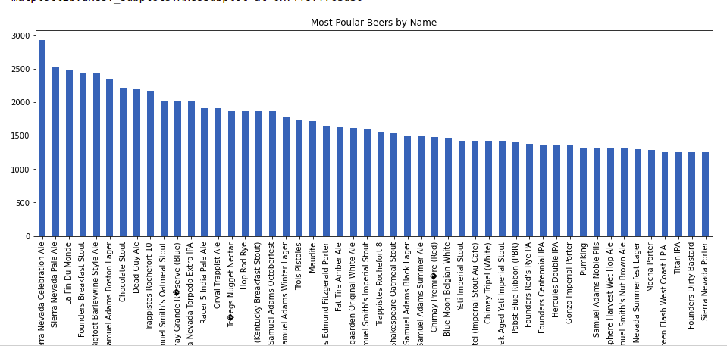
Visualization
Most popular beer my name

Slide 6
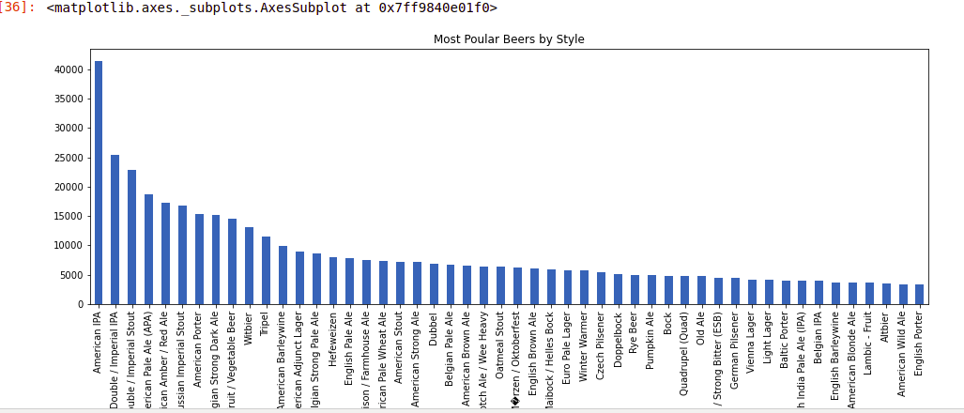

Slide 7
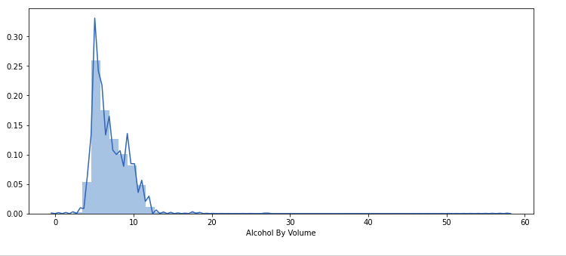
Beer ABV

Slide 8
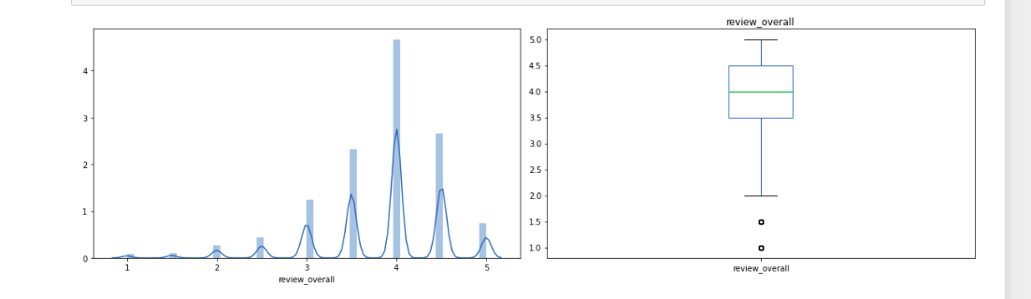
Review Overall

Slide 9
Review Overall

Slide 10
#Q1.Rank top 3 Breweries which produce the strongest beers?
beer_brewreId mean_beer_abv
1. 6513 24.69%
2. 736 13.50%
3. 24215 12.46%

Slide 11
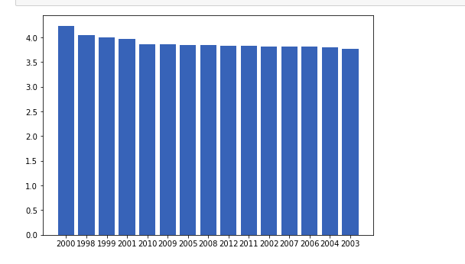
# Q2 : Which year did beers enjoy the highest ratings ?

Slide 12
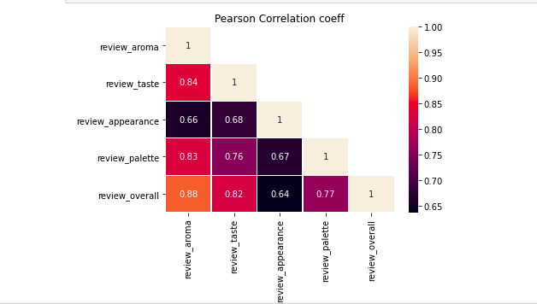
#Q3 : Based on the user’s ratings which factors are important among taste,
aroma, appearance, and palette?

Slide 13
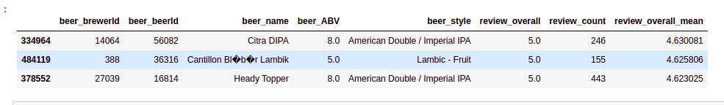
#Q4 : If you were to recommend 3 beers to your friends based
on this data which ones will you recommend?

Slide 14
Thank You

