Slide 1

INCIDENT IMPACT PREDICTION
Presented By- Group 3

Slide 2
Business Problem :
To predict the impact of the incident raised by the customer.
OBJECTIVE :
The objective of the analysis is to predict an impact on the basis of tickets raised.

Slide 3
Project Architecture / Project Flow
Data Cleaning Phase- Visualizing the dataset, Finding null values, Changing column names, Conversion Into Dummies, Droping the columns.
Smote was used to handle Imbalanced Data
Feature Selection-Used different methods to get the best features.
Train & Test Splitting
Algorithms- Multiple Algorithms Used & Their Accuracies
Cross Validation & Hyper parameter Tuning
Deployment Phase

Slide 4
Dataset Details
The dataset is having incidents raised by customers. Which contains an event log of an incident management process extracted from a service desk platform of an IT company.
Dataset contains total 25 features.Out of which 24 features are independent and 'Impact' Feature is output variable.
The Prediction needs to be Classified into 3 Classes:
High Impact
Medium Impact
Low Impact

Slide 5
Description about the dataset
Sl No |  | Description
1 | No. of rows and columns | 349 rows & 25 columns
2 | No. of Missing values | Some rows contain ‘?’ which was replaced by NaN. Created_by & created_at-62 User_symptom-45 ,support_incharge-155, problem_id-267, change_request-343
3 | Numerical Variables | Count_reassign,count_opening,count_updated,ID_caller,opened_by, opened_time,Created_by,created_time, updated_by , updated_at ,location CategoryId,user_symptom,Support_groupsupport_incharge,problem_id ,change_request.
4 | Categorical Variables | ID, ID_status, active,Doc_knowledge,Impact,confirmation_check,notify
5 | Datatypes | bool(3), datetime64[ns](2), int64(3), object(17)
6. | Duplicate Rows | -
7. | Drop unnecessary Columns | support_incharge, problem_id, change_request
8. | Remove strings | Columns which contained such as opened by,created by,resolved by-these strings where removed and only numerical values where kept.

Slide 6
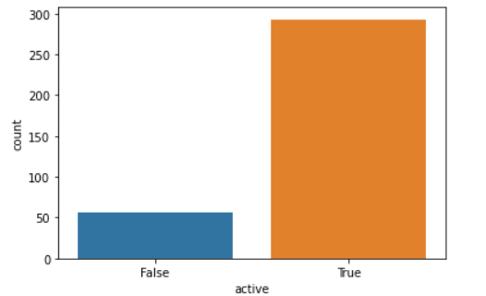
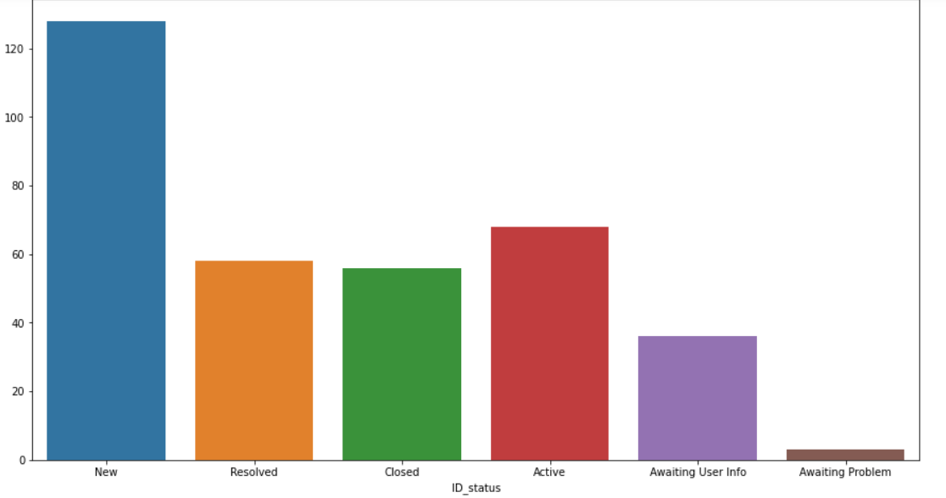
Visualization
From the visualization we can note that, No. of new records are more and if we compare resolved and closed attributes, they are nearly equal which also says awaiting problem is very less.
Active Records are more then closed/cancelled records.
Active Records: True- 293 False-56

Slide 7
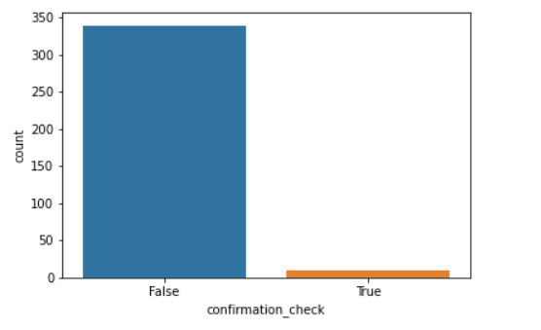
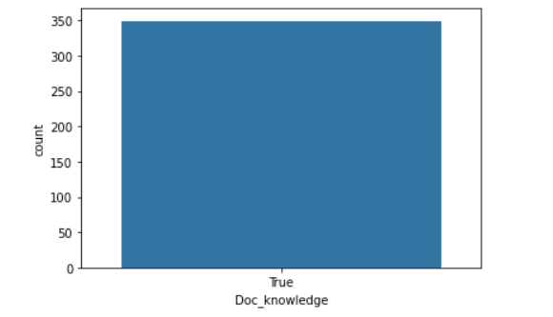
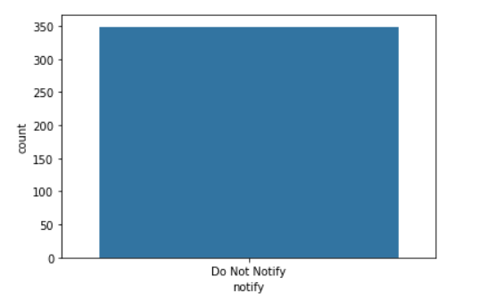
Shows that lack of priority field is not properly double-checked.
All the records Knowledge based document was used to solve the problem.
All the records notification was not sent.
Confirmation_check : True-10 False-339
Notify &Doc_knowledge-349 records belongs to same category

Slide 8
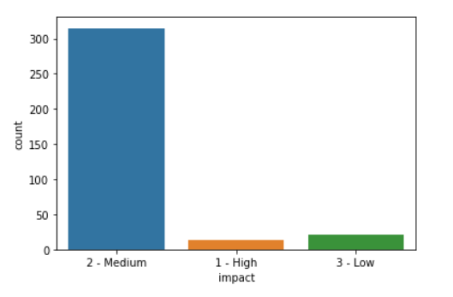
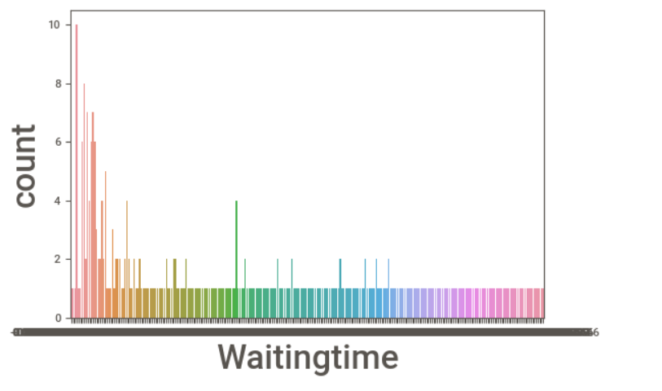
More then 300 records falls to the medium range, Low & high are nearly same.
Impact:Low-21,Medium-315,High-13

Slide 9
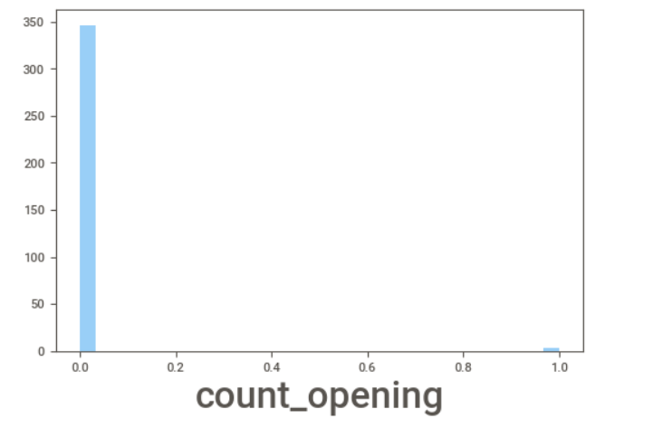
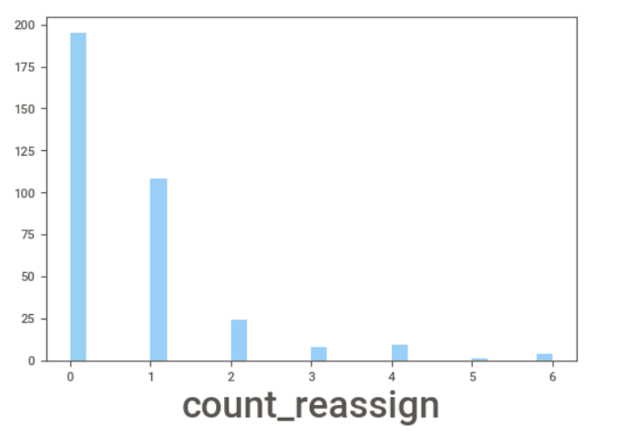
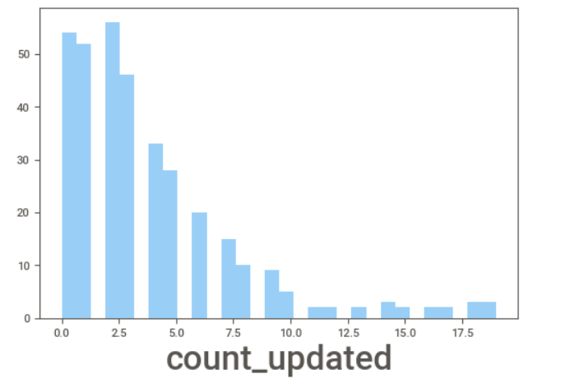
Visualization for Numerical Attributes
In count_opening only 3 times incident resolution was rejected by the caller
Count_opening: 0-349 1-3
Only few times support analyst where changed to solve the problem
Count_reassign: 0-195, 1-108, 2-24, 3-9, 4-8, 5-4, 6-1
Count_updated:Count updating tooks n no. of times.(max 17 times updation took place)

Slide 10
Transformation
Label encoding is performed on the variables type_contact', 'Doc_knowledge', 'active', 'confirmation_check', 'ID_status.

Slide 11
Feature Selection

Slide 12
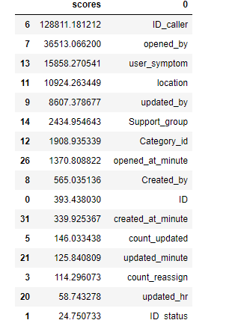
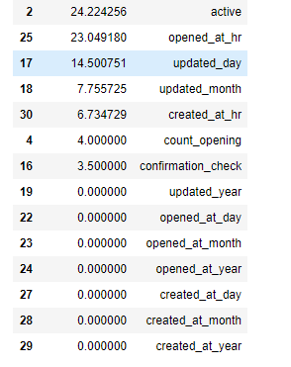
Chi-Square Test
The scores achieved on performing chi-square test

Slide 13
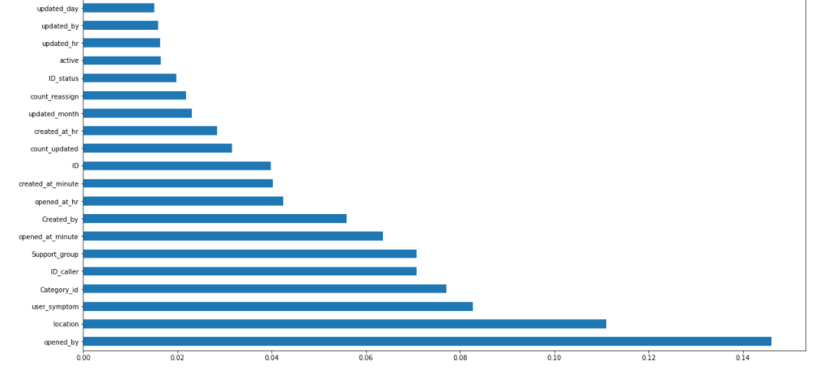
Extra Tree Classifier

Slide 14
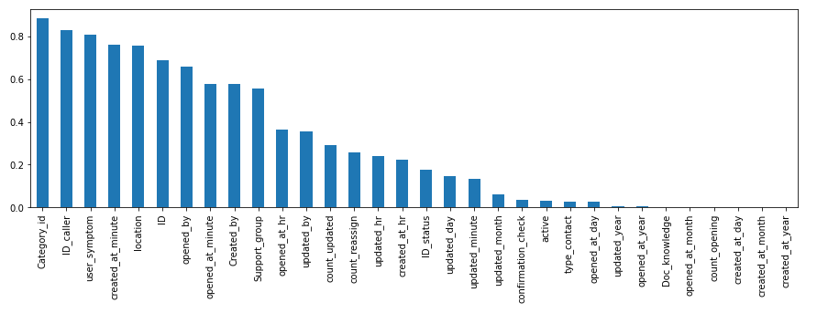
Mutual Information Classifier

Slide 15
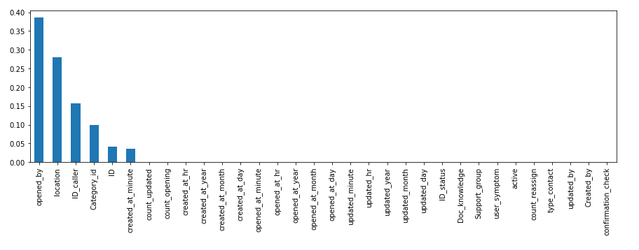
Decision Tree Classifier
Hence based on this features such as opened_by, location, ID_caller, Category_id, ID where selected.

Slide 16
ML Algorithm Used
Algorithm Used | Train Accuracy | Test Accuracy
Random Forest | 100.0% | 98.09%
Neural Network | 77.2% | 83.8%
Support Vector Classifier | 100.05 | 93.3%
KNN | 98.1% | 96.1%
Decision Tree Classifier | 95.0% | 91.4%
Gausian NB | 94.4% | 88.5%
Voting Classifier (KNN+Gausian NB+DT) | 99.3% | 99.0%
Bagging Classifier | 100.0% | 98.0%
Ada Boost Classifier | 100.0% | 98.0%
XgBoost Classifier | 100.0% | 98.0%

Slide 17
Hyperparameters Tuning
The hyperparameters used in the model are:
GridsearchCV
1. Best parameters found:
bootstrap: True
criterion': gini
max_depth': 4
max_features': auto
min_samples_leaf': 1
min_samples_split: 2
n_estimators': 200
2. Best Score found: 0.9969788450595275

Slide 18
Deployment

Slide 19
Model Deployment using Streamlit on Heroku
Model is Deployed on Heroku Platform with Streamlit Framework.
Heroku: https://impact-prediction-of-incident.herokuapp.com/

Slide 20
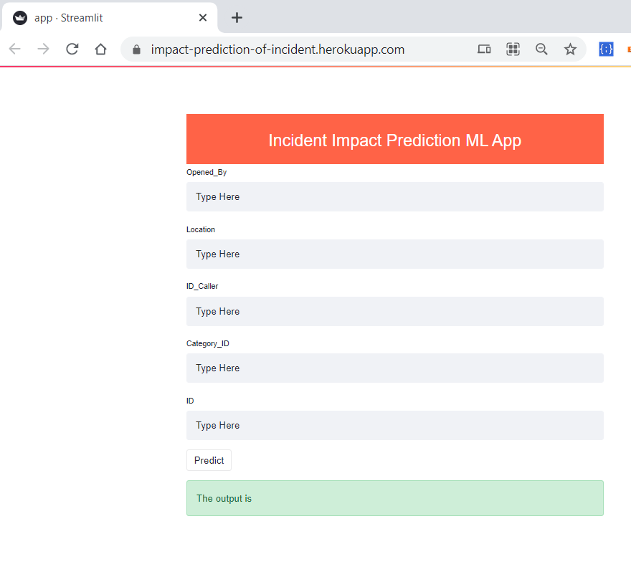

Slide 21
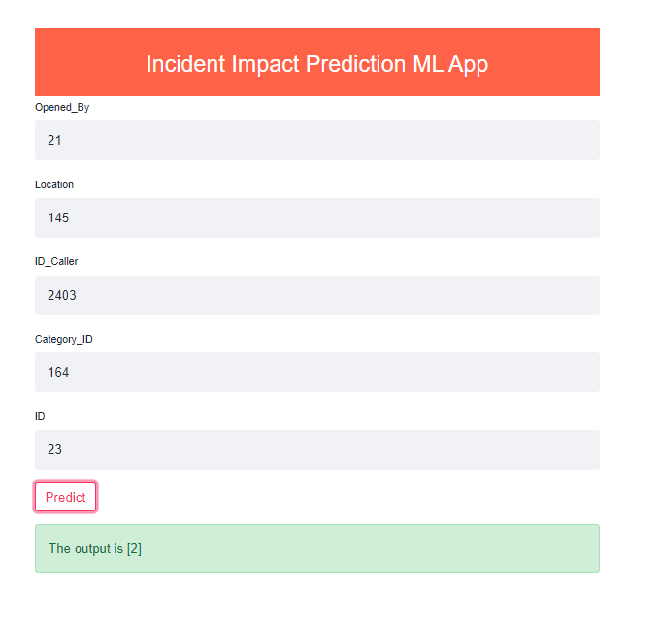

Slide 22
Challenges Faced?
Feature selection
Model building was challenging as data was imbalanced.
In Deployment Phase, Collection of User input Values from Home HTML Template Form and making operations on them in Backend was challenging.
How did we over come?
Different techniques where used to find the best features for prediction.
Sampling method such as SMOTE was used.
We used streamlit to build an front end and later deployed on Heroku. The model choosen for prediction was passed over here in streamlit app.

Slide 23
THANK YOU

