Slide 1

Phishing Website Detection by Machine Learning Techniques
By : Prerna Garsole (016015831)

Slide 2
OUTLINE
Introduction
Objective
Current state of the art / exciting solution
Approach
Dataset and Preprocessing
Proposed Solution
Results
Conclusion

Slide 3
INTRODUCTION
Phishing is a commonly used method in social engineering and cyber attacks.
Phishers aim to fraudulently obtain sensitive information when targeting users.
In order to avoid getting phished
Users need to be aware of phishing websites.
Users should maintain a blacklist of known phishing websites, which requires recognizing websites identified as phishing.
Employ machine learning and deep neural network algorithms to detect phishing websites early on.

Slide 4
Objective
A phishing website is a common social engineering method that mimics trustful uniform resource locators (URLs) and webpages.
The goal of this project is to use a dataset to train machine learning models and deep neural networks for predicting phishing websites.
A dataset is compiled by collecting the phishing URLs of websites, from which relevant URL and website content-based features are extracted.
The performance level of each model is measures and compared.

Slide 5
Current state of the art / exciting solution
Machine Learning Algorithms: Implementing advanced algorithms like Recurrent Neural Networks (RNNs) for phishing detection, e.g., analyzing text and URLs.
Feature Engineering: Extracting and analyzing specific web content features, such as HTML elements, to spot malicious links or mismatched domains.
Real-Time Detection: Identifying and blocking emerging phishing sites through continuous web scanning, ensuring instant protection.
Natural Language Processing (NLP): Using NLP to analyze textual content for suspicious language and typos, such as identifying phishing emails with deceptive text.

Slide 6
Approach
Gather a dataset comprising phishing and legitimate websites from open-source platforms.
Develop a code to extract essential features from the URL database.
Conduct an analysis and preprocess the dataset using Exploratory Data Analysis (EDA) techniques.
Divide the dataset into training and testing sets. Implement selected machine learning and deep neural network algorithms, such as SVM, Random Forest, and Autoencoder, on the dataset.
Create a code to display the evaluation results, considering accuracy metrics.
Compare the results obtained from the trained models and determine which one performs better.

Slide 7
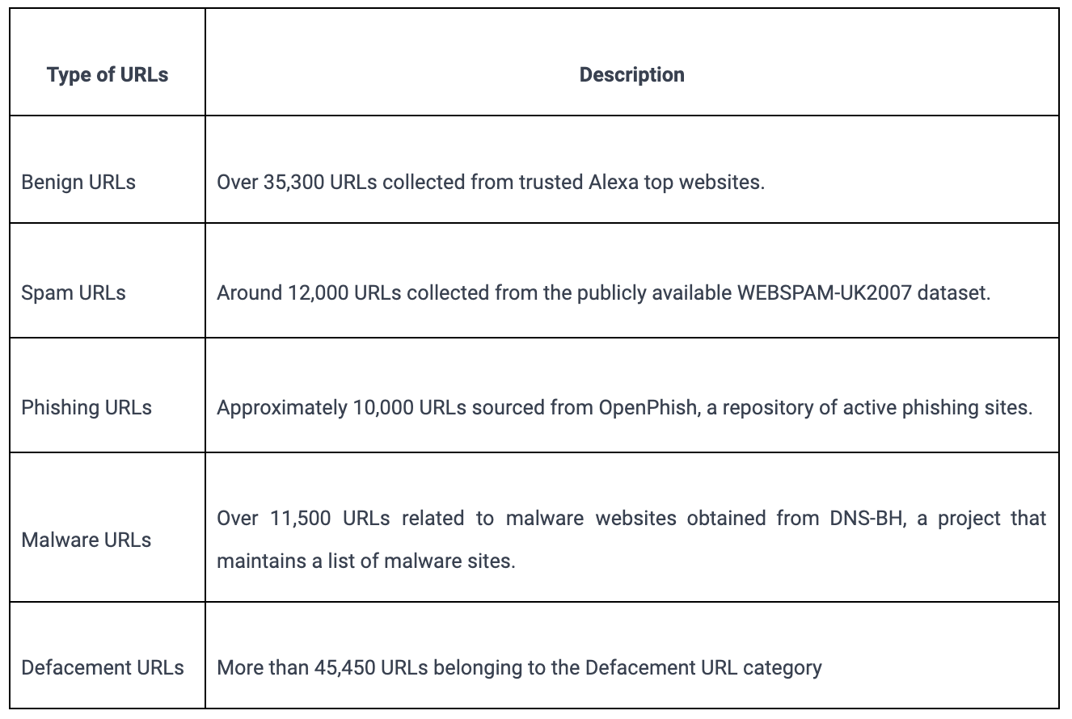
DATASET AND PREPROCESSING
Legitimate URLs are collected from the dataset provided by University of New Brunswick, https://www.unb.ca/cic/datasets/url-2016.html.
From the collection, 5000 URLs are randomly picked.
The dataset focuses on URLs used as a major vehicle for online criminal activities. It is designed to aid in the detection and categorization of malicious URLs based on their attack type.

Slide 8
Proposed Solution
Address Bar Features:
Domain of URL
Redirection ‘//' in URL
IP Address in URL
'http/HTTPs' in Domain name
'@' Symbol in URL
Using URL Shortening Service
Length of URL
Prefix or Suffix "-" in Domain
Depth of URL
Feature Selection Approach:
Domain based Features:
DNS Record
Age of Domain
Website Traffic
End Period of Domain
HTML and JavaScript based Features:
Iframe Redirection
Disabling Right Click
Status Bar Customization
Website Forwarding
Total Features Extracted: 17

Slide 9
Machine learning models
The dataset is treated as a classification problem, distinguishing between phishing and legitimate URLs. Various supervised machine learning models are considered for training.
Decision Tree
Random Forest
Multilayer Perceptrons
XGBoost
Autoencoder Neural Network
Support Vector Machines

Slide 10
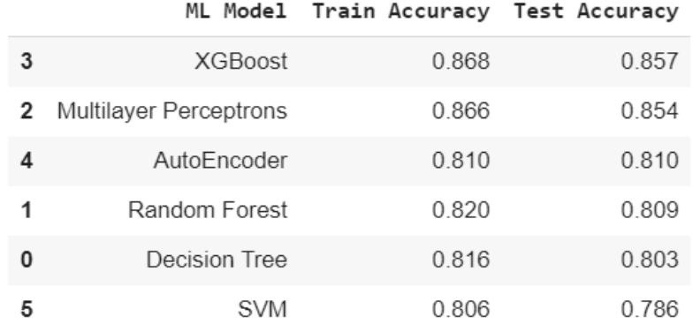
Results (Model evaluation)
The models undergo evaluation, with accuracy as the chosen metric.
The figure illustrates the accuracy of the training and test datasets for each respective model.
For the above it is clear that the XGBoost model gives better performance. The model is saved for further usage.

Slide 11
Conclusion
During the evaluation, XGBoost demonstrates superior performance in both the training and test datasets.
The chosen features effectively enhance the detection of phishing websites.
The superiority of the XGBoost model justifies its retention for future use.
This robust solution significantly aids in accurately identifying malicious URLs.
The incorporation of well-defined features and advanced machine learning techniques, particularly XGBoost, contributes to improved accuracy and efficiency in phishing website detection.

Slide 12
Thank You

