Slide 1
TECHNOLOGY, MEDIA & TELECOMMUNICATIONS
Project Anchorage
Microsoft's Acquisition of
Activision Blizzard, Inc.
M&A Deal Analysis — Illustrative Client Presentation
$95.00 / SHARE • $68.7BN EQUITY VALUE • ANNOUNCED JAN. 2022 • CLOSED OCT. 2023
Prepared by Prerna Dudhmande | July 2026

Slide 2
Agenda
01
Executive Summary
07
Valuation Summary
02
Transaction Overview
08
Financial Impact
03
Company Overviews — Microsoft & Activision Blizzard
09
Regulatory Review
04
Gaming Industry Overview
10
Risk Assessment & SWOT
05
Investment Highlights & Strategic Rationale
11
Market Reaction & Post-Acquisition Performance
06
Synergy Analysis
12
Recommendation
Project Anchorage | Confidential — Illustrative
2

Slide 3
SECTION 1
Executive Summary
$68.7bn
~45%
~21 mo.
3rd
Equity purchase price
($95.00/share, all-cash)
Premium to unaffected
share price (Jan. 14, 2022)
Signing to closing
(Jan. 2022 – Oct. 2023)
Largest gaming company
globally by revenue, post-close
Microsoft's acquisition of Activision Blizzard is the largest transaction in the video game industry's history and the largest acquisition in Microsoft's corporate history. The deal was designed to accelerate Xbox Game Pass subscription growth, establish a leadership position in mobile gaming via King, and build scale in cloud gaming — while surviving the most extensive multi-jurisdictional antitrust contest yet seen in technology M&A.
Bottom line: a strategically coherent, full-value acquisition, financed conservatively, that has delivered clear commercial validation (Call of Duty: Black Ops 6) alongside substantial integration disruption — with financial value creation still being confirmed.
Project Anchorage | Confidential — Illustrative
3

Slide 4
SECTION 2
Transaction Overview
Acquirer | Microsoft Corporation (NASDAQ: MSFT)
Target | Activision Blizzard, Inc. (formerly NASDAQ: ATVI)
Consideration | $95.00 per share, all-cash
Equity Purchase Price | $68.7bn (announced) / $75.4bn (final, at closing)
Implied Enterprise Value | ~$62.3bn (net of target cash)
Announcement / Closing | January 18, 2022 / October 13, 2023
Structure | Reverse triangular merger; all-cash; balance sheet cash + $27bn short-term borrowings
Acquirer / Target Advisors | Goldman Sachs & Co. LLC / Allen & Company LLC
Regulatory Approvals | United States (FTC), United Kingdom (CMA), European Union (EC), ~40 other jurisdictions
Project Anchorage | Confidential — Illustrative
4

Slide 5
SECTION 3
Acquirer Overview — Microsoft Corporation
• Redmond, WA-headquartered technology company; ~$2.3tn market cap at signing • Three segments: Productivity & Business Processes, Intelligent Cloud, More Personal Computing (incl. Gaming) • Cloud-and-subscription-first strategy; Xbox Game Pass is the gaming analogue of Office 365 • ~$125–132bn of cash & short-term investments at signing; top-tier (Aaa/AAA-adjacent) credit profile
Competitive Advantages
• Balance sheet scale enabling an unconditioned, all-cash offer at this size • Cross-platform distribution: Windows, Xbox, and Azure — unmatched by any pure-play publisher • Azure hyperscale infrastructure underpins Xbox Cloud Gaming's structural cost advantage • Proven subscription go-to-market muscle (Office 365) transferable to Game Pass
Project Anchorage | Confidential — Illustrative
5

Slide 6
SECTION 3
Target Overview — Activision Blizzard, Inc.
Three Reportable Segments • Activision — Call of Duty (premium + mobile), ~$4.4bn • Blizzard Entertainment — WoW, Diablo, Overwatch, ~$1.9bn • King — Candy Crush Saga (mobile F2P), ~$2.6bn Three billion-dollar franchises (Call of Duty, World of Warcraft, Candy Crush) — an unusually high concentration of evergreen IP that commanded strategic buyer interest despite a depressed, scandal-affected trading price.
~9,500–10,000 employees • ~400mn monthly active users • ~190 countries • ~43% EBITDA margin (FY2021)
Project Anchorage | Confidential — Illustrative
6

Slide 7
SECTION 4
Gaming Industry Overview
Largest entertainment category globally by consumer spend — bigger than film box office and recorded music combined. Mobile is the largest and most contested platform segment; industry-wide consolidation (Take-Two/Zynga, Sony/Bungie) accompanied this transaction.
Project Anchorage | Confidential — Illustrative
7

Slide 8
SECTION 5
Investment Highlights
1
Subscription Flywheel
2
Mobile Gaming at Scale
Owning (not licensing) marquee franchises removes recurring licensing risk and accelerates Xbox Game Pass subscriber growth and retention.
King's Candy Crush franchise provides immediate, scaled entry into the largest platform segment — one Microsoft lacked standalone.
3
Cloud Gaming Content Moat
4
Competitive Repositioning
First-party ownership anchors Xbox Cloud Gaming's differentiation, leveraging Azure's hyperscale infrastructure.
Moves Microsoft to the third-largest gaming company globally by revenue — a repositioning rarely achievable organically.
5
Disciplined Pricing
6
Conservative Financing
Implied multiple sits below the average paid in comparable precedent gaming transactions (Section 8).
All-cash, minimal incremental leverage; Microsoft retained its top-tier credit ratings throughout.
Project Anchorage | Confidential — Illustrative
8

Slide 9
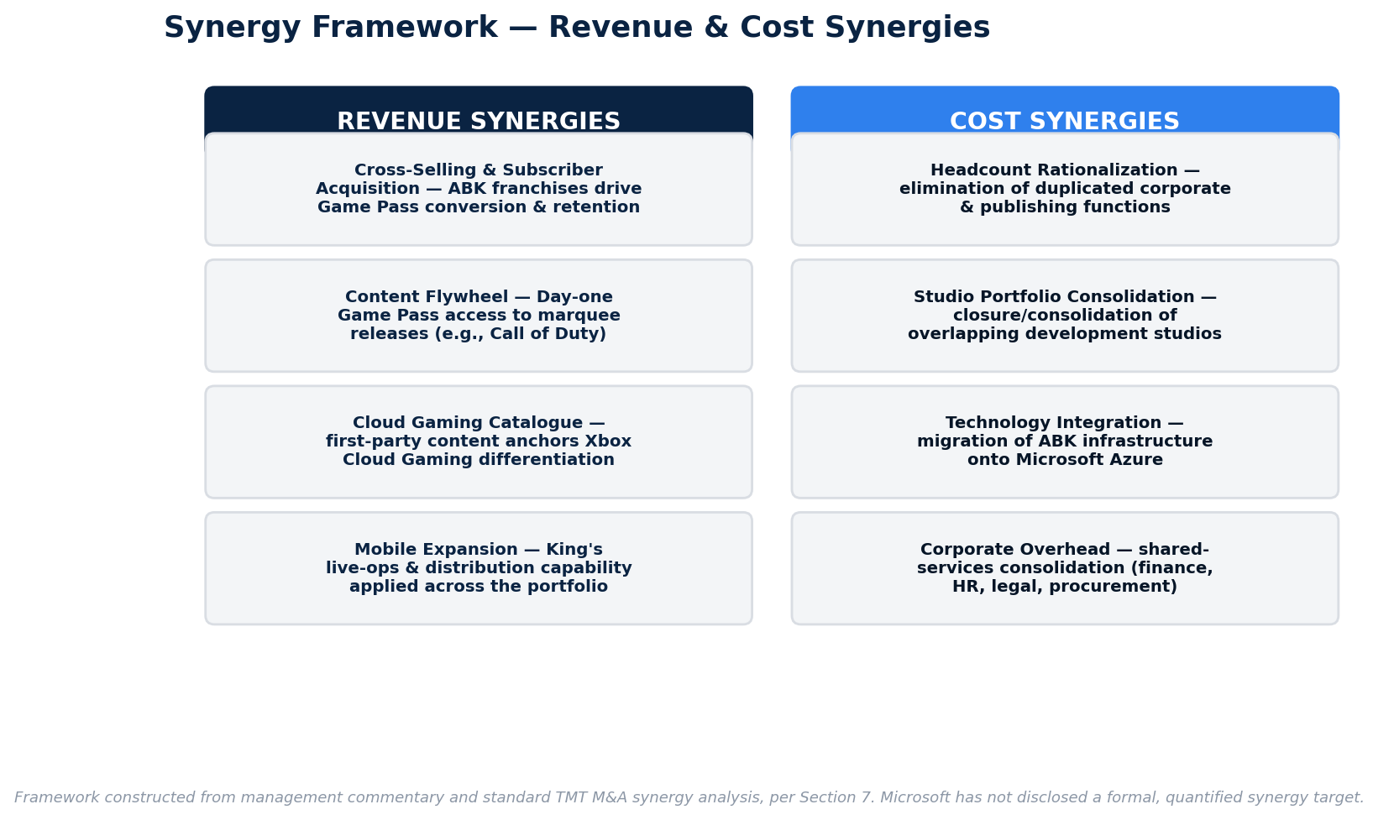
SECTION 6
Synergy Analysis
Microsoft has not disclosed a formal, quantified synergy target. Revenue synergies (Game Pass, cross-sell) have materialized faster and more visibly than cost synergies, which have been realized through a protracted, multi-year cadence of layoffs and studio closures (Section 7.3).
Project Anchorage | Confidential — Illustrative
9

Slide 10
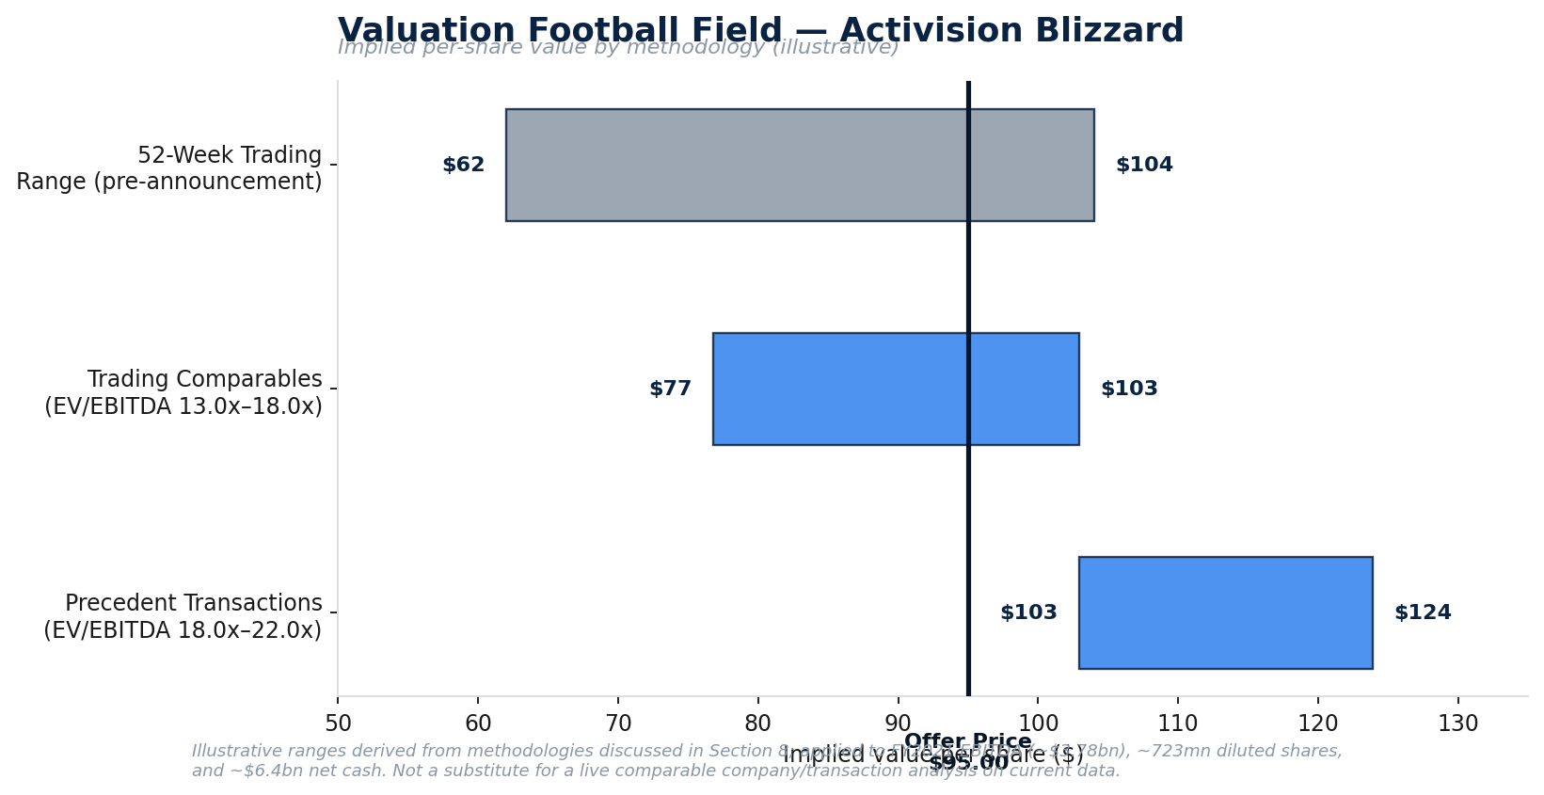
SECTION 7
Valuation Summary
Offer of $95.00/share sits within the trading-comparables range but below the precedent-transaction range — consistent with disciplined, rather than promotional, pricing for a scarce, category-leading asset.
Project Anchorage | Confidential — Illustrative
10

Slide 11
SECTION 7
Comparable Company Analysis
Company | EV / Revenue | EV / EBITDA | P / E
Electronic Arts | ~5–6x | ~15–17x | ~24–27x
Take-Two Interactive | ~5–7x | ~17–20x | ~28–32x
Ubisoft Entertainment | ~2–3x | ~9–12x | ~15–20x
Activision Blizzard (unaffected) | ~4x | ~13x | ~17x
Peer Median (approx.) | ~4–5x | ~15x | ~24x
Implied by Microsoft's Offer | 7.1–7.8x | 16.5–18.2x | ~25x
Illustrative, approximate multiples for analytical purposes — refresh against live Bloomberg/CapIQ data in a live deal context.
Project Anchorage | Confidential — Illustrative
11

Slide 12
SECTION 7
Precedent Transaction Analysis
Date | Acquirer | Target | Deal Value
Sept. 2020 | Microsoft | ZeniMax Media (Bethesda) | $7.5bn
Jan. 2022 | Take-Two Interactive | Zynga | $12.7bn
Jan. 2022 | Sony Interactive Ent. | Bungie | $3.6bn
May 2022 | Embracer Group | Square Enix Western Studios | ~$0.3bn
2023 | Savvy Games Group (Saudi PIF) | Scopely | ~$4.9bn
Jan. 2022 | Microsoft | Activision Blizzard | $68.7bn
Average EV/EBITDA across comparable recent gaming M&A: ~20x (median ~21x) — Microsoft's implied 16.5–18.2x multiple sat below this average.
Project Anchorage | Confidential — Illustrative
12

Slide 13
SECTION 8
Financial Impact
Metric | FY2024 Actual | FY2024 Pro Forma* | Delta
Revenue ($mn) | 245,122 | 247,442 | +2,320
Net Income ($mn) | 88,136 | 88,308 | +172
Diluted EPS ($) | 11.80 | 11.82 | +0.02
*Pro forma as if acquired July 1, 2022. Source: Microsoft FY2024 Form 10-K.
Near-neutral EPS impact through FY2024 — purchase-accounting amortization and integration costs have largely offset underlying revenue growth to date.
Purchase Price Allocation: $51.0bn goodwill • $22.0bn intangibles • $75.4bn total consideration at closing
Project Anchorage | Confidential — Illustrative
13

Slide 14
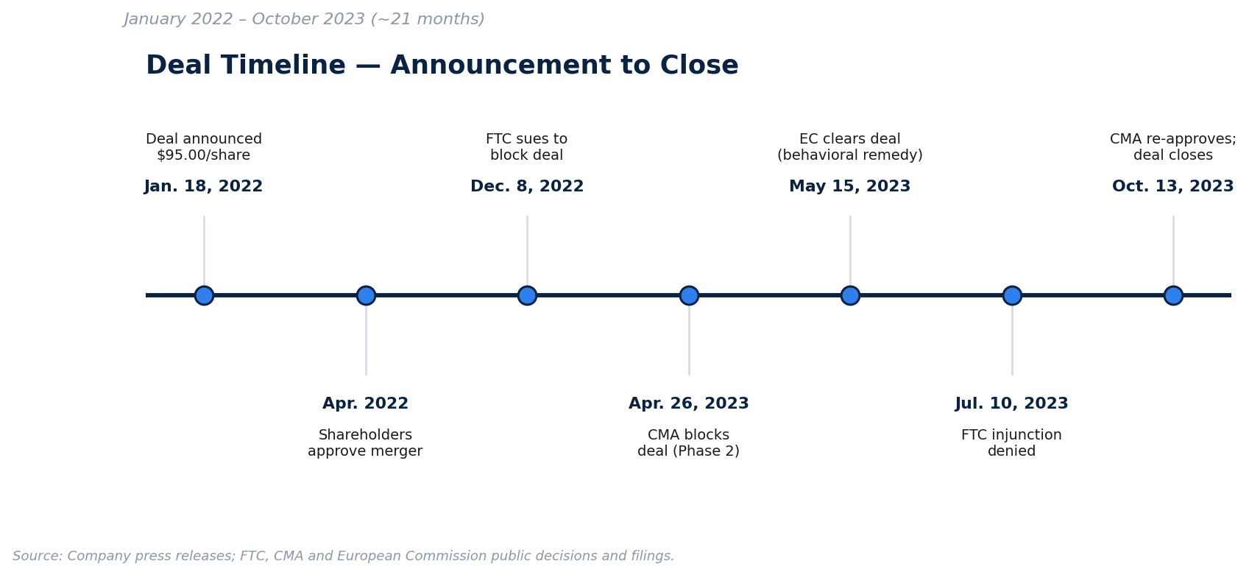
SECTION 9
Regulatory Review — Deal Timeline
Three regulators, three outcomes on similar facts: FTC litigation loss for the agency (deal cleared); CMA outright prohibition, later reversed via a structural Ubisoft divestiture; EC conditional clearance via a behavioral licensing remedy.
Project Anchorage | Confidential — Illustrative
14

Slide 15
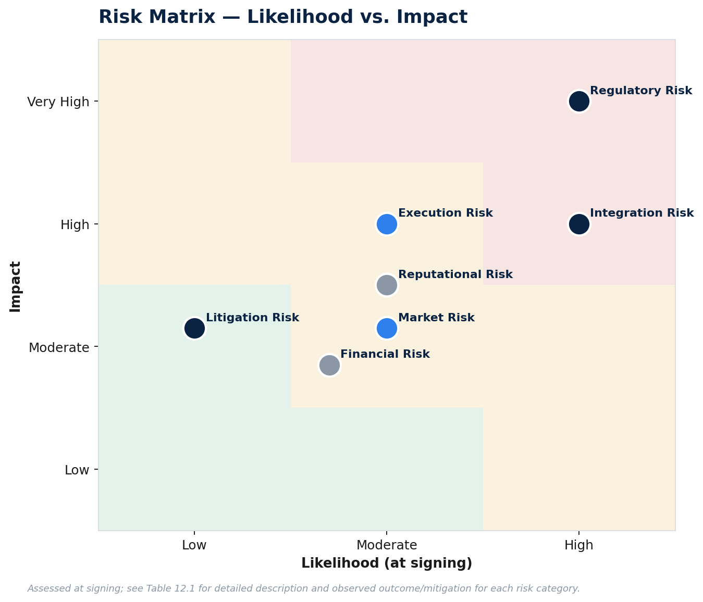
SECTION 10
Risk Assessment
Project Anchorage | Confidential — Illustrative
15

Slide 16
SECTION 10
SWOT Analysis — Combined Entity
STRENGTHS
WEAKNESSES
• Unmatched first-party franchise breadth • Cross-platform distribution (Windows, Xbox, Azure) • Exceptional balance sheet strength • Proven subscription go-to-market capability
• Persistent integration disruption • Console hardware sub-scale vs. PlayStation • Reputational overhang from price increases • Slower mobile cross-portfolio synergy realization
OPPORTUNITIES
THREATS
• Further Xbox Cloud Gaming scaling via Azure • International Game Pass expansion (King footprint) • Cross-IP mobile/transmedia extensions • AI-driven development efficiency gains
• Continued antitrust & political scrutiny • Game Pass subscriber attrition risk • Competitive response (Sony, Tencent/NetEase) • Capex reallocation toward AI infrastructure
Project Anchorage | Confidential — Illustrative
16

Slide 17
SECTION 11
Market Reaction
Jan. 18, 2022 ATVI +26% on announcement; still traded ~14% below the $95 offer, pricing in deal-completion risk. Throughout 2022–23 MSFT largely unaffected — the deal was ~3% of Microsoft's market cap. ATVI traded as a merger-arb security, moving with regulatory news. Oct. 2023 ATVI converges toward $95 as closing certainty increases.
Project Anchorage | Confidential — Illustrative
17

Slide 18
SECTION 12
Post-Acquisition Performance
Strategic Wins
Remaining Challenges
• Call of Duty: Black Ops 6 (Oct. 2024) — largest franchise launch on record; unit sales on PS5/Steam +60% YoY • Gaming segment revenue: $21.5bn (FY24) → $23.5bn (FY25) • No goodwill/intangible impairment recognized to date
• Game Pass subscribers last disclosed at ~34mn (Feb. 2024) — no update since • Multiple layoff rounds (Jan. '24, Sept. '24, Jul. '25) and 2 studio closures • Ongoing Delaware Chancery shareholder litigation (Oct. 2025)
Project Anchorage | Confidential — Illustrative
18

Slide 19
RECOMMENDATION & CONCLUSION
Provisionally value-creating on strategic grounds — financial value creation still being confirmed.
Well-executed deal process: disciplined pricing below precedent-transaction averages, conservative all-cash financing, and a deal-protection structure that correctly priced regulatory risk.
Clear commercial validation of the multi-platform strategy, evidenced by Call of Duty: Black Ops 6's record performance across Xbox, PlayStation, and Steam.
Near-neutral GAAP EPS impact through FY2024 is typical of large acquisitions in their first 24 months — not evidence of value destruction, but not yet confirmed accretion either.
Organizational and reputational costs (layoffs, studio closures, Game Pass pricing backlash, ongoing litigation) are real and only partially visible in the financial statements.
Full economic assessment will likely require a five-to-seven-year view, consistent with large strategic acquisitions in content-driven industries.
Project Anchorage | Confidential — Illustrative
19

Slide 20
APPENDIX
Key Sources & Disclaimer
Selected Sources • Microsoft Corporation Form 10-K / 10-Q filings, FY2021–FY2025 • Activision Blizzard, Inc. Form 10-K filings and merger proxy statement (PREM14A) • U.S. Court of Appeals for the Ninth Circuit, FTC v. Microsoft Corp. (May 2025) • UK Competition and Markets Authority and European Commission merger decisions • Newzoo Global Games Market Reports; company press releases and earnings materials Disclaimer This presentation is an independent, illustrative deal analysis prepared for educational and portfolio purposes. It is not affiliated with, endorsed by, or produced on behalf of Microsoft Corporation, Activision Blizzard, Inc., or any financial institution referenced herein. It does not constitute investment advice or an offer of any securities.
Project Anchorage | Confidential — Illustrative
20

