Slide 1
Violent Crimes in California
By Prerna Kapoor

Slide 2

Overview
Crime has been prevalent in our society for a very long time.
Hundreds of crimes are recorded daily by the data officers working alongside the law enforcement authorities throughout the United States.
Every aware citizen in today’s modern world wants to live in a safe environment and neighborhood.
Crimes in California demands significant measures by the Government and the Police authorities to control.

Slide 3








Problem statement
Is there a real difference in the total rate of violent crimes in different regions of California?
Comparing the rate of violent crime (crimes per 1,000 population) in each region of California.
Does the crime rate change between the year 2009 and 2013?

Slide 4
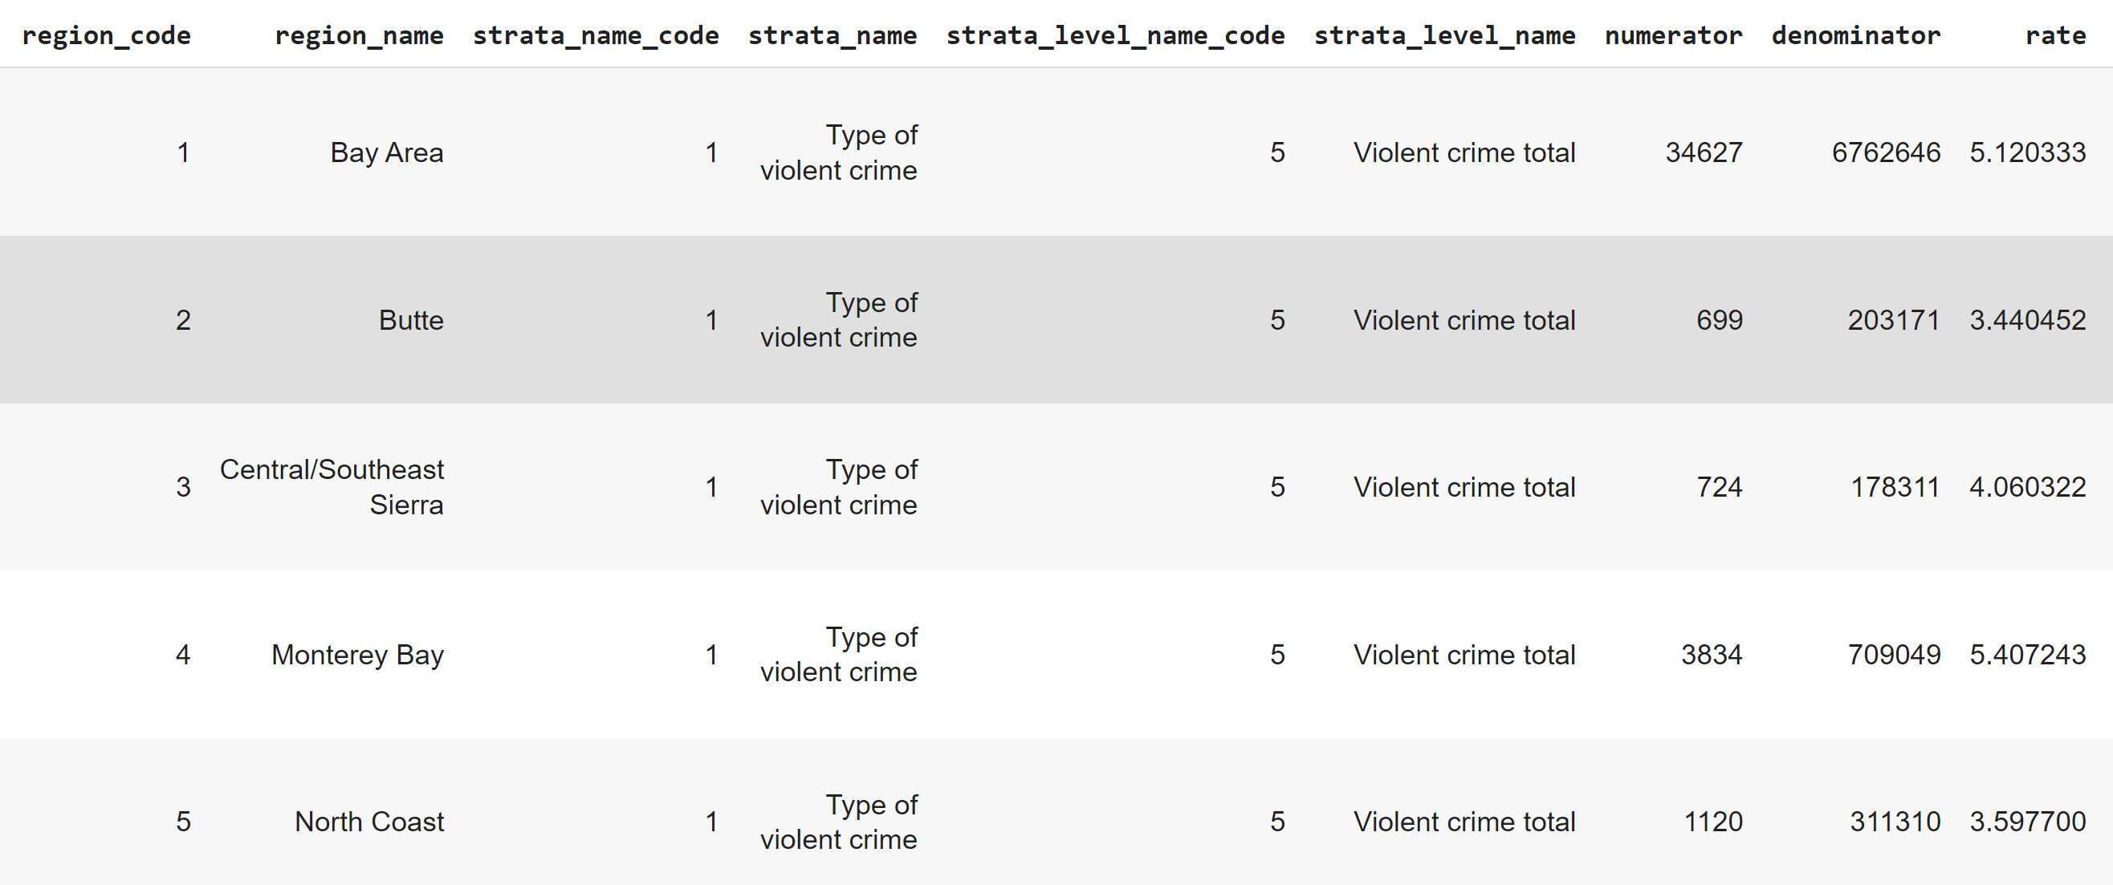

violent crime Rate in California

Slide 5
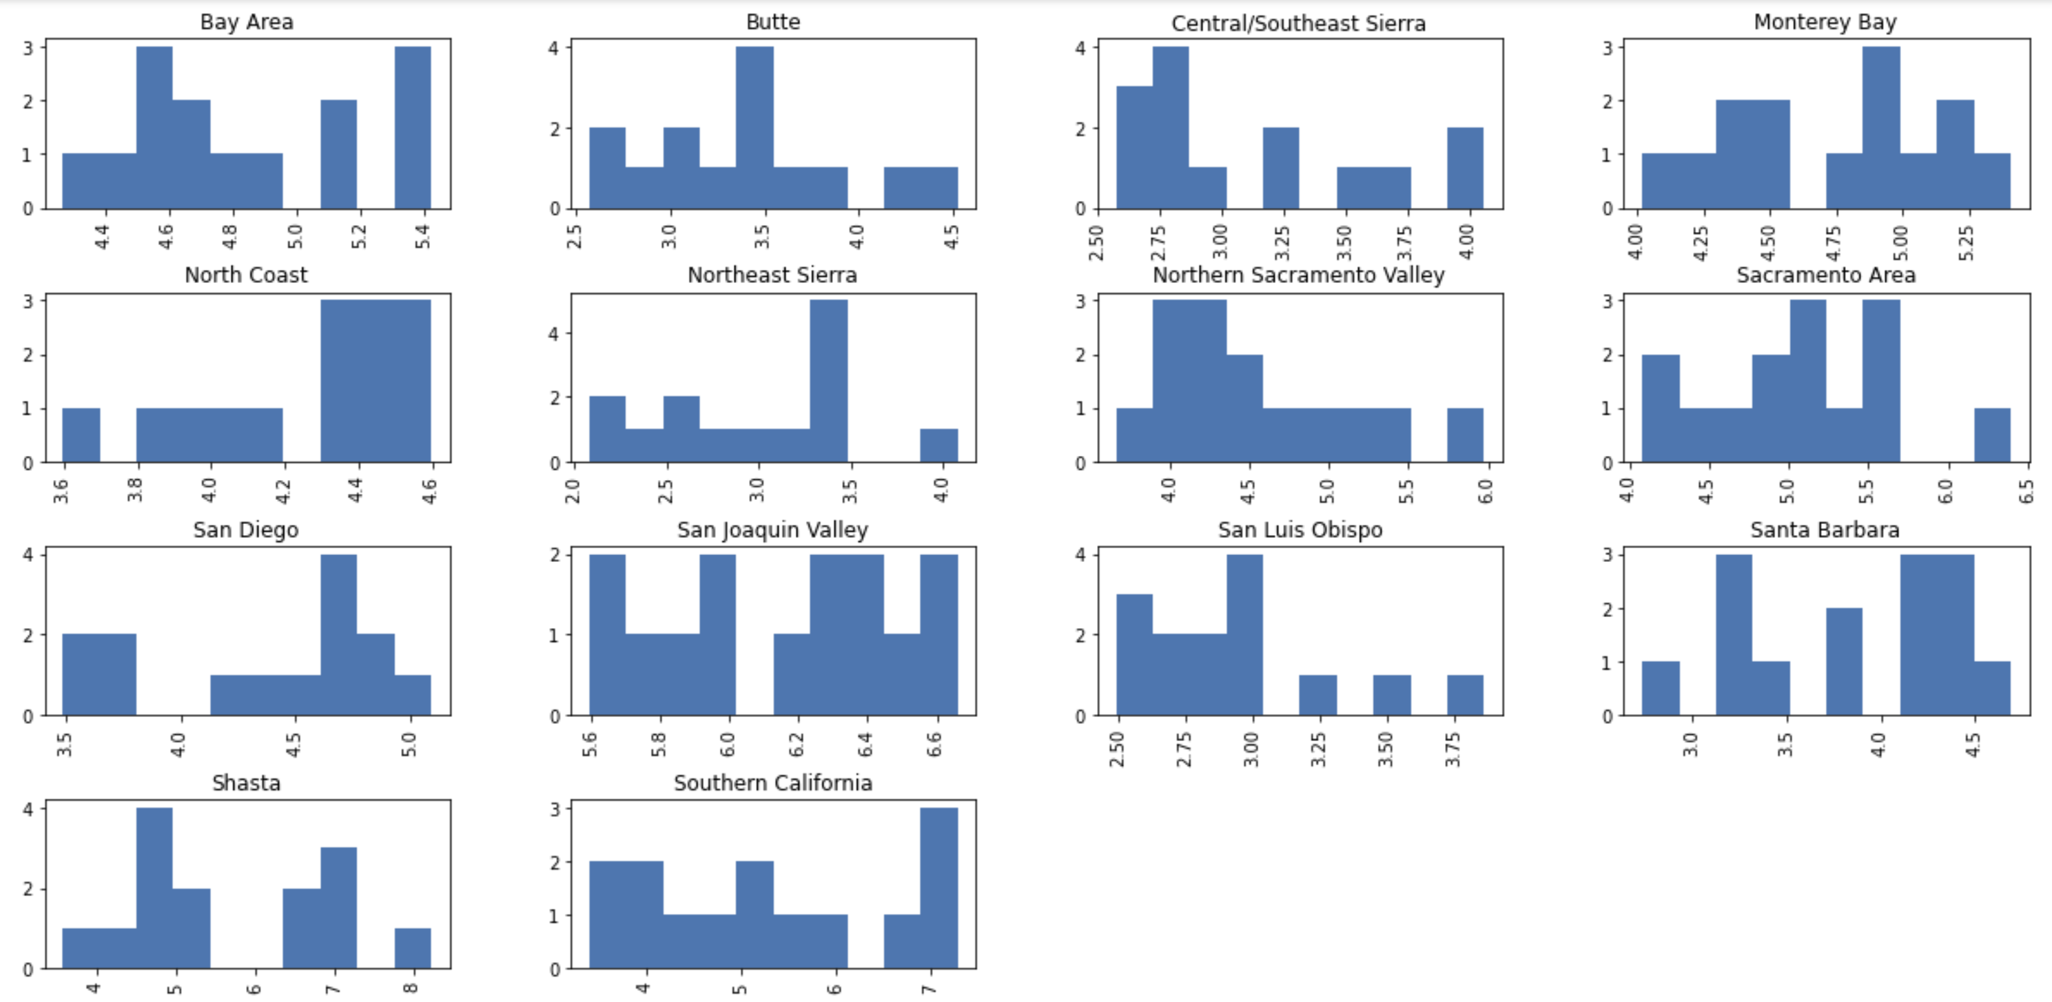
Graphical representation of Total violent crimes rate in CAlifornia

Slide 6
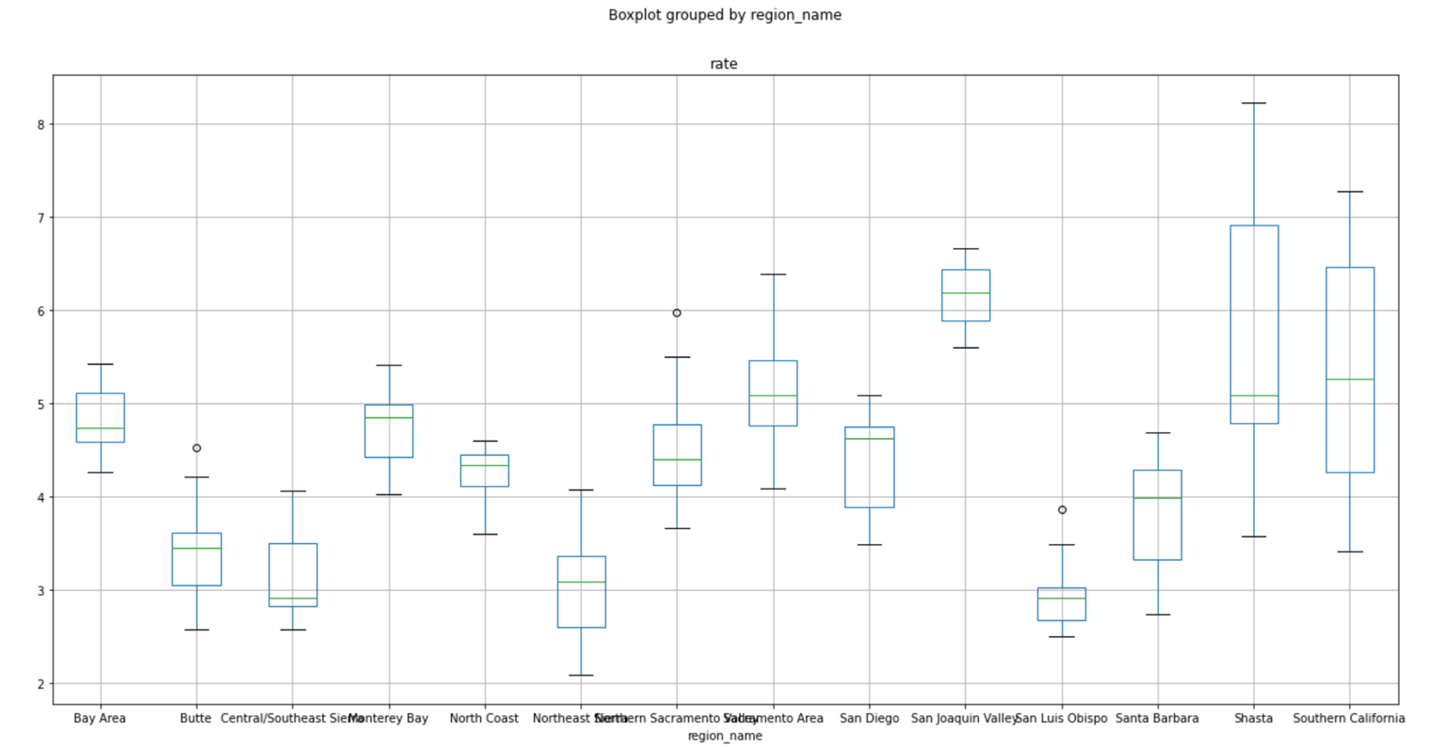
frequency of Crimes in Multiple regions

Slide 7
Insights
It appears that the rate of violent crime is likely to differ.
Butte is safe region to live in as comparison to Bay area.
Monterey Bay requires more security measures as compared to Central/Southeast Sierra.
San Joaquin Valley require strict measures as compared to Sacramento with 95% confidence, the level of the rate of violent crime lies between 0.196 and 1.9563
Strict policies should be established to reject violence and other crimes in Shasta as compared to Santa Barbara.
Notes:
We can compare the p-value against our desired alpha (.05) to determine statistical significance.
Multiple Comparison of Means - Tukey HSD, FWER=0.05
Group1 group2 meandiff p-adj lower upper reject
Bay Area Butte -1.4559 0.001 -2.3358 -0.576 True
Sacramento San Joaquin Valley 1.0764 0.0038 0.1965 1.9563 True
Central/Southeast SierraMonterey Bay 1.5955 0.001 0.7156 2.4754 True
Santa Barbara Shasta 1.8796 0.001 0.9997 2.7595 True

Slide 8
Total violent crime rate between Year 2009 & 2013
There is no significant difference in the crime rate between the years 2009 and 2013.
Notes:
Using Statistical ttest, anova test we conclude to:
The pvalue of 0.36 is above our significance level (0.05). Therefore we fail to reject the null hypothesis.
There is no significant difference in the crime rate between the years 2009 and 2013.

Slide 9





Recommendations
More thorough investigations in high crime regions.
Implement more security measures for the citizens to have a safe environment.
Improving surveillance around homes, businesses and public places to deter criminals.
Consider adding CCTV to the commercial sites and public places.
More efficient street lighting is an important service that each city government should provide.
Dimly lit neighborhoods make it easy for criminals to operate unnoticed.
Establish community standards and policies that reject violence and other crimes.

Slide 10

Questions?

Slide 11

ThanK YOu

